Slide 1
Fiserv Financial Hack
Group members: Yuexing Hao, Xiaoyan Deng, Casandra Begin

Slide 2
Application
Financial institutions lose money every year from customers that default on bills or loans. Default is the customer’s failure to repay a debt including interest or principal on a loan or security
We use R programming to better predict the default type.
We first divided our datasets into two parts, 20% for testing data, 80% for training data.
We built models for our training data and employed the models to the testing datasets. We will calculate the error rate on testing datasets.

Slide 3
Initial Model Accuracy With All Variables
Method | Accuracy
Random forest | 0.81728
Logistic Regression | 0.8224
Naive Bayes | 0.6256
rpart | 0.82192

Slide 4
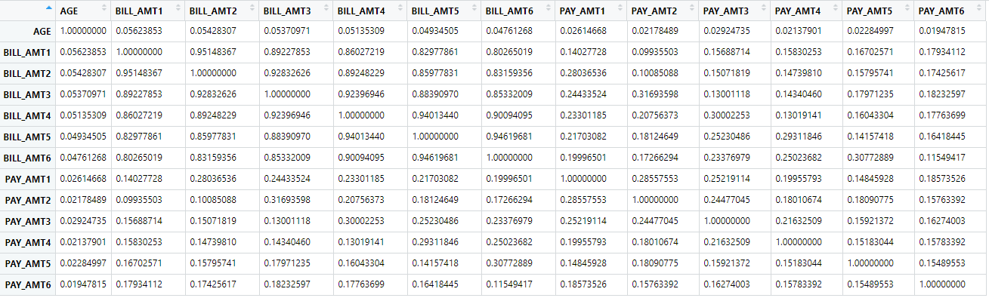
Collinearity Among Continuous Variables

Slide 5
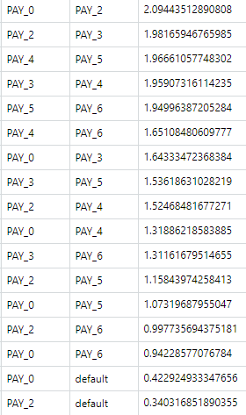
Collinearity Among Categorical Variables

Slide 6
Variable Importance: measure in mean decrease in accuracy
EDUCATION 5.551841
SEX 8.673867
MARRIAGE 18.782685
PAY_AMT1 24.395375
LIMIT_BAL 25.413892
AGE 25.994445
PAY_AMT2 27.121341
PAY_AMT4 28.822543
PAY_AMT5 30.106831
PAY_AMT6 31.837931
PAY_5 38.963028
PAY_2 41.225209
PAY_AMT3 41.544696
PAY_6 43.182329
PAY_4 44.930574
PAY_3 45.971778
BILL_AMT4 47.678359
PAY_0 150.024549

Slide 7
Collinearity exist:
Association between variables (among PAY_X variable group) is higher than 0.93. Other categorical variables association is lower than 0.8.
Correlation among BILL_AMTX variable group is higher than 0.8
Variable Selected:
"AGE","SEX","EDUCATION","MARRIAGE","LIMIT_BAL","PAY_0","BILL_AMT4"

Slide 8
Prediction Result After Variable Selection
Method | Accuracy
Random forest | 0.81808
Logistic Regression | 0.82192
Naive Bayes | 0.82064
Recursive Partitioning And Regression Trees | 0.82192

Slide 9
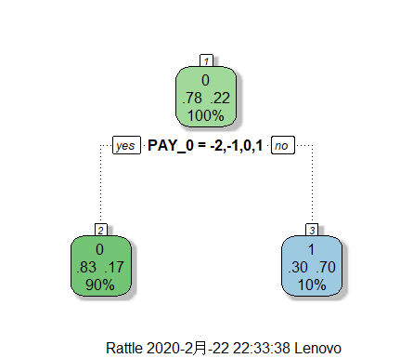
Logistic Regression (Stepwise Result):
Accuracy: 0.82208
Model:
default ~ SEX + EDUCATION + MARRIAGE + LIMIT_BAL + PAY_0 + BILL_AMT4
Recursive Partitioning And Regression Trees:
(After pruning)
Accuracy: 0.82129
Model:
Logistic Regression is recommended with higher accuracy and reasonably more information included in the model for later generalization

Slide 10
Target Description
People who are more likely to default are:
Higher bill amount, marriage, other/unknown education, higher amount of given credit, default for shorter time

Slide 11
Extension:
Creating website for financial specialists to input/search customer information
Connect websites with customer database and algorithm using Apache or other server, each time by inputting/searching customer information, specialists can get prediction on the next traction (default or not)
Return prediction(default/not) for new customer by only inputting information on the website

Slide 12
Highlights!
The beauty of simplicity.
Technologies together make work easier.
We learned many machine learning techniques through this project.
It is a nice chance for us to approach the real-world data.

Slide 13
Thank you!

