Slide 1
用户分析系统数据与算法结构框架
POI
Sentiments
Food Preference
Tavel Favourite
Social
Feeling
Moodily
Excited
Gloomy
Action
Pattern
Environment
Text
Video
Image
Match
Extractor
Anchor Point
ReGarbage
Extraction
Semantic
NLP
Content Type
Review times
Retention time
Tap numbers
Tags
React Map
Towards
UserProfile
Algorithm
Monitor
Apriori
FP-Tree
ARIMA
GARCH
CNN
DNN
Fundamental Service
API Based
History Cache
Statistics
User Analyzer

Slide 2
目的地匹配算法数据维度
Tags
Spider/UGC/Recommend
Praise
Point/Cost/Performance
Location
Distance/Convenient
Ranking
Hot/Popularity/Feeling
Route
Pass stop/Recommend gift/Surprised
Dimension
High/Dimension/Matrix/Global/Classify

Slide 3
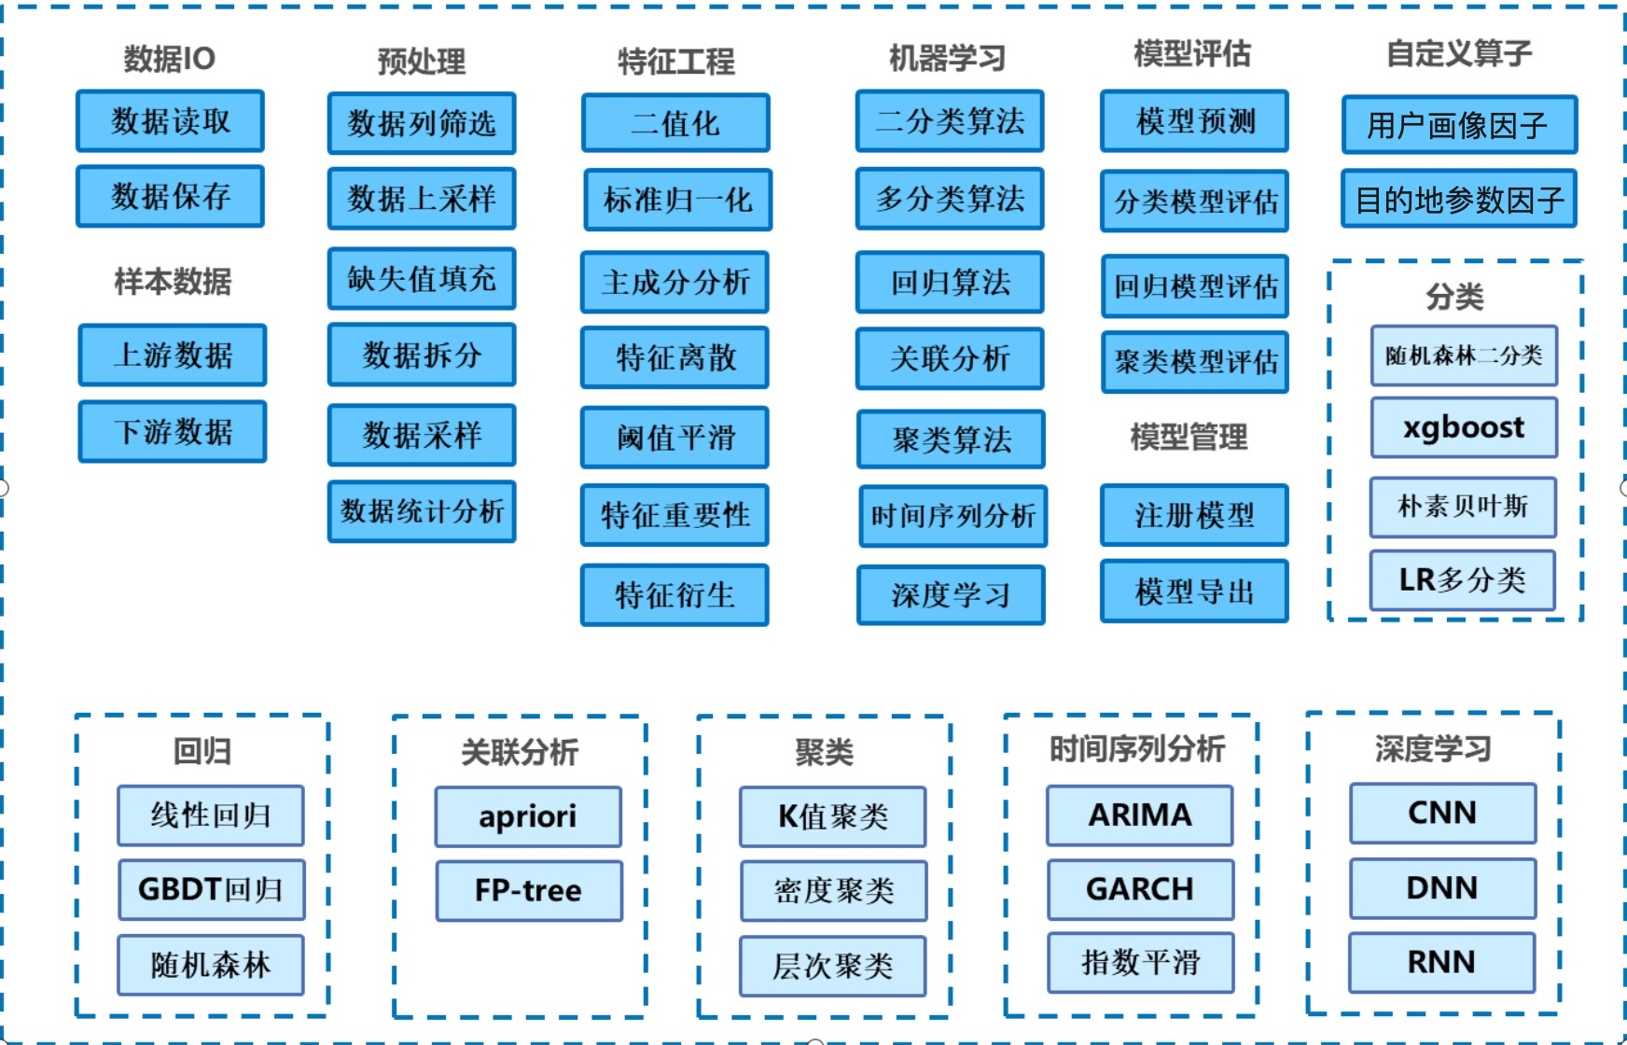
决策出行系统算法模型汇总

