Slide 1



An Attention-based Long Short-Term Memory Framework for Detection of Bitcoin Scams
Puyang Zhao¹, Wei Tian¹, Lefu Xiao¹, Xinhui Liu¹ and Jingjin Wu¹
IEEE HDIS 2022, 9 December 2022
Faculty of Science and Technology, BNU-HKBU United International College, China

Slide 2

1
Introduction
2
Related work
Outline
3
Data Collection
4
Multi-Class Classification
5
Results & Conclusion

Slide 3
1
Introduction
2
Related work
Outline
3
Data Collection
4
Multi-Class Classification
5
Results & Conclusion

Slide 4


Introduction
Part 1
Highest market share among all cryptocurrencies (45%) as of October.
Scams in the cryptocurrency space have been on the rise and are growing rapidly in 2019.
Since the start of 2021, more than 46,000 people have reported losing over $1 billion in crypto to scams.
Scam Payment Methods

Slide 5


Introduction
Part 1
Cyber-Crime:
Ponzi schemes
E-mail frauds
Ponzi schemes generated almost $7 billion in cryptocurrency revenue in 2019.
The decentralized nature of blockchain technology allows scammers to bypass centralized cryptocurrency authorities.
The immutability of blockchain systems makes the transfer of funds irreversible.

Slide 6


Motivation and Objective
Part 1.1
Motivation
More and more investors are becoming victims of cyber scams.
It is important to detect online fraud at an early stage to ensure a properly functioning online society.
Objective
Classify all Bitcoin transactions into three categories
Ponzi scheme
Other scams (eg: Email scams, Romance scams)
Normal transactions
As a result, we can prevent scams in advance or detect them in the early stage of fraud.
Cryptocurrency Scam
Notes:
A general trend is that more and more people are becoming victims of cryptocurrency scams. So detect cyber scams in their early stages is important. In this paper, we classify all Bitcoin transactions into three categories: 1) transactions involved in a Ponzi scheme, 2) transactions involved in other types of scams, or 3) normal non-scam transactions

Slide 7
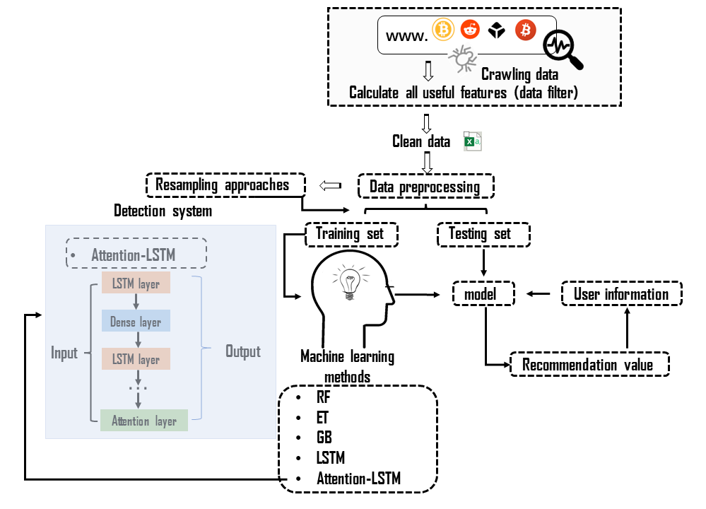
Classification Framework
Part 1.1
Main contributions:
We design a crawler which can crawl information about Bitcoin transactions that potentially involve scams.
“Ponzi”, “profit”, “HYI”, “multiplier”, “investment”, “MLM”
We study the features that distinguish normal transactions from those involving cyber scams.
We develop a framework that can accurately detect Ponzi schemes and other scams conducted by Bitcoin transactions with a method called attention-based Long Short-Term Memory (A-LSTM).
Workflow of our detection framework

Slide 8
1
Introduction
2
Related work
Outline
3
Data Collection
4
Multi-Class Classification
5
Results & Conclusion

Slide 9
Related works
Part 2
Although the number of scams is rapidly increasing, few public datasets are available for analysis.
It is difficult to gather sufficient data since Bitcoin scammers frequently change their IP addresses.
Existing data mining classifiers for this purpose are all binary, thus failing to classify Ponzi schemes and other Bitcoin scams.
In terms of classifiers, the most popular one used in existing studies is Random Forest (RF).
To the best of our knowledge, our proposed method is the first to add attention mechanisms to identify Bitcoin scams.

Slide 10
1
Introduction
2
Related work
Outline
3
Data Collection
4
Multi-Class Classification
5
Results & Conclusion

Slide 11
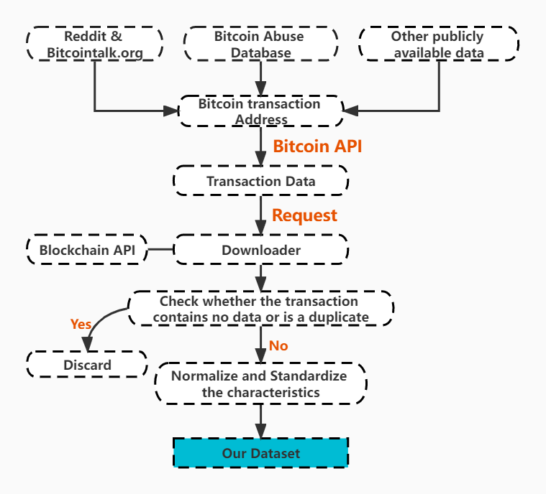



Part 3.1
Collection of Bitcoin addresses
The two largest Bitcoin communities Reddit and Bitcointalk.org contain addresses that conduct Bitcoin transactions.
We focus on investigating advertisements related to High-Yield Investment Programs (HYIPs).
Bitcoin Abuse Database website report addresses related to cyber scams.
Other existing relevant papers also provide publicly available data.
Types | Bitcoin address
Ponzi Scheme | 19g9exzmtJ2sQbBBB3x2PiY9pReVCm8HqA
Other Scam | 1CamL5swGf1sVCkzuya6TyE1KXAT3xmdxZ
Non-Scam | 1AfSRAGjxx5azGtCgboxnAP1F6pB95VALW
… | …

Slide 12
Dataset Construction
Part 3.2
Data Extraction:
Extract transaction data from Bitcoin addresses through Bitcoin APIs.
Access transaction data by Blockchain APIs with web crawlers.
Discard duplicate transactions or transactions containing no data.
Standardize the characteristics when necessary.
Types | Bitcoin address
Ponzi Scheme | 19g9exzmtJ2sQbBBB3x2PiY9pReVCm8HqA
Other Scam | 1CamL5swGf1sVCkzuya6TyE1KXAT3xmdxZ
Non-Scam | 1AfSRAGjxx5azGtCgboxnAP1F6pB95VALW
… | …

Slide 13
Dataset Construction
Part 3.3
Divide data into training and test set with a ratio of 80:20. The number of transactions belonging to each category is shown below
Type | No. of instances
Normal Instances | 3008
Ponzi Schemes | 285
Other Scams | 3526
The dataset has serious proportion imbalances across the three categories. Such imbalance may affects the prediction and has to be addressed properly.
Types | Bitcoin address
Ponzi Scheme | 19g9exzmtJ2sQbBBB3x2PiY9pReVCm8HqA
Other Scam | 1CamL5swGf1sVCkzuya6TyE1KXAT3xmdxZ
Non-Scam | 1AfSRAGjxx5azGtCgboxnAP1F6pB95VALW
… | …

Slide 14
1
Introduction
2
Related work
Outline
3
Data Collection
4
Multi-Class Classification
5
Results & Conclusion

Slide 15
Part 4.1
Traditional Data Mining Methods
Random Forest (RF)
𝐑𝐅 is a classifier containing multiple 𝐝𝐞𝐜𝐢𝐬𝐢𝐨𝐧 𝐭𝐫𝐞𝐞𝐬, and its output is determined by each tree of each output category.
Extra Trees (ET)
ET is a variant of RF. For the training set, each decision tree uses the original training set. After the division features are selected, extra trees randomly select a feature value to further divide the decision tree.
Gradient Boosting (GB)
In GB, each iteration generates a weak learner that fits the gradient of the loss function with respect to the previous cumulative model and then adds this learner to the cumulative model.

Slide 16
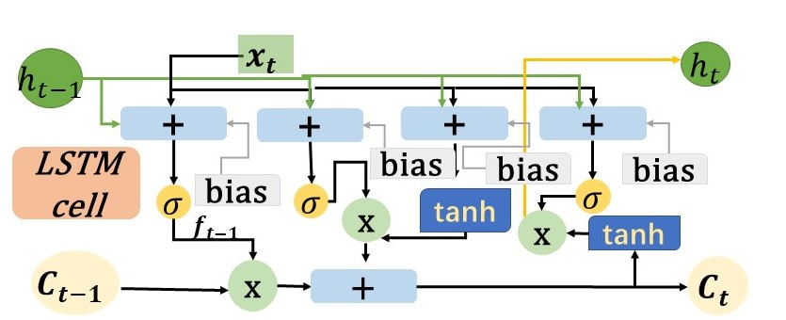
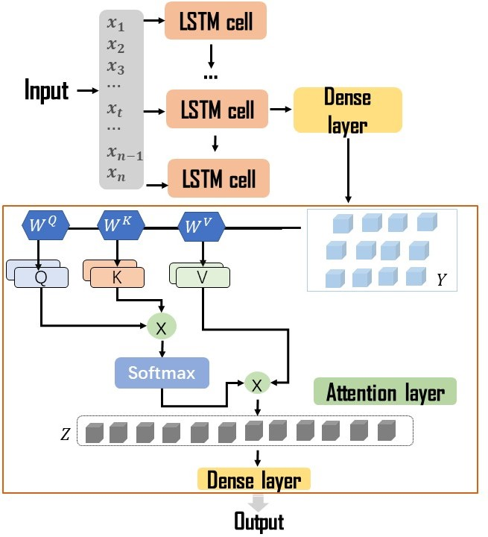
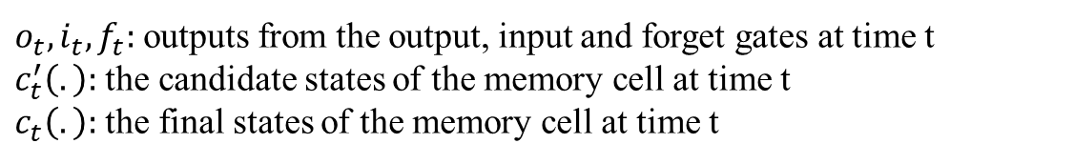

Input Gate
Forget Gate
Output Gate
Part 4.2.1
Our proposed A-LSTM
LSTM evolved from recurrent neural networks (RNN) and solve the gradient vanishing problem of RNN in capturing long-range information.
$h_{t}$, the output of the LSTM at time t, can be calculated by:
$$h_{t}=o_{t}∗tanh⁡(i_{t}∗c_{t}^{′}+f_{t}c_{t−1 })$$
$o_{t},i_{t}, f_{t}:$outputs from the output, input and forget gates at time t
$c_{t}^{′}\left(.\right):$ the candidate states of the memory cell at time t
$c_{t}\left(.\right):$ the final states of the memory cell at time t

Slide 17
Input Gate
Forget Gate
Output Gate
Part 4.2.2
Our proposed A-LSTM
Adds an attention mechanism to LSTM can better capture global information
In fraud detection, we need to focus on the key features first and discard the redundant features
The attention mechanism is capable of handling the dependence among the LSTM outputs
17

Slide 18
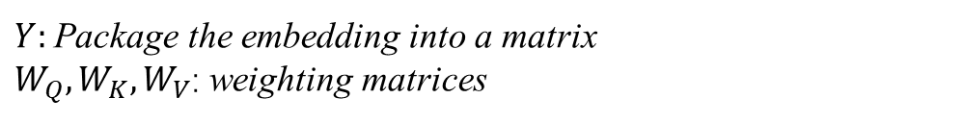
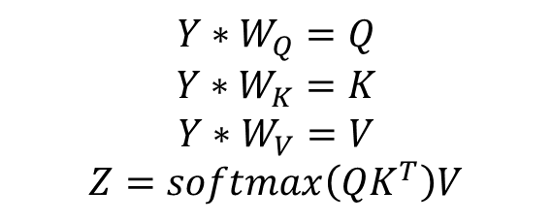
Input Gate
Forget Gate
Output Gate
Part 4.2.3
Our proposed A-LSTM
Attention mechanism handling the dependence among the LSTM outputs by the attention weights matrices Q (query), K (key value), and V (value)
Packing the embeddings into a matrix Y and get the output Z of the attention layer by:
$$Y∗W_{Q}=Q$$
$$Y∗W_{K}=K$$
$$Y∗W_{V}=V$$
$$Z=softmax\left(QK^{T}\right)V$$
$Y:$ Package the embedding into a matrix
$W_{Q},W_{K}, W_{V}$: weighting matrices

Slide 19


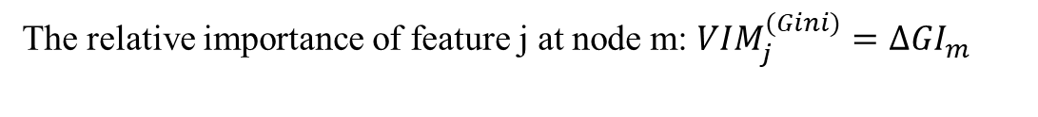
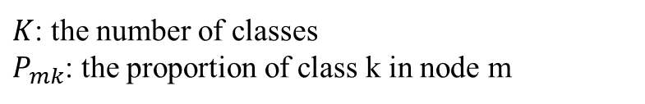
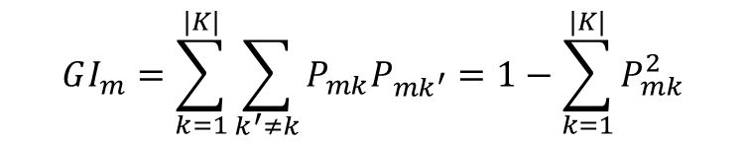
Part 4.3
Performance measures
The following are our performance measures
Precision
Recall
F1-score
$$=\frac{2×(Recall×Precision)}{Recall+Precision}$$
We consider the change in the Gini index caused by branching a certain feature vector $x_{j} (VIM_{j}^{\left(Gini\right)})$, to represent the relative importance
The Gini index of $x_{m}∈\{x_{1},x_{2},…,x_{M}\}$:
$K$: the number of classes
$P_{mk}$: the proportion of class k in node m
$$GI_{m}=\sum_{k=1}^{|K|}{\sum_{k^{′}≠k}{P_{mk}P_{mk^{′}}=1−\sum_{k=1}^{|K|}{P_{mk}^{2}}}}$$
The relative importance of feature j at node m: $VIM_{j}^{(Gini)}=ΔGI_{m}$

Slide 20
1
Introduction
2
Related work
Outline
3
Data Collection
4
Multi-Class Classification
5
Results & Conclusion

Slide 21
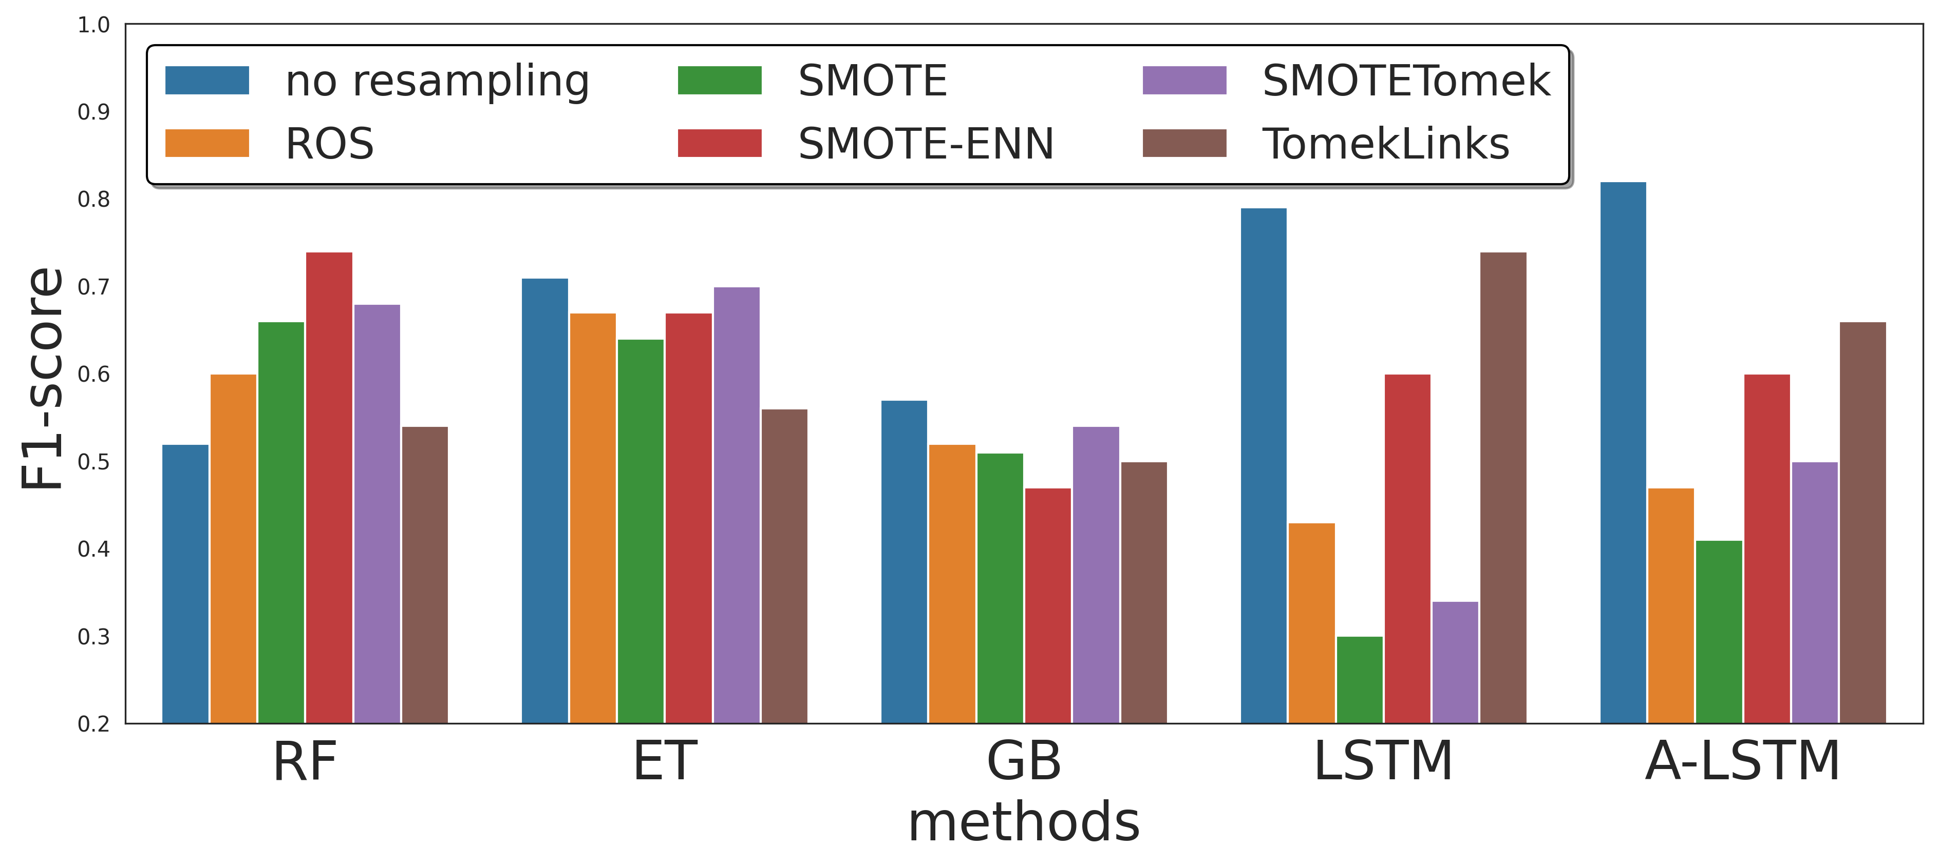
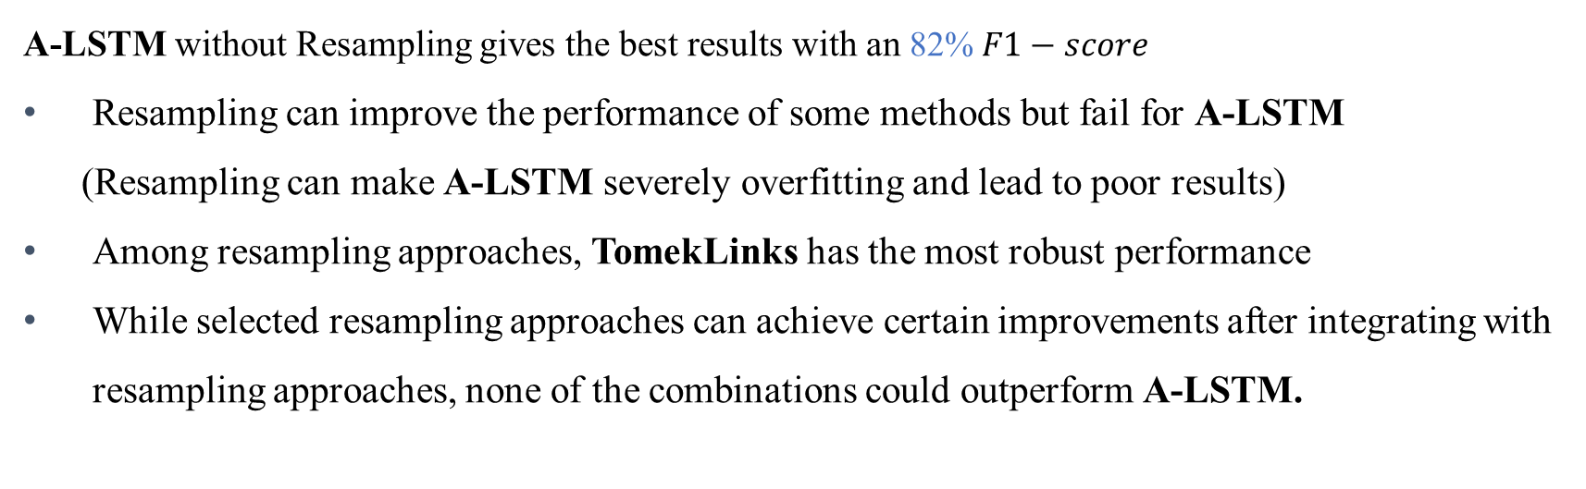
Part 5
Performance comparison
A-LSTM without Resampling gives the best results with an 82% $F1−score$
Resampling can improve the performance of some methods but fail for A-LSTM
(Resampling can make A-LSTM severely overfitting and lead to poor results)
Among resampling approaches, TomekLinks has the most robust performance
While selected resampling approaches can achieve certain improvements after integrating with resampling approaches, none of the combinations could outperform A-LSTM.
0.82
0.74
0.79

Slide 22
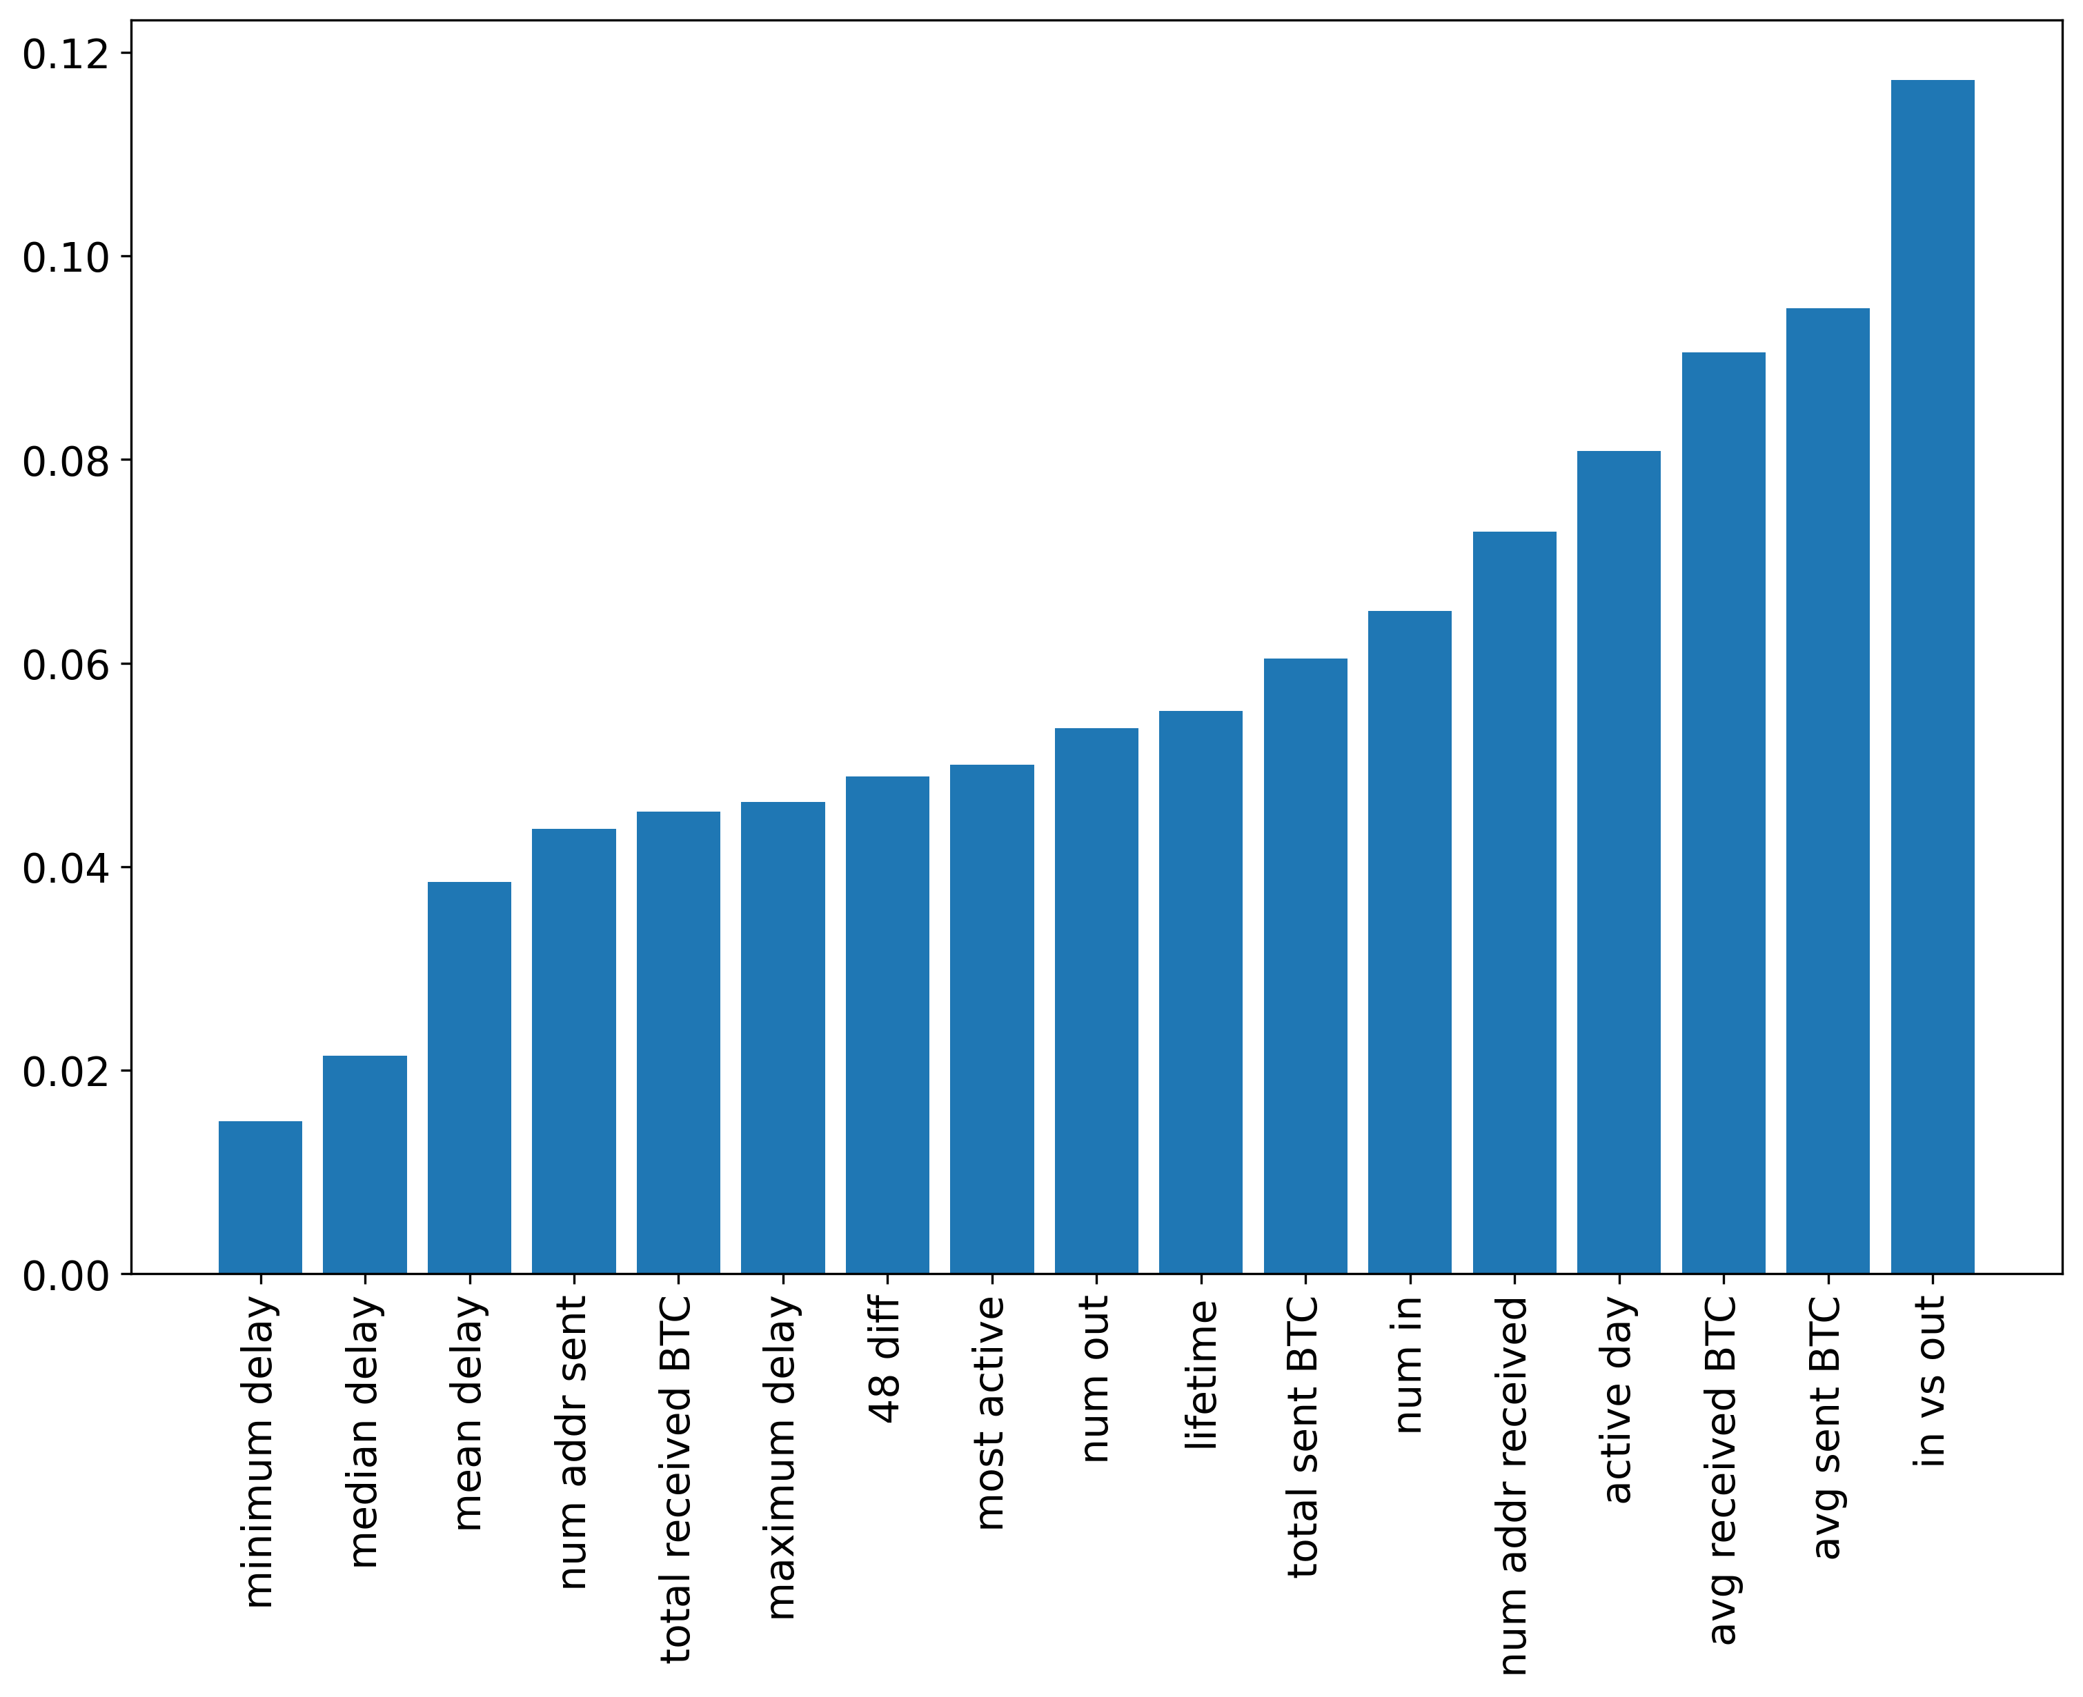
Part 5
Importance of features
The five most discriminating features sorted by the change in the Gini index (in ascending order of relevance):
in vs out
avg received BTC
avg sent BTC
total spent BTC
total received BTC

Slide 23
Part 5
Conclusion
We proposed a framework to collect Bitcoin transaction data and classify whether a transaction is a scam and focused on the Ponzi scheme.
The dataset of Ponzi schemes collected by our crawler is much larger than existing studies on similar topics.
We proposed the A-LSTM approach and demonstrated that it outperformed existing popular approaches.
We also analyzed the relative importance of features.
We plan to find new methods to expand the data in the future, such as Generative Adversarial Network.

Slide 24
Thank you!

