Slide 1
Actor-Critic Methods for Automated Stock Trading
Presenter: Yufan Zhu, Rutwik S. Dharanappagoudar, Xin Fei

Slide 2
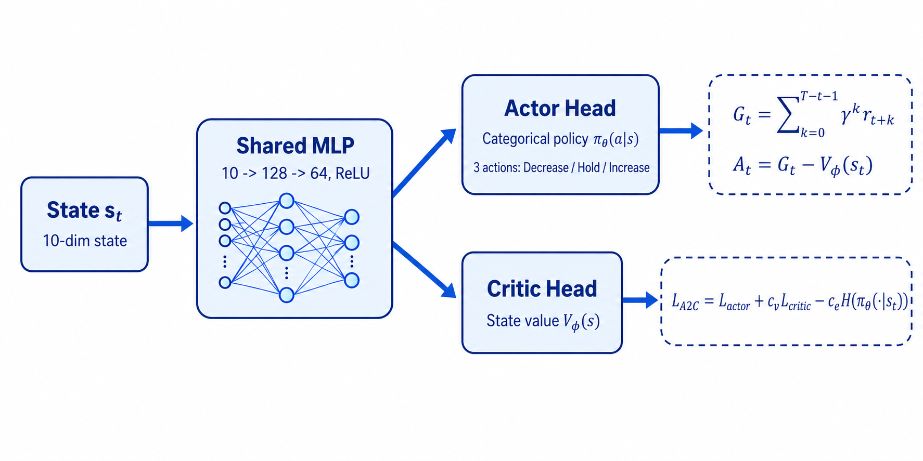

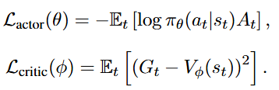
A2C Implementation
Environment Setting
Same TradingEnv as DQN and DDQN
Same state, action space, reward and transaction cost
: entropy regularisation
Notes:
On this slide, I introduce our A2C implementation.
The motivation is to extend our comparison beyond value-based methods such as DQN and DDQN. Instead of learning a Q-value for each action, A2C uses an actor-critic structure.
The input state is the same as in our DQN setting. It is a 10-dimensional state, including 9 technical indicators and the current position. This state first goes through a shared MLP with two hidden layers. After that, the network splits into two heads.
The actor head outputs a categorical policy over the three trading actions: Decrease, Hold, and Increase. In other words, it directly learns the probability of choosing each action.
The critic head estimates the state value, which tells us how good the current state is expected to be.
During training, we collect one episode rollout, compute the discounted return, and then estimate the advantage as the difference between the actual return and the critic’s value estimate. If the advantage is positive, the actor is encouraged to choose that action more often. Otherwise, the probability of that action is reduced.

Slide 3
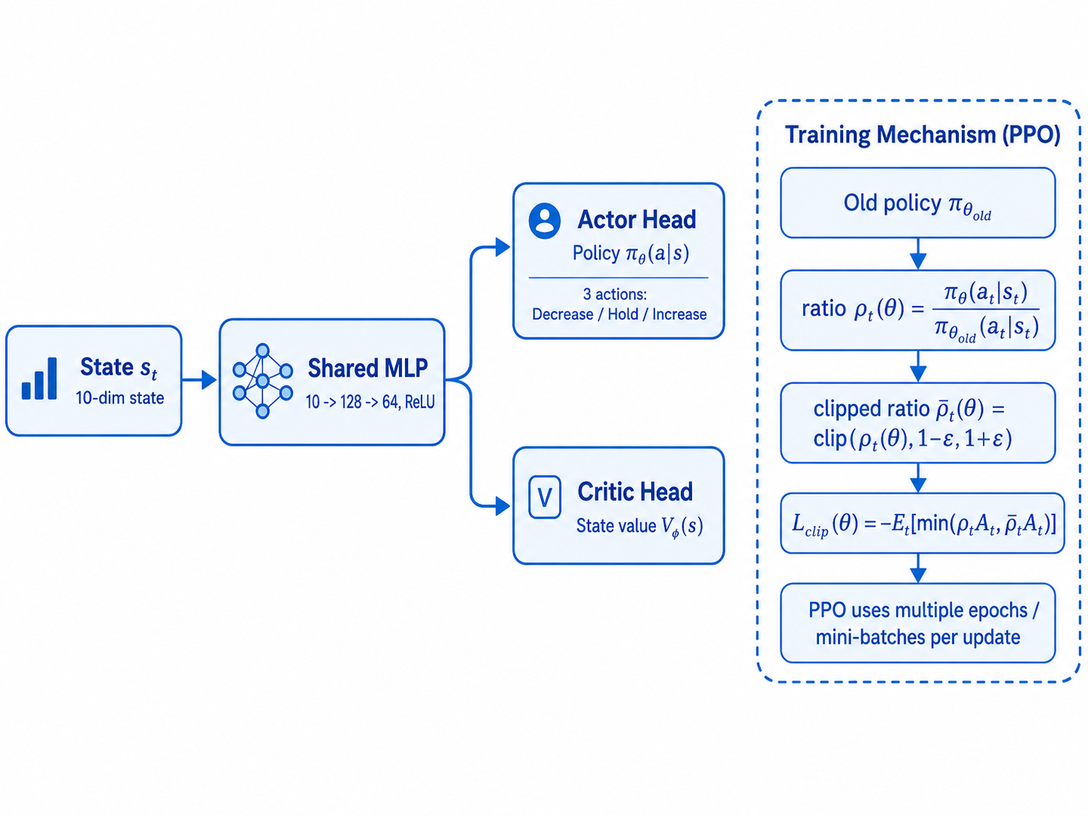
PPO Implementation
Environment Setting
A2C can suffer from unstable policy updates
PPO improves stability in noisy trading envionments
PPO stabilizes policy update by clipping how much the new policy can deviate from the old policy.
Notes:
Similarly, we also implement PPO to learn the policy.
PPO uses almost the same actor-critic network structure as A2C. It still has a shared MLP, an actor head for the policy, and a critic head for the value function.
The main difference is not the network architecture, but the policy update rule.
A2C directly updates the actor using the estimated advantage, but this can sometimes make the policy change unstable, especially in noisy environments like stock trading.
PPO addresses this problem by comparing the new policy with the old policy. It computes a probability ratio between them. If the new policy changes too much from the old policy, PPO clips this ratio within a fixed range.
This clipped objective prevents overly large policy updates and usually makes training more stable. In our implementation, PPO also reuses the same rollout for multiple update epochs with mini-batches.
So, in one sentence, A2C directly updates the actor using the advantage, while PPO stabilizes this update by clipping how much the new policy can deviate from the old policy.

Slide 4
Results and Conclusion
Metrics | DQN | DDQN | A2C | PPO | Momentum-20
Cum. Return | +171.7 % | +172.5 % | +182.9 % | +184.3 % | +167.0 %
Sharpe | +2.73 | +2.73 | +2.79 | +2.81 | +2.61
Max Drawdown | -15.5 % | -15.9 % | -17.1 % | -16.7% | -17.5 %
• A2C/PPO recovered much more of the AAPL uptrend than DQN/DDQN.
• Similar drawdowns to buy-and-hold suggest limited downside-risk control.
Notes:
The results are shown in this table.
From the results, actor-critic agents perform much better than DQN and DDQN on this AAPL test split.
A2C achieves a cumulative return of about 152.8%, and PPO achieves about 138.2%, both much closer to buy-and-hold than the value-based RL agents.
However, their maximum drawdowns are still close to buy-and-hold. This suggests that A2C and PPO mainly learned a long-biased policy that captured the strong upward trend of AAPL, rather than a policy with strong downside-risk control.
Therefore, our conclusion is that actor-critic methods improve return capture compared with DQN and DDQN, but they still do not beat the simple 20-day momentum rule in risk-adjusted performance.

Slide 5
Thanks for your attention
Presenter: Yufan Zhu, Rutwik S. Dharanappagoudar, Xin Fei

