Slide 1

STAT 4011 IEEE-CIS Fraud Detection
1155092111 Yaoxi
1155092065 Yufei
1155091863 Tianye
1155092133 Ziwei
1155092023 Anni

Slide 2

Flow 1.Baseline model 2 FE & Models 3.Ensemble+Blending 4.Black Magic

Slide 3
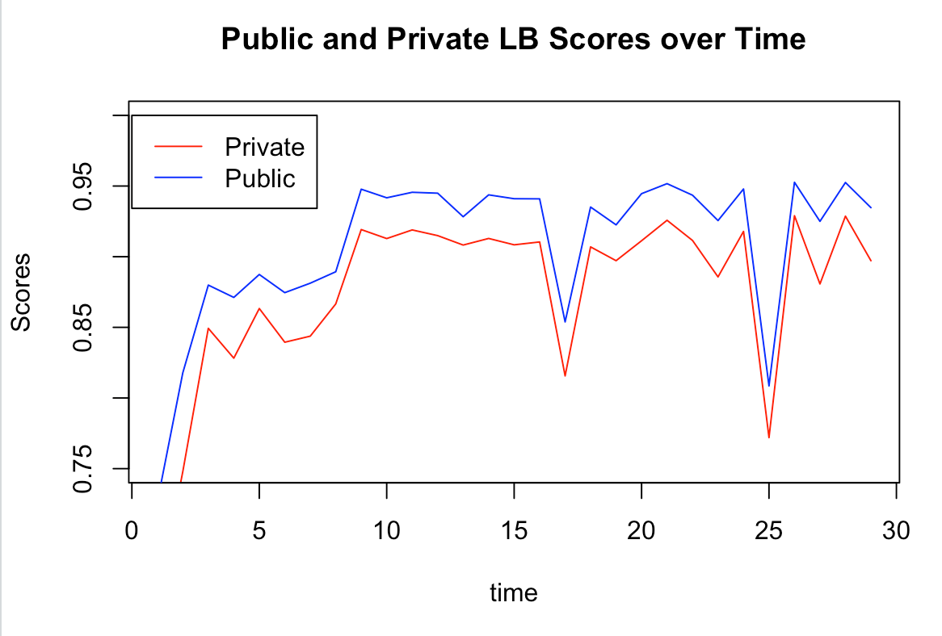

Slide 4
The story begins...
Mainly use tree models
randomForest (with imputation to NA)
Drawback : there are too many NA in both train set and test set. Imputation is not accurate.
Notes:
Having spent a long time trying models and imputation for missing value.
Then find LightGBM is a good model to use. Score boost to 0.928 for public (which is our baseline model)

Slide 5
Catboost
1. Handle NA in a better way
Data cleaning: set all NA be –1000 before apply the model
it is guaranteed that a split that separates missing values from all other values is considered when selecting trees
I

Slide 6
Catboost
2. Smarter in dealing with categorical variables
Different from the popular one-hot encoding
Categorical features are transformed to numerical. This is done using various statistics on combinations of categorical features and combinations of categorical and numerical features

Slide 7
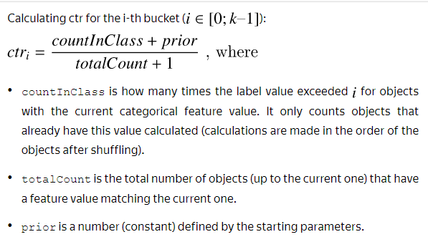
Catboost

Slide 8
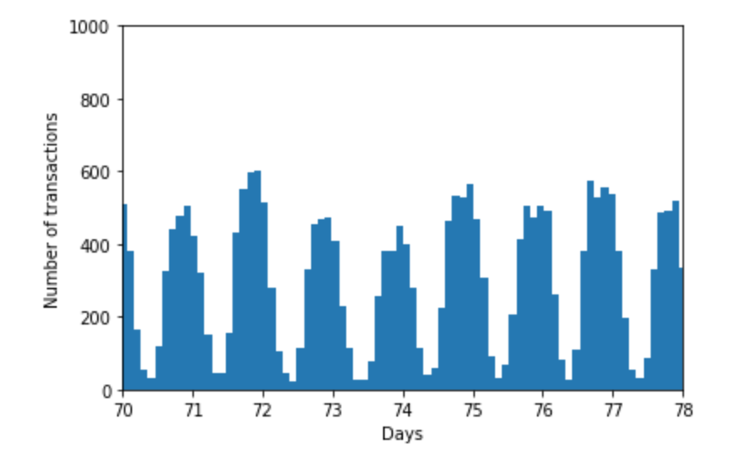
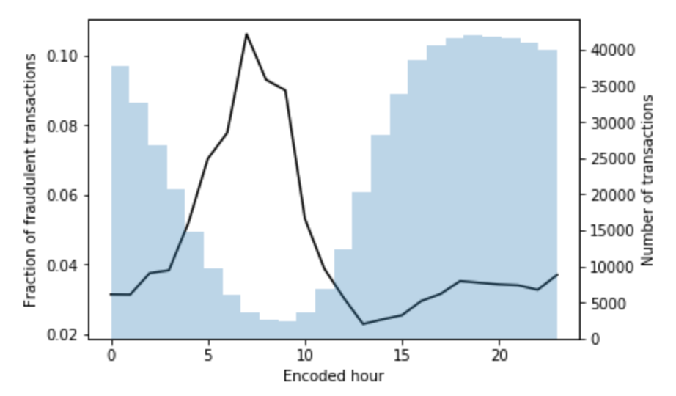
Part 2: Basic FE: TransactionDT
A timedelta from a given reference start time (1st Dec, 2017)
Periodicity:
Year
Month
Weekday
Hour
Date(UTC)
Notes:
Since we're quite new to this machine learning competition. We first get started by learning from the great kernels on Kaggle, try to run their code and understand why they were doing so. By incorporating other Kagglers' feature engineering ideas and our own thoughts, we did the following basic feature engineering.
TransactionDT: (Visualization&EDA ：https://www.kaggle.com/nroman/eda-for-cis-fraud-detection#Transaction-DT）
How they infer the time feature from TransactionDT:https://www.kaggle.com/fchmiel/day-and-time-powerful-predictive-feature
As we can see, there is not a significant correlation on the day of the week and whether a transaction is fraudulent. Actually, in our model this feature was not that useful.

Slide 9
Part 2: Basic FE: High cardinality features
Email binning for P_emaildomain (60 categories) and R_emaildomain (61 categories)
e.g. "icloud.com", "mac.com", "me.com" -----> "apple"
Count encoding
Combine train and test datasets
Count encoding
Normalizaton
High cardinality features:
e.g. addr1, card1, card2,card3, P_emaildomain, R_emaildomain
Notes:
A good EDA:https://www.kaggle.com/robikscube/ieee-fraud-detection-first-look-and-eda#Distribution-of-Target-in-Training-Set
By EDA, emaildomain is an important feature in this model. They both have around 60 categories, so we need to deal with them before encoding.
We combined the email domains from the same company into a new category. E.g. apple
https://www.kaggle.com/c/ieee-fraud-detection/discussion/100778#latest-605444
Frequency encoding: (replacing categories with their counts)
First combine train and test and then encode. Devide by the most frequent category to obtain nomalized values, so that our training process is stabilized.
Why count encoding? (https://www.kaggle.com/nroman/eda-for-cis-fraud-detection with EDA)
1. According to the discussion board, applying count encoding did boost the local CV scores.
2. It helps tree based model, like LightGBM, to detect outliers which occur infrequently since LightGBM cannot detect this type of outliers on its own.

Slide 10
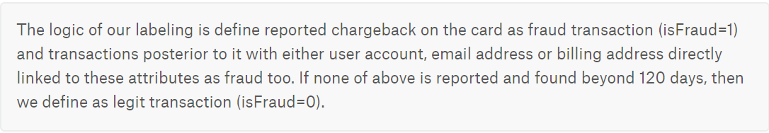
Mechanism
Part 3: Secret Feature: UID
WHY WE NEED UID?
Notes:
https://www.kaggle.com/akasyanama13/eda-what-s-behind-d-features
In order to further improve our model and scores, we turned our eyes to find some secret features which might be a combination of several features and convey extra information. By reading the disbord and notebooks, we find a key information provided by the holder of the competition.

Slide 11

Important features for finding UID
Important features for finding UID
-card1:Issuer Identification Number (IIN)
-card2:bank-branch in some place
-card3:country
-card4:company of the card
-card5:bind to third party software which hold your money before you receive your goods （not sure)
-card6:credit/debit
Addr1: purchaser's billing region
Addr2: purchaser's billing country

Slide 12
Important features for finding UID
D1-D5: time deltas, in units of days
-D1: time delta(days, rounded down) since first transaction for one card
-D3: time delta since the previous transaction for one card
-D4: time delta since first transaction for all cards on the account
-D5: time delta since the previous transaction for all cards on the account
Notes:
References:
Card1:https://www.kaggle.com/c/ieee-fraud-detection/discussion/100340#latest-579307 (13553 unique values in train dataset)
Card1-card6: https://www.kaggle.com/c/ieee-fraud-detection/discussion/107833#latest-629166
Addr1,addr2:https://www.kaggle.com/c/ieee-fraud-detection/discussion/102910#latest-595293
D1-D15:https://www.kaggle.com/c/ieee-fraud-detection/discussion/108704#latest-628569

Slide 13
Find Transaction Date
-D1n: first transaction date for one card
D1n = Transaction Date – D1
-D4n: first transaction date for all cards on the account
D4n = Transaction Date – D4
(Here Transaction date is calculated by TransactionDT)
Notes:
References:
Card1:https://www.kaggle.com/c/ieee-fraud-detection/discussion/100340#latest-579307 (13553 unique values in train dataset)
Card1-card6: https://www.kaggle.com/c/ieee-fraud-detection/discussion/107833#latest-629166
Addr1,addr2:https://www.kaggle.com/c/ieee-fraud-detection/discussion/102910#latest-595293
D1-D15:https://www.kaggle.com/c/ieee-fraud-detection/discussion/108704#latest-628569

Slide 14
Construct a UID
Find the Account (Failed):
UID=Card1+Card2+Card3+D4n
2. Find the Client for each card
UID=Card1+Card2+Card3+Address1+D1n+P_email

Slide 15
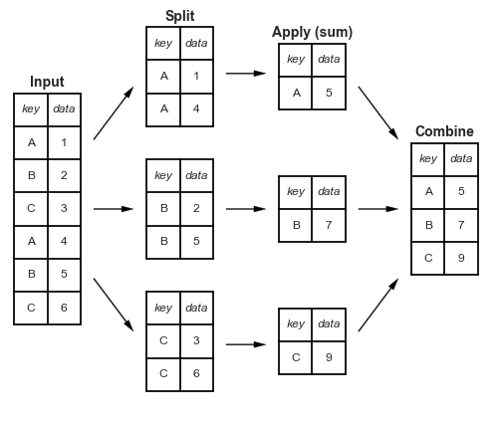
EDA+FE Part 3: Aggregation
Notes:
After making up reasonable uids, extracting meaningful data and information is still a problem.
For example, you might need to verify your account if you first login into this computer but it seldom happens on your own laptop.
Similarly, transaction amount can not show us anything unless you know the consuming habit of the card. That's why we need aggregation.

Slide 16
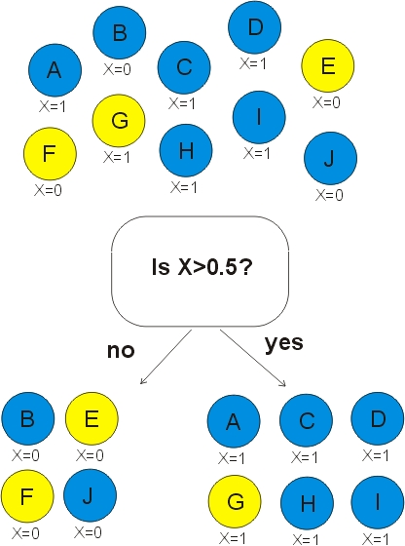
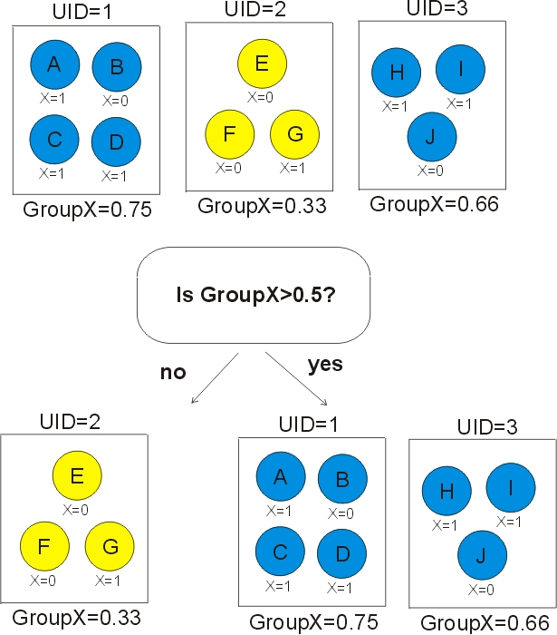
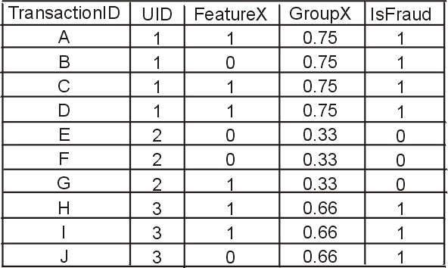
Aggregation
Notes:
Here is an intuitive example for the advantage of aggregation.
Following the post by the host of competition,we assume transactions with the same uid have the same label, either 1/0.
As we can see from the chart, according to different transaction information, the model will generate different Feather X. But only based on Feature X, there are still three transactions went into the wrong class.
After take the average of Feature X with the same uid, the model can classify all the transactions correctly.

Slide 17
Aggregation
Consistency
96.95% are always isFraud=0
2.45% are always isFraud=1
Only 0.6% have a mixture of isFraud=0 and isFraud=1
Notes:
Why we can make the assumption that same uid have the same label? You may think that after 120 days, a card becomes nonFraud.
But We rarely see that in the training data. (Perhaps fraudulent credit cards get terminated instead of reused).
The pie chart above shows this. More than 90% of the card are always nonfraud. Only (0.6%) have a mixture of fraud and nonFraud.
In order for easier modelling, we just ignore that propotion.

Slide 18
Aggregation
12.4% of data are in both the train and test dataset
87.6% cards first appear in testing dataset
Notes:
The plot showed 87.6% of the cards in private dataset first appear in the dataset. Only around 12% data we 've already know.
Therefore, the key for the competition is to build a model that can predict unseen clients (not unseen time).

Slide 19
UID Aggregation
TransactionAmt
dist1
D features (D1n, D4n, D10n, etc.)
C features
Notes:
Here are some aggregated features we made.
Transaction amount, the distance between the bank and the where he used the card, time delta and card information. We mainly calculate the average and the standard deviation.
Let's move on to the models we used.

Slide 20
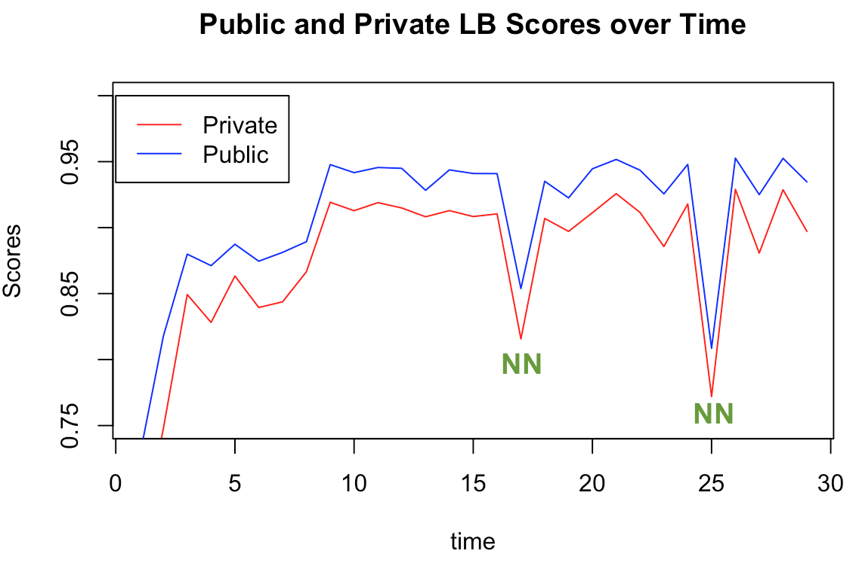
Models
LightGBM
XGBoost
CatBoost
Neural Network
Notes:
Four models
Didn't include NN in the final submission
Plot: two big dropings

Slide 21
NN: Version2: DNN with embedding (Keras)
Features: Basic FE features
Preprocess:
Numerical: Log transformation -> Standardization -> Fill NA by mean
Categorical:
-Fill NA as a new category as "miss".
-Use embedding layer for categorical features.
-Concatenate embedding layer to the
dense layer of numerical features.
-Feed them to neural network.
Architecture: DNN​
3 layers: 200-100-1​
Dropout=0.2​
Activation: relu-relu-sigmoid​
Loss: binary_crossentropy
Optimizer: adam
Epochs=10
Batch_size=32
Notes:
No significant improvement
Architecture:
By learning from discussion board and my own parameter tuning experiments. But clearly not enough.
20 embedding layers+1 dense layer for continuous features
The reason why using embedding layer for categorical features did not give me a boost is probably that

Slide 22
NN: Reflection
Why NN underperforms in this competition?
Structured data (in a tabular format)
It needs much time tuning the hyperparameters in the NN model.
-Architecture, loss, dropout, activation, hidden layer......
However,
NN is still worth trying since a well performed NN could add diversity to the predictions and help boost the score.
Notes:
Why NN....?
I've seen a lot of Kagglers discussing this problem. Quite difficult to answer.
Structured data comforms to a tabular format with relationship between the different rows and columns. E.g. excel files/SQL databases
In this competition, the data are structured, which conforms to a tabular format. In this case, neural network is much harder to understand and need much time finetuning the hyperparameters in the model. We have to deal with many different structures and losses, tune the dropout layers, activations, denses and so on.
Although it requires much more efforts to train a NN model, it's still manageble. According some of the top competitors, a well performed NN could add diversity to the models and help boost the score a lot.
The more I explored on the discussion board, the more I found that my neural network could be further improved.

Slide 23
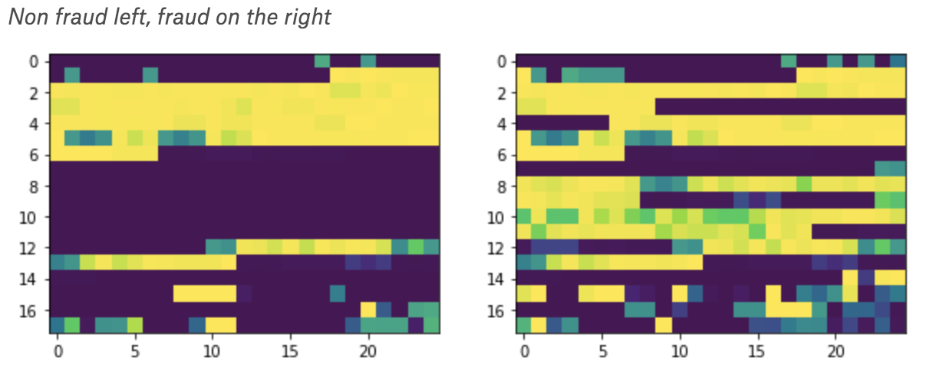
NN: Improvements
Add UID related features into NN model, apply embedding method
Try DNN using one-hot encoding instead of embedding
An interesting idea:
2D representation
of the normalized
data
Notes:
The more I explored on the discussion board, the more I found that my neural network could be further improved.
Since NN is good at dealing with unstructured data, like image recognation, natural language processing.
He created a 2D representation of the normalized data, and there was a pattern visible by the naked eye.
He tried to feed these "images" to resnets, but it didn't really worked out.
It did give us an sight into how to make use of NN in this kind of data in the future.

Slide 24
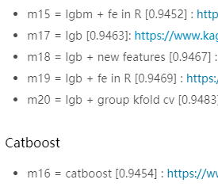
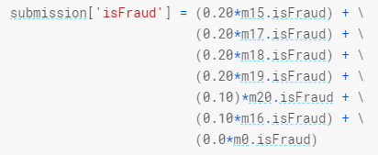
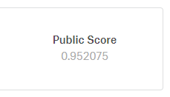
Blending and ensemble
https://www.kaggle.com/priteshshrivastava/ieee-cis-blendt
Regression? Weight average?
This enlightened us to try to weight different models with different feature engineering. And we will get a big upgrade at least on the public leaderboard (Indeed it also worked for the private leaderboard).

Slide 25



Final submission
XGboost
Catboost
LightGBM
On the last day, we have no time for other work, so we used all our 5 submissions to find the weight which attained the best on the public leaderboard.
How we select?
Best blending and best single model on public leaderboard. And we made correct decision.

Slide 26
Black Magic
1. Pay attention to discussion board (lots of useful info)
2. RDS (reduce reading time from 5mins to 30secs )
3. Google Cloud (awesome computation power, avoid limitation of Hardware)
4. Use Kernel (free GPU -> accelerate training process)
5. 'parallel working' (faster, less correlation)

Slide 27
Q&A

Slide 28
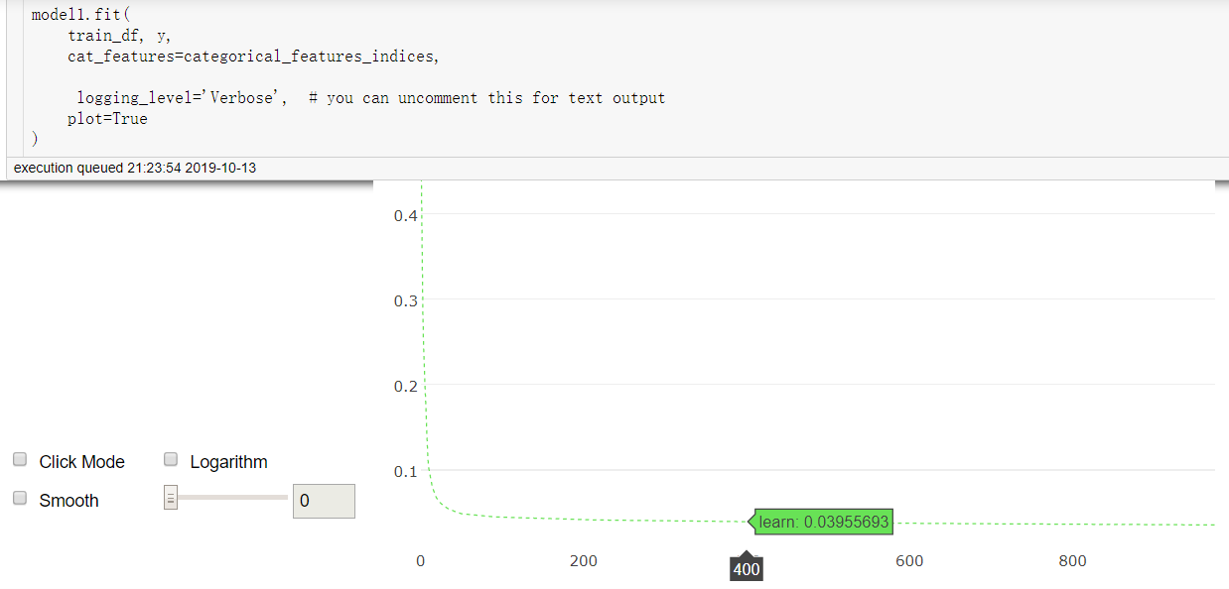
Tuning parameters

Slide 29
Post processing—tricks for boosting scores
We believe each to be an individual client (credit card). Analysis shows us that all transactions from a single client (one of Konstantin's UIDs) are either all isFraud=0 or all isFraud=1. In other words, all their predictions are the same. Therefore our post process is to replace all predictions from one client with their average prediction including the isFraud values from the train dataset. We have two slightly different versions so we apply them sequentially.
Assume transactions from the same uids have the same labels
According to the dataset, the proportion of different labels under the same uid is low
Assume the probabilities of a fraud transaction for the same uid are the same
We found that auc will improve after the transformation

Slide 30
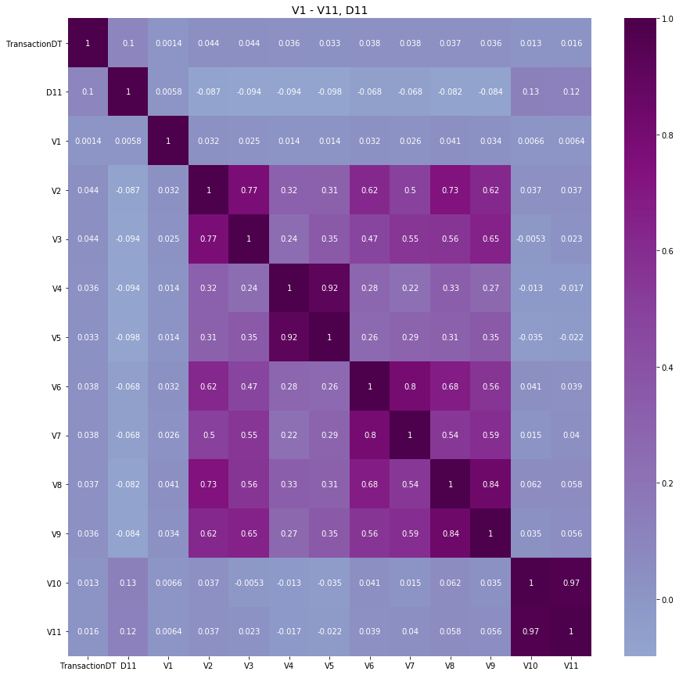
Appendix Selection for V column
Divide into several groups
Based on missing rate

