Slide 1
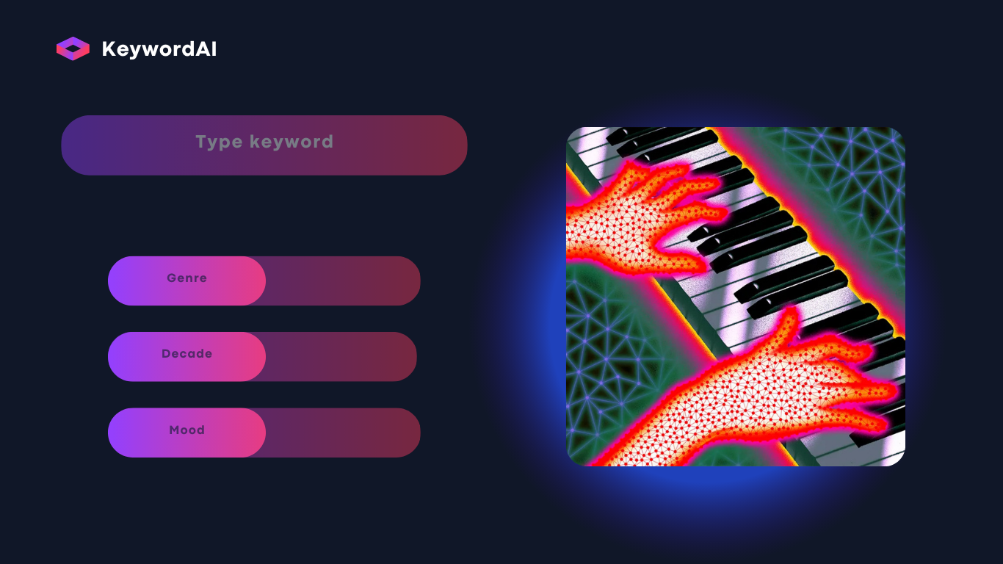
Playlist Generator based on keywords

Slide 3
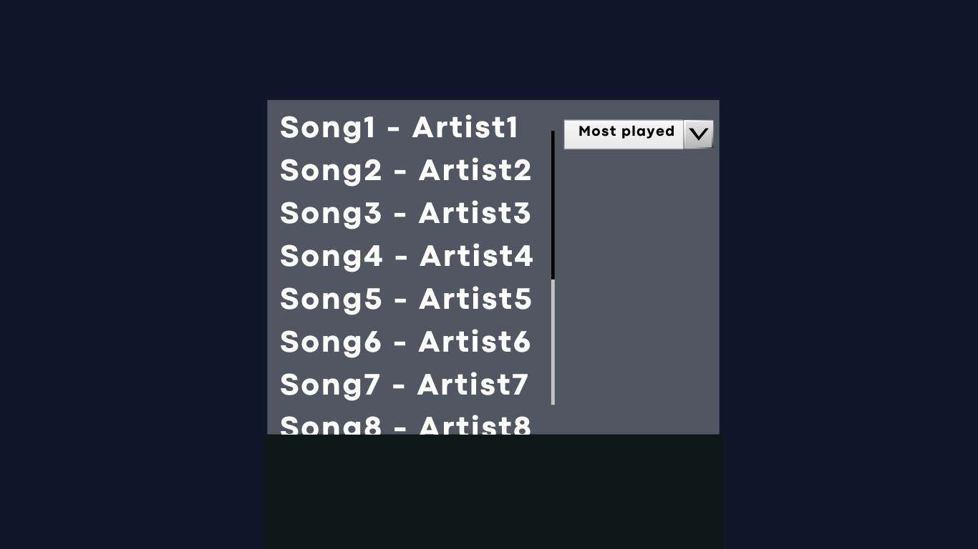

Slide 4
Motivation
Interested in Machine Learning and AI technology
Alternative (fun) way of creating playlist
Integrating interpretation of the word and how it represents the song
Meeting every week to delegate tasks, track our progress
Design inspiration
Soundiiz

Slide 5
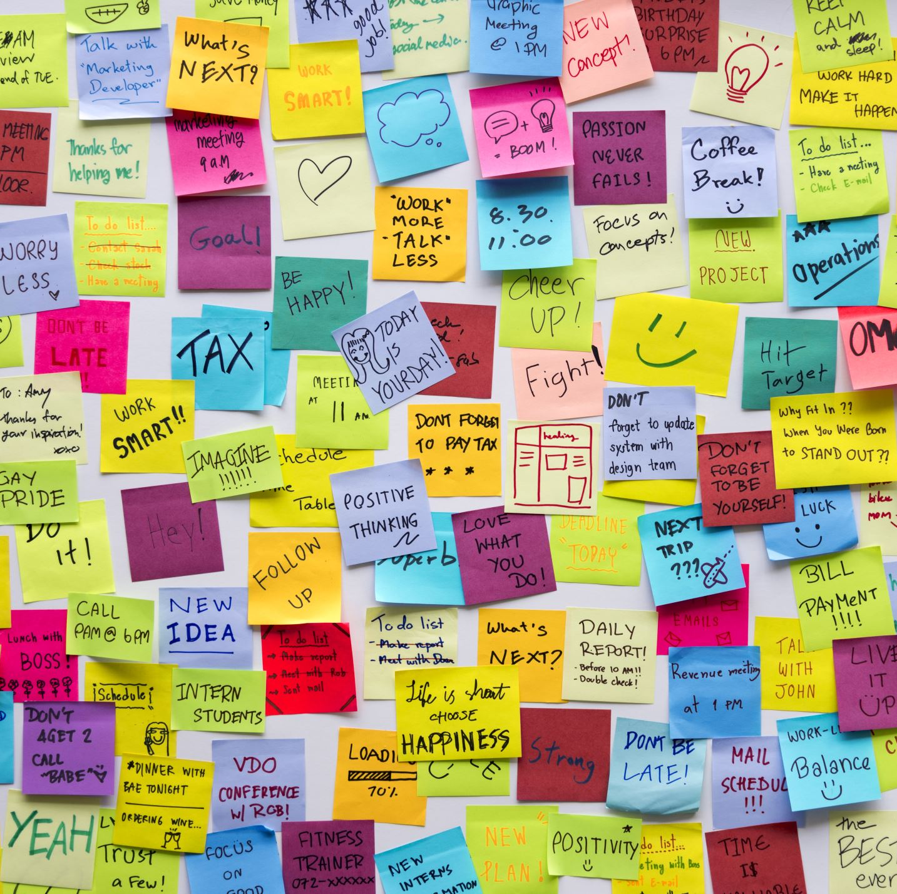
Project Overview
Idea: Type a word as an input
Recognizing songs based on this word
For example:
input= Irish -> output=Fields of atheary
Input=Green -> output=Fields of atheary
Different modes of searching: title, lyrics etc…
Creates the playlist in your Spotify account

Slide 6
Technical stack
Programming language: JavaScript, HTML, CSS, MangoDB
Link with Spotify database
Data processing: Machine learning, Research algorithms

