Slide 1
NLP
Making predictions over amazon review dataset
Yufei (Olivia) Wu
https://github.com/USCDataScience/sparkler
Notes:
Slides can vary as per your presentation, but header and footer should be consistent

Slide 2
Predictions

Slide 3
The purpose of this analysis is to make up a prediction model where we will be able to predict whether a recommendation is positive or negative. In this analysis, we will not focus on the Score, but only on the positive/negative sentiment of the recommendation.
To do so, we will work on Amazon’s review dataset, we will build a Term-doc incidence matrix using term frequency and inverse document frequency ponderation. When the data is ready, we will load it into predicitve algorithms. In the end, we hope to find the "best" model for predicting the recommendation's sentiment.

Slide 4
Loading the data

Slide 5
As we only want to get the global sentiment of the recommendations (positive or negative), we will purposefully ignore all Scores equal to 3. If the score id above 3, then the recommendation wil be set to "postive". Otherwise, it will be set to "negative".
The data will be split into an training set and a test set with a test set ratio of 0.2

Slide 6
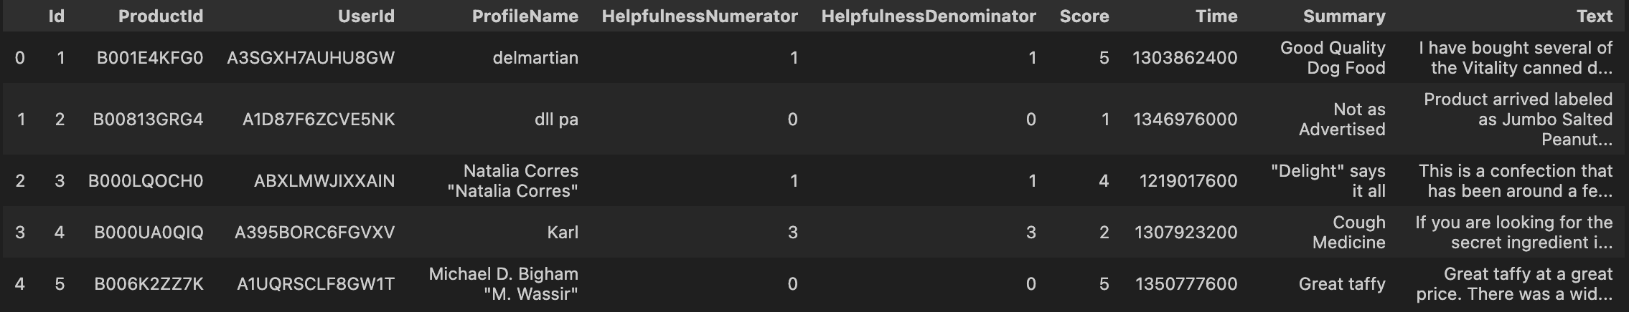
dataset

Slide 7
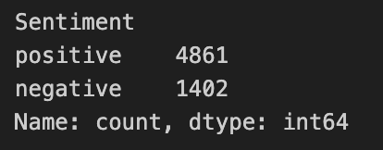
numerical into category variable
imbalance????

Slide 8
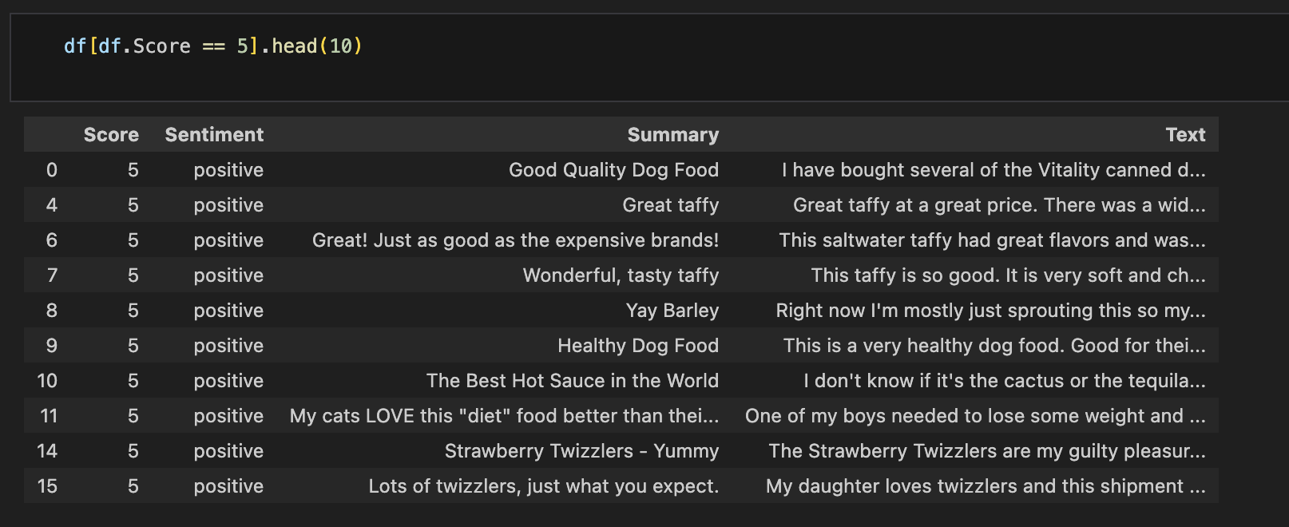
some score 5 data

Slide 9
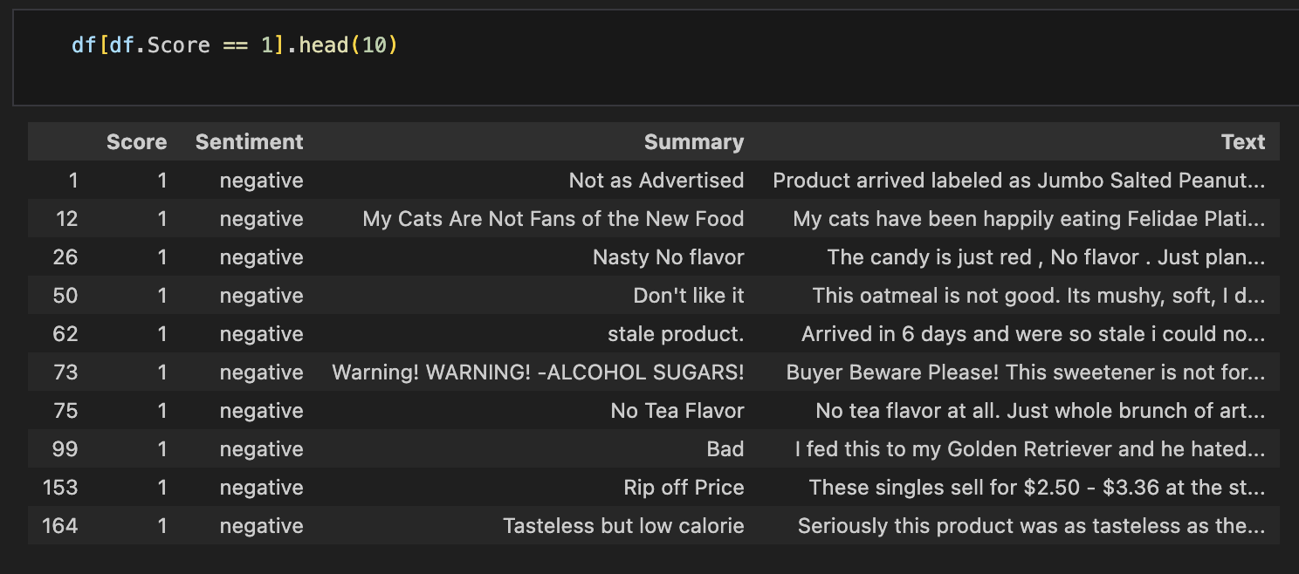
some score 1 data

Slide 10
Cleaning the data

Slide 11
Term-doc incidence matrix
To format our data and build the Term-doc incidence matrix, many operations will be performed on the data :
Stop words removal
Stemming
Punctuations
Lowering

Slide 12
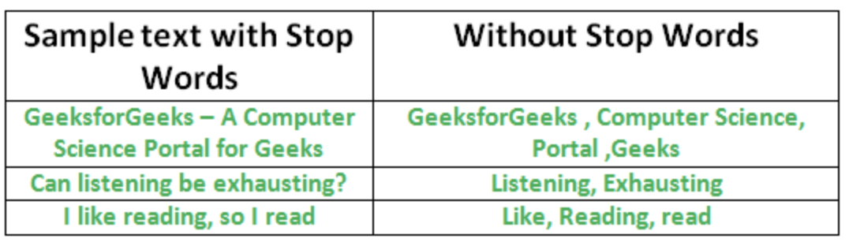
Stopwords
A stop word is a commonly used word (such as “the”, “a”, “an”, “in”) that a search engine has been programmed to ignore, both when indexing entries for searching and when retrieving them as the result of a search query.

Slide 13
do not use stopwords removal
do not use stopwords removal.
b/c stopwords like 'not', "hadn't" for example, have strong negative signal.

Slide 14
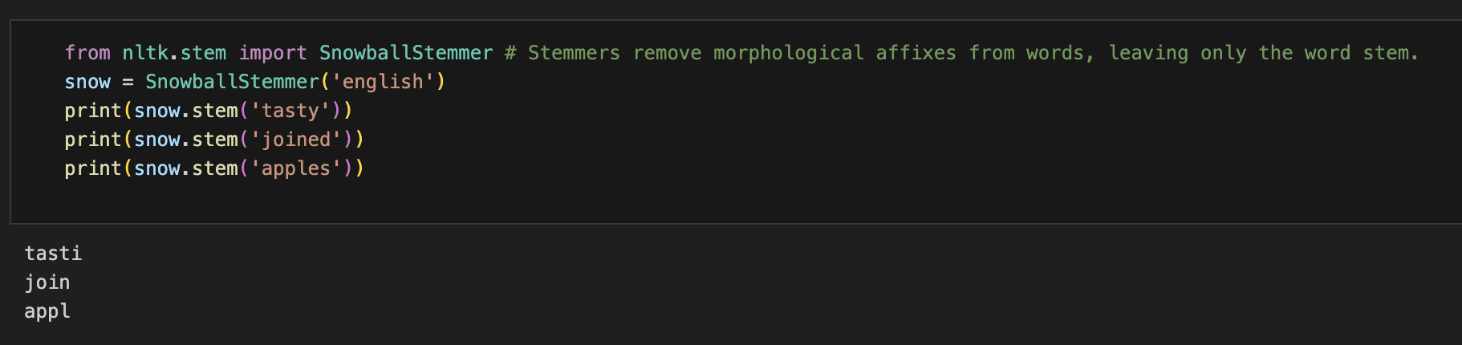
Stemming

Slide 15
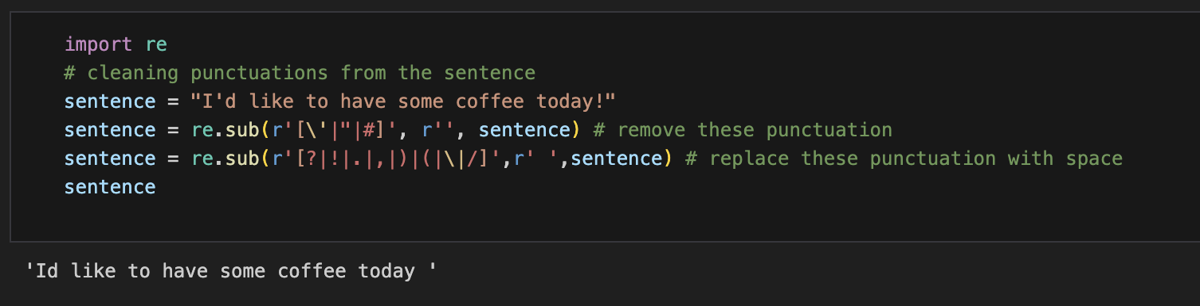
Punctuations removal

Slide 16
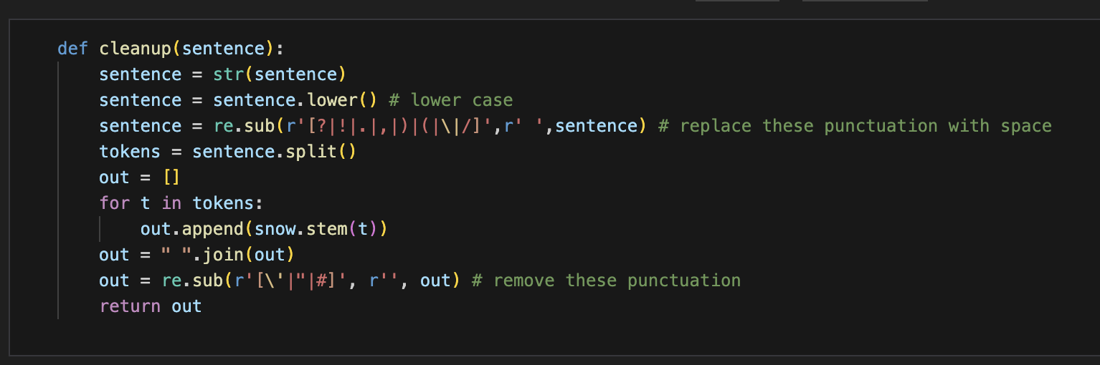
Combine

Slide 17
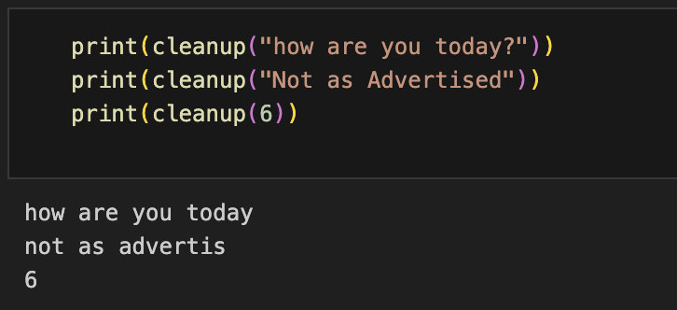

Slide 18
Wordclouds

Slide 19
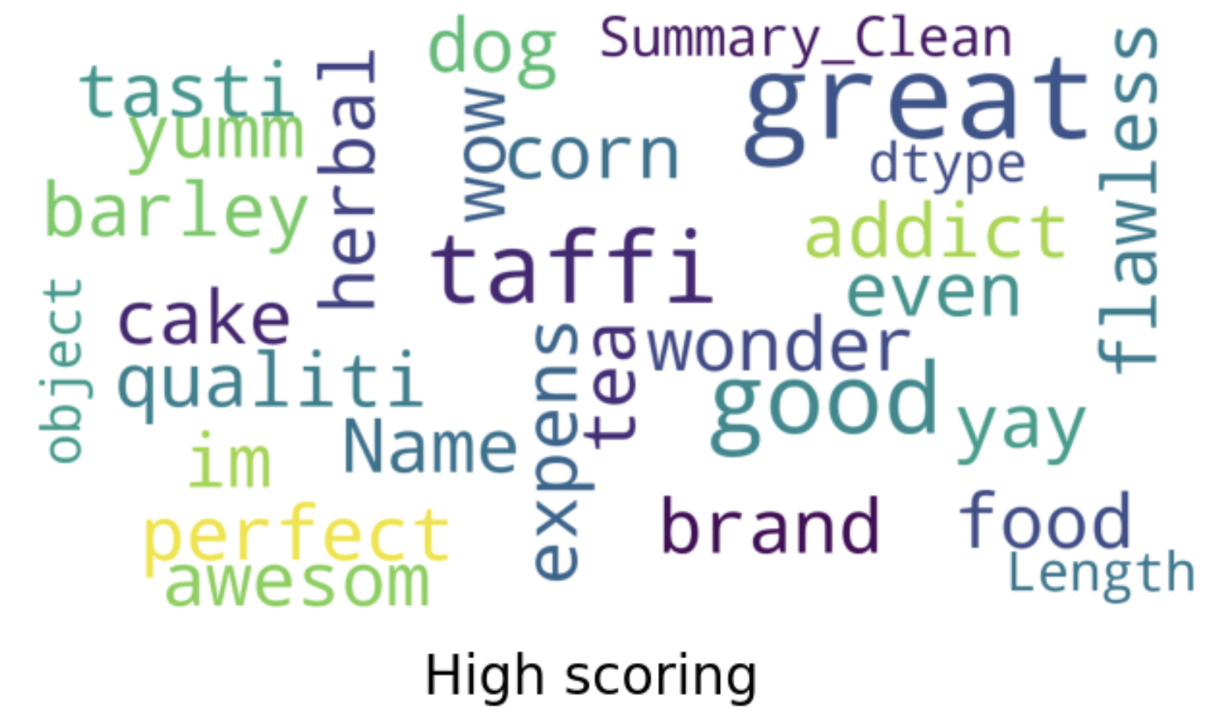
High score

Slide 20
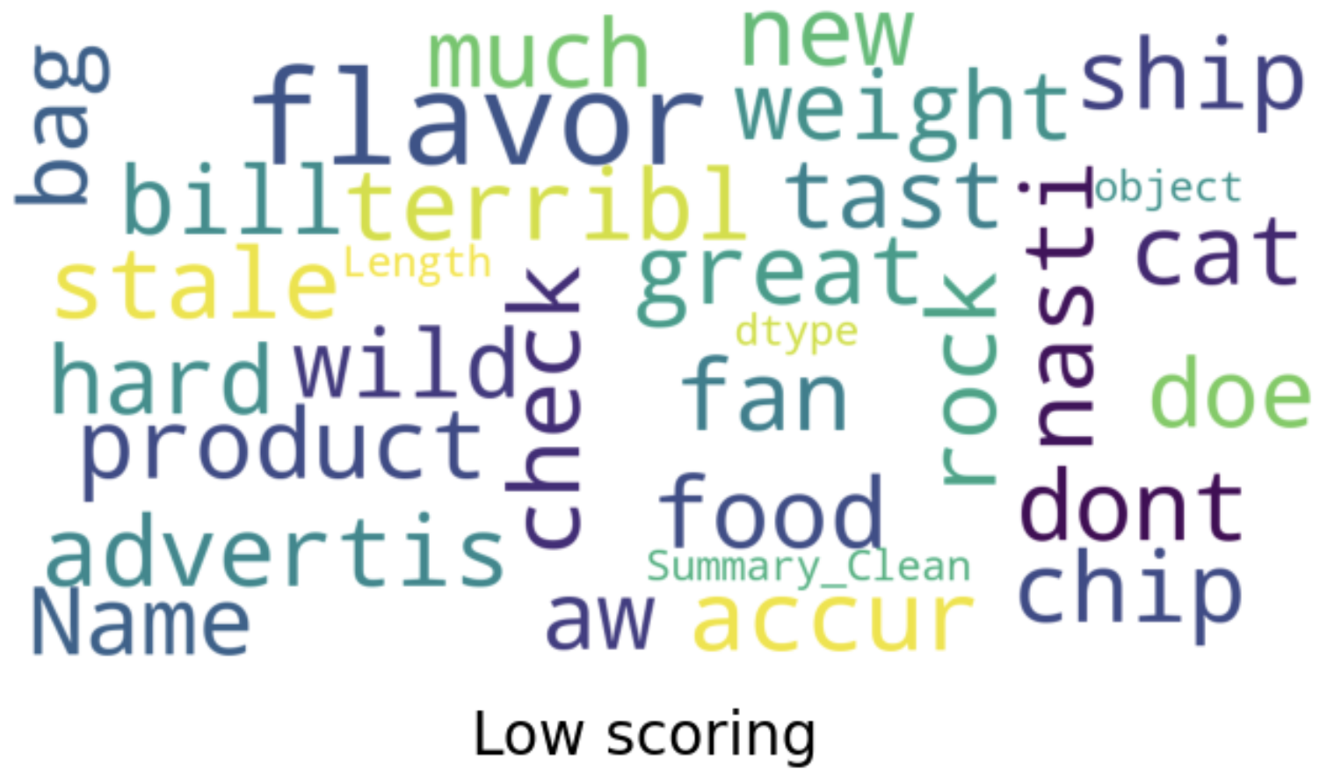
Low score

Slide 21
Train test split

Slide 22
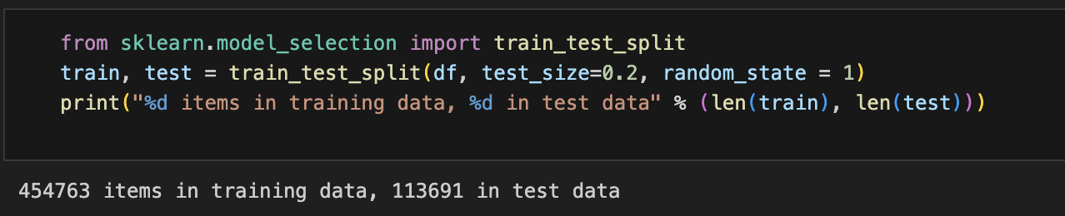

Slide 23
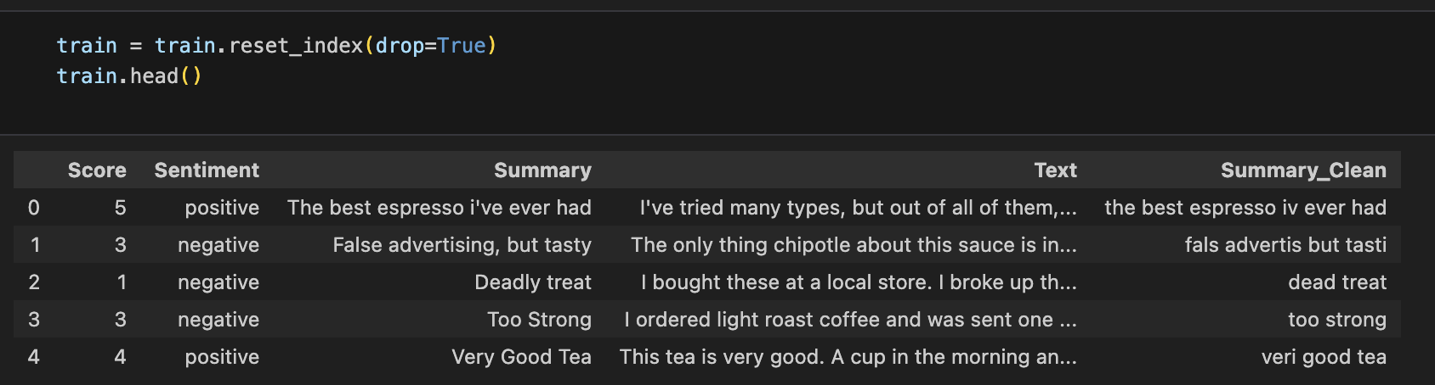
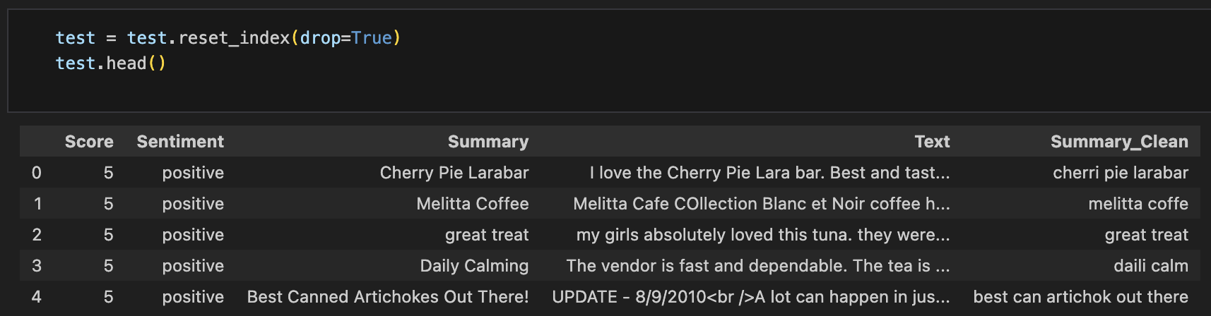

Slide 24
Word2Vector

Slide 25
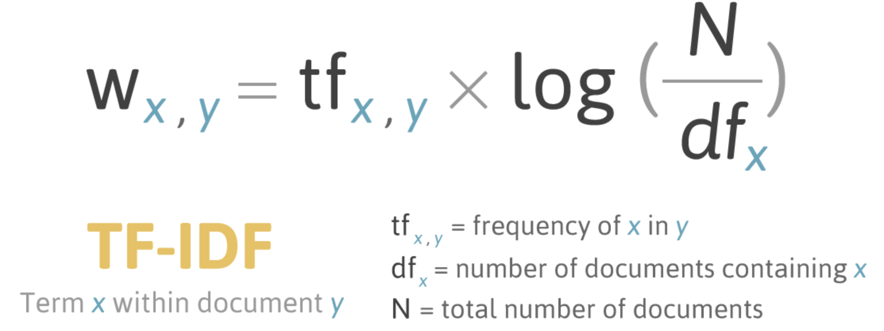
TF-IDF
TF*IDF is an information retrieval technique that weighs a term's frequency (TF) and its inverse document frequency (IDF). Each word or term has its respective TF and IDF score. The product of the TF and IDF scores of a term is called the TF*IDF weight of that term

Slide 26
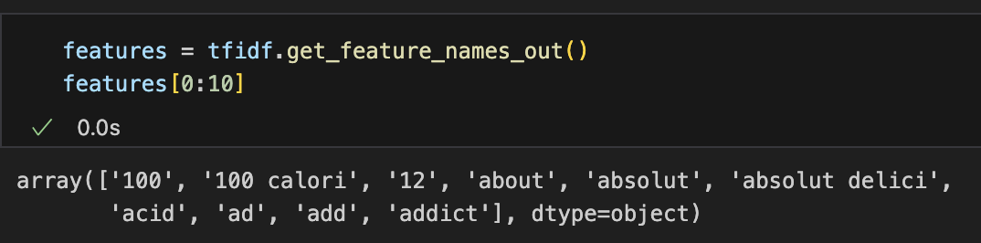

Slide 27
Logistic Regression

Slide 28
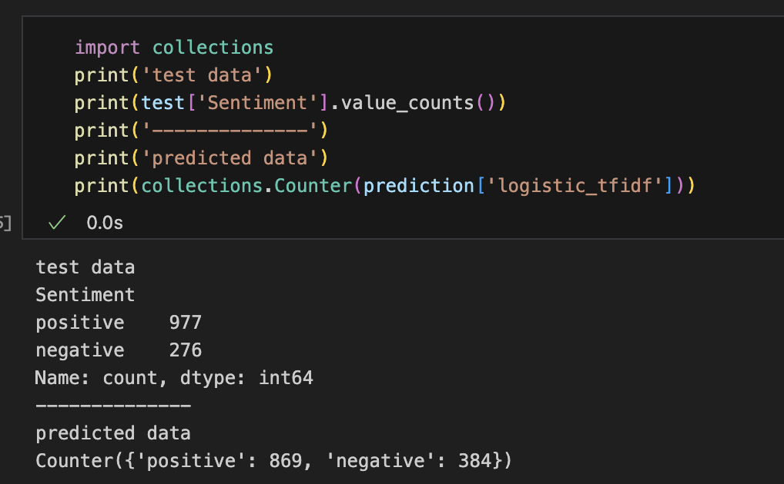

Slide 29
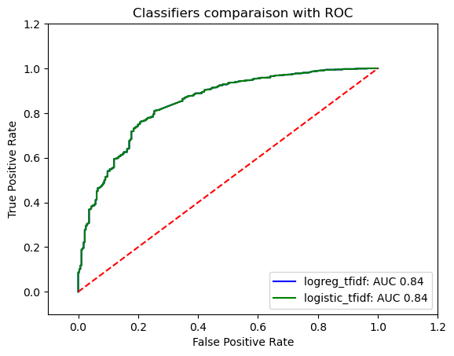

Slide 30
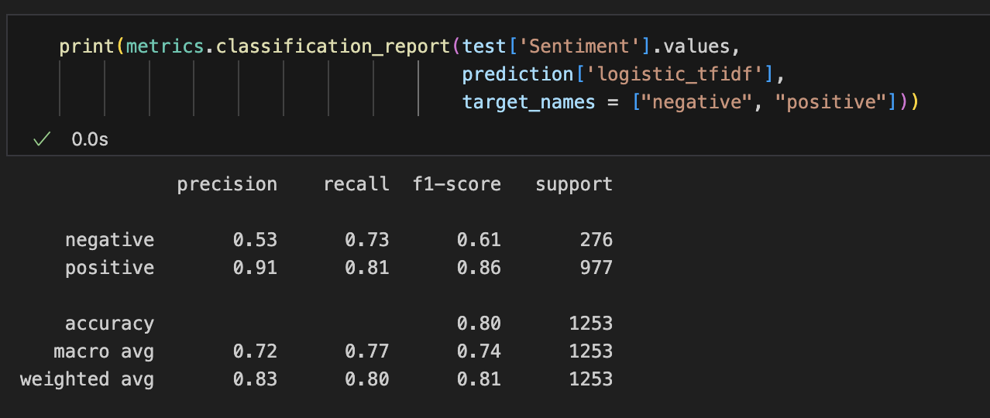

Slide 31
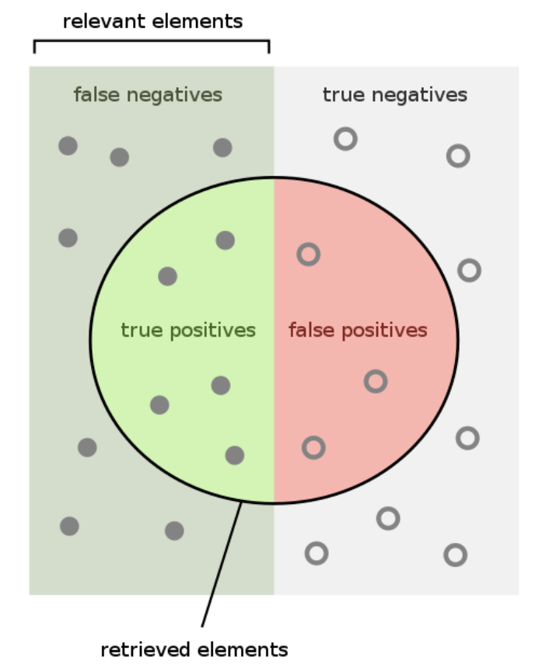
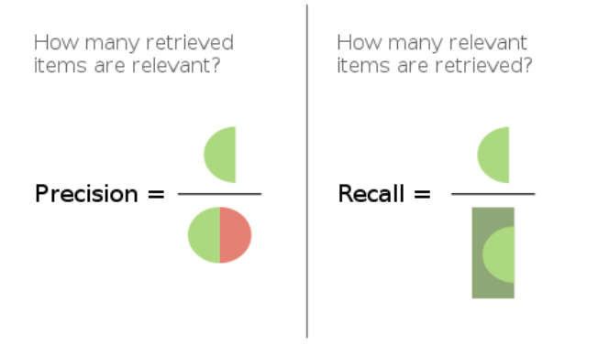

Slide 32
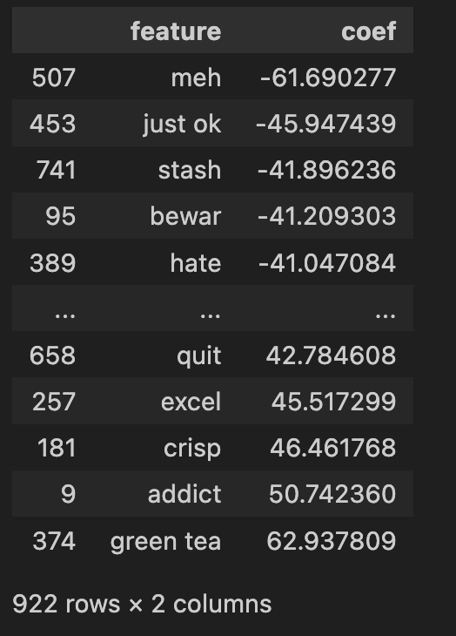

Slide 33
Random Forest

Slide 34
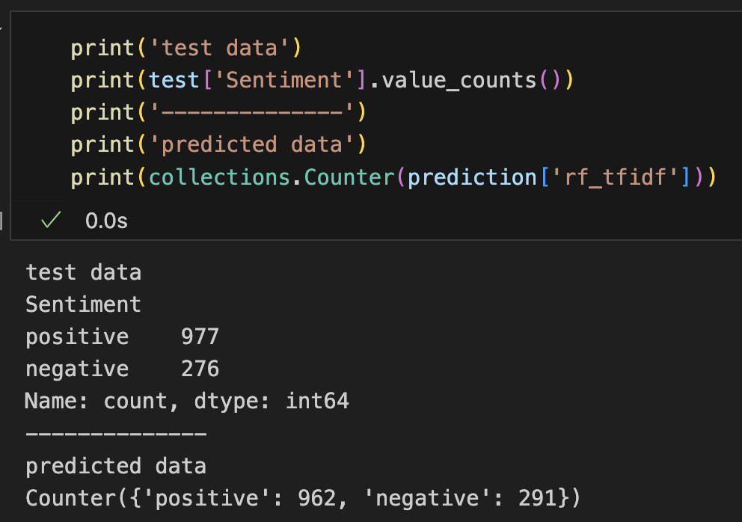

Slide 35
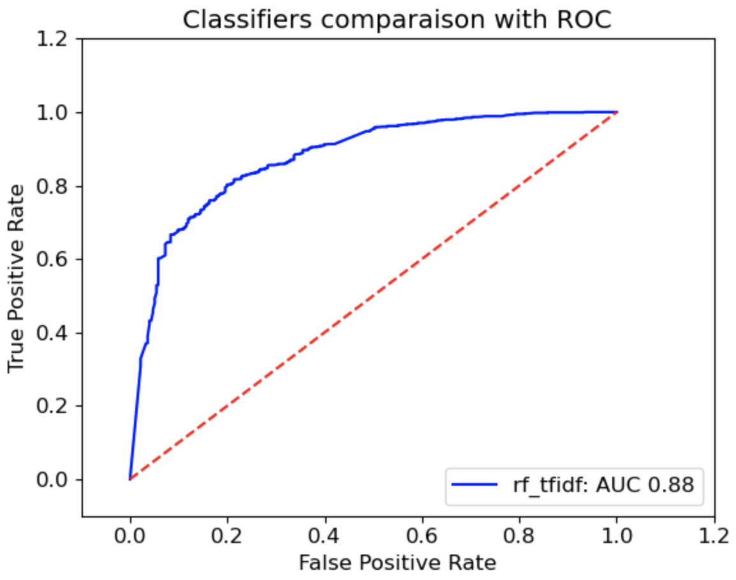

Slide 36
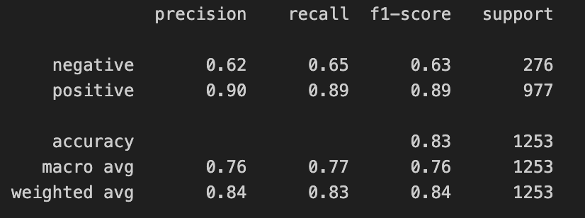

Slide 37
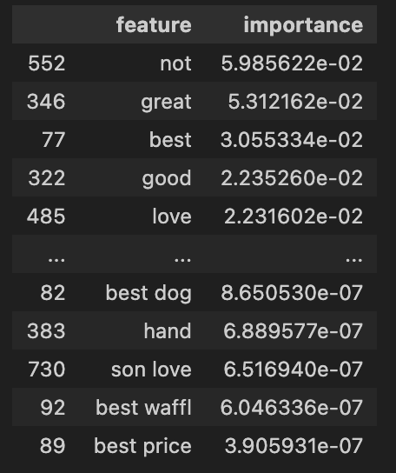

Slide 38
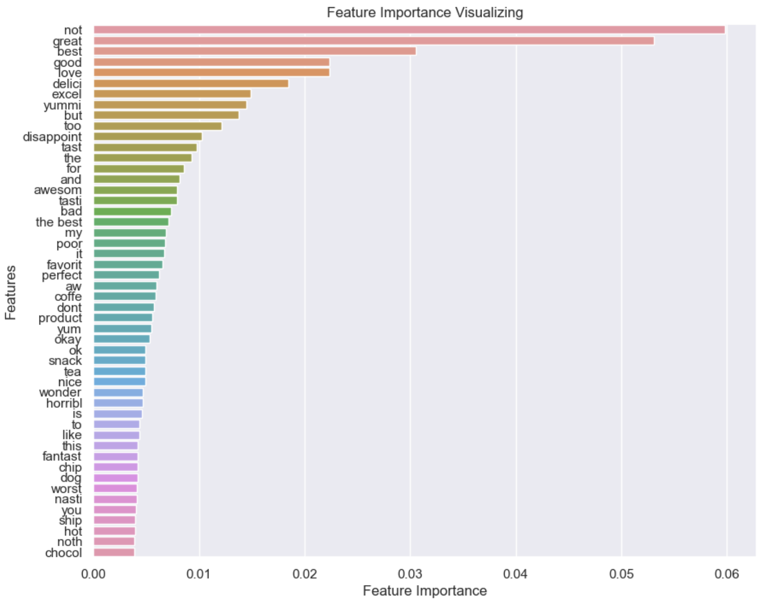

Slide 39
XGBoost

Slide 40
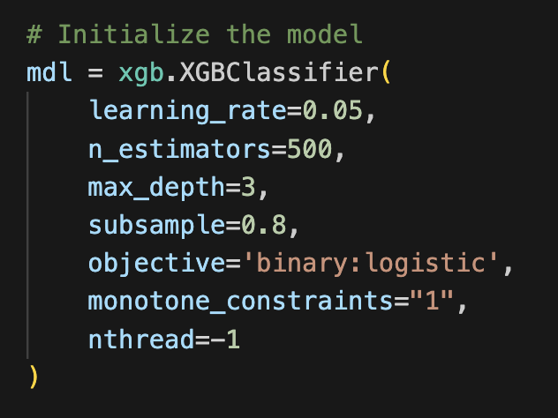

Slide 41
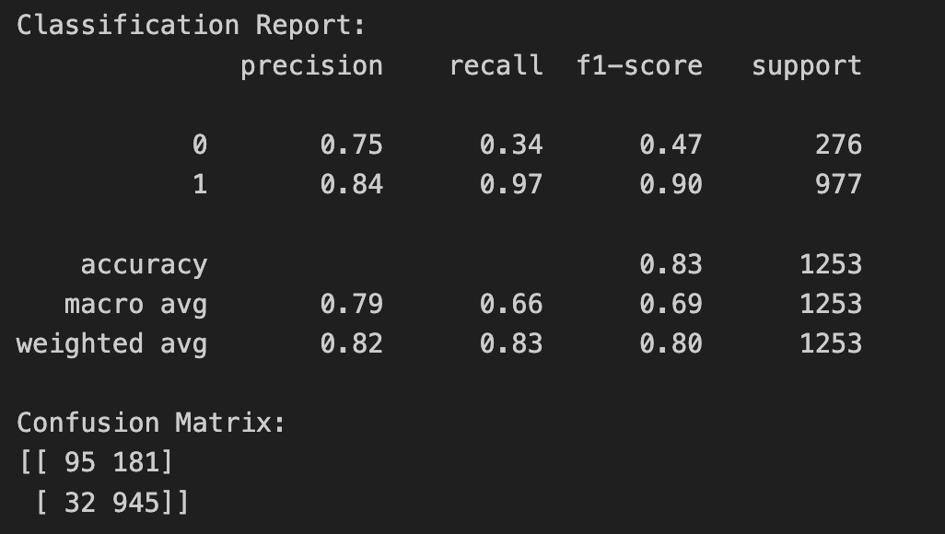

Slide 42
wrap up

Slide 44
LDA

Slide 73
THANK YOU

