Slide 1

Ray Tracing in Practic
- BY YUFEI LIN -

Slide 2
General Idea
Use a 3D renderer built by myself to reconstruct a Cornell Box to explain how people are translating the ideas of physics into language of computer.

Slide 3
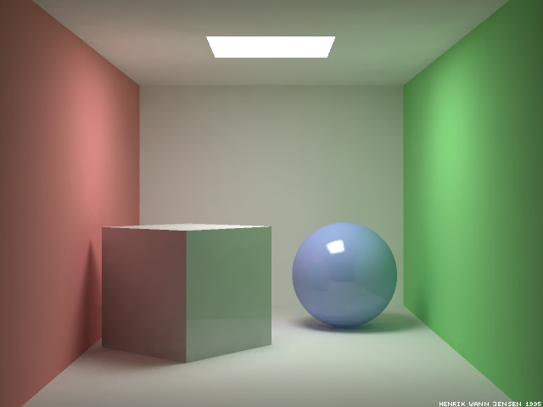
Cornell Box
Cornell box is a 3D test model aimed at determining the accuracy of rendering software by comparing the rendered scene with an actual photograph of the same scene.

Slide 4
Physics Behind

Slide 5
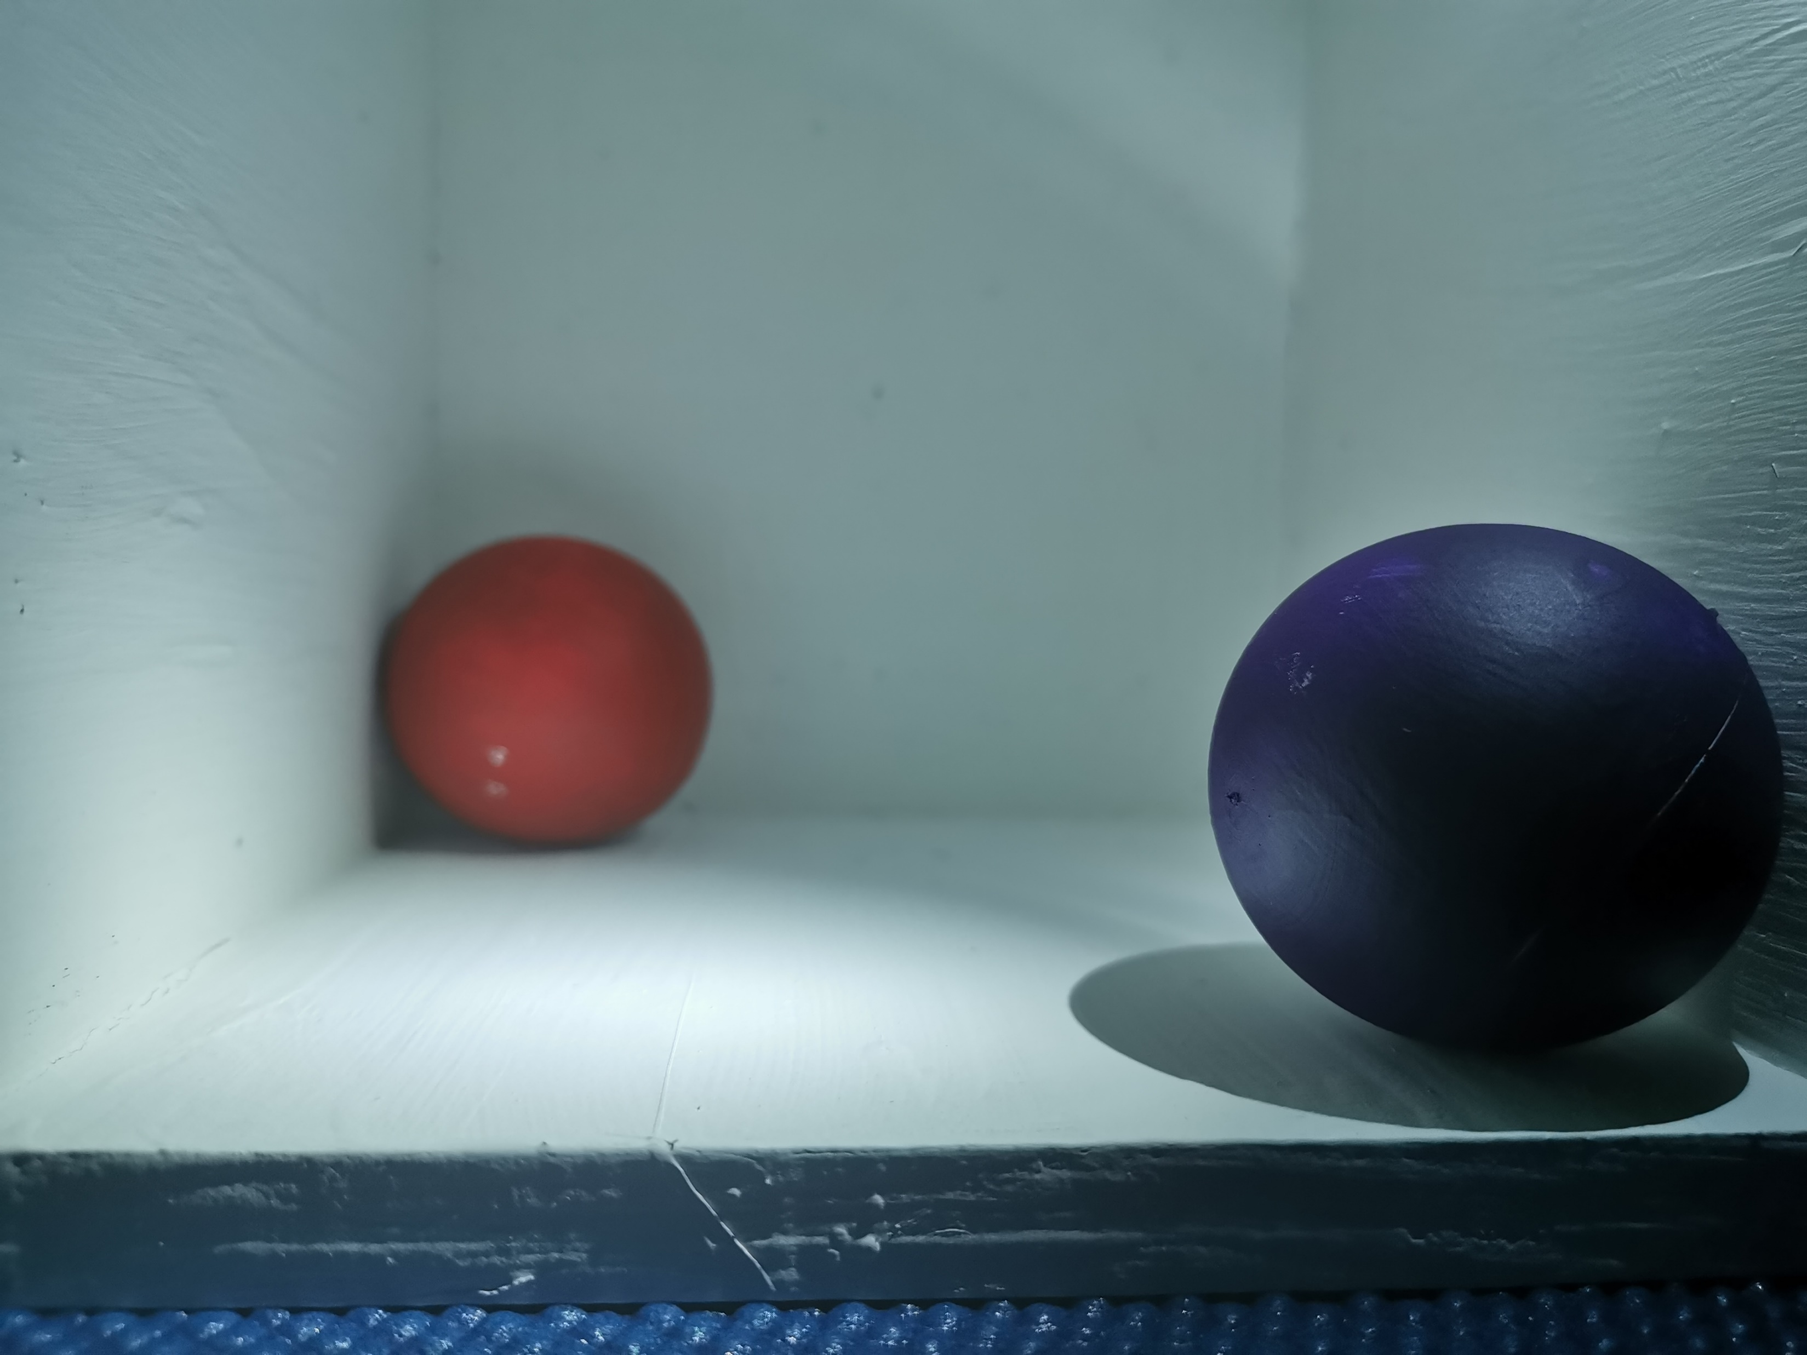
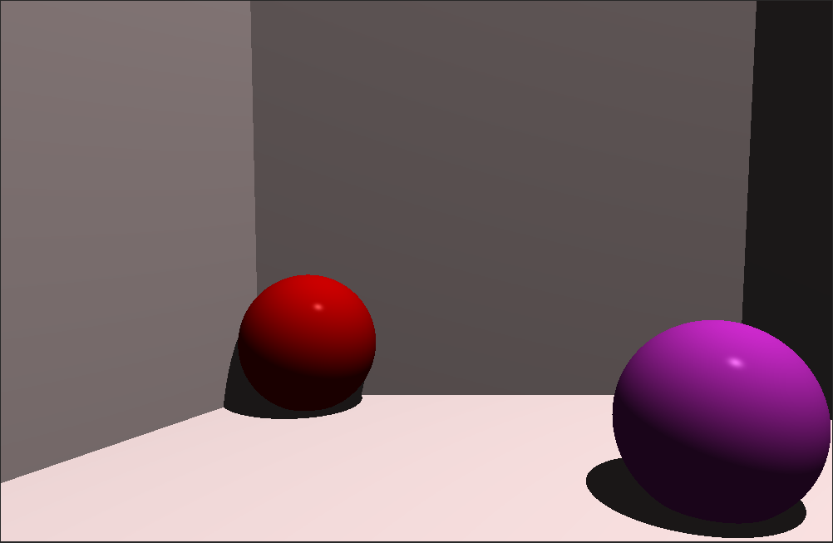
Compare and contrast
Original
Product

Slide 6
Future Plan
A Cornell Box with more than one size of sphere
A Cornell Box with more than one type of object
A Cornell Box with more than one type of light source

