Slide 1

Real-time Motion Retargeting to Highly Varied User-Created Morphologies
Notes:
During the next 45 minutes I’m going to talk to you about Motion Retargeting.
My Seminar is based on the Sigraph paper of the same title by Chris Hecker et al: …

Slide 2
Online Compatibility Version
No videos
No macros
Low resolution pictures
Please download the full presentation to see everything and enjoy the real-time IK solvers ☺

Slide 3
What I’m going to talk about..
What is Motion Retargeting?
Motivation for Motion Retargeting
Conventional Animation Authoring
Unknown Morphologies
  Generalizing the Selection Step
  Generalizing the Posing Step
  Movement Modes
  Mathematical Realization
Animation Instantiation
  Branching
  Variants
Gaits
IK Solver
Adding Wiggling
Conclusion
Appendix
Notes:
A short

Slide 4
What is Motion Retargeting?
A method to retarget animations onto models with different morphologies.

Slide 5
What is Motion Retargeting?
A way to remap animations onto characters with very different animation-specific structures.

Slide 6
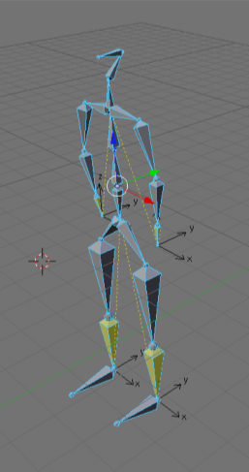
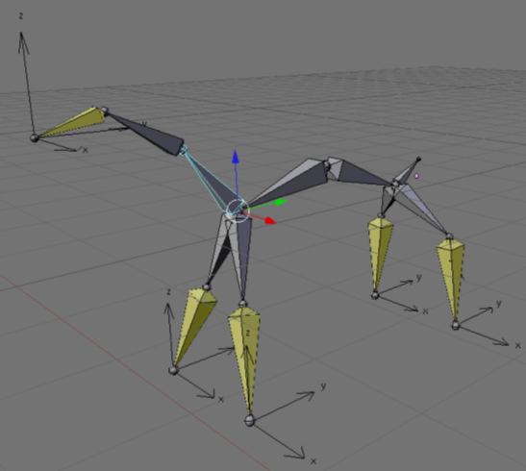
What is Motion Retargeting?

Slide 7
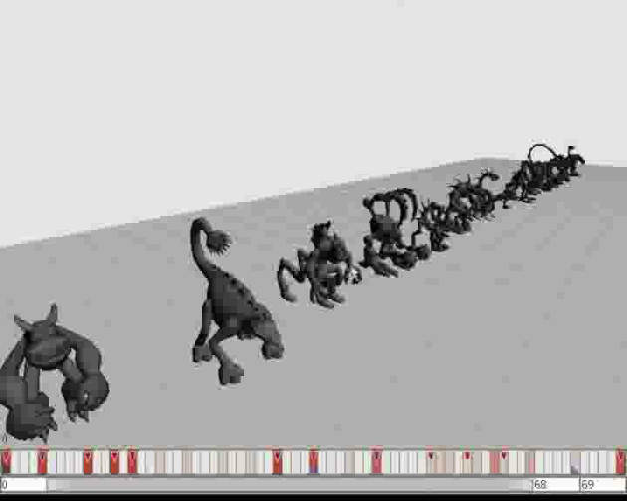
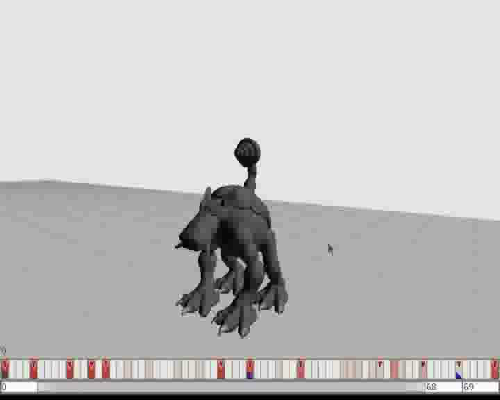
What is Motion Retargeting?
Notes:
Multiple characters do the same flip in sync.

Slide 8
Motivation for Motion Retargeting
Improves content reuse
Allows for a more dynamic game experience
Easy integration of procedurally generated animations
(IK, gaits, wiggles – more about it later)
Possibility to create exciting new game concepts (example: Spore)
Notes:
-> gaits and wiggles are procedurally generated

Slide 9

Spore as Main Example
Spore uses motion retargeting extensively
Spore is the only application making use of this concept so far
The paper this presentation is based on has been a by-product of Spore’s development
→ Spore will be used as main example in this presentation
Notes:
*Spore uses motion retargeting extensively
*The paper this presentation is based on has been a by-product of Spore’s development
*Spore is the only application making use of this concept so far
→ Spore will be used as main example in this presentation

Slide 10
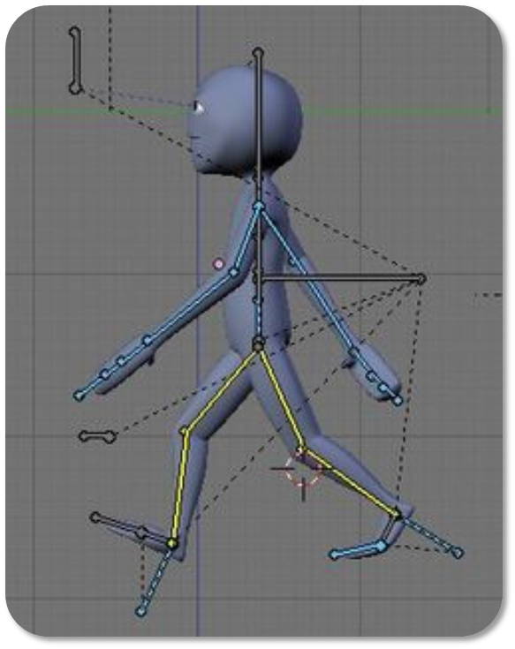
Conventional Animation Authoring
Animation Authoring consists of 4 steps:
  Selecting the bones
  Moving the bones into a new pose
  Saving a key frame
  Playback to locate issues
Notes:
Every model has a rig – joints, bones and constraints.
We animate the rig usually and use IK to create new poses by moving the end effectors around.
4legsANIM.blend

Slide 11
Unknown Morphologies
What do we do when we don‘t know the model and the rig?
Pretty much the same -
We just need to generalize the known concepts!
Notes:
Remember: We need to generalize the concepts

Slide 12
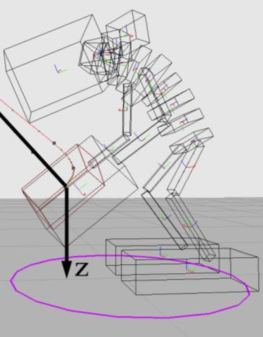
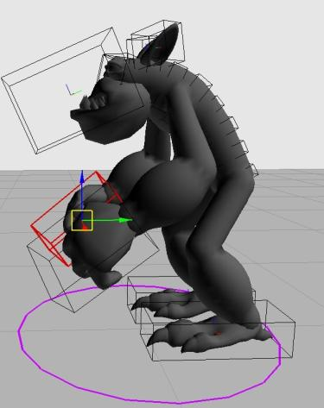
Models in Spore
Models are made up of:
bodies
meshes
textures
Notes:
Before we can go and generalize, we need to talk about the models first.

Slide 13
Models in Spore
Bodies consist of:
position
orientation
caps (capabilities)
e.g. used to distinguish graspers from mouths
deform curves
Meshes are attached to bodies.
Notes:
body == bone + metadata about the attached mesh (if it’s a special one and not a metaball)

Slide 14
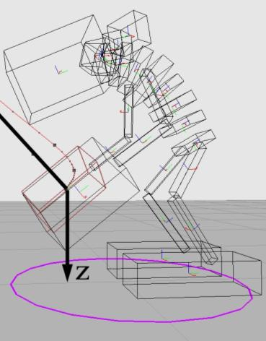
Models in Spore
The bodies form a DAG with a sequence of spine bodies at the root
One spine body is designated as root body
The pose a body is created in is known as rest pose or standard pose
Notes:
DAG – actually just a tree because its simpler to create

Slide 15
Example
Caps:
Mouth
Spine Bodies
Graspers
Feet

Slide 16
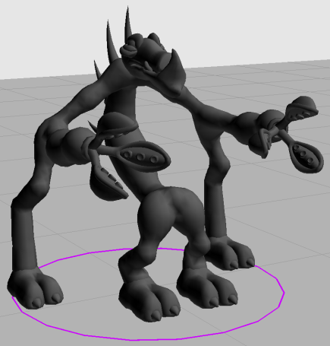
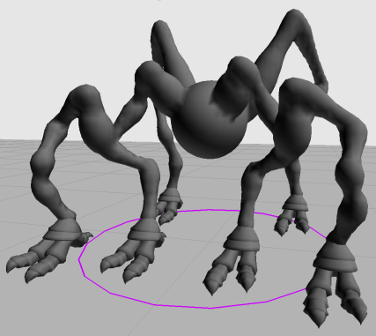
Two More Complex Examples
Notes:
Notice how the front legs are branched in pairs.

Slide 17
Generalizing the Selection Step
How do we select something we don’t know?
We actually know what body we want to select. The problem only is that we don’t know where exactly it will be in the model or if the specific body exists at all.

Slide 18
Generalizing the Selection Step
What you do usually:
  You want to select the left foot
  You select it in the editor by clicking on it (body #17 for example)
What we do:
  We want to select the left foot
  We tell the editor to select the left foot by describing it accurately

Slide 19
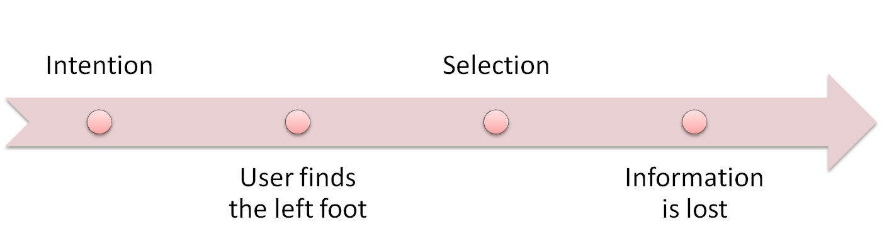
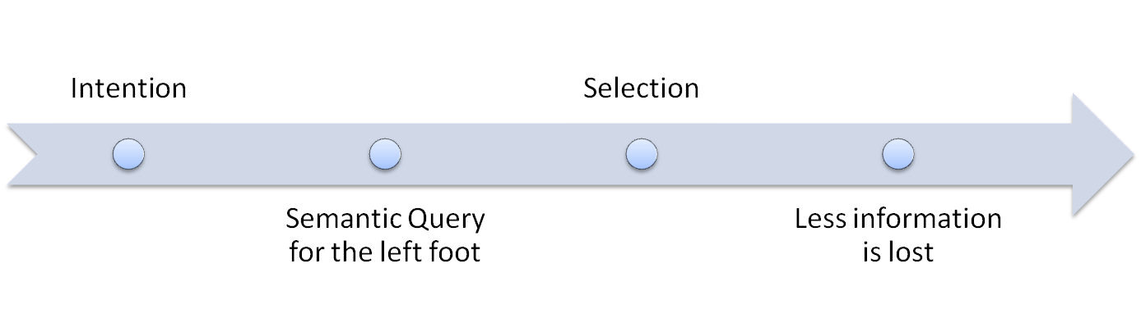
Generalizing the Selection Step
Notes:
Here we find an important principle (storing and using semantics/meta-information)

Slide 20
Generalizing the Selection Step
We use queries to select the parts we’re interested in.
The context is specified by queries.
Notes:
Remember:
All selected bodies are moved in the same way (more about that later) in one channel.
We can’t really know if we select 0, 1 or multiple bodies – but we don’t need to care either.

Slide 21
Animations in Spore
Animations are made up of channels.
A channel consists of:
context
data to animate the bodies selected by the context
Notes:
Context => the query to select the body – the context of the channel
“data to animate the bodies selected by the context”? More about that later!

Slide 22
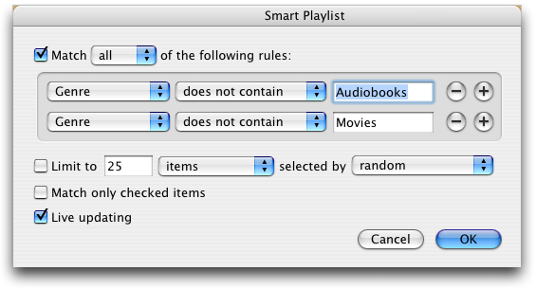
Query User Interface
Notes:
Itunes/favorite music player → queries are used a lot here because its difficult to find your favorite songs otherwise

Slide 23
Contexts in Spore
What can a context query contain?
caps
spatial query
extent query
limb modifier
Notes:
They are all optional.
E.g. you don’t have to use the extent query if you don’t want to!

Slide 24
Contexts in Spore
What can a context query contain?
caps
spatial query
extent query
limb modifier
  What is the type of the body:
  mouth
  graspers
  spine
  root

Slide 25
Contexts in Spore
What can a context query contain?
caps
spatial query
extent query
limb modifier
  Where are the bodies:
  Front/Center/Back
  Left/Center/Right
  Top/Center/Bottom
  relative to:
  the character
  other bodies with the same caps

Slide 26
Contexts in Spore
What can a context query contain?
caps
spatial query
extent query
limb modifier
Select the body that is:
FrontMost/BackMost
LeftMost/RightMost
TopMost/BottomMost

Slide 27
Contexts in Spore
What can a context query contain?
caps
spatial query
extent query
limb modifier
Traverse the body hierarchy from the selected bodies upwards and select the first spine body hit.
Notes:
Limb modifiers are important because the modifier let’s us select the hips/shoulders

Slide 28
Contexts in Spore
What can a context query contain?
caps
spatial query
extent query
limb modifier

Slide 29
Note from Spore’s Development
They have tried to automate the query generation, but it turned out to be moot.
Notes:
There were too many ways to select the same bodies -> Semantics from the user are needed to do the right thing!
Instead we can try to provide the animator with a nice user interface.

Slide 30
Note from Spore’s Development
So instead they have decided to make the user interface user-friendly and reduce duplicate tasks.
Notes:
There were too many ways to select the same bodies -> Semantics from the user are needed to do the right thing!
Instead we can try to provide the animator with a nice user interface.

Slide 31
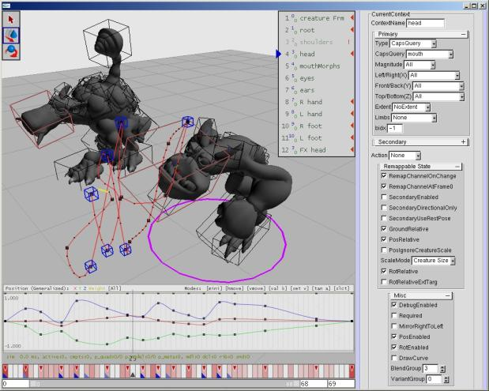
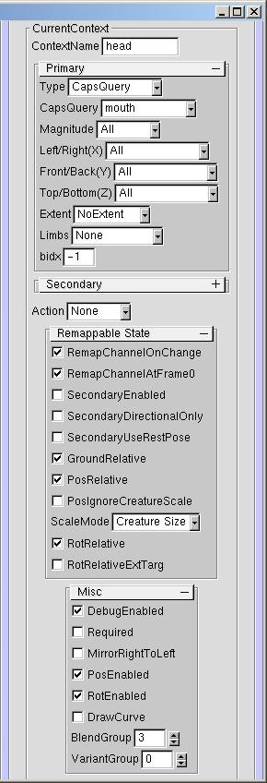
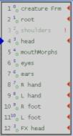
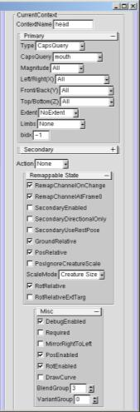
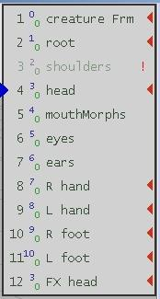
Spasm’s User Interface
Notes:
Notice:
List of saved contexts to make it easier to reuse often needed contexts.
An okay and straight-forward user interface to select the bodies one is interested it.

Slide 32
Generalizing the Posing Step
How we do specify a pose for the bodies once we have selected them using a context query?

Slide 33
Generalizing the Posing Step
We apply the same principle again –
by providing additional semantics!

Slide 34
How do we pose bodies?
Generalize the posing process by:
Providing different movement modes
Applying changes from the active body to all bodies according to the movement mode
Note:
  Channels animate specific DoFs only:
  → Rotation and position can be animated by different channels
Notes:
movement modes → next slide
Channels animate specific DoFs → just keep this in mind when we talk about the movement modes

Slide 35
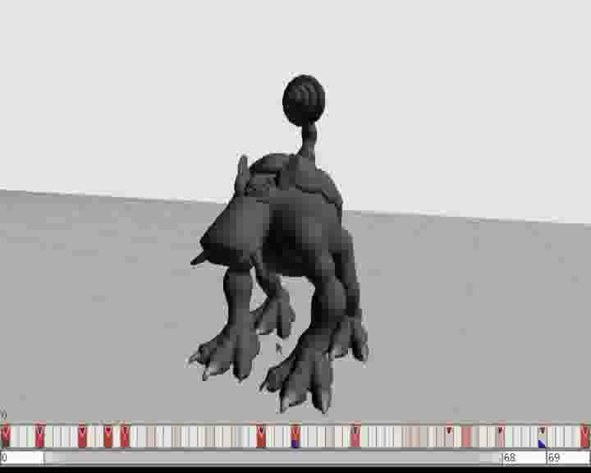
Posing Bodies in Spasm

Slide 36
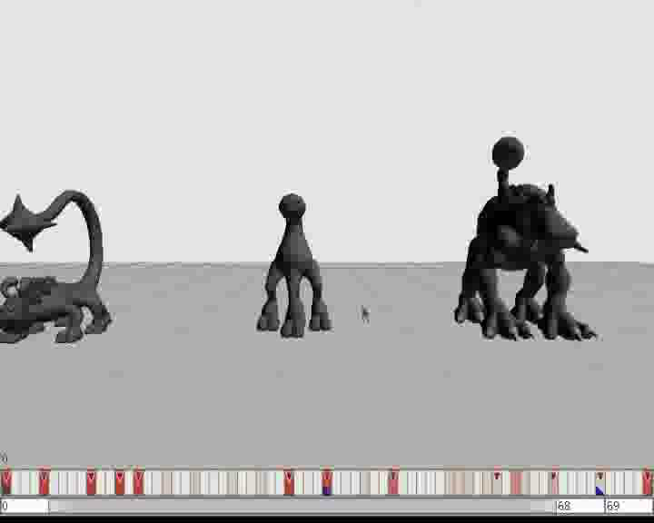
Posing Bodies in Spasm

Slide 37
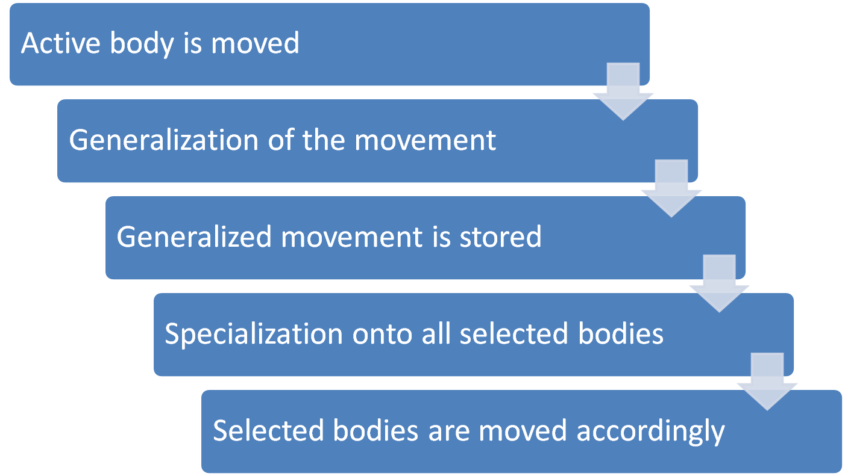
Realization

Slide 38
Movement Modes
Movement Modes:
Identity
Rest Relative
Scale Mode
Ground Relative
Secondary Relative Movement
Lookat
Mirroring Mode

Slide 39
Movement Modes
Movement Modes:
Identity
Rest Relative
Scale Mode
Ground Relative
Secondary Relative Movement
Lookat
Mirroring Mode
Absolute movement mode. Bodies are assigned the same position and orientation.
Notes:
the same position – character-relative
Only useful for rotations

Slide 40
Movement Modes
Movement Modes:
Identity
Rest Relative
Scale Mode
Ground Relative
Secondary Relative Movement
Lookat
Mirroring Mode
Movement is relative to the orientation and position of the body in its respective rest pose.
Notes:
the same position – character-relative

Slide 41
Movement Modes
Movement Modes:
Identity
Rest Relative
Scale Mode
Ground Relative
Secondary Relative Movement
Lookat
Mirroring Mode
Scaling of the relative movement depending on:
CreatureSize
LimbLength
Notes:
Limb-length == path length from the body to the nearest spine segment (nearest defined using the same definition as for the limb modifier)

Slide 42
Movement Modes
Movement Modes:
Identity
Rest Relative
Scale Mode
Ground Relative
Secondary Relative Movement
Lookat
Mirroring Mode
Changes one axis to be perpendicular to the ground.
Scales it so 0.0 is the height of the body in the rest pose and 1.0 is on ground level.

Slide 43
Movement Modes
Movement Modes:
Identity
Rest Relative
Scale Mode
Ground Relative
Secondary Relative Movement
Lookat
Mirroring Mode
An ExternalTarget is chosen and an axis is aligned with the distance vector of the external target and the body in a way that 0.0 is at the rest position of the body and 1.0 is at the target.
We can also only use the direction in SecondaryDirectionalOnly mode.

Slide 44
Movement Modes
Movement Modes:
Identity
Rest Relative
Scale Mode
Ground Relative
Secondary Relative Movement
Lookat
Mirroring Mode
Rotates the body towards the ExternalTarget and applies soft constraints on the rotation if it the object “is behind” the body.

Slide 45
Movement Modes
Movement Modes:
Identity
Rest Relative
Scale Mode
Ground Relative
Secondary Relative Movement
Lookat
Mirroring Mode
Mirrors the movement on an automatically generated sagittal mirror plane depending on which side of the plane the body is.

Slide 46
Movement Modes
Movement Modes:
Identity
Rest Relative
Scale Mode
Ground Relative
Secondary Relative Movement
Lookat
Mirroring Mode

Slide 47
Blending & Keying
Animators can define blend groups for each channel to control the way how different animations are combined or how the transitions are done
The generalized pose data is saved using Hermite splines which can be edited directly, too, to give the animator maximum possible control.
Notes:
Blend groups: multiple channels can select the same bodies -> priority and grouping system needed.
Blend groups can share ownership of bodies -> animation blending possible
I don’t want to go into the details here…

Slide 48






Mathematical Realization
Two invertible functions and with .
is the generalization function
is the specialization function
: body : mirroring flag
: generalized pose
: specialized pose
Notes:
More about $$m$$ later.

Slide 49


Mathematical Realization
We can define a movement mode function:
(and thus )
The movement mode describes how a specialized pose is converted into a generalized and vice-versa
Movement mode can be switched transparently because the functions are invertible

Slide 50


Mathematical Realization
Movement modes: and .
Switching from to :
→ This allows us to change the movement mode without losing anything from the original animation
Notes:
M is the specialization function

Slide 51
Animation Instantiation
Generalized animations are retargeted upfront (on load) onto models.
Two features to control the variety of possible animations:
  branching
  variants
Notes:
talk about the Select One Only option for channels/contexts

Slide 52
Branching
It’s not always possible to create animations that fit all imaginable characters
Add branch predicates to animations to filter the possible animation set
For example:
UprightSpine
HasGraspers
HasFeet
Possible values: true, false, ignore
Notes:
It’s rather impossible actually…
Branch flags?
Animators can thus create different animations for different character types (HasGraspers/not HasGraspers) -> to fix issues, but is expensive because it adds additional animations which need to be maintained, too

Slide 53
Variants
How many ways are there to play an animation on a character?
“Select Only One”-option for channels can add lots of combinations ☺
Possibility to group channels in variant groups
Put constraints on the spatial relationship between channels in variant groups

Slide 54
Variants (Example)
A
z
Possible Combinations (animation that accesses one body):
A B x y z
B
X
y
Notes:
A, B are graspers
1,2,3 are mouths

Slide 55
Variants (Example)
A
z
Possible Combinations (animation that accesses one of each):
Ax Ay Az
Bx By Bz
B
X
y
Notes:
A, B are graspers
1,2,3 are mouths

Slide 56
Variants (Example)
A
z
Possible Combinations (opposite-side pairs only):
Ax Ay
Bz
B
X
y
Notes:
A, B are graspers
1,2,3 are mouths

Slide 57
Variants (Example)
A
z
Possible Combinations (same-side pairs only):
Az
Bx By
B
X
y
Notes:
A, B are graspers
1,2,3 are mouths

Slide 58
Gaits
Characters also need to walk and run, that is be able to move in a convincing way
If characters have no legs, they still need a way to move:
  by crawling
  by floating
Notes:
Floating is obviously the last resort..

Slide 59
Gaits
A gait is a pattern of locomotion characteristic of a limited range of speeds, described by quantities of which one or more change discontinuously at transitions to other gaits.
[Alexander]

Slide 60
Gaits
Gaits describe different ways of moving (e.g. walking, running, gallopping, etc.).

Slide 61
Gaits
Gaits can often be generated procedurally and still look good
In fact if you have to generate part of them dynamically because one can’t guess the leg configurations, etc.
In Spore a part of the system (for small leg numbers) can be tuned by animators, everything else is done procedurally

Slide 62
Gaits
Gaits are cyclic
Leg movements are cyclic, too
The duty factor for a leg describes the period of time (percentage of the total gait cycle length) in which the foot is on the ground
The step trigger is the time (normalized) in a gait cycle on which the foot leaves the ground
Other definitions possible but similar usually

Slide 63
Gaits (Example)
From Steve Rotenberg’s Computer Animation course:
.25
.75
.0
.5
.0
.5
Biped Walk
Quadruplet Walk
Duty Factor: .6 ~ .8
Duty Factor: .6 ~ .8

Slide 64
Gaits in Spore
Legs are grouped by leg length
Gait cycles are created for each group
The ratio of the gait periods is roughly equal to the ratio of the leg lengths in the groups.
Animators can tune the gait parameters for groups with less than 6 legs
Gaits for groups with more legs are generated procedurally
Notes:
Duty factor & step tripper for each leg group

Slide 65
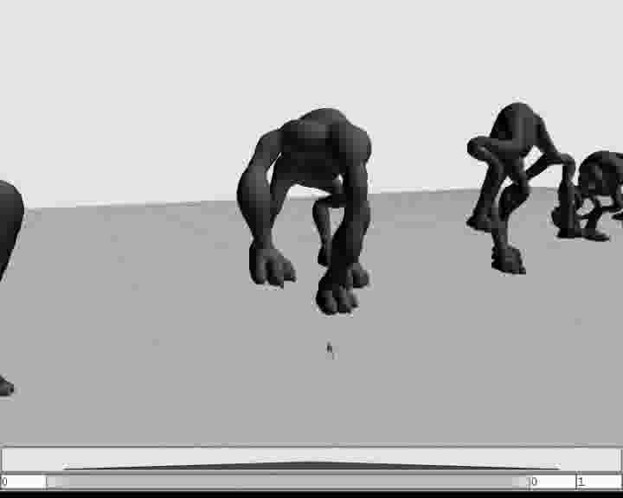
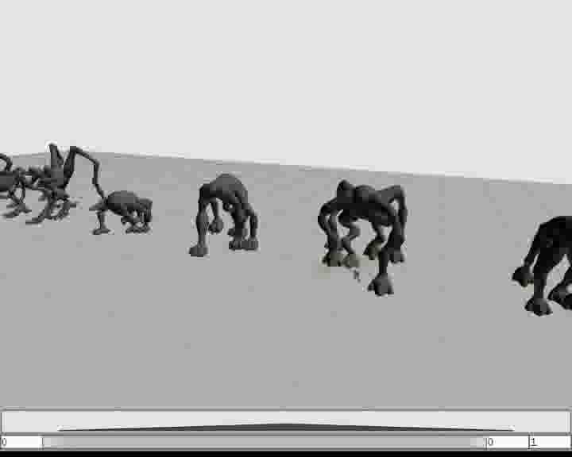
Gaits in Spore

Slide 66
IK Solver
Animations actually only specify pose goals for the selected bodies
We use inverse kinematics to solve those pose goals in real-time
A Particle IK Solver is used to perform the inverse kinematics operation for several reasons

Slide 67
IK Solver
What are our main objectives for the IK solver?

Slide 68
IK Solver
High performance
Accurate and natural inside the workspace
Graceful failures
Path independence

Slide 69
A short history of Spore
IK Solver 1.0:
  CCD-based (Cyclic Coordinate Descent)
  Full 6 DoFs
  Black box
  Slow
  Not tunable at all

Slide 70
A short history of Spore
IK Solver 2.0:
  Uses a particle IK solver
  Molecular Dynamics researchers have been using particle IK solvers for ages
  Very fast
  Over-constrained
  Did not fail gracefully
  Not stable in general
Notes:
… since the 1960
… would be twitchy and “explode” if the goal couldn’t be achieved

Slide 71
A short history of Spore
IK Solver 2.5:
  More laidback approach
  Most constraints have been removed
  Two different solver phases
  Less code in the solver
  Tunable
  Fails gracefully
  Path independent
Notes:
… since the 1960
… would be twitchy and “explode” if the goal couldn’t be achieved

Slide 72
How does it work in Spore?
Goals are retrieved from the retargeted animation
Some goals delegated to their respective spine (remember the limb modifier for example)
Two phases:
  Spine Phase
  Limb Phase
We always start with the rest pose to stay path independent

Slide 73
Spine Phase
We solve for the spine first (the position of the spine bodies)
We add simplified constraints for the limb goals:
  One particle at the end-effector
  One particle at the spine attachment point
  We ignore everything in-between

Slide 74
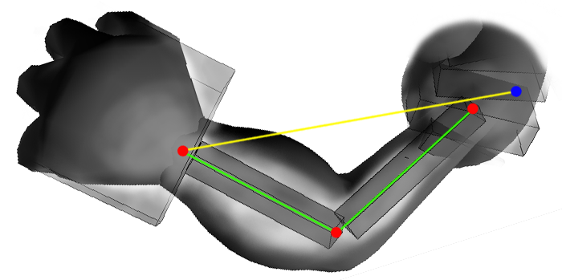
Spine Phase (Limb Constraints)
Length Constraint
End-Effector/Goal Position
Spine Attachment Point

Slide 75
Spine Interpolation
We don’t add particles for all spine bodies
Instead we only add particles where they are needed (→ spine attachment points) and interpolate between them
For this we fit a quintic Hermite spline on the spine

Slide 76
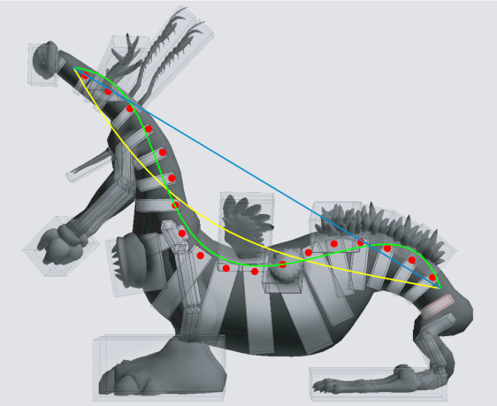
Spine Interpolation
Hermite spline
Notes:
Notice how it doesn’t fit perfectly…
We cant just interpolate!!!!!!!!!!!!

Slide 77
Spline Interpolation
We iterate through all spine bodies and determine the parameter t for which the position on the spline approximates the body’s position best.
We store the value of t and the relative offset and relative orientation of the body to the spline at that position for each spine body

Slide 78
Spine Phase
We then let the IK solver run – a few outer iterations (5 in Spore)
The constraints are allowed to compress to 10% of their rest length or to stretch to up to 120% of their rest length – we assume that the limbs or spine will bend to reach the position
After each iteration we check if the spine has buckled (using a heuristic) and “relax” it if necessary to unbuckle it

Slide 79
Spine Reconstruction
After we’re done, we recreate the spine pline in the now solved spine attachment points
We iterate through all spine bodies:
  Using the stored parameter t and the relative offset and orientation we reconstruct the spine body’s position and orientation

Slide 80
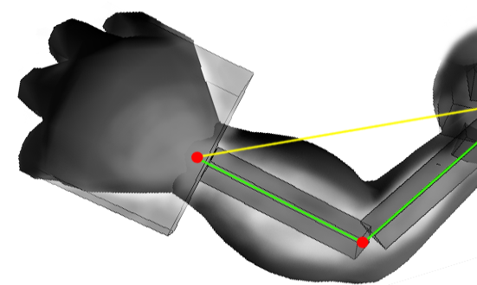
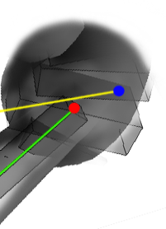
Limb Phase
Once the spine has been positioned we really solve the goals for the limbs
This time every limb body gets it own constraint

Slide 81
Limb Phase
The limbs are preconditioned:
  We look at the rest post and determine the rest position of the end-effector and the rest position of the spine attachment point
  We construct the difference vector between the two and create a transformation (rotation and scale) that moves the rest positions to the spine attachment point from the Spine solver and the goal position respectively.

Slide 82
Limb Preconditioning
We apply this transform as pre-step before starting the IK solver again
Of course, various length constraints will be violated at the beginning
The IK solver must be able to start with an invalid configuration
This favors rotations at the spine joints, which is more natural

Slide 83
Adding Wiggling
To generate more convincing animations a passive animation system can be implemented
It adds basic physics to bodies that are “touched” by the solver
Dampening of movements is a possible feature
Important:
It should be totally passive and not influence the IK solver and/or the real animations that are played.

Slide 84
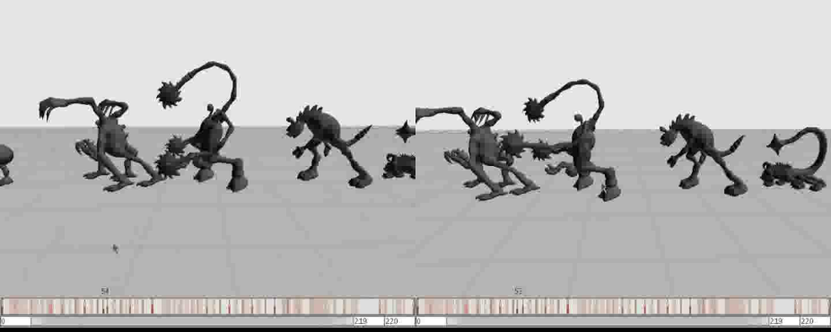
Wiggling

Slide 85
Conclusion
Emphasize content reusability and the benefits of adding more semantic details to animations and assets in general during authoring.
“It’s easy to add semantic attributes for you, but it’s incredibly hard (for the computer) to figure it out later.”

Slide 86
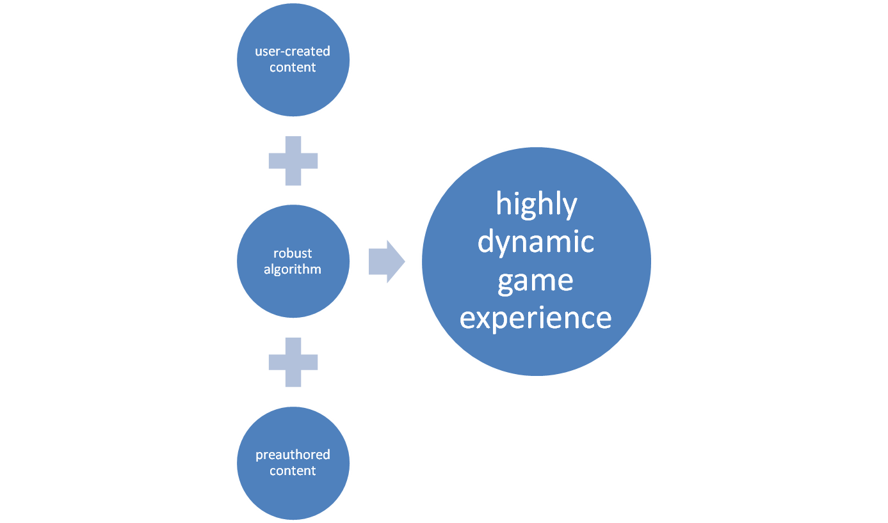
Conclusion
Notes:
Pre-authored content and other content enriched with semantic information

Slide 87
Conclusion
Always try to simplify the problem you work on
Complicated solutions are often too rigid to be practical
Iterate your design and code a few times to find the best implementation

Slide 88

Euphoria

Slide 89
Euphoria
Used by:
Grand Theft Auto 4
Star Wars: The Force Unleashed
Certainly more to follow..

Slide 90
Thank You
And a special thanks to Chris Hecker for making available some awesome videos and providing lots of material on his homepage!

Slide 91
Appendix
Bibliography
Cyclic Coordinate Descent Algorithm
Particle IK Solver

Slide 92
Bibliography
Chris Hecker and Bernd Raabe and Ryan W. Enslow and John DeWeese and Jordan Maynard and Kees van Prooijen, Real-time Motion Retargeting to Highly Varied User-Created Morphologies, Proceedings of ACM SIGGRAPH '08
Chris Hecker, How to Animate a Character You’ve Never Seen Before, Games Developer Conference 2007
Rotenberg, S., 2004, UCSD CSE169: Computer Animation Lecture Notes
Jakobsen, T., 2001, Advanced character physics. Game Developers Conference 2001
David Rosen, 2007, Starting Point for Physics-Based Character Animation
Kastenmeier, T., and Vesely, F. J., 1996, Numerical Robot Kinematics Based on Stochastic and Molecular Simulation Methods, Robotica 14
Alexander, R.M, 2003, Principles of Animal Locomotion, Princeton University Press
Welman, C., 1993, Inverse Kinematics and Geometric Constraints for Articulated Figure Manipulation, Master’s Thesis, Simon Fraser University
Notes:
All of them can actually be found online, if needed..

Slide 93
Cyclic Coordinate Descent
We look at a serial chain of bones with a fixed base
We want to move the end effector to a goal
Algorithm:
  We iterate from the most distant bone to the base bone and minimize the distance of the end effector to the goal
  Rinse and repeat a few times → it converges

Slide 94
Cyclic Coordinate Descent
We look at a serial chain of bones with a fixed base
We want to move the end effector to a goal
Algorithm:
  We iterate from the most distant bone to the base bone and minimize the distance of the end effector to the goal
  Rinse and repeat a few times → it converges
ANIMATE
Notes:
Note how slowly the base joint converges – it would converge a lot faster if we were to switch between starting with the base joint and end effector in turns…

Slide 95
Particle IK Solver
Simple principle:
  We only deal with particles that only 3 DoF (position)
  Only a 1 DoF constraint type:
    distance between two particles
Quickly solvable using iterative algorithms [see Jakobsen or Kastenmeier & Vesely]
We can easily implement soft constraints

Slide 96
Particle IK Solver
To solve a constraint we use multiple iterations again (inner and outer iterations)
We calculate the direction vector between two particles and fix the length constraint (at once or partially for soft constraints)

Slide 97

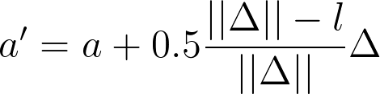
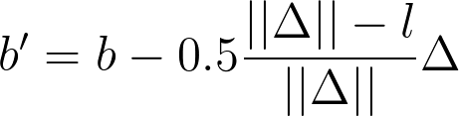
Particle IK Solver
If , are the positions of the two particles and
is their length, then we get the new positions with:

Slide 98
Particle IK Solver
We iterate over all constraints as inner iterations
We iterate a few times over the inner loop and we’re done
The algorithm is pretty fast and easy to implement

Slide 99
Particle IK Solver
ANIMATE

