Slide 1
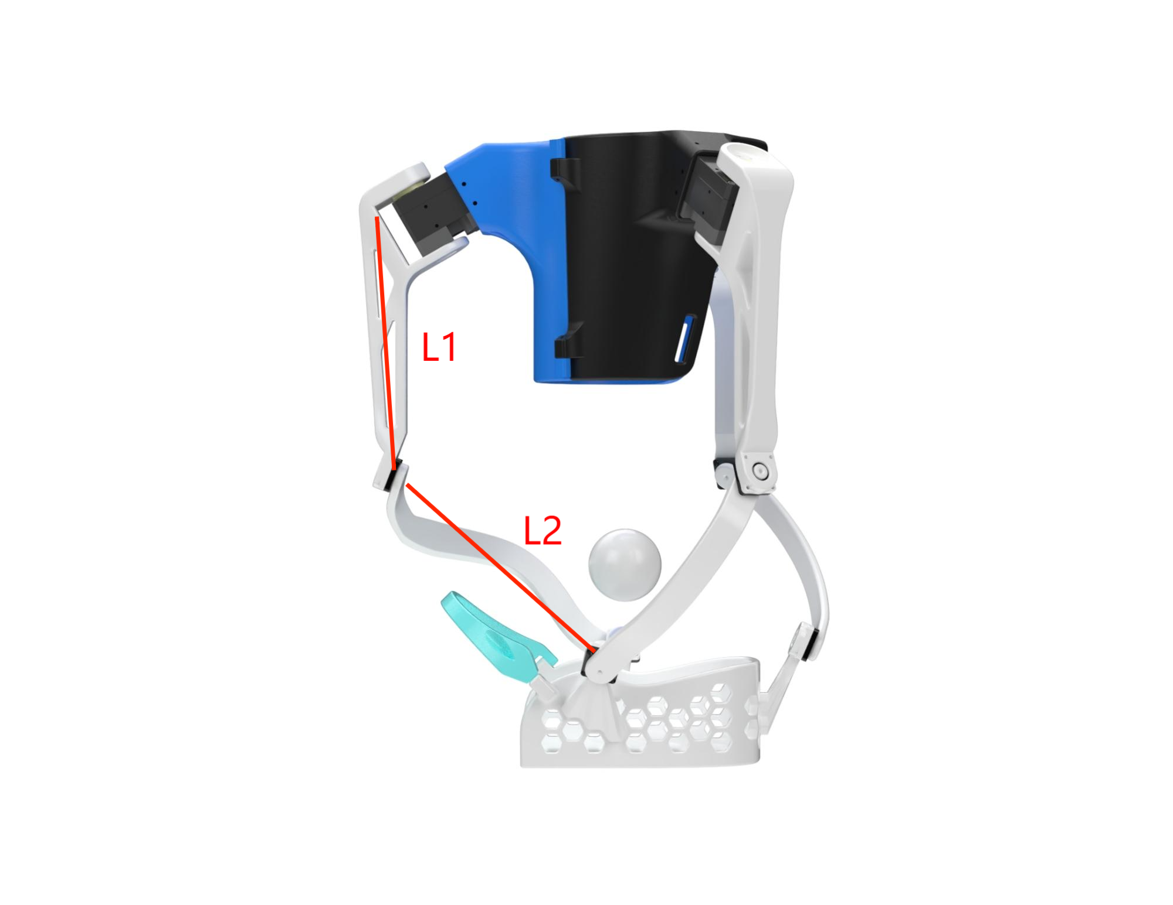
AMR Research Course · Closing Presentation
Design and Validation of a Wearable Ankle Rehabilitation Robot with an Anatomically Aligned 3-RRR Spherical Parallel Mechanism
Yufei Zhang
Department of Mechanical Engineering, Columbia University in the City of New York
Advisor: Prof. Sunil K. Agrawal
Email: yz4917@columbia.edu
Source code (MIT, open-source):
github.com/YufeiZhang0601/wearable-3rrr-ankle-rehab

Slide 2
Outline
How the next 18 minutes are structured
• 1. Motivation: clinical need & gap in the state of the art
• 2. Mechanism: anatomically aligned 3-RRR SPM + shoe-tray foot plate
• 3. Kinematics: closed-form & numerical inverse kinematics
• 4. Dynamics & baseline PID; proposed Assist-As-Needed control
• 5. Embedded system & hardware integration
• 6. Open-source ROS 2 / Gazebo simulation pipeline
• 7. Closed-loop tracking demo (recorded video)
• 8. Planned ablation experiments & quantitative metrics
• 9. Honest project status & invitation to extend
Yufei Zhang · AMR Research Course · May 2026
2 / 19

Slide 3
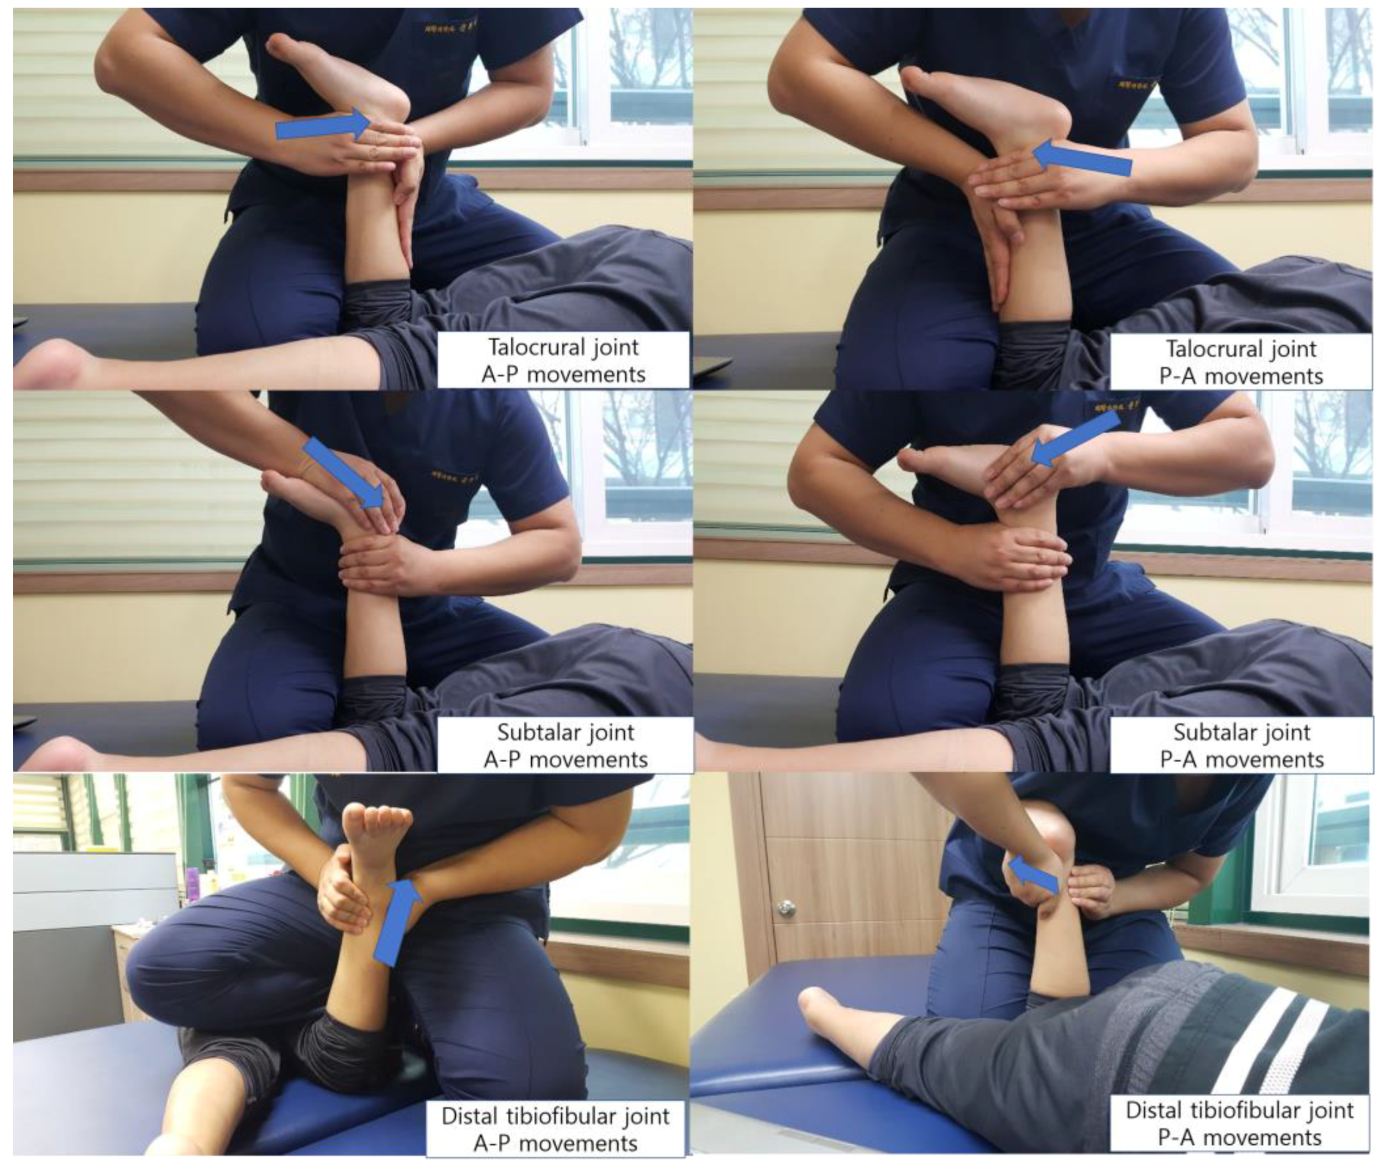
Motivation: Clinical Need
Why a robotic, dose-controlled ankle rehab device?
• Ankle injuries (sprains, fractures, post-op) and neurological deficits (stroke, foot-drop) are very common
• Standard of care is therapist-driven manual mobilization (talocrural, subtalar, tibiofibular joints)
• Highly dependent on clinician experience; little quantitative dosing or trajectory tracking
• Robotic platforms can provide repeatability, dose control, and objective outcome metrics → this work
Clinical reference: manual ankle mobilization
Yufei Zhang · AMR Research Course · May 2026
3 / 19

Slide 4
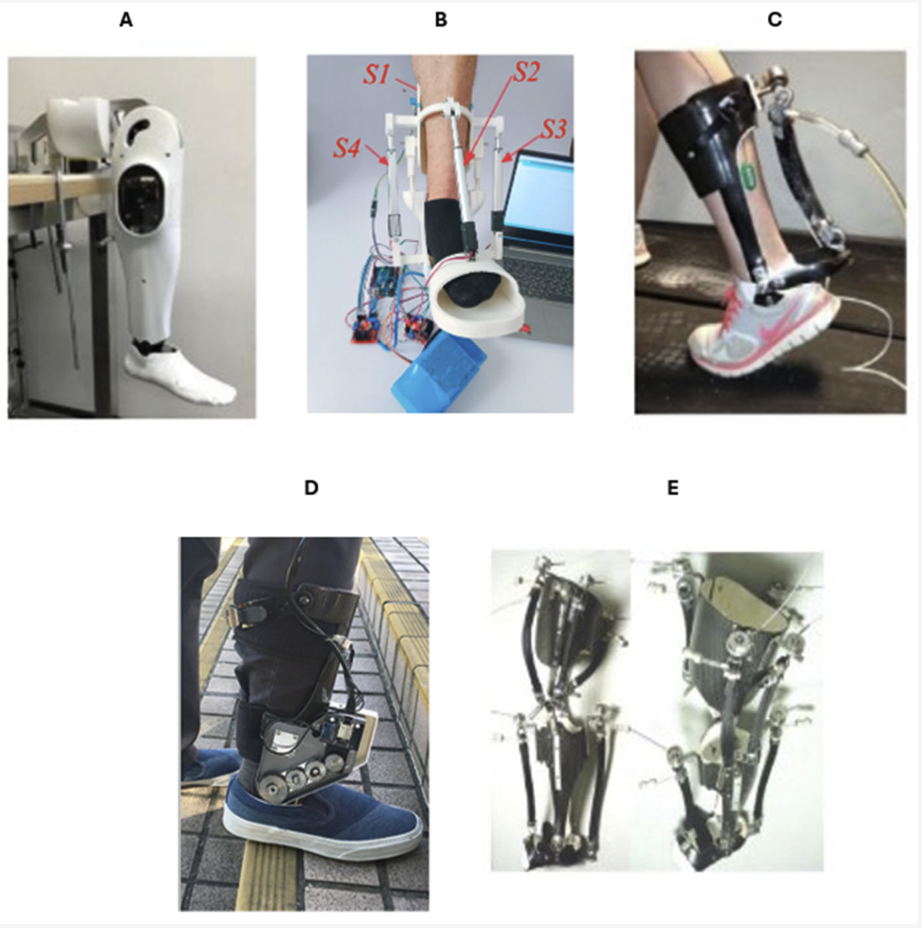
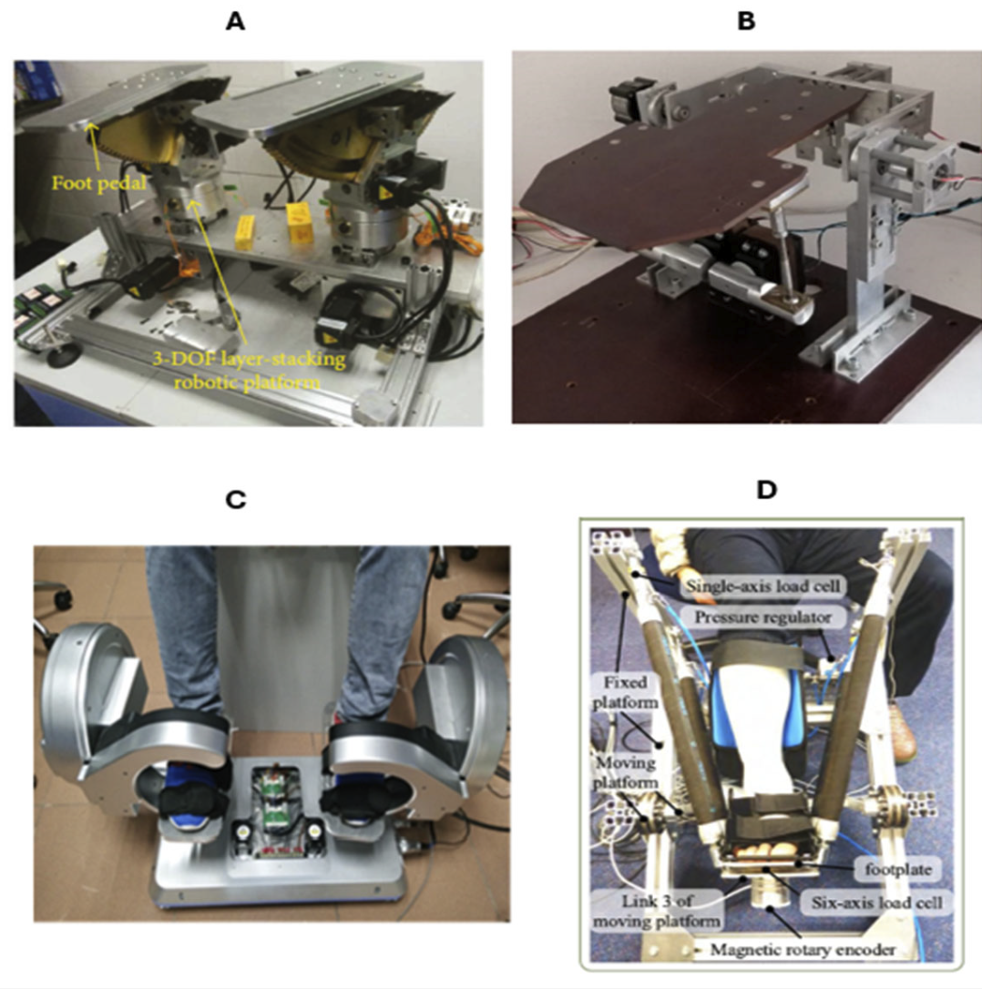
State of the Art & the Gap
Wearable exoskeletons vs. platform-style ankle rehab robots
• Existing wearable devices: only 1–2 DOF, miss inversion / yaw motion of the ankle complex
• Existing platform robots: full 3–6 DOF, but stationary, and their center of rotation does NOT coincide with the talocrural joint → parasitic shear
• This work: target the gap — a wearable mechanism whose remote center of rotation is anatomically aligned with the human ankle
(a) Wearable exoskeletons – portable, often 1–2 DOF
(b) Platform robots – multi-DOF, but stationary & non-anthropomorphic
Yufei Zhang · AMR Research Course · May 2026
4 / 19

Slide 5
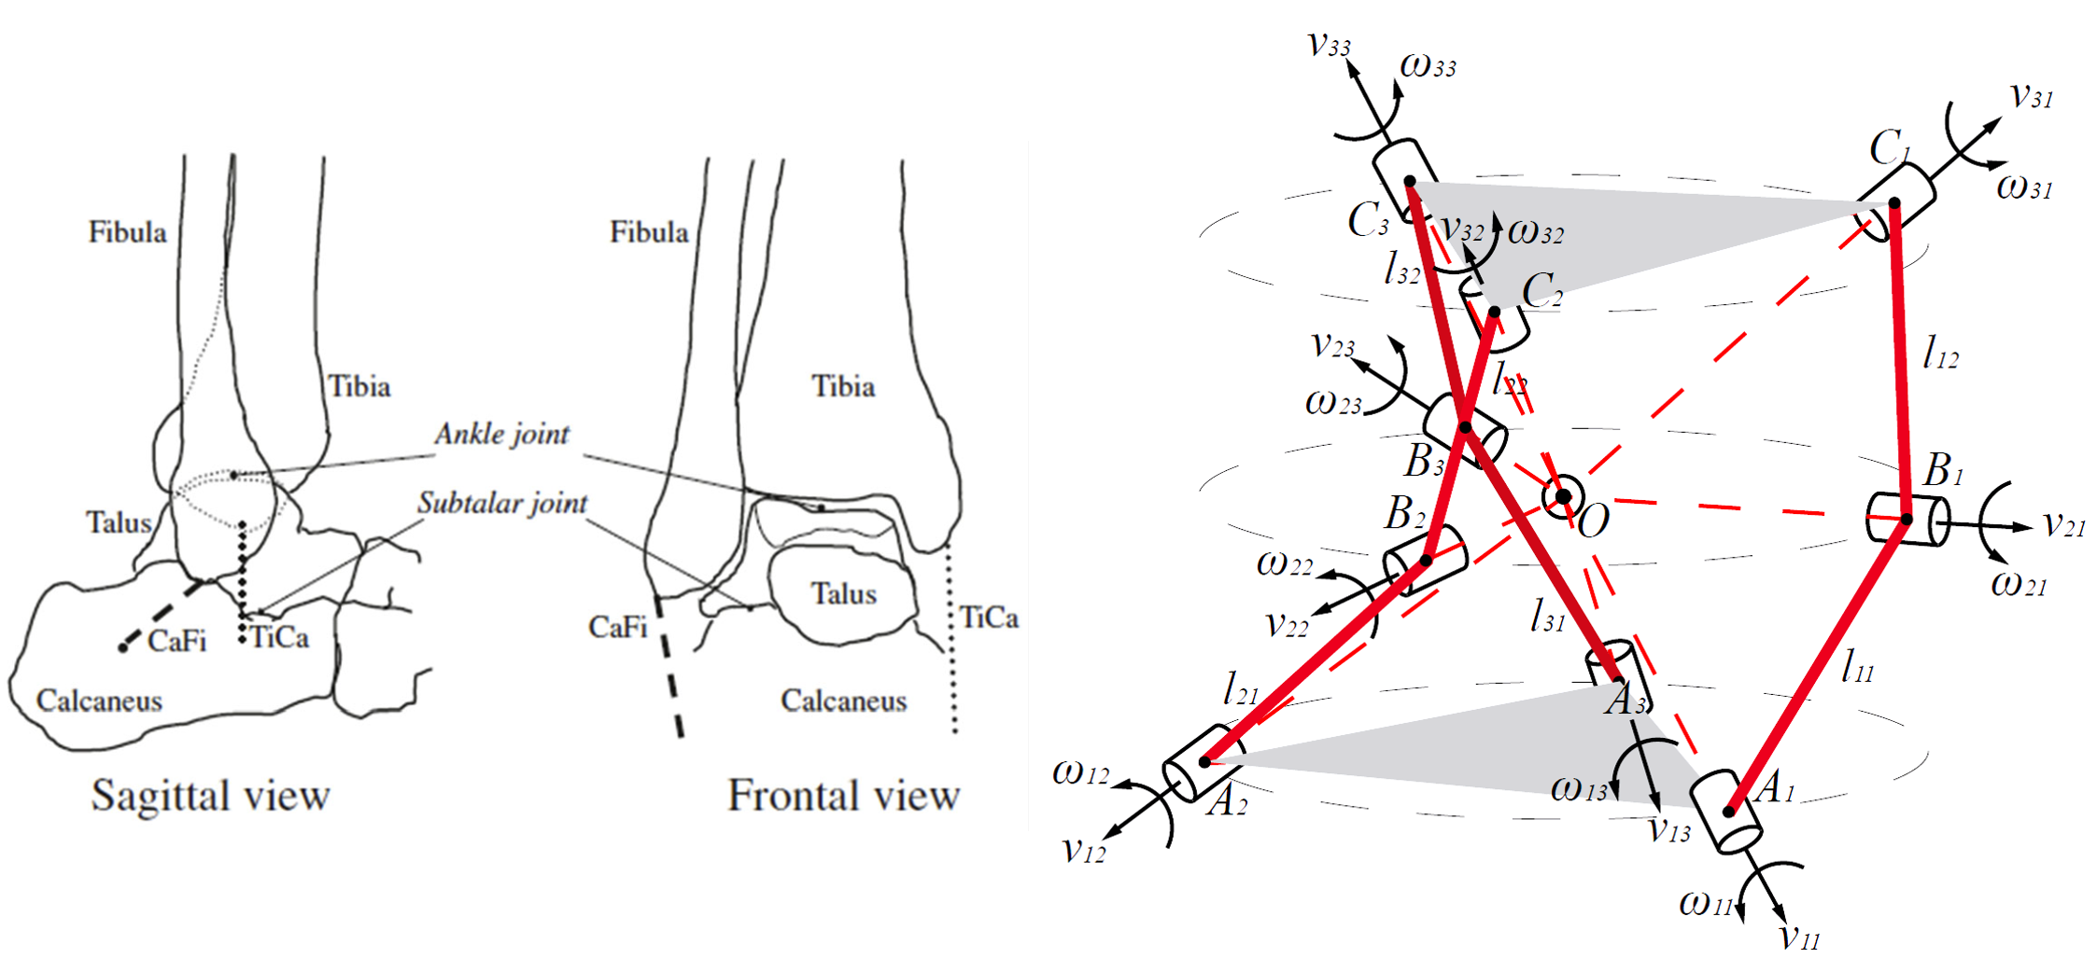
Biomechanical Motivation → 3-RRR SPM
Anatomy of the talocrural / subtalar complex matches a spherical mechanism
• Ankle: 3 rotation axes converge near a single anatomical point
• 3-RRR SPM: 9 revolute joints whose axes intersect at one common spherical center O
• Three pure rotations ≡ dorsi/plantarflexion, inversion/eversion, internal/external rotation
• Aligning O with the talocrural complex eliminates parasitic translation
Yufei Zhang · AMR Research Course · May 2026
5 / 19

Slide 6
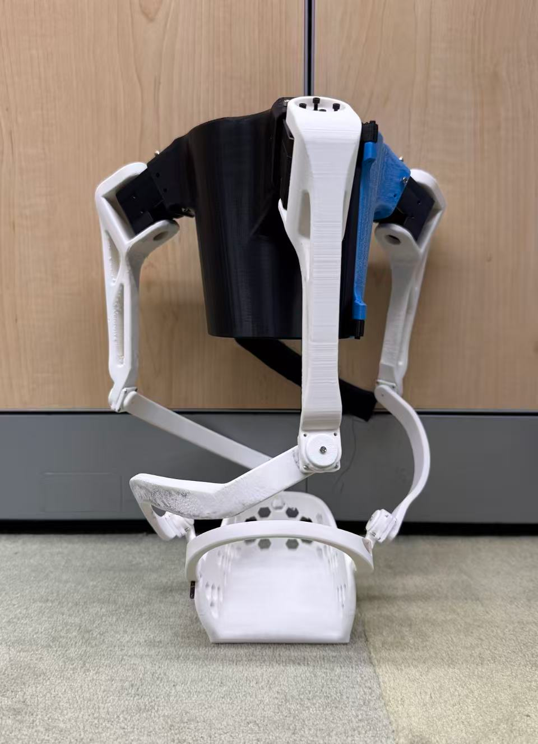
Mechanism Design
Wearable strap-mounted device with annotated link lengths L₁ (proximal) and L₂ (distal)
• Three identical RRR limbs at 120°
• Open-back base ring + adjustable shank cuff
• Strap-mounted, wearable form factor
• All actuator axes intersect at the ankle center
• 3D-printed for fast design iteration
CAD render with link annotation L₁ / L₂
3D-printed prototype (assembled)
Yufei Zhang · AMR Research Course · May 2026
6 / 19

Slide 7
Foot-Plate Innovation: Shoe-Tray Design
Subject keeps their own shoes; straps fix the foot in the tray; the device drives the tray
Why a shoe tray?
• Survey of comparable rehab devices: rigid foot plates fit one foot size; soft sandals lose stiffness
• Our choice: a tray sized for street shoes; the subject just steps in
• Velcro / strap fixation across the dorsum and around the heel → firm coupling without tooling
What this buys us
• Comfort: no skin contact, normal shoe sole → longer training sessions tolerable
• Generalization: one device fits a wide range of foot sizes (typically EU 36 – 46) without remanufacturing
• Clinic-friendly: don/doff is a single step-in motion
Foot-plate (lower right): a shoe-tray that the wearable strap-mounted device drives directly
Yufei Zhang · AMR Research Course · May 2026
7 / 19

Slide 8
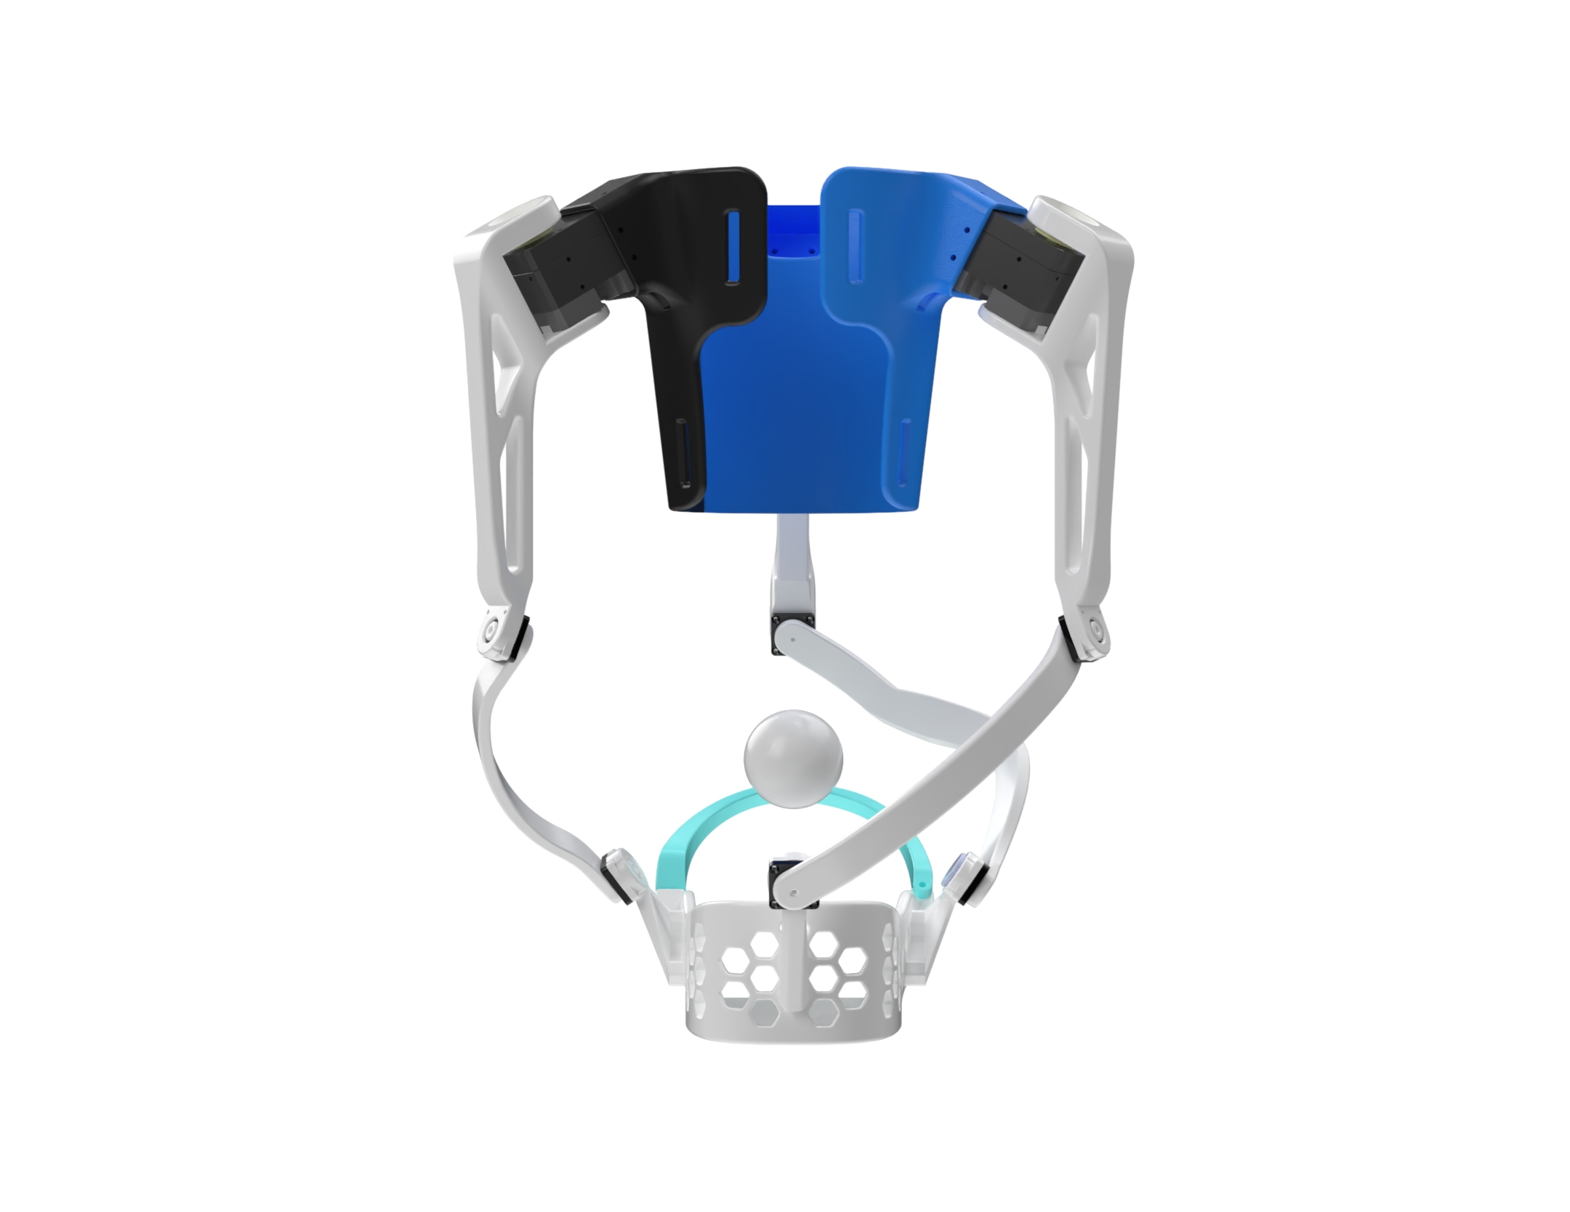
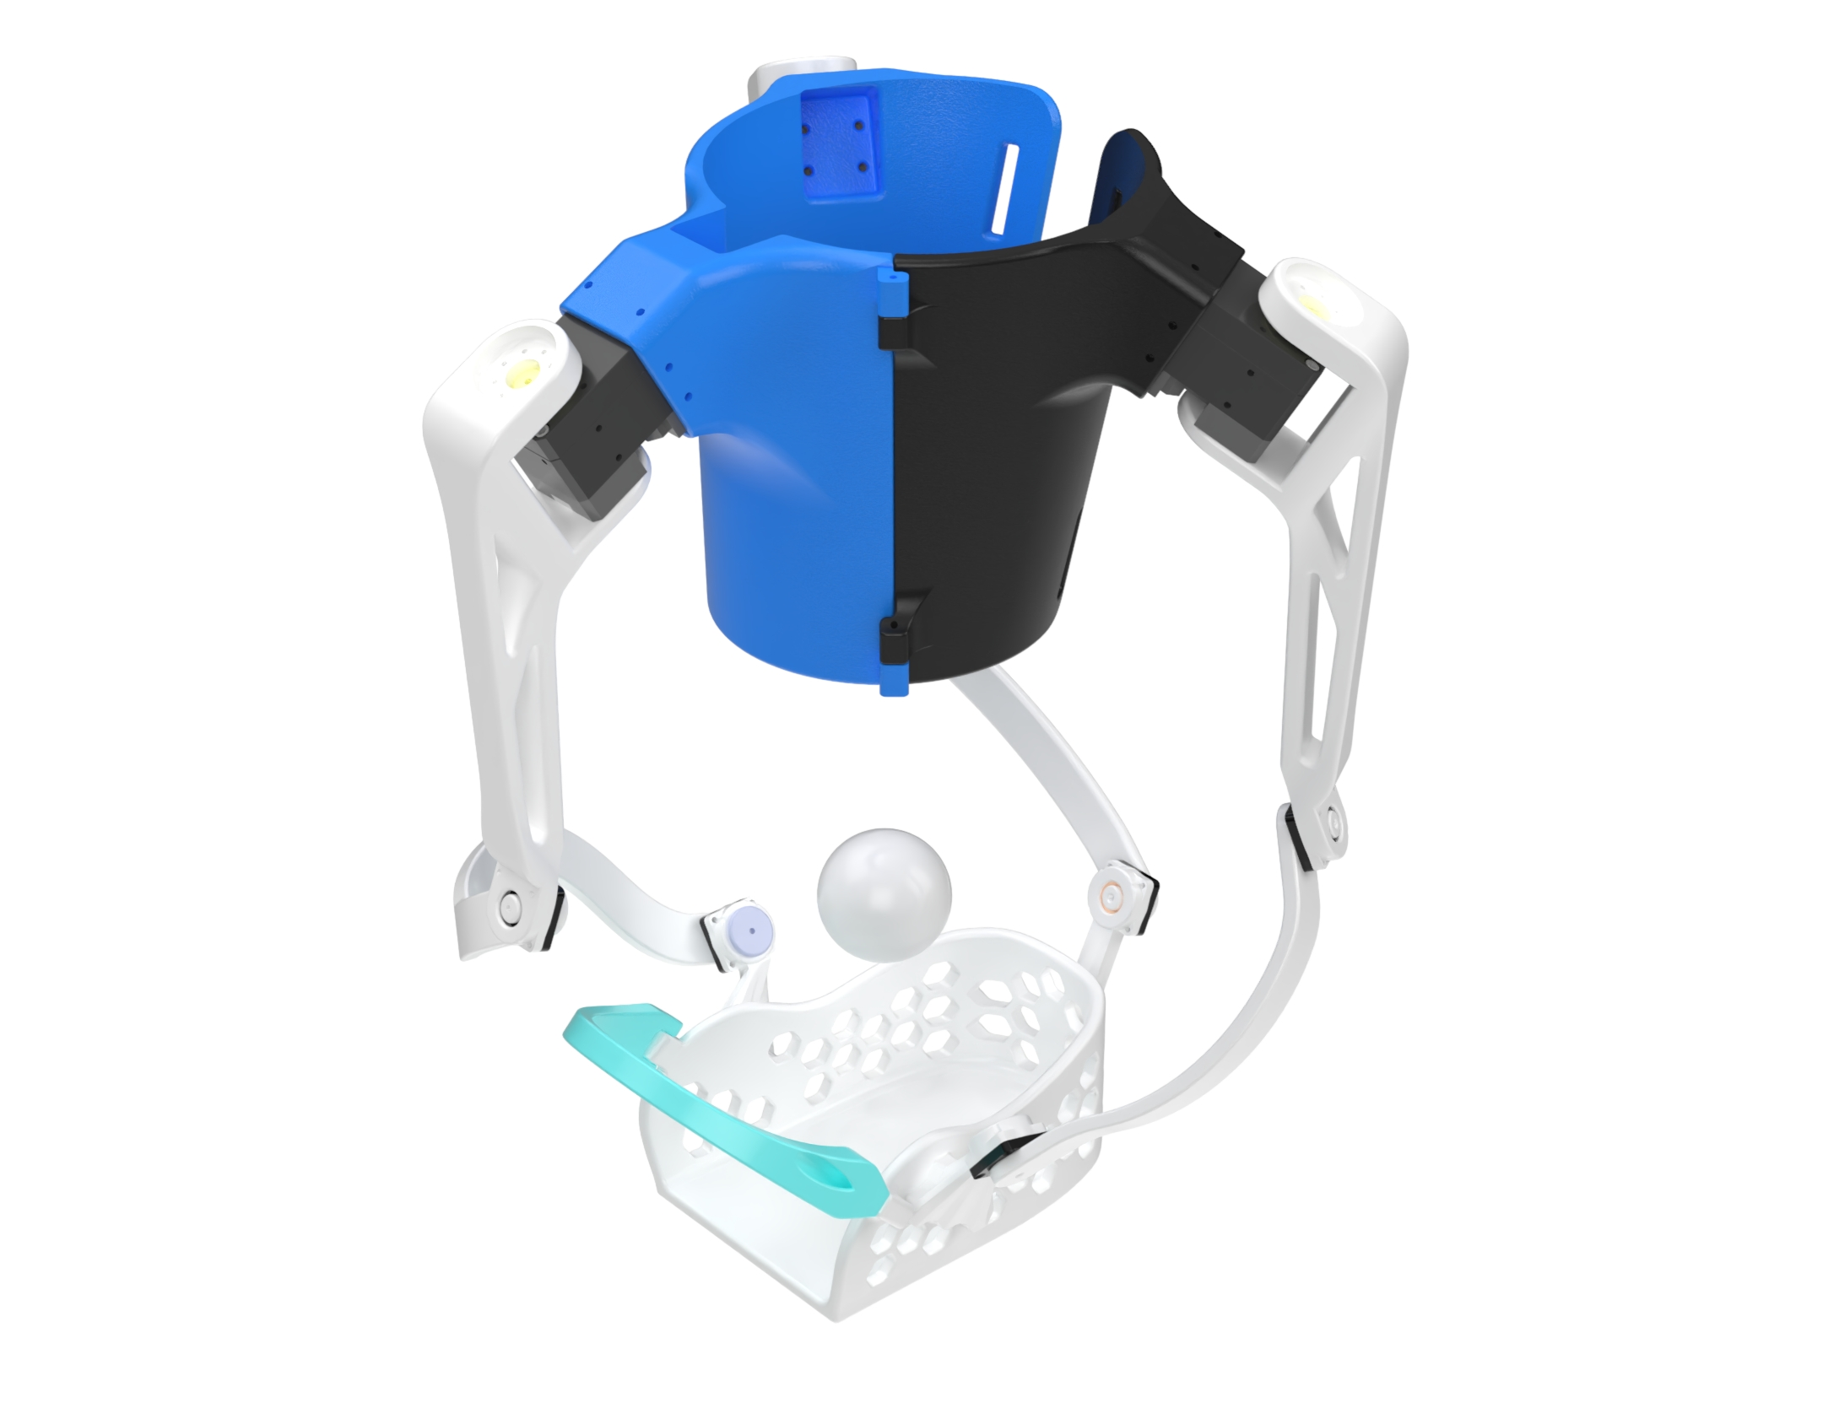
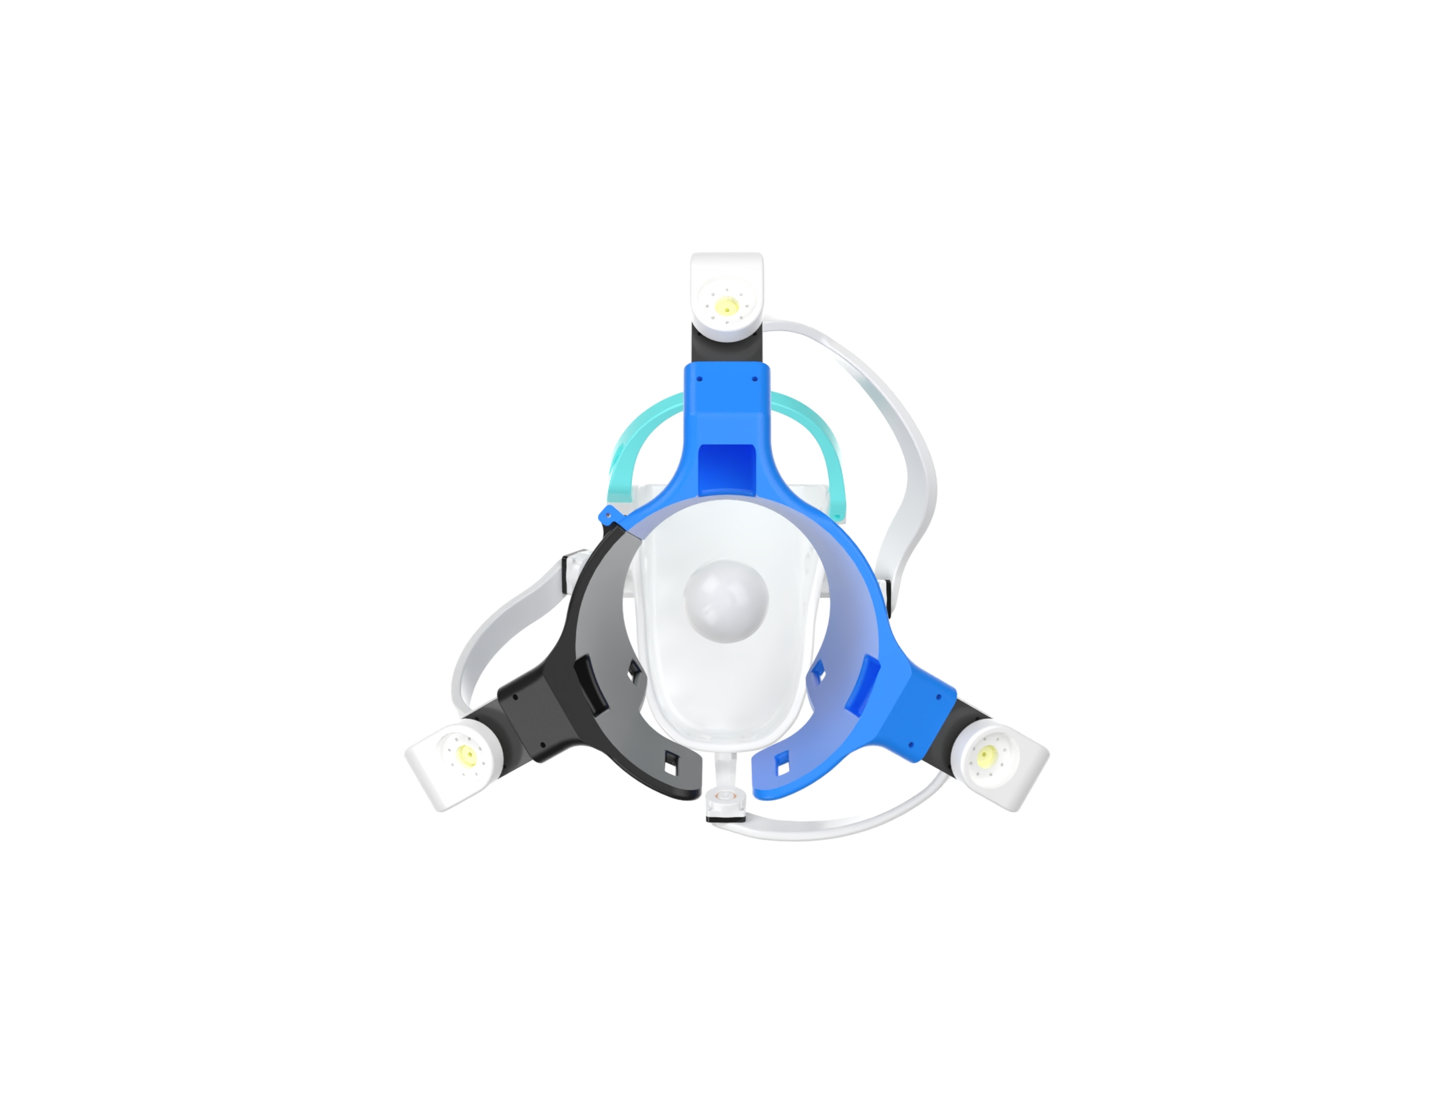
CAD Multi-View
Three views of the wearable form factor
(a) Front
(b) Perspective
(c) Top
Yufei Zhang · AMR Research Course · May 2026
8 / 19

Slide 9
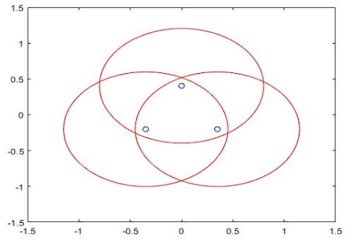
Singularity-Aware Geometry
Link ratio ρ = L₂ / L₁ controls the rotational-Jacobian conditioning
• Type-2 singularity: det(A) → 0 → platform loses stiffness → unsafe under patient load
• Following Saheb … (2021) and Wu & Bai (2019), pick ρ ≈ 1.15
• Result: + ~20 % global isotropy index of Jᵣ
• Result: singular curves pushed to the workspace boundary
• → stiffness preserved across the clinical ROM
Per-leg reachable circles → their intersection is the singularity-free common workspace
Yufei Zhang · AMR Research Course · May 2026
9 / 19

Slide 10
Inverse Kinematics (Algorithm 1)
Closed-form derivation → numerical bisection for real-time control
Closed-form (per leg):
Algorithm 1 per-cycle parallel IK
• Bᵢ = Aᵢ + η (Cᵢ − Aᵢ) + ξ ‧ ((Cᵢ − Aᵢ) × N) / |·|
• θᵢ = arccos( (Bᵢ − Aᵢ) · uᵢ / |Bᵢ − Aᵢ| )
• Used for offline workspace evaluation
input : (roll, pitch, yaw), prior q⁻
output : motor angles q = (q₁, q₂, q₃)
Rₐₑ ← Rₘ(yaw) Rᵧ(pitch) Rₓ(roll)
for each leg i in {1,2,3}:
Pᵢ ← Rₐₑ · Pᵢᶠ
fᵢ(q) ← |Pᵢ − Aᵢ(q)| − Lᵢ
bracket ← grid containing q⁻ᵢ
qᵢ ← bisect(fᵢ, bracket)
return q
Numerical (real-time, used in code):
• Each leg: scalar residual fᵢ(qᵢ) = |Pᵢ − Aᵢ(qᵢ)| − Lᵢ
• Coarse bracket → bisection → root-continuity rule
• Dependency-free, runs in ROS 2 and on host laptop alike
Yufei Zhang · AMR Research Course · May 2026
10 / 19

Slide 11
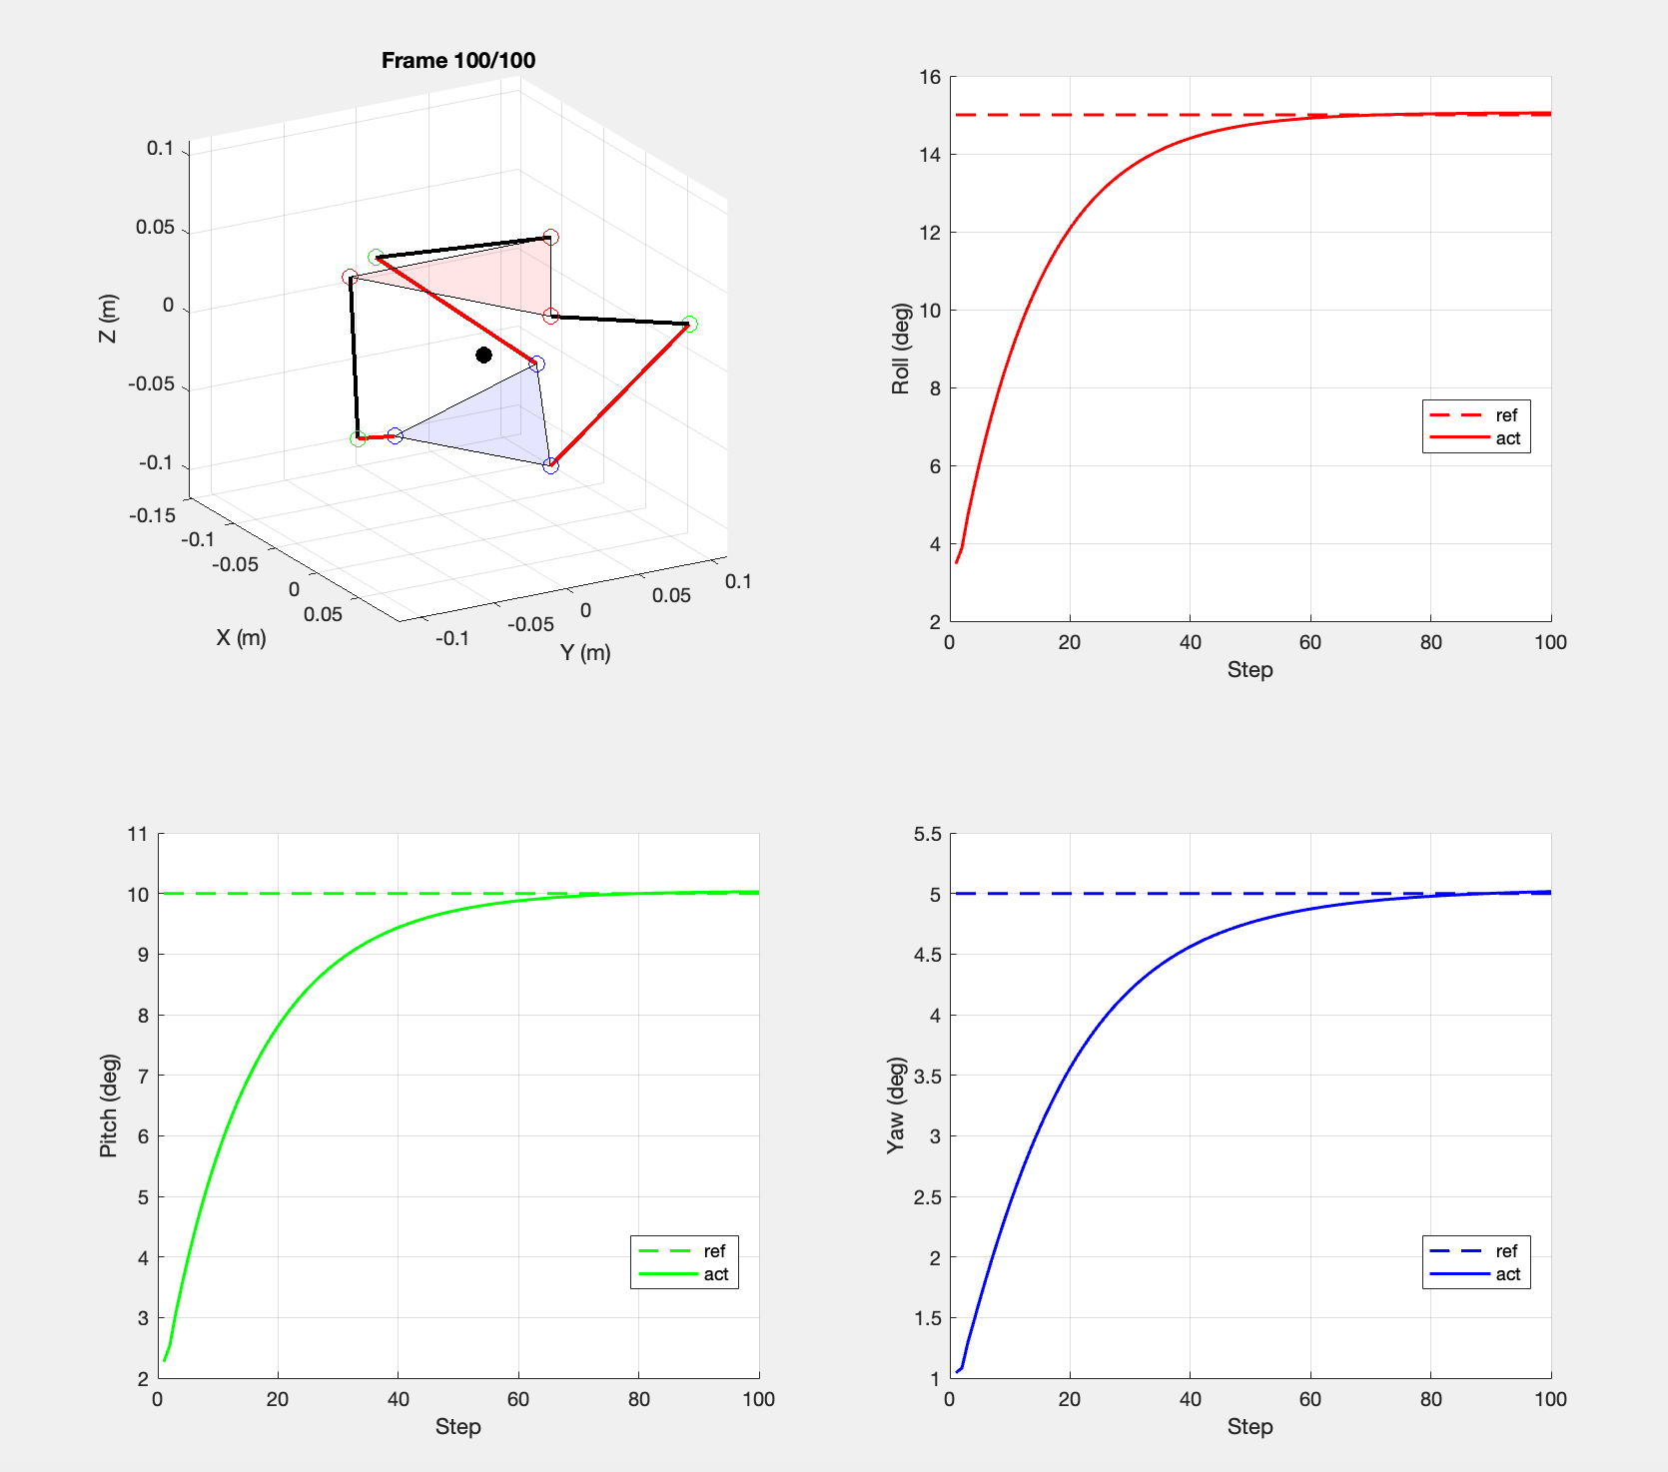
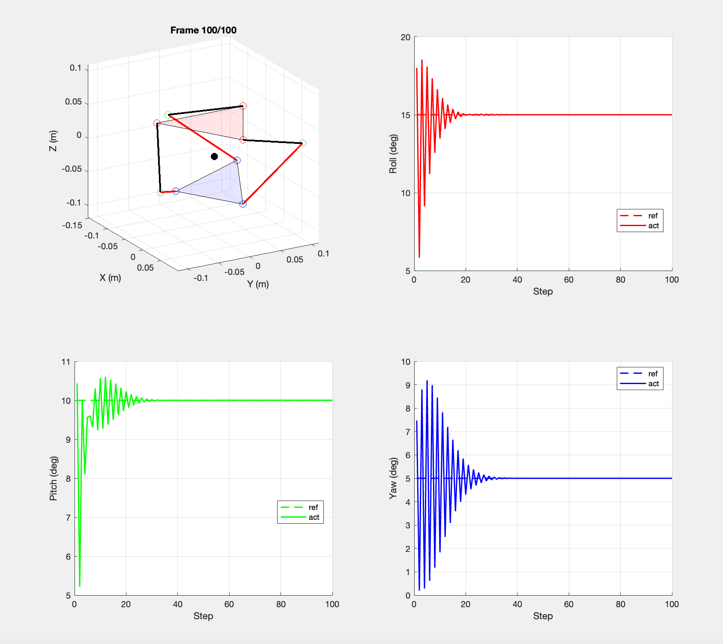
Dynamics & Baseline PID
Stiff vs. compliant tuning brackets the AAN operating range
Underdamped: Kp = 20, Kd = 0.5, Ki = 1 → soft, oscillatory
Critically damped: Kp = 50, Kd = 2, Ki = 5 → stiff, monotonic
• Three independent PID loops on the actuator angles θᵢ
• Even on a rigid SPM, feedback gains modulate effective compliance
• These two regimes bracket the spectrum that the AAN controller interpolates online
Yufei Zhang · AMR Research Course · May 2026
11 / 19

Slide 12
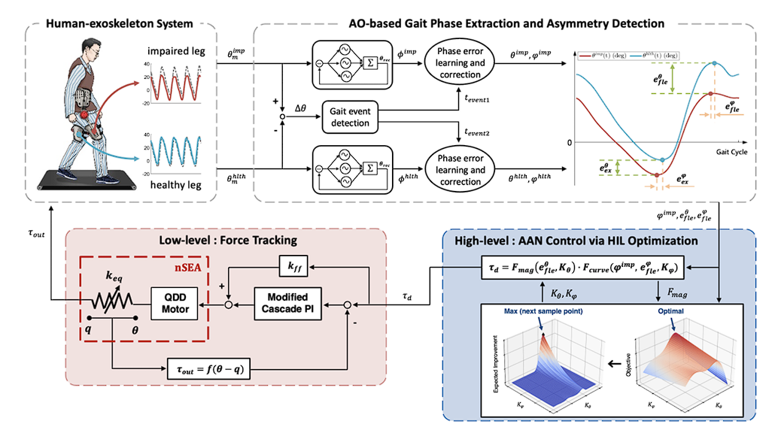
Assist-As-Needed Control (proposed)
Patient-torque estimation from motor current, no distal F/T sensor required
• Estimator: τ_ext ≈ K_t · I_m − τ_model(q, q̇, q̈_ref)
• Assist law: τ_assist = k_aan(t,e) · [τ_ref − τ_ext]₊
• Adaptive gain k_aan grows with tracking error, decays with successful tracking
• Removes need for distal load cell; uses Dynamixel current feedback
• Listed as a planned/proposed contribution — not yet deployed on hardware
AAN architecture (top: gait-phase + asymmetry; bottom: low-level force tracking)
Yufei Zhang · AMR Research Course · May 2026
12 / 19

Slide 13
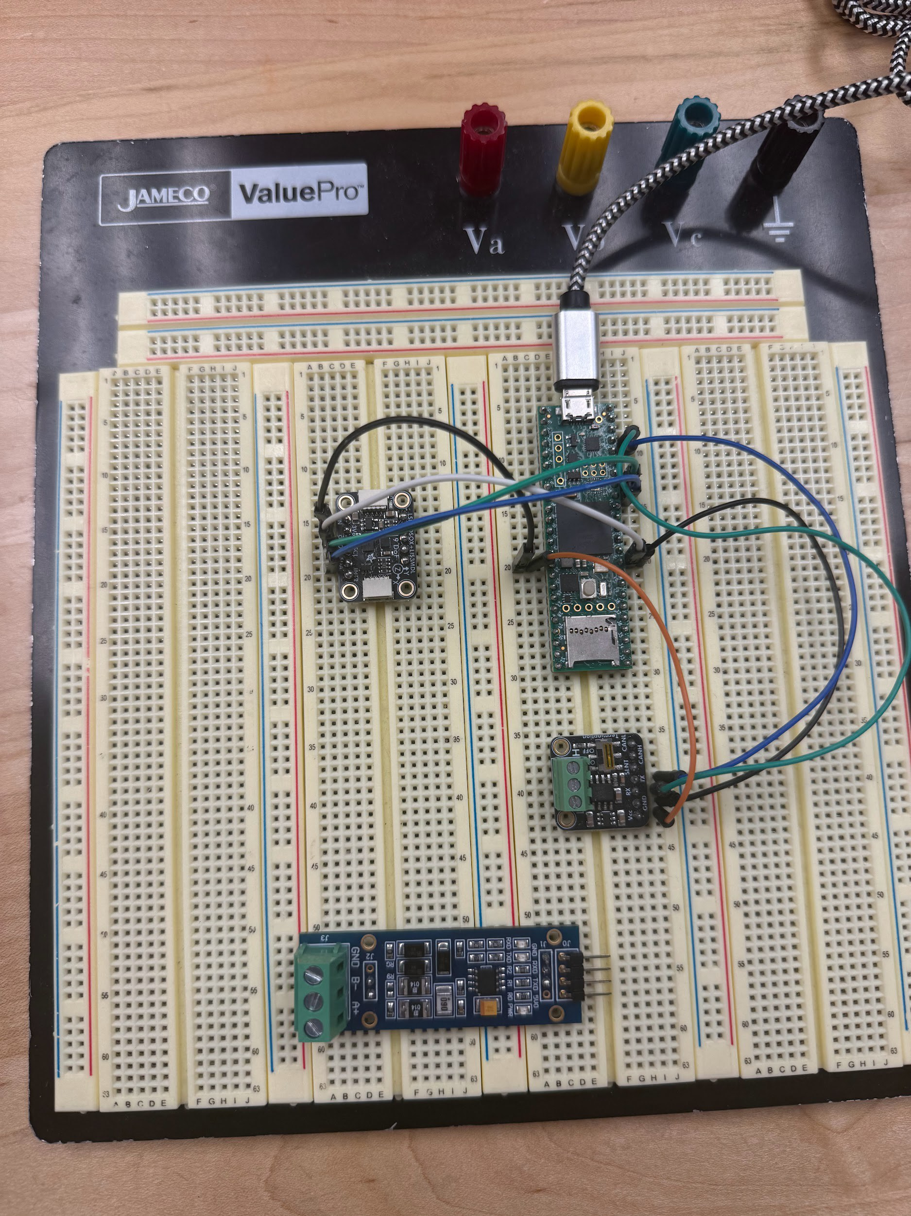
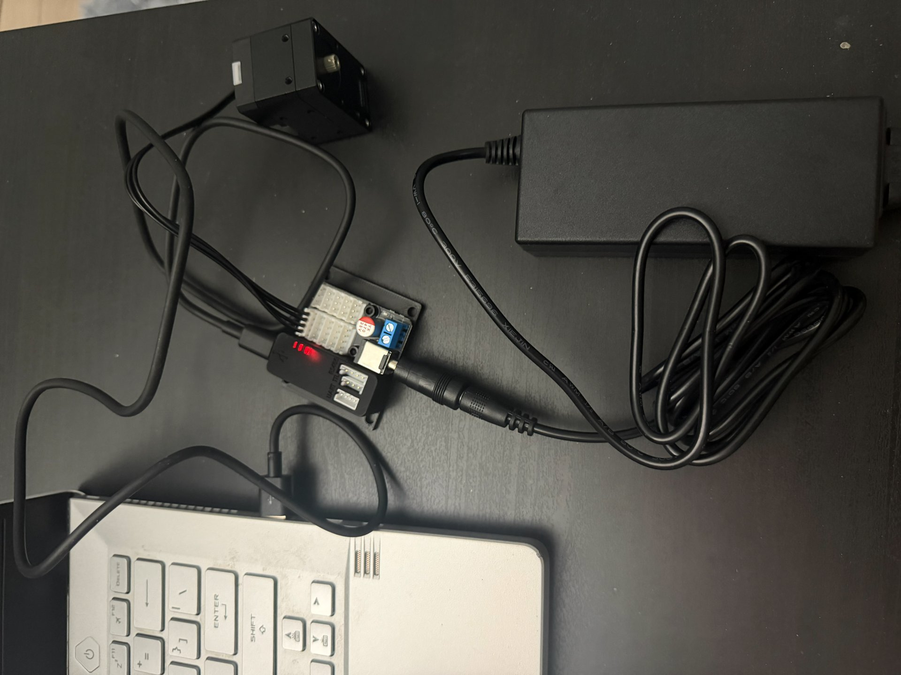
Embedded System & Hardware
Teensy 4.1 master · RS-485 bus · dual IMU · instrumented gait mat
• 1 kHz control loop on Teensy 4.1
• RS-485 daisy chain: 3 × XM430-W350-R
• Position-control mode + current telemetry
• Encoder resolution 0.088° / tick
• Dual IMU (shank + foot) for absolute reference
• Gait mat for stance time, plantar pressure, CoP
Prototype electronics stack: Teensy 4.1 + IMU + RS-485 transceiver
Servo control wiring: Dynamixel + U2D2 + power supply + host
Yufei Zhang · AMR Research Course · May 2026
13 / 19

Slide 14
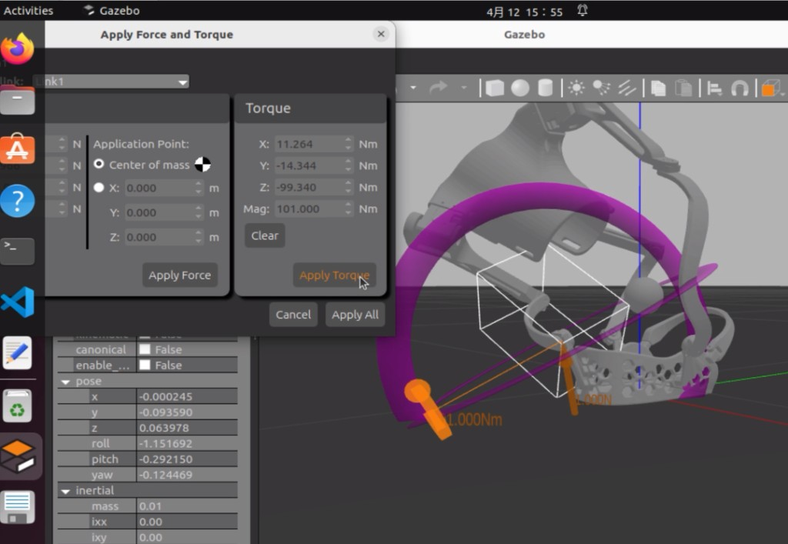
Open-Source ROS 2 / Gazebo Pipeline
From CAD to closed-loop simulation in three lines
Repository (MIT licensed):
github.com/YufeiZhang0601/wearable-3rrr-ankle-rehab
• ROS 2 ament_python package
• URDF + Xacro, 22 STL meshes, 4 launch files
• Parallel-IK solver — one shared kinematic core
• Gazebo verification: sweep force/torque grid → no NaN inertias, no mesh interpenetration
• Dependency-free closed-loop demo (Python stdlib only)
• JSON parameter templates → swap hardware without touching Python
Gazebo URDF smoke test: 101 Nm pure torque applied to the proximal link
Yufei Zhang · AMR Research Course · May 2026
14 / 19

Slide 15
Closed-Loop Tracking Demo (Algorithm 2)
Reproduces the IK + safety supervisor against the URDF model
Algorithm 2 closed-loop ankle-rehab tracking demo
• Reference: ± 12° dorsi/plantar, ± 6° invert/evert, 0.05 Hz, 3 s ramp
• Safety caps: τ ≤ 1.2 Nm, q̇ ≤ 0.8 rad/s
• Logs commanded vs. measured q, residual error, Dynamixel ticks
• Recorded video shipped in the repo: media/closed_loop_demo.mp4 (≈25 MB)
parse URDF; pick (j₁, j₄, j₆) as the three Dynamixel actuators
q ← 0; t ← 0
while running:
σ(t) ← min(t / Tsoft, 1) # soft start
pitch ← σ(t) · A_p sin(2π f t)
roll ← σ(t) · A_r sin(2π f t)
q_ref ← ParallelIK(roll, pitch, 0) # Algo 1
Δq ← clamp(q_ref − q, q̇_max · Δt)
τ ← clamp(controller(Δq), τ_max)
q ← q + Δq # virtual actuator
log(t, q_ref, q, τ, ToTicks(q)) # CSV row
t ← t + Δt
Yufei Zhang · AMR Research Course · May 2026
15 / 19

Slide 16
Planned Experiments
Quantitative metrics + simulated foot-drop protocol
Quantitative metrics
Four sub-experiments
• Limb Symmetry Index (LSI) — north-star clinical metric
• Jerk = d³x/dt³ from foot-plate IMU (smoothness)
• Interaction torque τ_int (sensorless estimator, eq. 16)
• Center of pressure (CoP) trajectory from gait mat
• Human-contribution ratio η_h = τ_ext / (τ_ext + τ_assist)
• E1 Simulated-impairment recovery (controlled foot-drop)
• E2 Transparency evaluation (R² ≥ 0.95 vs. barefoot)
• E3 Active participation under AAN (η_h trend over sessions)
• E4 Passive transfer effect after CPM bout
Statistics
• Within-subject paired t-tests (or Wilcoxon if non-normal); Bonferroni-Holm correction at the experiment level
• Across-session trends: linear mixed-effects model with subject as a random effect
• Bootstrap 95 % CIs (n = 10 000)
Yufei Zhang · AMR Research Course · May 2026
16 / 19

Slide 17
Implementation Status — Honest Snapshot
Three concrete deliverables; two open items left for the next phase
Item | Status | Outcome / Notes
Wearable 3-RRR mechanism (link ratio ρ≈ 1.15) | Done | + ~20 % isotropy index
Shoe-tray foot-plate design (size-generalizing, comfortable) | Done | Subject keeps own shoes
Closed-form & numerical inverse kinematics | Done | Algorithm 1, in repo
Open-source simulation controller (ROS 2 + Gazebo) | Done | MIT-licensed release
Closed-loop tracking demo against the URDF | Done | Algorithm 2 + recorded video
Embedded electronics stack (Teensy + RS-485 + IMU) | Done | Bench-tested
Ablation experiments + quantitative metrics designed | Done | LSI / jerk / τ_int / CoP / η_h
AAN control law formulated | Proposed | Eq. (16) – (18); pending HW deploy
Standalone untethered operation (battery, free walking) | Not yet | Next milestone
Human-subject experiments (E1–E4) | Not yet | Platform built; subjects pending
Yufei Zhang · AMR Research Course · May 2026
17 / 19

Slide 18
Conclusion & Open Invitation
What this project leaves on the table for the next student
Delivered (turn-key)
• Wearable, anatomically-aligned 3-RRR SPM with the shoe-tray foot plate that fits a wide range of foot sizes
• Closed-form + numerical IK that maps (roll, pitch, yaw) to motor angles in real time
• MIT-licensed ROS 2 / Gazebo simulation controller, verified end-to-end against the URDF
• Ablation-experiment design and a full set of quantitative rehab metrics (LSI, jerk, τ_int, CoP, η_h)
Open for the next phase
• Standalone untethered operation: battery, free wearable walking on the gait mat
• Subject experiments E1–E4: healthy-subject simulated foot-drop → IRB-approved patient cohort
An open invitation to future students
The simulation codebase, the wearable hardware design, and the experimental protocol together form a turn-key starting point. Pull the repo, plug in your own subject trials, and the project picks up exactly where this report leaves off.
Yufei Zhang · AMR Research Course · May 2026
18 / 19

Slide 19
Thank you.
Questions & discussion
Yufei Zhang · yz4917@columbia.edu
Advisor: Prof. Sunil K. Agrawal
github.com/YufeiZhang0601/wearable-3rrr-ankle-rehab

