Slide 1

JsUnit www.jsunit.net
An introduction to unit testing in-browser JavaScript with JsUnit
Edward Hieatt
edward@jsunit.net
February, 2005
JsUnit version 2.1
Note: this presentation assumes the reader/audience is familiar with basic unit testing concepts

Slide 2
JsUnit: Part 1
Writing and manually running JavaScript Tests with the XUnit framework for in-browser JavaScript

Slide 3
What is an XUnit framework?
A standardized set of language-independent concepts and constructs for writing and running unit tests
There is an XUnit framework for virtually every language
Examples are JUnit for Java, CppUnit for C++, PHPUnit for PHP, UTPL/SQL for Oracle SQL
Traditionally open-source
All support certain constructs:
TestCase and TestSuite are well-defined entities
The assertion syntax follows rough standards, e.g. assertEquals(comment, expected, actual)
All provide a TestRunner program to run tests
Listed at http://xprogramming.com/software.htm

Slide 4
JsUnit: background
The XUnit framework for JavaScript
www.jsunit.net
Open source (hosted on Sourceforge)
Preserves the standards of a typical XUnit framework
Written in 100% JavaScript
Runs on “most” browser/platform combinations
Development began in early 2001
~10,000 downloads and ~1000 members of the news group

Slide 5
JsUnit: conforming to XUnit
Unit tests in JsUnit are called Test Functions
Test Functions live in an HTML page called a Test Page
A Test Page is any HTML page that has a JavaScript “include” of jsUnitCore.js
jsUnitCore.js provides the assertion functions of JsUnit, e.g. assertEquals(comment, arg1, arg2)
JsUnit supports setUp() and tearDown()
A Test Suite Page declares a suite() function that returns a JsUnitTestSuite for grouping Test Pages
The JsUnit testRunner.html page runs Test Pages
The TestRunner HTML page can be run from a file server or a web server

Slide 6
JUnit <-> JsUnit
JUnit
Test Methods
Test Classes
Extend junit.framework.TestCase
junit.framework.TestSuite
AWT/Swing/IDE TestRunners
public void setUp(), tearDown()
Runs in the target Java VM
Pure Java
JsUnit
Test Functions
Test Pages (HTML)
Include jsunit/app/jsUnitCore.js
Test Suite Pages (HTML)
Pure HTML/JS TestRunner
function setUp(), tearDown()
Runs in the target browser(s)
Pure JavaScript

Slide 7
Test Page Example 1: Testing some simple math (code in Test Page)
<html>
<head>
<script language="JavaScript" src="../app/jsUnitCore.js"></script>
<script language="JavaScript">
function multiplyAndAddFive(arg1, arg2) {
return arg1*arg2+5;
}
function testWithValidArguments() {
assertEquals("2 times 3 plus 5 is 11", 11, multiplyAndAddFive(2, 3));
assertEquals("Should work with negative numbers", -15, multiplyAndAddFive(-4, 5));
}
function testWithInvalidArguments() {
assertNull("null argument", multiplyAndAddFive(2, null));
assertNull("string argument", multiplyAndAddFive(2, "a string"));
assertNull("undefined argument", multiplyAndAddFive(2, JSUNIT_UNDEFINED_VALUE));
}
function testStrictReturnType() {
assertNotEquals("Should return a number, not a string", "11", multiplyAndAddFive(2, 3));
}
</script>
</head>
<body>
This is a Test Page for multiplyAndAddFive(arg1, arg2).
</body>
</html>

Slide 8
Test Page example 2: Testing form field/DOM interaction (code in .js file)
<html>
<head>
<script language="JavaScript" src=“/path/to/jsunit/app/jsUnitCore.js"></script>
<script language="JavaScript" src=“/path/to/my/app/myCode.js"></script> //contains a “validate” function
<script language="JavaScript">
function setUp() {
document.myForm.field1.value=“foo”;
}
function testInitialConditions() {
assertEquals(“”, document.getElementById(“resultMessage”).innerHTML);
}
function testPushOK() {
pushOKButton();
assertEquals(“No value in field 2”, document.getElementById(“resultMessage”).innerHTML);
}
function testFillingInField2() {
document.myForm.field2.value=“bar”;
pushOKButton();
assertEquals(“Good values”, document.getElementById(“resultMessage”).innerHTML);
}
function tearDown() {
document.myForm.field1.value=“”;
document.myForm.field2.value=“”;
}
function pushOKButton() {
validate();
}
</script>
</head>
<body>
<form name=“myForm”>
<input type=“text” name=“field1”/>
<input type=“text” name=“field1”/>
<div id=“resultMessage”></div>
<input type=“button” value=“OK” onclick=“validate()”/>
</form>
</body>
</html>

Slide 9
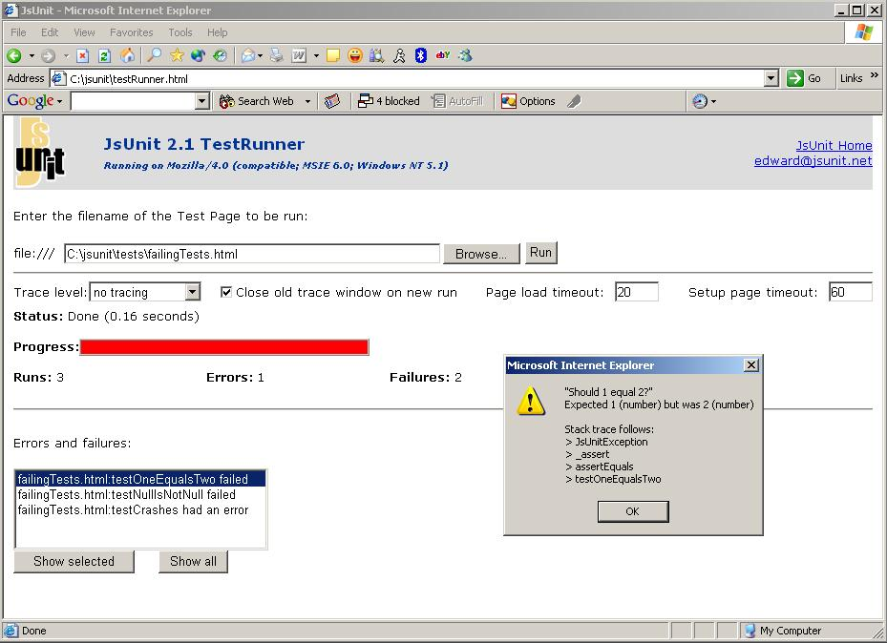
JsUnit: the TestRunner

Slide 10
JsUnit Tracing (debugging output)
JsUnit includes certain functions that output “traces” to a debugging window
Tracing is a way to view output without using JavaScript “alerts”
Tracing is an alternative to a debugger if one is not available for a certain browser/platform
There are 3 trace functions:
debug(message) (level 3)
warn(message) (level 2)
inform(message) (level 1)
For a particular run of the tests, you can set the trace level to any of the 3 levels
Traces cascade, i.e. trace message at lower levels show up when the level is set higher

Slide 11
Supported Browsers/OSs
MS Internet Explorer 5.5+ on:
Windows NT/2000/XP/95
Mac OS 9, Mac OS X
Gecko-based 0.9.4+ browsers on all platforms, e.g.:
Mozilla 0.9.4+
Firefox 0.9+
Netscape 6.2.3+
Konqueror 5+ on Linux KDE 3.0.1+
Safari 1.2+ on Mac OS X

Slide 12
JsUnit: the most FA’d Q
JsUnit is not usually appropriate for submitting forms/other navigation that interacts with a web server:
It is intended to test purely client-side functionality – it’s a unit testing framework of the in-browser JavaScript that usually lives in .js files included by generated/static HTML pages
Testing “walking through” a web application should be done in HTTPUnit/JWebUnit
In most cases, the desire to submit a form points at the need to instead mock out the submission in order to create a true unit test.
However, there is currently work in progress to support the ability for a Test Page to submit a form in a separate page that lives in a Frame/IFrame in the Test Page

Slide 13
JsUnit: Part 2
The automation of runs of JsUnit Test Pages/Suites on multiple local or remote browsers/OSs from an Ant script or JUnit suite (and hence in a continuous build)

Slide 14
The goals of automated test runs
We have seen how JsUnit allows you to run your tests in almost any particular browser on most OSs
It is desirable to be able to easily run your tests in all of your target browsers:
while you are writing code and tests, without having to manually start up each browser and press “Run”
as part of a regression test suite in a continuous build
It is also important that the tests be run on target browsers on all the target OSs, rather than just one machine
We want to get instant feedback on which test failed on which browser on which OS, and also create logs of each test run
That is, we don’t want to have to get out of our seat and go to a bank of test machines running various browsers – we want visual or programmatic feedback, as we get with the green bar.

Slide 15
Automation on a single machine: StandaloneTest
JsUnit provides a Java JUnit TestCase class called net.jsunit.StandaloneTest
StandaloneTest can be invoked from the JsUnit Ant build.xml
You can configure StandaloneTest with respect to:
Which browsers to run tests in (a list of paths to browser executables)
Which Test Page to run (usually it is your highest-level Test Suite Page)
When run, StandaloneTest starts each browser in turn and runs the specified Test Page without any user interaction
If any test fails in any of the browsers, Standalone Test fails with a failure message indicating which test failed in which browser
In this way, we can repeatedly run our Test Pages on all target browser for the machine we are using with the push of a button

Slide 16
StandaloneTest: how it works
StandaloneTest starts a lightweight Java HTTP server called the JsUnitServer
Each browser is launched as an external process
Certain parameters are passed in the TestRunner URL that tell the test runner to collect results in a form field and submit the form to the JsUnitServer over HTTP
The JsUnitServer waits for all browsers to finish, and inspects the submitted results
If any browser fails, StandaloneTest fails

Slide 17
Automation on multiple machines: DistributedTest
StandaloneTest allows for automated runs on a single machine, but we still need to be able to automatically launch all our tests on all target OSs
This means we need to be able to programmatically kick off JsUnit tests on remote machines
JsUnit provides a second Java JUnit TestCase class called net.jsunit.DistributedTest
DistributedTest is configured to be aware of a list of multiple remote machines
When run, DistributedTest asks each remote machine in turn to run specified Tests on the browsers relevant for the respective OS
Each remote machine runs the specified tests on each browser relevant to its OS
If any test fails on any browser on any remote machine, DistributedTest fails with an error message indicating the failure
In this way, we can repeatedly run our Test pages on all target browser/OS combinations with the push of a button

Slide 18
DistributedTest: how it works
We start a JsUnit server on each remote server
Each JsUnit server is configured with target browsers for its OS
The JsUnit servers listen for requests from DistributedTest to run tests
DistributedTest tells each remote JsUnit server (over HTTP) to run tests
Each JsUnitServer runs StandaloneTest
For each JsUnitServer, if any test fails on any browser, a failure message is sent back to DistributedTest; otherwise a success message is returned (the messages are XML strings)
If any failure message is received, DistributedTest fails

Slide 19
Running in a continuous build
StandaloneTest can be repeatedly run by a developer as he/she is writing code and tests
However, StandaloneTest is a JUnit test, so it can be added to a JUnit suite just like any other test, and thereby run in a continuous build
Alternatively, because JsUnit can be launched from Ant, the Ant task can be added to a continuous build (such as Anthill or Cruise Control)

Slide 20
StandaloneTest: Logging
For each run, StandaloneTest writes a log file to disk
The filename is generated (and unique) or it can be specified by a parameter in the TestRunner
The log file format matches JUnit’s; the details of each Test Function are given

Slide 21
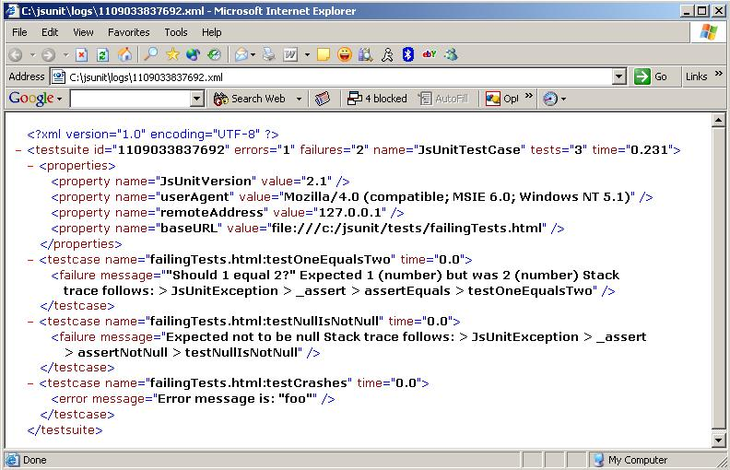
Sample Log File

