Slide 1
CGIS 2026 · Yaoundé Girls in STEAM Hackathon
SMS Scam Detector
🛡️
AI-powered, explainable smishing detection for safer Mobile Money and everyday communication.
Détection explicable des SMS frauduleux pour protéger les familles, élèves et utilisatrices au Cameroun.
🚀
Built to demo live
🇨🇲
Built for impact
Démo prête
Impact local
Application + modèle + explications
Exemples locaux FR/EN
Streamlit app + trained ML pipeline + risk explanations.
Local examples: Orange Money, MTN MoMo, French and English scams.
Team: [Add team name & members] ENSPY · July 2, 2026

Slide 2
The winning thesis
Notre angle gagnant
1
Problem that matters
2
Solution that works live
3
Impact beyond the demo
Problème réel
Solution démontrable
Impact durable
SMS fraud targets trust, urgency and Mobile Money habits. It is a daily cybersecurity risk, not an abstract issue.
A judge can paste any message and immediately see: class, confidence, risk cues and safety advice.
The app teaches users how to recognize scams, which makes it useful for schools, families and communities.
Risque quotidien
Résultat immédiat
Éducation cyber
One-sentence pitch
“We help people detect SMS scams before they click, pay, or share secrets — and we explain the warning signs in plain language.”
« Nous aidons les personnes à détecter les arnaques SMS avant de cliquer, payer ou partager un code secret — avec des explications simples. »
CGIS · Yaoundé Girls in STEAM Hackathon · SMS Scam Detector
2

Slide 3
Problem: scams exploit human behavior
Problème: les arnaques exploitent le comportement humain
⚠
Fear trigger
🎁
Reward trigger
🏦
Authority trigger
🔐
Secrecy trigger
Déclencheur peur
Déclencheur gain
Autorité
Secret
“Your account will be blocked.”
“You won a prize / bonus.”
“Bank / telecom / tax office.”
“Send PIN / OTP.”
« Compte bloqué »
« Vous avez gagné »
Banque/opérateur
PIN / OTP
Why users need help
Ce que l’outil doit faire
Scam SMS are short, emotional and action-oriented.
Attackers use local channels people already trust.
Even a smart user can be fooled when the message feels urgent.
A good tool must be fast, clear and explainable.
Detect: classify the message.
Explain: show warning signs.
Advise: tell the user what not to do.
Educate: build cyber awareness over time.
CGIS · Yaoundé Girls in STEAM Hackathon · SMS Scam Detector
3

Slide 4
Live demo flow: under 60 seconds
Démo live: moins de 60 secondes
1
1. Paste SMS
Incoming SMS / SMS reçu
Coller le SMS
User inputs the message.
Orange Money account blocked. Verify immediately: https://om-secure-login.com
2
2. Predict
Prédire
Model returns safe / spam / smishing.
SMISHING · 91%
3
3. Explain
Expliquer
App highlights risky cues.
4
4. Advise
Conseiller
User gets a simple safety action.
Judge experience: visible product, understandable AI, clear local relevance.
Expérience jury: produit visible, IA compréhensible, pertinence locale claire.
CGIS · Yaoundé Girls in STEAM Hackathon · SMS Scam Detector
4

Slide 5
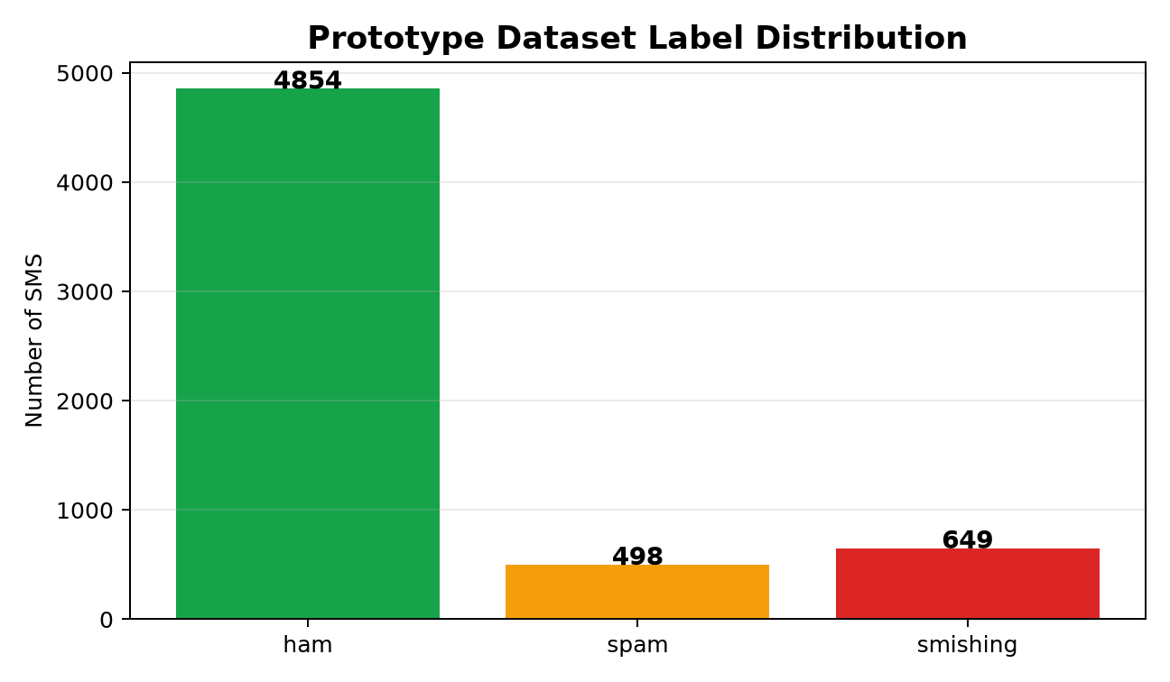
Data strategy: from prototype to robust product
Stratégie données: du prototype au produit robuste
Current prototype dataset
Dataset actuel
Démonstration rapide
30 labeled SMS examples for fast offline demo: ham, spam and smishing.
Competition-ready extension
Extension hackathon
Données publiques + locales
Replace with the referenced Mendeley/public dataset + anonymized Cameroon examples.
Ethics and safety
Éthique
Anonymisation
No real phone numbers, no personal data, no live phishing links; anonymize before training.
Label design
3 classes pour l’analyse, 2 classes pour simplifier l’usage
Conception des classes
3-class view for insight: ham vs spam vs smishing. Optional 2-class view for users: safe vs scam.
CGIS · Yaoundé Girls in STEAM Hackathon · SMS Scam Detector
5

Slide 6
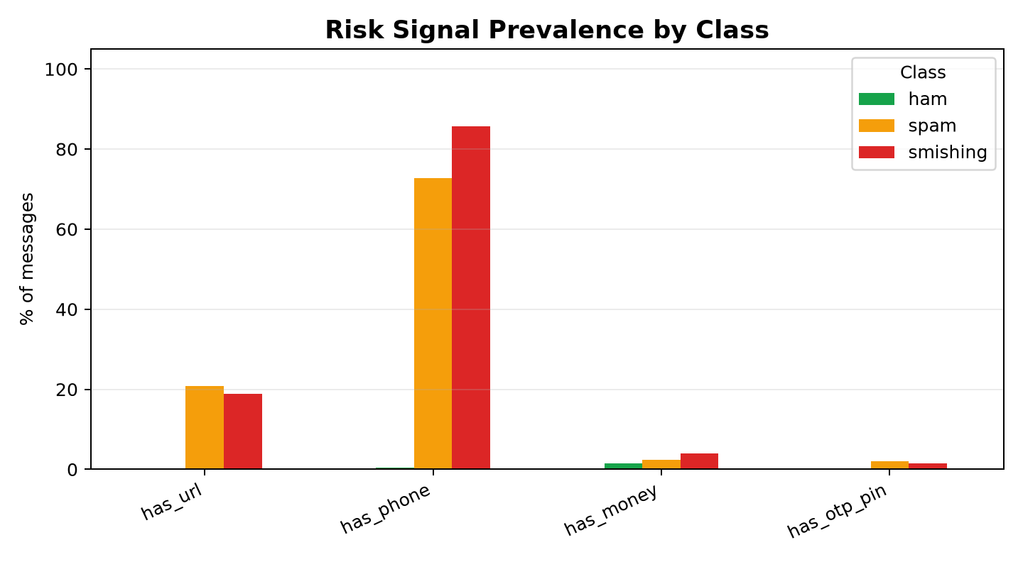
Exploratory analytics: scams have measurable signals
Analyse exploratoire: les arnaques ont des signaux mesurables
Key insight
Smishing messages often combine several weak signals into one strong risk pattern.
URL + urgency + money context is more suspicious than any single word alone.
This is why we combine text features and structural features.
Insight clé: le risque vient souvent de la combinaison des indices, pas d’un seul mot.
Design implication
Implication produit
Expliquer les combinaisons de risque
The app should explain combined risk: “link + urgency + PIN request”.
CGIS · Yaoundé Girls in STEAM Hackathon · SMS Scam Detector
6

Slide 7
Model architecture: lightweight, explainable, deployable
Architecture: légère, explicable, déployable
SMS text
Cleaning
TF‑IDF words + bigrams
Structural risk features
Logistic Regression
Prediction + Explanation
Texte SMS
Nettoyage
Mots + bigrammes
Signaux de risque
Régression logistique
Prédiction + explication
Feature set
Why not a black-box model?
Text: TF‑IDF unigrams and bigrams
Structure: URL, phone, email, digits, punctuation, length
Semantics: urgency, reward, threat, money, PIN/OTP keywords
Output: class probabilities + risk indicators
Runs on a normal laptop
Can work offline during the pitch
Easy to retrain with better data
Easier for judges and users to trust
CGIS · Yaoundé Girls in STEAM Hackathon · SMS Scam Detector
7

Slide 8
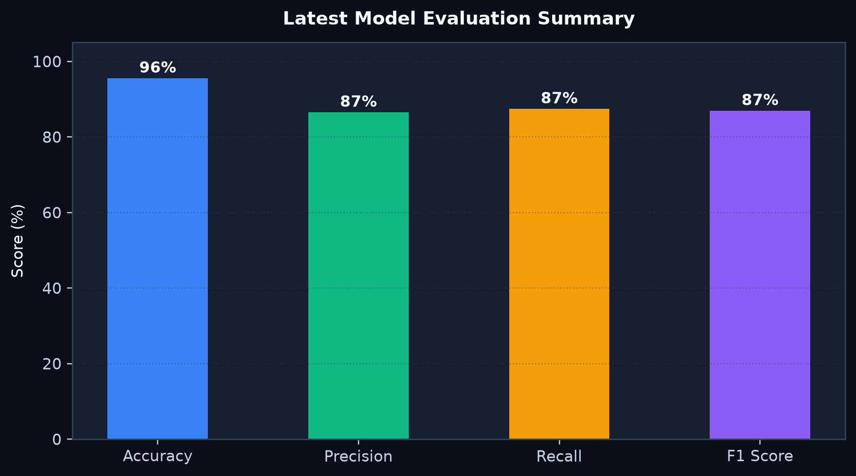
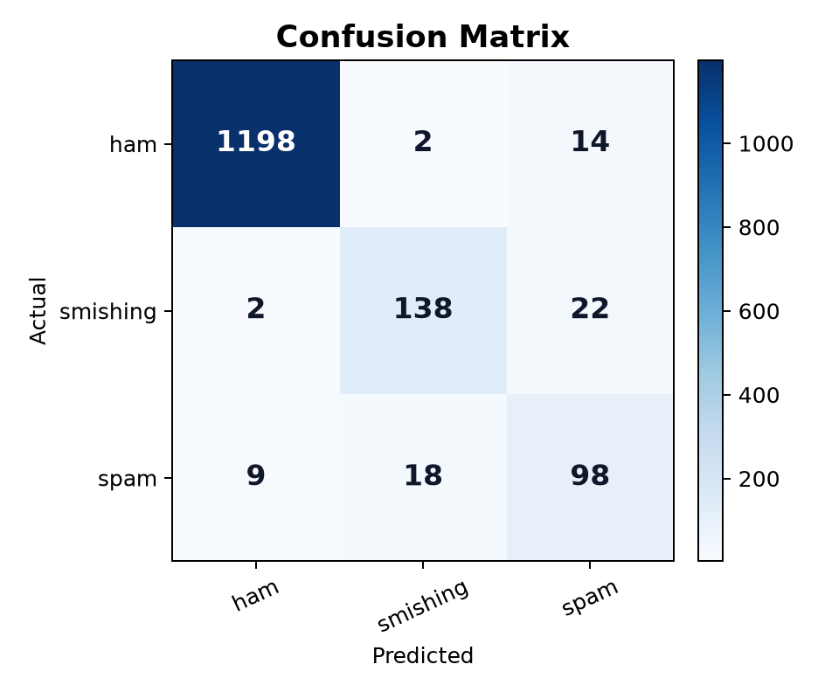
Evaluation snapshot and what we optimize
Évaluation et objectif d’amélioration
96%
87%
87%
87%
0
Accuracy
Macro precision
Macro recall
Macro F1
Missed scams in test
Exactitude
Précision macro
Rappel macro
F1 macro
Scams ratés au test
How we will improve after adding real data
Optimize recall for smishing: missing a scam is more dangerous than a false alarm.
Use stratified train/test split and class-by-class error review.
Add Cameroon-specific examples: Mobile Money, school fees, parcel delivery, fake grants.
Calibrate thresholds for “high risk” warnings.
Note: current metrics and charts are regenerated after training, so this slide reflects the latest model artifacts.
CGIS · Yaoundé Girls in STEAM Hackathon · SMS Scam Detector
8

Slide 9
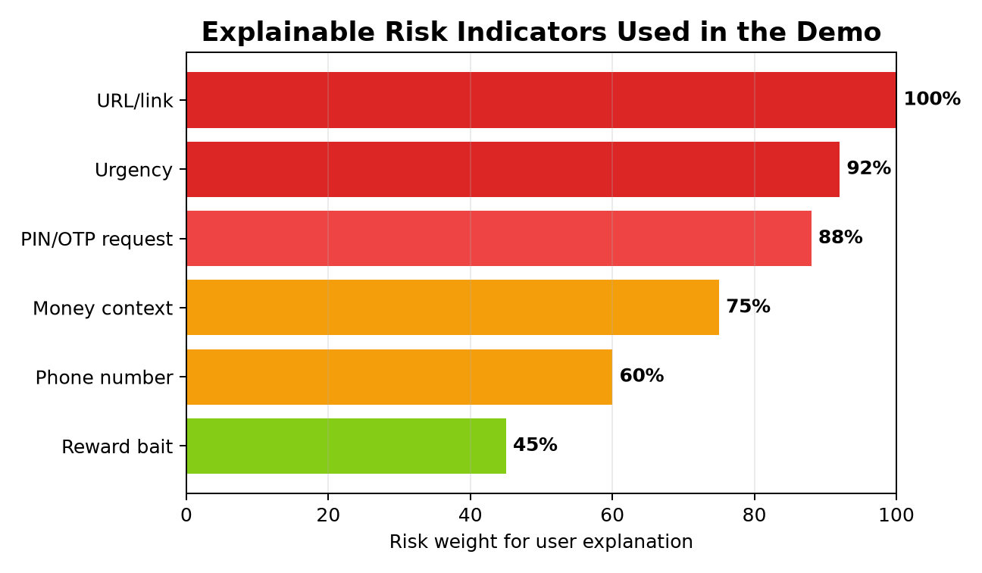
Explainability is our trust advantage
L’explicabilité est notre avantage de confiance
Example output
Sortie exemple
Ne pas cliquer, vérifier officiellement
Prediction: SMISHING · Confidence: 91% · Action: do not click, verify through official channel.
Why flagged
Pourquoi
Lien + urgence + compte
Contains a link, urgency, account-pressure language and money/account context.
Why judges should care
Pourquoi c’est fort
IA + éducation cyber
This turns AI from a hidden score into a cyber-awareness coach.
Winning point: We are not only detecting scams — we are teaching people how scams work.
Point gagnant: nous ne faisons pas seulement une prédiction, nous formons les utilisateurs aux réflexes cybersécurité.
CGIS · Yaoundé Girls in STEAM Hackathon · SMS Scam Detector
9

Slide 10
Product experience: designed for real users
Expérience produit: pensée pour les vrais utilisateurs
UX
Simple interface
🎨
Clear colors
Incoming SMS / SMS reçu
Interface simple
Couleurs claires
Text box, sample messages and one-click analysis. No technical knowledge needed.
Green for safe, amber for spam, red for smishing. The risk is visible instantly.
Votre compte sera suspendu. Confirmez ici: http://banque-verif.net
Aucune expertise requise
Risque visible
CM
Local examples
💾
Offline backup
Exemples locaux
Backup hors ligne
HIGH RISK
French and English messages with Mobile Money and Cameroon-relevant scams.
Model artifacts are saved; demo can run from a clean environment without internet.
FR/EN Cameroun
Démo sécurisée
Accessibility next step
Conseils vocaux et bilingues
Prochaine accessibilité
Add voice guidance and simple French/English safety tips for younger users and families.
CGIS · Yaoundé Girls in STEAM Hackathon · SMS Scam Detector
10

Slide 11
Impact plan: from hackathon demo to community protection
Plan d’impact: de la démo à la protection communautaire
👥
Target users
🏫
Pilot channel
📊
Success metrics
🤝
Partners
Utilisateurs
Canal pilote
Métriques
Partenaires
Students, parents, small business owners, Mobile Money users.
CGIS workshops, school clubs, campus cybersecurity awareness.
Scam recall, false alarm rate, user understanding, demo adoption.
Schools, women in STEAM groups, telecom/cybersecurity mentors.
Élèves, familles, commerçantes
Ateliers et clubs
Rappel, faux positifs, adoption
Écoles, mentors, télécoms
Why this fits CGIS
Pourquoi CGIS
STEAM: data science + app design + social impact.
Leadership: young women solving a local cyber problem.
Entrepreneurship: can become a safety product, training tool or API.
Compétences techniques visibles.
Projet utile immédiatement.
Message fort: les filles construisent la cybersécurité locale.
CGIS · Yaoundé Girls in STEAM Hackathon · SMS Scam Detector
11

Slide 12
Roadmap: realistic next steps
Feuille de route: prochaines étapes réalistes
Today
7 days
14 days
30 days
Aujourd’hui
7 jours
14 jours
30 jours
Live demo + explainability
Add verified dataset + more local examples
Threshold tuning + French/English evaluation
Pilot awareness session at a school/club
Démo + explications
Données vérifiées + local
Seuils + évaluation FR/EN
Pilote école/club
Technical backlog
Impact backlog
Model comparison: Logistic Regression vs SVM vs Naive Bayes
Better calibration for high-risk warnings
Continuous update with new scam patterns
Bilingual user education cards
Offline deployment package
Partner feedback from cyber mentors
CGIS · Yaoundé Girls in STEAM Hackathon · SMS Scam Detector
12

Slide 13
Final ask
Help us turn SMS safety into a habit.
With better data, mentorship and field testing, this prototype can become a practical cyber-safety assistant for communities in Cameroon.
Avec plus de données, de mentorat et de tests terrain, ce prototype peut devenir un assistant de prévention utile pour les communautés au Cameroun.
✓
What we built
→
What we need
!
Why now
Ce que nous avons construit
Ce dont nous avons besoin
Pourquoi maintenant
Model + app + explanations + demo script.
Data access, cyber mentors and pilot users.
Scams evolve fast; education must be fast too.
Modèle + app + explications
Données + mentors + pilotes
Les arnaques évoluent vite
Thank you · Merci · Questions?

