Slide 1



2ND HACKATHON CAMEROONIAN GIRLS IN STEAM · GIRLS IN CYBER DEFENSE
PhishLense
A prototype for detecting smishing now, expanding next to phishing links, websites, and deepfakes.
👥 Team: Genesys · Challenge: Girls in Cyber Defense · Members: Serge, Noel, Scripture, Aliya
WITH THE SUPPORT OF OUR PARTNERS
Notes:
Annoncez le nom du projet, votre slogan, votre équipe et le défi choisi. 20 secondes maximum.

Slide 2
01 · THE PROBLEM
The problem we are solving
⚠️ Phishing has moved beyond email — into SMS, links, fake websites, and deepfakes.
Users react fast, because scam messages look urgent, familiar, or trusted.
In Cameroon, online scams and phishing continue to cause major financial losses.
💸 A striking figure:
1.027 billion CFA
lost to online scams in Cameroon in 2025.
2nd Hackathon Cameroonian Girls in STEAM · Girls in Cyber Defense
⏱ ≈ 45 s
Notes:
Rendez le problème concret et humain. Un chiffre marquant capte l'attention du jury.

Slide 3
02 · THE SOLUTION
Our solution
💡 In one sentence:
PhishLense is a working cybersecurity prototype that detects smishing messages and is designed to grow into phishing link and deepfake detection.
🔔 Benefit 1:
Warns users before they click, reply, or share sensitive information.
🎯 Benefit 2:
Gives a label, a confidence score, and a simple explanation.
🙌 Benefit 3:
Built for real users, not only for technical demonstrations.
2nd Hackathon Cameroonian Girls in STEAM · Girls in Cyber Defense
⏱ ≈ 45 s
Notes:
Une phrase claire vaut mieux qu'un long discours. Mettez en avant 3 bénéfices concrets.

Slide 4
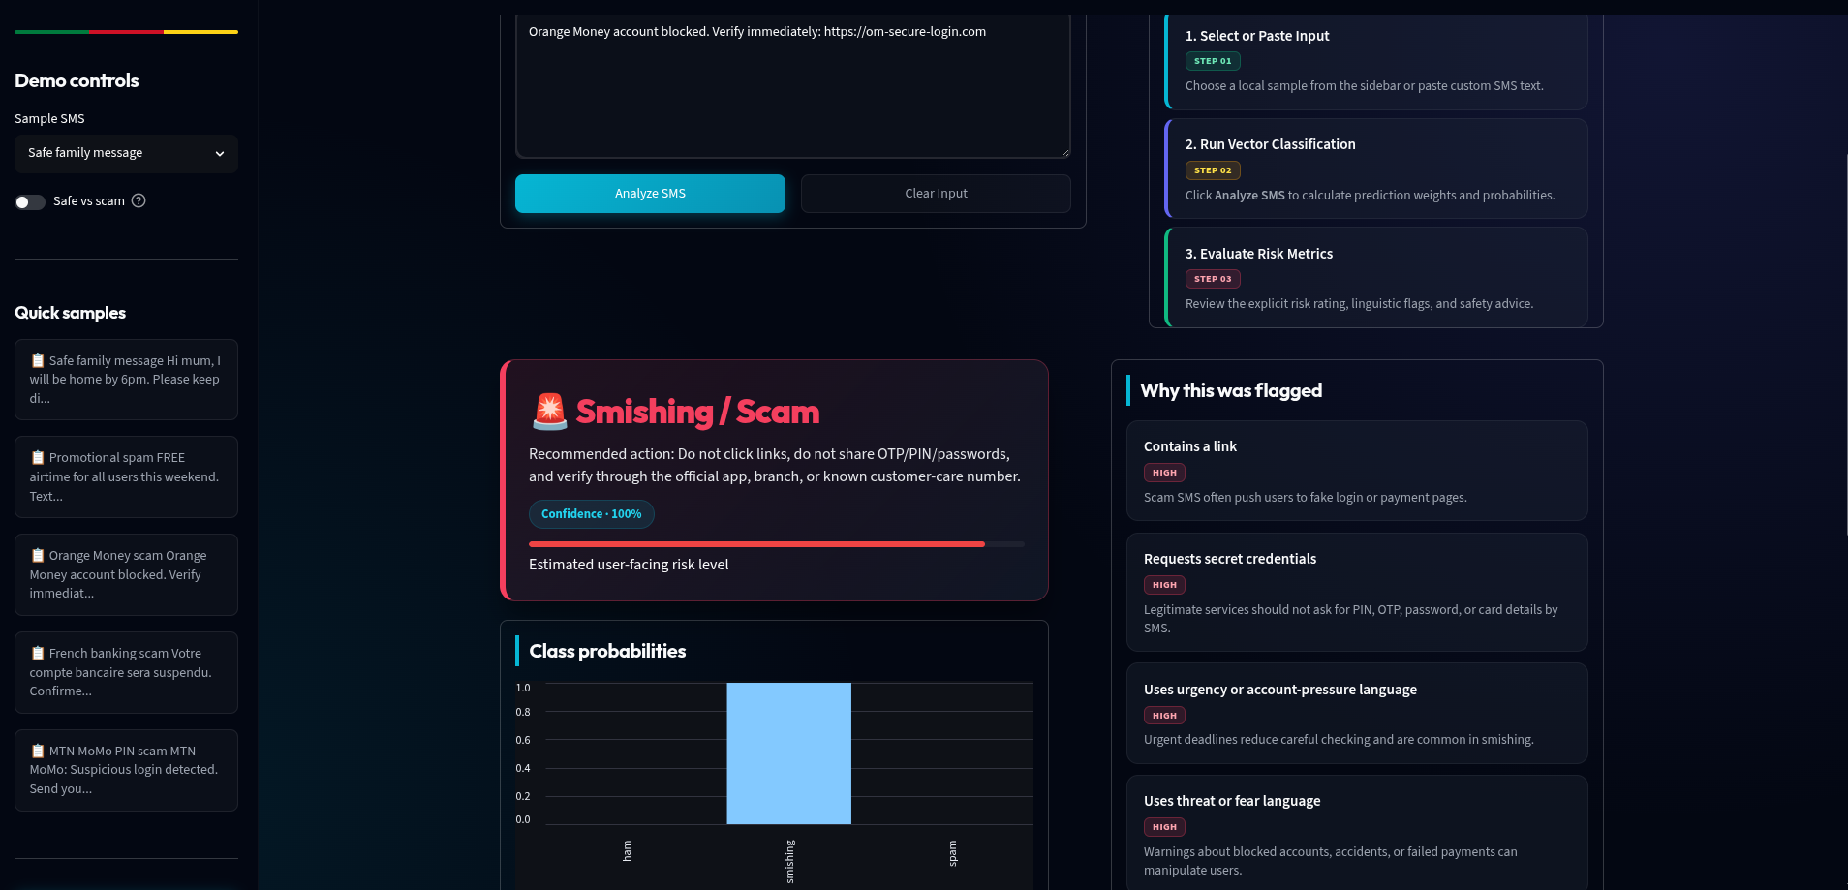


03 · DEMONSTRATION
Here is our prototype
The highlight moment
Paste a message.
Show the prediction.
Show the explanation.
Use the backup screenshot if needed.
[ Insert a screenshot of your prototype
or switch to a live demo ]
2nd Hackathon Cameroonian Girls in STEAM · Girls in Cyber Defense
⏱ ≈ 90 s
Notes:
C'est le cœur du pitch. Préparez un parcours de démo fluide et une capture d'écran de secours.

Slide 5

04 · THE HEART OF THE HACKATHON
Our cybersecurity component
🔐 AI-based detection flags suspicious SMS, fake URLs, and phishing sites in real time.
Warns users before they click, log in, or send money — stopping social engineering in its tracks.
Explains clearly why a message, link, or site is risky.
Teaches users over time — every alert builds scam awareness.
2nd Hackathon Cameroonian Girls in STEAM · Girls in Cyber Defense
⏱ ≈ 45 s
Notes:
Slide indispensable. Expliquez concrètement votre brique cyber et le bénéfice pour l'utilisatrice. 20 points en dépendent.

Slide 6
05 · MARKET & IMPACT
For whom, and what impact?
👥 For whom?
PhishLense is for mobile users, students, families, and small businesses.
Also built for developers and organizations integrating our API.
This expands the product from a simple app into a reusable security tool.
📈 What impact?
PhishLense warns users before they click, reply, or pay, helping stop scams early.
Clear risk signals teach users to spot scams themselves.
This can reduce fraud, protect money, and improve digital trust in everyday phone use.
2nd Hackathon Cameroonian Girls in STEAM · Girls in Cyber Defense
⏱ ≈ 30 s
Notes:
Montrez que le problème touche beaucoup de monde et que votre impact est réel, y compris sur la sécurité numérique.

Slide 7
06 · MODEL & DIFFERENTIATION
Viable and unique
💰 How is it adopted / funded?
Free app for individuals.
Paid API access for developers and organizations.
Revenue from subscriptions, enterprise licenses, and custom integrations.
This makes PhishLense both a standalone app and a security layer inside other systems.
⭐ What makes you unique?
Trained on Cameroon-relevant data.
Built to support bilingual use.
Detects SMS scams, fake URLs, phishing websites, and future deepfake threats.
Helps users learn by explaining why content is suspicious.
2nd Hackathon Cameroonian Girls in STEAM · Girls in Cyber Defense
⏱ ≈ 30 s
Notes:
Un modèle simple et crédible suffit. Dites clairement ce qui vous différencie.

Slide 8

07 · THE TEAM
Who we are
Serge
Coordinator
Noel
Developer
Scripture
Model Training
Aliya
Data Mining
2nd Hackathon Cameroonian Girls in STEAM · Girls in Cyber Defense
⏱ ≈ 20 s
Notes:
Présentez rapidement chaque membre et son rôle. Ajoutez ou retirez des cartes selon la taille de l'équipe.

Slide 9
08 · OUR ASK
Thank you!
🤝 We're seeking mentoring, partnership, incubation, and support to grow this prototype into a real product.
Contact: phishlense@gmail.com · +237671160734
WITH THE SUPPORT OF OUR PARTNERS
Notes:
Terminez par une demande claire et un vrai merci. C'est votre dernière impression : soignez-la.

