Slide 1
🚚
RISK
RouteGuard AI
Operational decision layer
Supply Chain Disruption &
Fleet Utilisation Optimizer
ROUTES
Operational decision layer
An end-to-end decision-support prototype for disruption-aware logistics operations.
FLEET
Operational decision layer
Team QuadraMind
COLD CHAIN
AI Track | Python + Streamlit + IBM watsonx.ai + IBM Bob
Operational decision layer
PROOF OF CONCEPT

Slide 2
The problem
02
Why disruption management needs a unified decision layer
⚠
Disruptions cascade
↔
Fleet imbalance
❄
Cold-chain exposure
Weather events, port strikes and geopolitical delays can affect multiple shipments and routes at once.
Some assets may remain underutilised while alternative routes and regions become overloaded.
Temperature excursions can turn a logistics delay into product-loss and delivery risk.
Operational teams need answers to four questions:
• Which shipments need attention first?
• What safer route or alternative should be considered?
• Which idle assets can be redeployed?
• Are any temperature-sensitive shipments already at risk?
RouteGuard AI • QuadraMind • IBM Bobathon

Slide 3
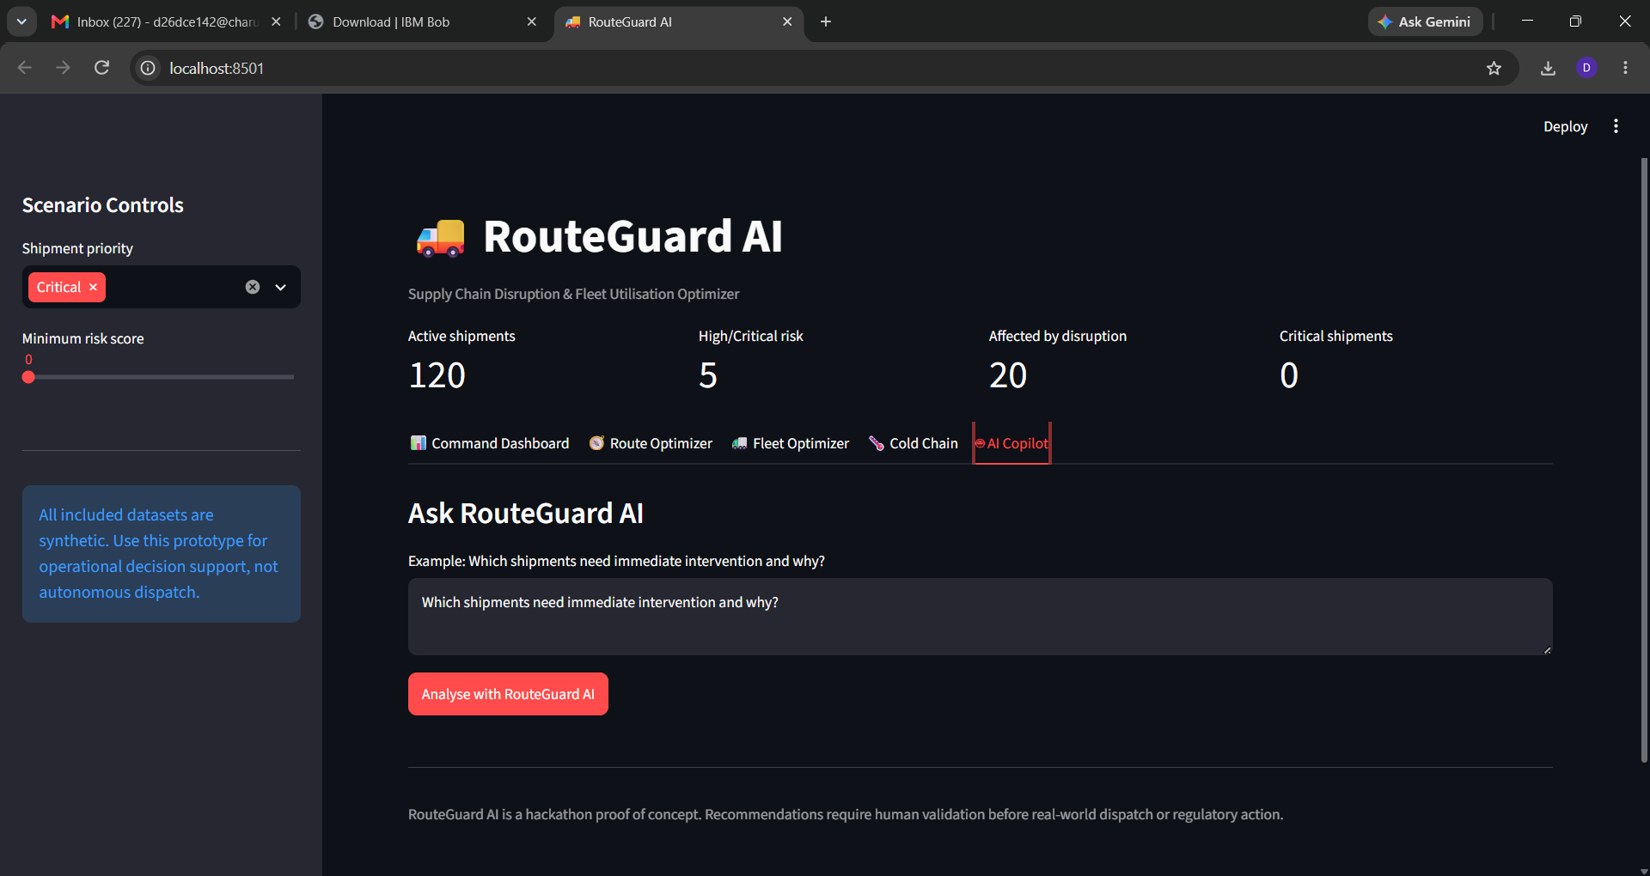
Our solution
03
RouteGuard AI brings the operational picture into one interactive dashboard
Five connected capabilities
01
Shipment risk
Prioritises active shipments using disruption and operational risk signals.
02
Route optimizer
Ranks alternative routes with disruption-aware scoring.
03
Fleet optimizer
Finds underutilised assets and suggests redeployment opportunities.
04
Cold-chain monitor
Detects temperature excursions and classifies severity.
05
AI Copilot
Uses IBM watsonx.ai for natural-language operational explanations.
RouteGuard AI • QuadraMind • IBM Bobathon

Slide 4
High-level architecture
04
Modular Python services behind a Streamlit interface
Streamlit UI
src/app.py
Data Loader
CSV datasets
Risk Engine
risk_engine.py
Route Optimizer
route_optimizer.py
Fleet Optimizer
fleet_optimizer.py
Cold Chain
cold_chain.py
AI Copilot
ai_copilot.py
IBM watsonx.ai
Synthetic CSV data keeps the prototype reproducible and locally runnable.
RouteGuard AI • QuadraMind • IBM Bobathon

Slide 5
Operational workflow
05
From disruption signals to actionable recommendations
1
2
3
4
5
Load
Score
Optimize
Monitor
Explain
Shipments, fleet, routes, disruptions and cold-chain readings
Calculate shipment risk and identify disruption-affected operations
Compare route alternatives and underutilised fleet assets
Detect temperature excursions and severity
Ask the AI Copilot for a prioritised operational summary
Decision-support, not autonomous dispatch
Recommendations are intended for human validation before real-world operational action.
RouteGuard AI • QuadraMind • IBM Bobathon

Slide 6
Shipment risk & disruption
06
Prioritise the shipments most exposed to active disruptions
120
5
20
0
Active shipments
High / Critical risk
Affected by disruption
Critical shipments in shown filter
Example priority view
Active disruption context
The dashboard surfaces shipment IDs and risk levels so an operator can focus on the most urgent interventions first.
Disruptions are represented with type, location, severity and affected route information, creating context for downstream decisions.
Demo dataset is synthetic and designed for repeatable evaluation.
RouteGuard AI • QuadraMind • IBM Bobathon

Slide 7
Disruption-aware route optimization
07
Prefer safer alternatives while balancing time and cost
🧭
Example: Ahmedabad → Delhi
✓
Recommended: R-002-B
↗
Alternative: R-002
RouteGuard compares candidate routes and incorporates disruption risk into the ranking.
496 km • 7.3 h • ₹18,405 base cost • effective risk 0.052
459 km • 8.0 h • ₹15,111 base cost • effective risk 0.3515
Illustrative route scoring
R-002-B
0.860
R-002
0.480
The optimizer is a transparent heuristic prototype rather than a commercial routing engine.
RouteGuard AI • QuadraMind • IBM Bobathon

Slide 8
Fleet utilisation optimizer
08
Turn idle capacity into redeployment opportunities
3
VH-021
VH-010
VH-023
Assets below 35% utilisation
Vessel • Lucknow • 17%
Vessel • Lucknow • 32%
Truck • Chennai • 32%
Suggested redeployment matches
↻
What this enables
VH-021 → SH-1030
Risk 67.7
Operators can see where utilisation is low and which shipments are candidates for redeployment—without requiring a full fleet management platform.
VH-010 → SH-1015
Risk 66.5
VH-023 → SH-1092
Risk 64.9
RouteGuard AI • QuadraMind • IBM Bobathon

Slide 9
Cold-chain monitoring
09
Detect temperature excursions before delivery risk becomes invisible
77
31
7
4
2–8°C
Sensor readings
Excursions
Major
Critical
Target range
!
Example: SH-1086
!
Example: SH-1006
Recorded temperature: 27.2°C • Deviation: 19.2°C • Classification: Critical
Recorded temperature: 12°C • Deviation: 4°C • Classification: Major
Prototype severity classification should be validated against operational and regulatory thresholds before production use.
RouteGuard AI • QuadraMind • IBM Bobathon

Slide 10
IBM watsonx.ai Copilot
10
Natural-language explanations grounded in the application's current results
AI
Ask in plain language
↳
Grounded context
✓
Human-in-the-loop
Example: “Which shipments need immediate intervention and why?”
The Copilot receives relevant operational results from RouteGuard before generating its explanation.
The output is a decision-support aid—not an autonomous dispatch instruction.
Copilot flow
RouteGuard results
Prompt
watsonx.ai
Operational explanation
IBM Bob IDE was used as the core development partner during the build.
RouteGuard AI • QuadraMind • IBM Bobathon

Slide 11
Technology stack
11
Practical, transparent components chosen for a fast hackathon prototype
Language
UI
Python
Streamlit
Data
Visualisation
Pandas • NumPy • CSV
Plotly
Optimisation
AI
Custom scoring • NetworkX
IBM watsonx.ai
Development
Testing
IBM Bob IDE
Pytest
No database or external logistics feed is required for the current proof of concept.
RouteGuard AI • QuadraMind • IBM Bobathon

Slide 12
Prototype snapshot
12
Interactive Streamlit dashboard for operational exploration
Command Dashboard
Shipment risk, disruption context and intervention priorities.
Route Optimizer
Compare route alternatives using disruption-aware scoring.
Fleet + Cold Chain
Find idle assets and inspect temperature excursions.
The same application also exposes the AI Copilot tab for natural-language analysis.
RouteGuard AI • QuadraMind • IBM Bobathon

Slide 13
Limitations & next steps
13
What would be required to move from prototype to production
Current limitations
Production roadmap
• Synthetic CSV datasets
• Heuristic route and fleet scoring
• No live GPS, carrier, weather or port feeds
• Cold-chain thresholds require domain validation
• Live logistics and IoT integrations
• Commercial-grade routing constraints
• Capacity, driver-hours and ETA modelling
• Historical data for predictive risk
• Alerts, audit trails and role-based access
Design principle
Keep recommendations explainable, reviewable and grounded in operational data.
RouteGuard AI is a proof-of-concept decision-support system; real-world dispatch requires human validation.
RouteGuard AI • QuadraMind • IBM Bobathon

Slide 14
QuadraMind
Thank you
RouteGuard AI
Supply Chain Disruption & Fleet Utilisation Optimizer
Team
• Patel Yug Bhaveshkumar — Team Lead
• Nishil Niraj Patwa
• Rishit Shailendrabhai Pitroda
• Krishn Shaileshbhai Padhariya
AI Track • IBM watsonx.ai • IBM Bob IDE
Decision support for resilient logistics.
QuadraMind

