Slide 1
SAFETYLENS
See the fall.
Start the response.
Workplace fall detection and guided incident response for factories and warehouses.
LOCAL DETECTION
Fast, private, token-free sensing
90-SECOND PITCH
Notes:
SafetyLens monitors workplace video for falls, then helps teams move from detection to a clear, reviewable response.

Slide 2
THE PROBLEM
Falls still create costly, time-sensitive emergencies
479,480
844
8 days
fall, slip and trip cases
involving days away from work
fatal workplace falls, slips
and trips in 2024
median time away from work
across serious cases
The gap is not only seeing a fall—it is getting the right people to act quickly and consistently.
SAFETYLENS / 02
Source: U.S. Bureau of Labor Statistics, 2024
Notes:
Falls remain a serious workplace problem. In 2024, BLS recorded 479,480 fall, slip and trip cases involving days away from work and 844 fatal incidents. Across days-away cases, the median was eight days.
Sources:
https://www.bls.gov/iif/latest-numbers.htm
https://www.bls.gov/iif/fatal-injuries-tables/fatal-occupational-injuries-table-a-7-2024.htm

Slide 3
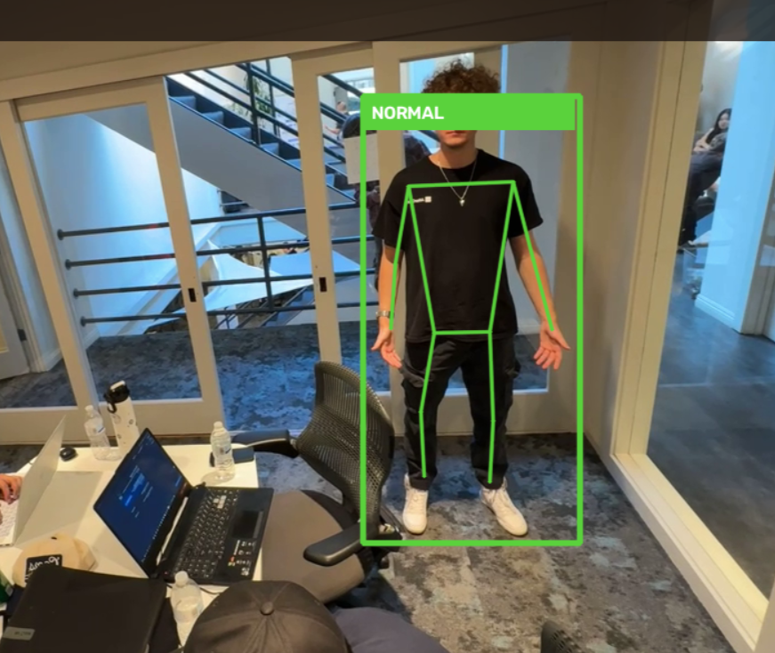
OUR SOLUTION
A simple path from live video to action
01
Watch
A local pose model monitors the camera feed.
02
Detect
A state machine confirms fall and recovery states.
03
Respond
Evidence, alerts and a reviewable action plan appear.
Core detection runs locally—no per-frame AI API cost.
SAFETYLENS / 03
Notes:
SafetyLens watches a live feed locally, confirms a fall through pose and time-based state logic, and gives the operator evidence plus a clear response workflow. Deeper AI analysis is optional and only runs after an event.

Slide 4
THE MARKET
Start where every second—and every incident—matters
CONSTRUCTION
INITIAL WEDGE
389
fatal falls / slips / trips
Factories +
warehouses
TRADE + TRANSPORT
104
fatal falls / slips / trips
Fixed cameras, active floors and clear escalation procedures make these sites a focused starting point.
MANUFACTURING
52
fatal falls / slips / trips
Expand by site, then by hazard.
Adjacent markets use the same core: camera sensing + verified response.
SAFETYLENS / 04
Source: U.S. Bureau of Labor Statistics, 2024
Notes:
Our entry market is factories and warehouses, where fixed cameras and formal response procedures already exist. The same platform can expand to other high-risk workplaces. BLS recorded 389 fatal falls, slips and trips in construction, 104 in trade, transportation and utilities, and 52 in manufacturing in 2024.
Source: https://www.bls.gov/opub/ted/2026/national-safety-stand-down-highlights-fall-hazards-in-construction.htm

Slide 5
WHY SAFETYLENS
Detection is the trigger. Response is the product.
 | SafetyLens | Kami Vision
Built for | Factories + warehouses | Homes + senior care
After a fall | Workplace SOP response | Trusted-contact alert
Human control | Review + approval gates | Caregiver notification
Evidence | Incident evidence + report | Event notification
SafetyLens combines local sensing with the structured workflow after an incident: evidence, policy-grounded next steps, human approval and reporting.
SAFETYLENS / 05
Competitor positioning: official product websites
Notes:
Kami Vision validates the need for camera-based fall detection in home and senior-care settings. SafetyLens focuses on workplace operations and the workflow after detection: local sensing, incident evidence, policy-grounded response steps, human approval and reporting. SafetyLens is a prototype, not a validated production safety system.
Source:
https://kamivision.com/en-us

