Slide 1
Weather Forecast
Professor: Dr. Amit Ganatra
Team: Yug Patel(AU1741017)
Aditya Bajaj(AU1741028)
Shivansh Nautiyal(AU1741037)

Slide 2

01
02
03
04
DATA Analysis
Data Visualisation
Overview
Attributes of data, Mounting the csv file, Shape of data.
Time series data plot,
Average Smoothing, Time Series Decomposition.
Weather Prediction Model
Validating Prediction
Validating Weather Prediction
Baseline model, SARIMAX model

Slide 3

01
DATA Analysis

Slide 4
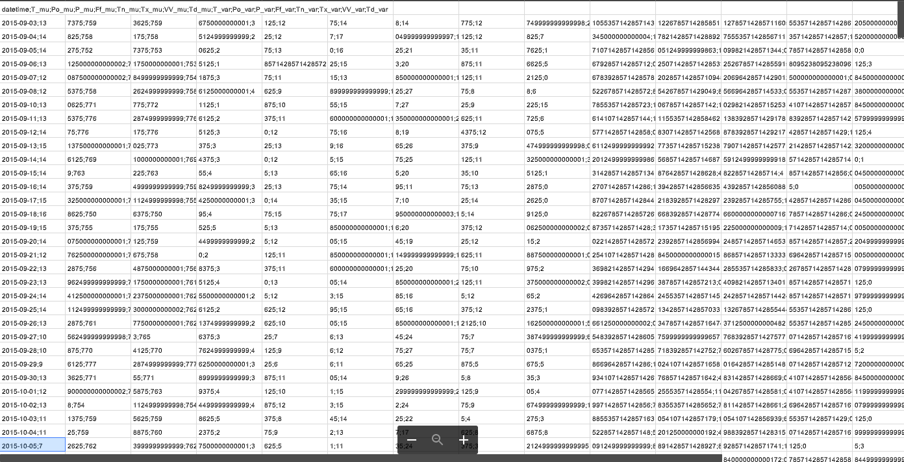
DATA
The dataset has been downloaded from http://rp5.ru/. The data are average daily temperatures collected by the weather station 2978 in Helsinki from September 2015 to May 2019..

Slide 5
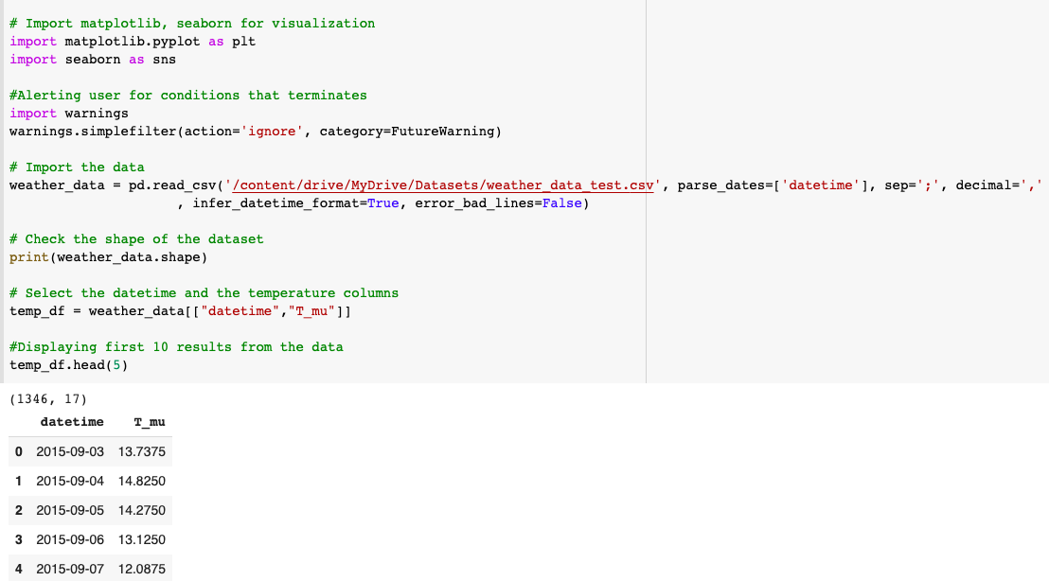
DATA- shape, Attributes
The original data have been resampled by each day and it contains 1346 rows and 17 columns but we are just using 2 columns and 1346 rows for the project; these two columns are “Datetime” and “Temperature”
First column is the index Datetime i which is in the format YYYY-MM-DD and Second column is the index T_mu which shows the average daily air temperature in degree Celsius.

Slide 6
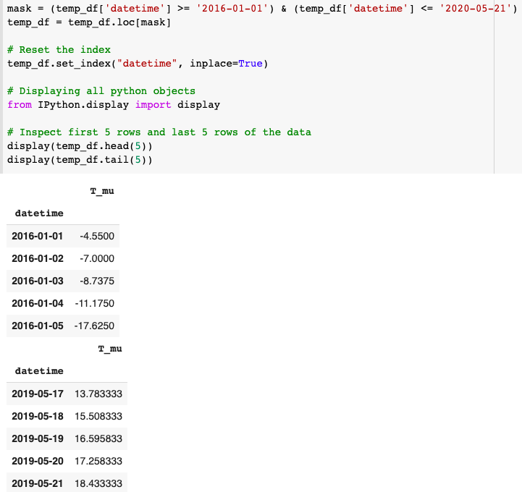
However we are not using the past temperature i.e 2015 as there are factors like gradual rising of temperature due to global warming.
Thus to have best possible analysis and forecast results we have taken subset of date from 2016 to 2019

Slide 7
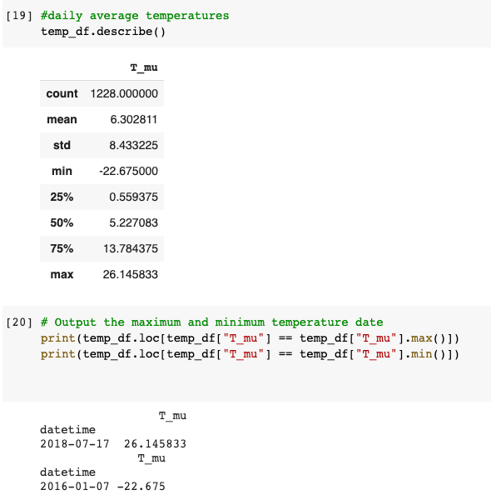
DATA CLEANING
We also removed all the NAN values from the dataset and printed the shape of the data but the results were same.
And we compare and found both have the same values.
For this we have first used python’s inbuilt function data.describe() which tells us the information about the data like mean, count, min, max etc. Here we got the minimum and maximum value.
And in the next step we printed the most minimum and maximum temperature from the column T_mu.

Slide 8

02
Data Visualisation

Slide 9
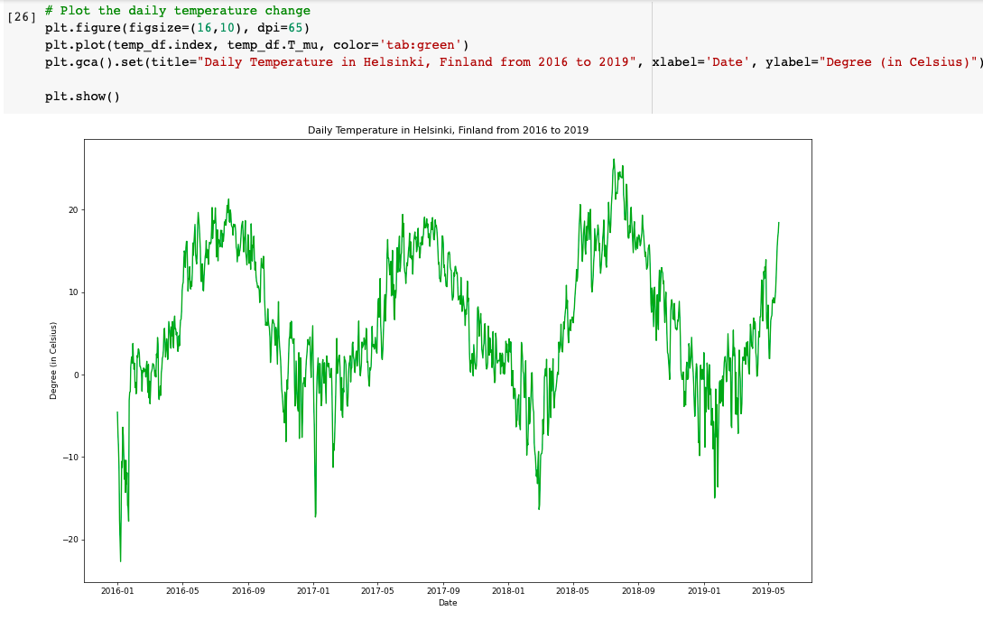
Time Series Data Plot
The figure on the right shows the average daily temperature in Helsinki, Finland from 2016 to 2019.
If we look to the plot we could see that there is minor change between the current date and next date

Slide 10
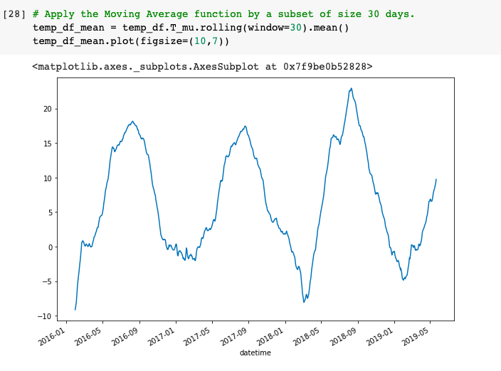
Average Smoothing
As we have seen in the earlier plot that it contains all the daily temperatures resulting into noisy plot.
By doing average smoothing only the main temperature change that are observed can be visualised.

Slide 11
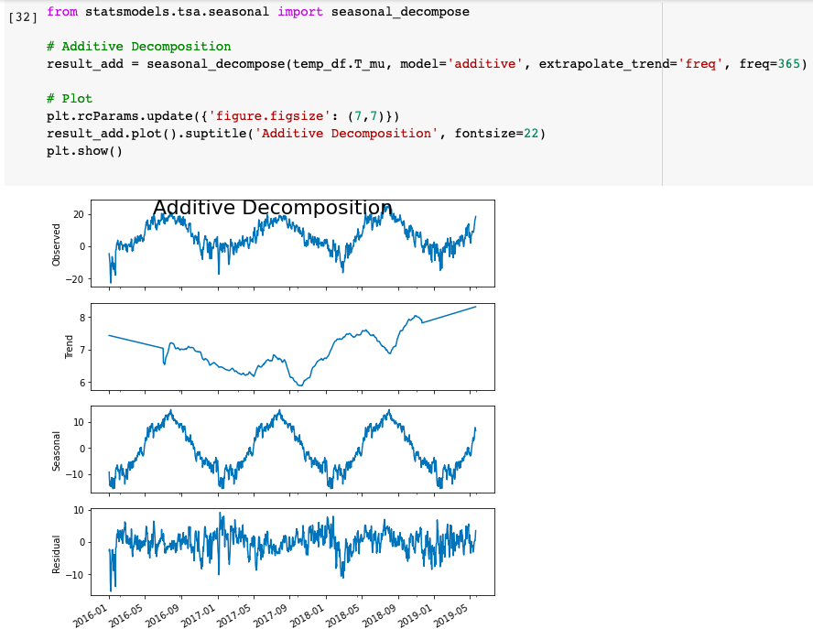
Time Series Decomposition
The time series have seasonality pattern as in earlier plot initially the temperature was low at the beginning of year and high in middle of year.
For this we have visualised our data further by using Time Series Decomposition that decomposed time series into trend, Seasonality and Trend.

Slide 12
03
Weather Prediction Model

Slide 13

Baseline Model
We were very confused on how to move ahead with the process as we had a very large dataset to work with.
To predict the temperature of tomorrow, we didn't need to analyze the data for the span of 4 years.
That would lead us to inaccurate prediction.

Slide 14

So what did we do?
We produced a basic model which used the current temperature as the prediction for the next day.
We used 1-step prediction to model the temperature as a time series.
The air temperature today would depend on the air temperature of yesterday and so on.

Slide 15
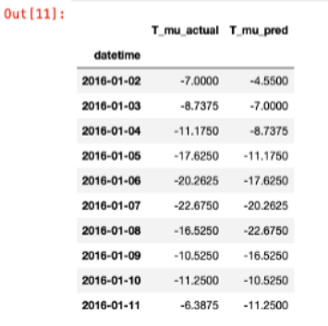
DId it work?
Absolutely!!!
We shifted the current temperature to the next day.
Concatenated the current and predicted temperature.
T_mu_actual represents the actual data and T_mu_pred represents the predicted data.

Slide 16
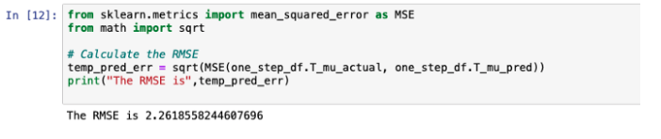
We then calculated the RMSE (Root mean square) to validate our model between the predicted and the actual temperature.
The RMSE that we got was comparatively very small with a value of 2.2 degree celsius.
Considering dealing here with weather, this was acceptable.

Slide 17
Did we stop there?
We wanted to reduce the RMSE and increase the accuracy of our prediction.
Hence, we decided to try another most commonly used model called as Seasonal Autoregressive Integrated Moving Average (SARIMA).
We used grid search to explore different parameters.
We used the Akaike Information criteria to measure our model.

Slide 18
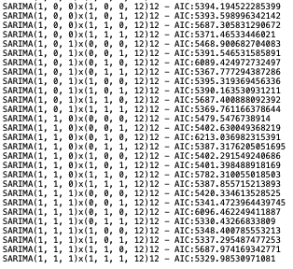
SARIMA has denoted as (p,d,q)(P,D,Q ,s).
So, for each combination of parameters, we have 3x4 combinations.
After analysing the result, we saw that the 12th value of the AIC yielded the lowest value of 5329.98.
We finalised this value (1,1,1)x(1,1,1,12)12.

Slide 19
04
Validating Weather Prediction

Slide 20
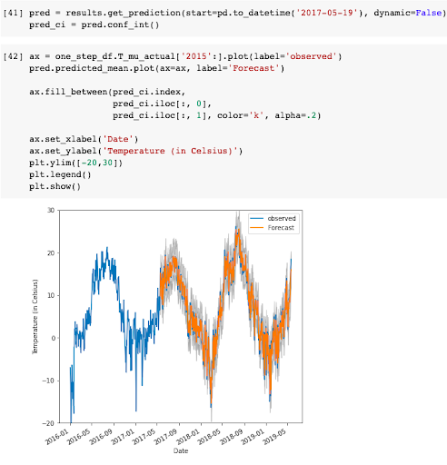
Validating Forecast
We start by validating our predicted values.
We compared our predicted values with the real values.
get_pridiction() and conf_int() used for getting values and confidence interval for the Forecast.
For Understanding accuracy we compared predicted to real temperature

Slide 21
Accuracy of Prediction
Here to find the accuracy of our Prediction we have used RMSE(Root Mean Square Error) method.
For each predicted value we will find its distance from the true value.
Here our RMSE value we obtained was +-2.19 degree Celsius.

Slide 22

Thanks!

