Slide 1

Sprint 1
Desi Hattie

Slide 2
Team Real
Puran Khanal (Project Manager)
Sushil Khadka (Researcher)
Jay Krishna (Programmer)
Keshav Dotel (Project Assistant)

Slide 3
Collaborations
.
.
.

Slide 4

Parbhjeet Kaur
Client

Slide 5
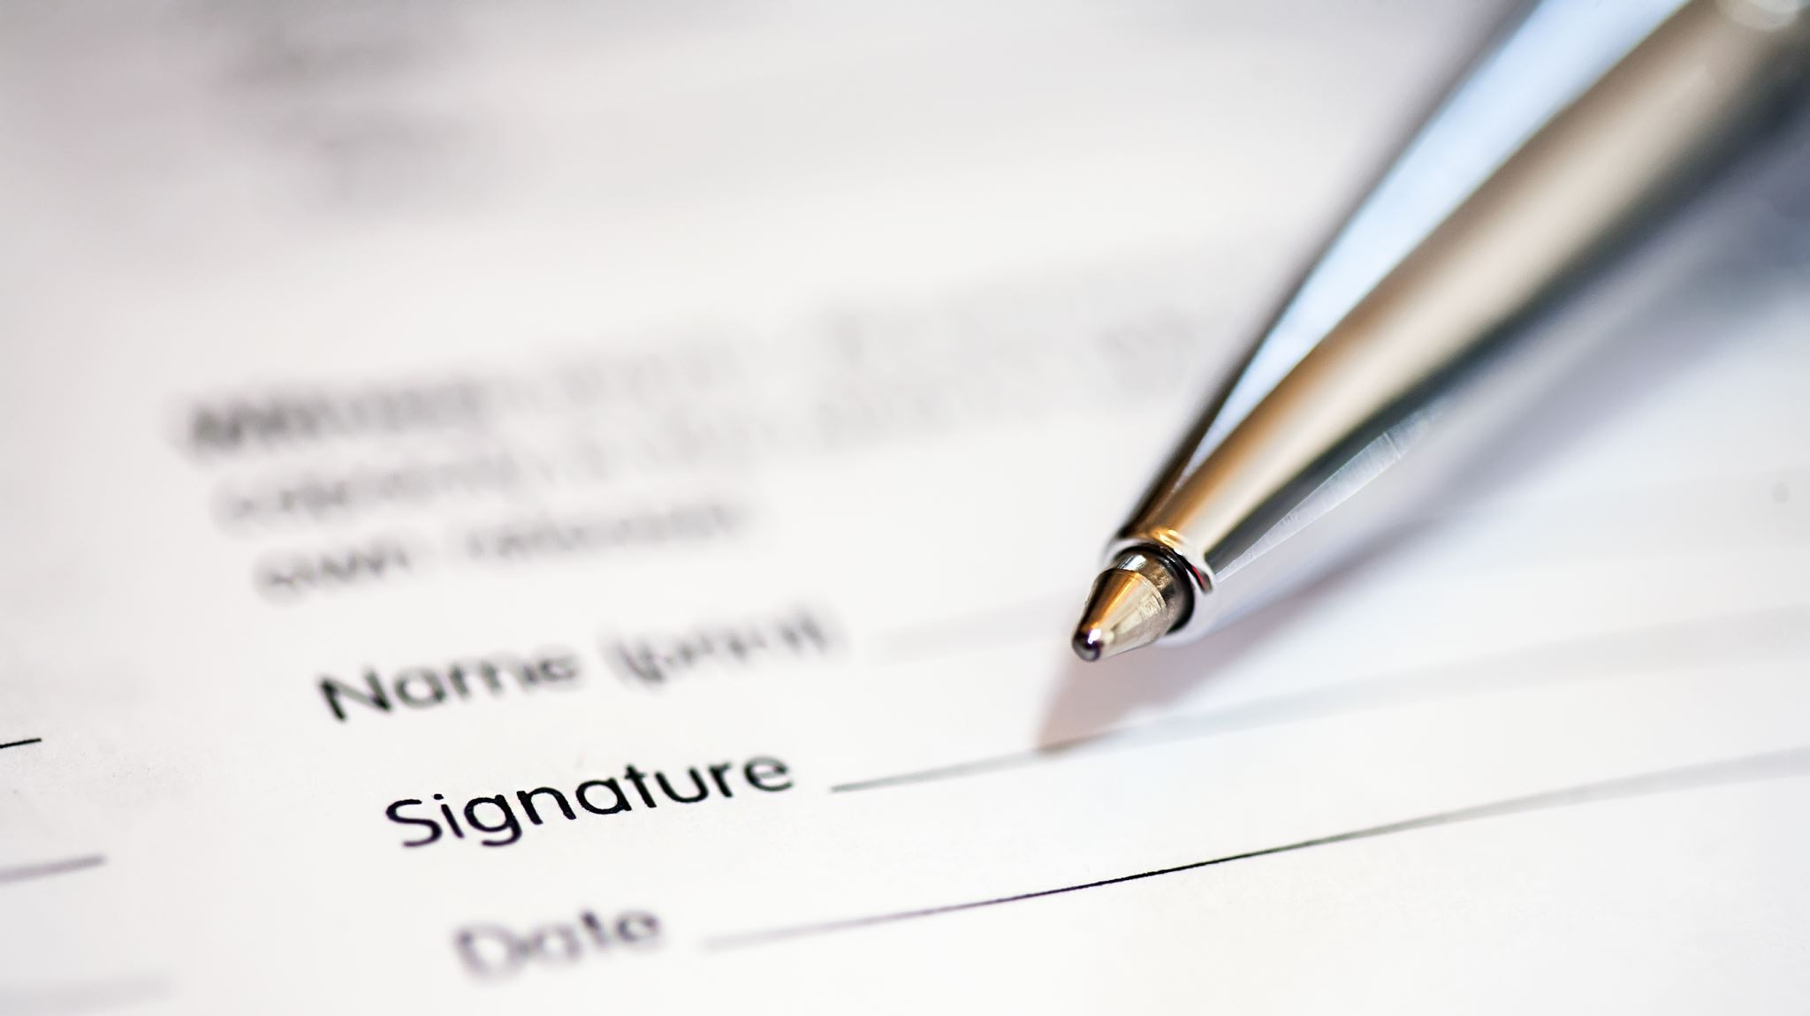
Client Information
Client Name: ‘Desi Hattie’
Owner Name: John Doe
Location: XYZ
Date of Establishment: DD/MM/YYYY

Slide 6
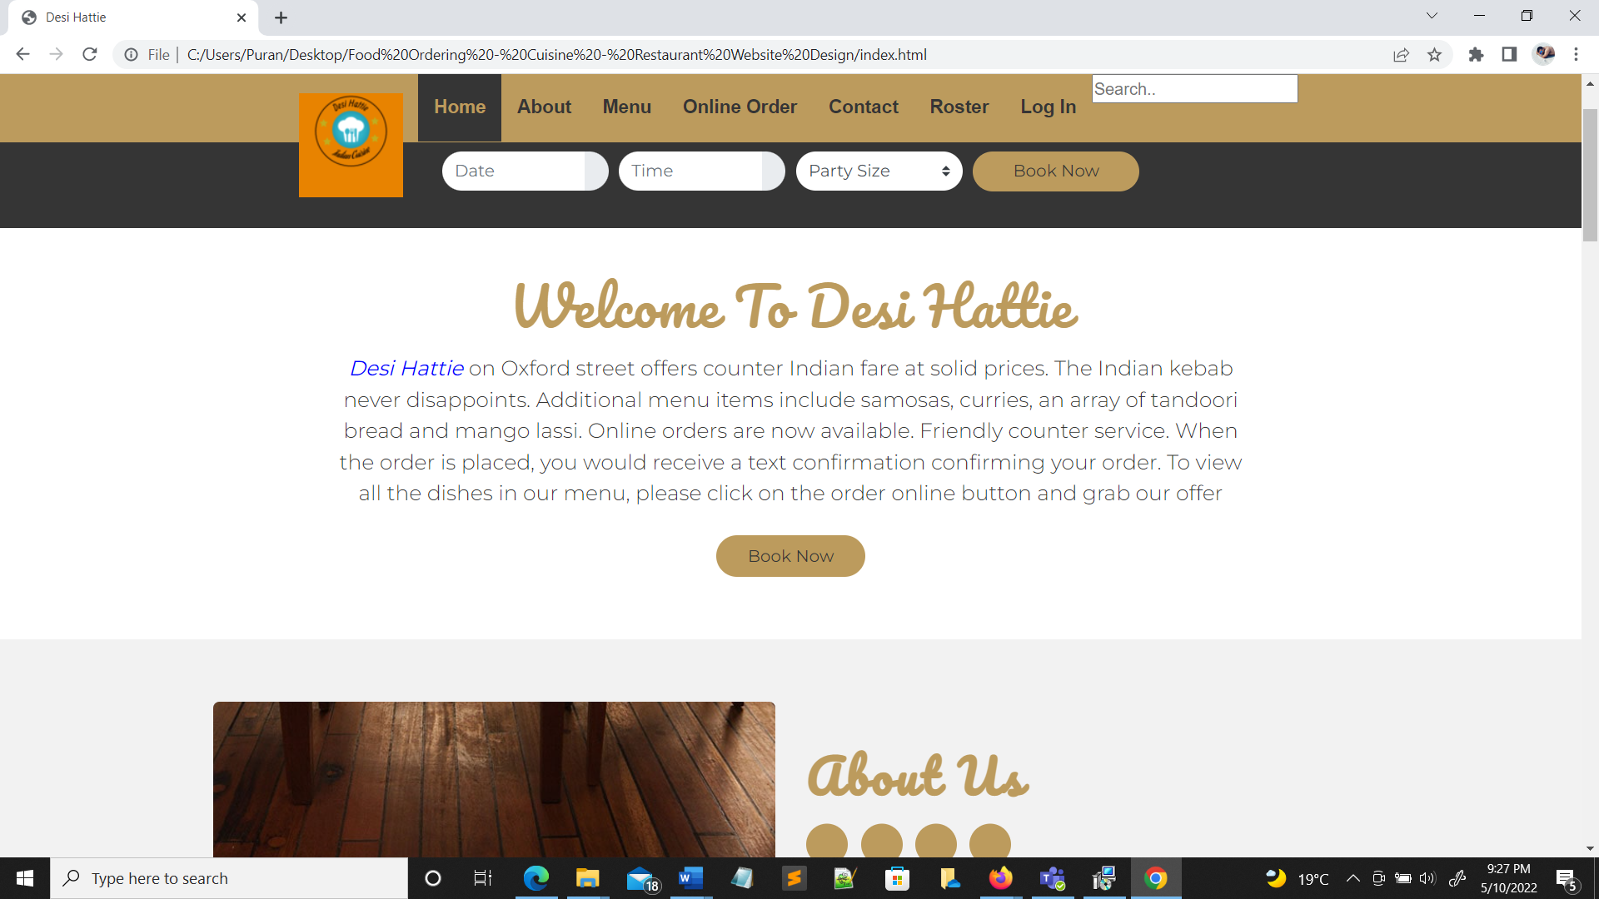
Project Name
Desi Hattie

Slide 7
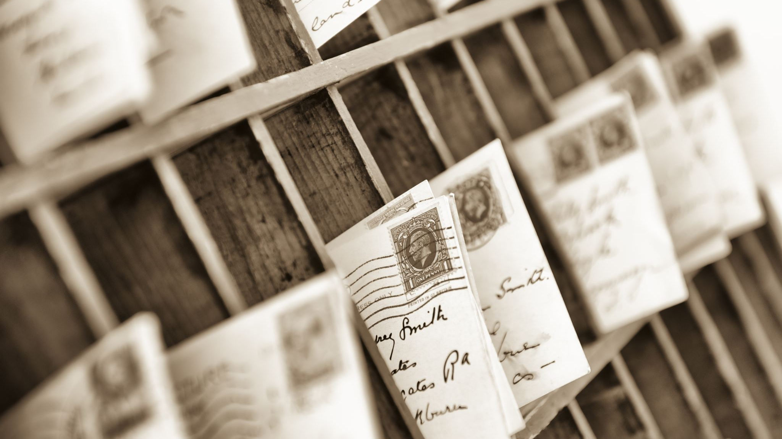
Theme and Wish list

Slide 9
List of User’s Stories Used in Sprint 1
As a user I want to:
Sign up using my personal information.
Login using the personal information.
Look over the restaurant's menu to see what's available.
See the restaurant's location and hours of operation on the internet so that I may plan my visit properly.
Rate the food and service of the Desai Hattie.

Slide 10

Contribution made by Puran Khanal

Slide 13
Contribution made by Sushil Khadka

Slide 16
Contribution made by Jay Krishna Dangi

Slide 19
Contribution made by Keshav Dotel

Slide 23

Demo

Slide 24

Reflection

Slide 25

What went well?
The customer comprehended the demo; thus, everything went smoothly.
During the demo process, team member collaboration was excellent.
Every member of the team completed their allocated responsibilities on time.
Early user story research aided in the timely documentation of the first sprint.
The time estimation was useful in keeping all the projects on track.
Before the demo, the supervisor gave each team member positive comments.

Slide 26

What Could Be Improved?
Supervisor comments should be obtained a few days prior to the demo, hours before.
Each team member should schedule their time such that none of the review sessions are missed.
It is necessary to enhance time management.
The development team should increase their task estimating time so that each task gets the time it deserves.
The scrum master should ensure that all project-related subjects are properly communicated among the team members.
Team meetings should occur at least three times each week.

Slide 27

What Can we do?
We may utilize the offered templates as a starting point for our sprint documentation.
Provide the project manager with our available time so that he may plan team meetings at least three times a week for the project's benefit.
We should not plan any other tasks around the time of the review meeting or team meetings.
Gather as much data as possible for our next sprint iteration.

Slide 28

End

