Slide 1
Surveying NLP Techniques for Question Answering on the SQuAD Dataset
BY
Yugal Garg
Guided By,
Dr. Neha Agarwal

Slide 2
Introduction
The aim of the project is to survey different word embedding techniques and models for question answering system.
How a machine can solve a question answering task such as reading comprehension without the help of human using NLP Techniques.

Slide 3
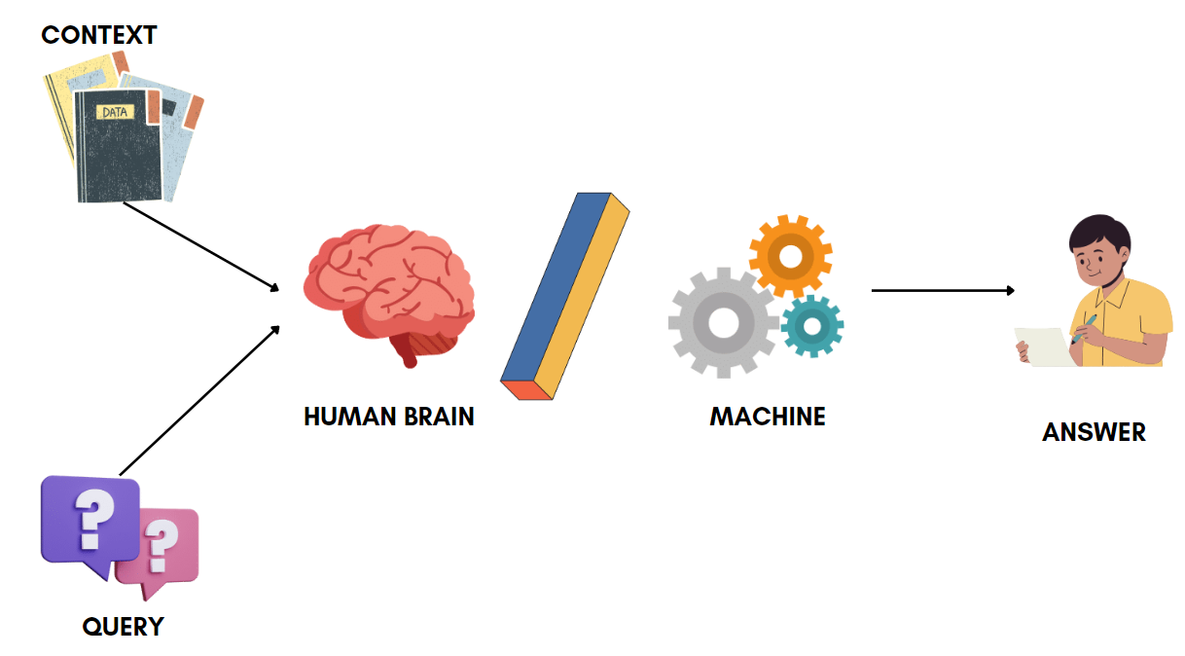
Question Answering
The goal of question answering is to build systems that automatically answer questions posed by human in natural language.

Slide 4
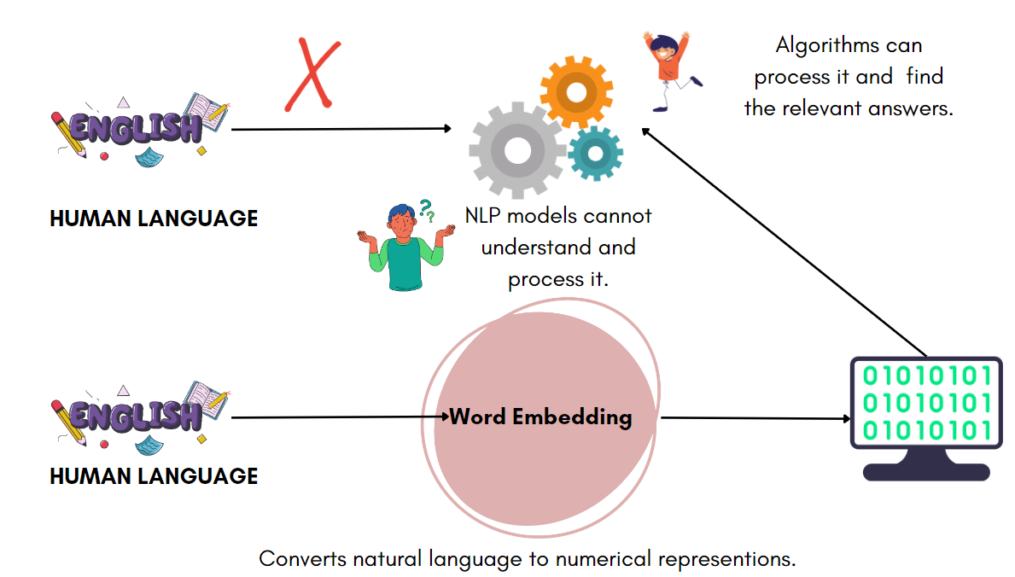
But??

Slide 5
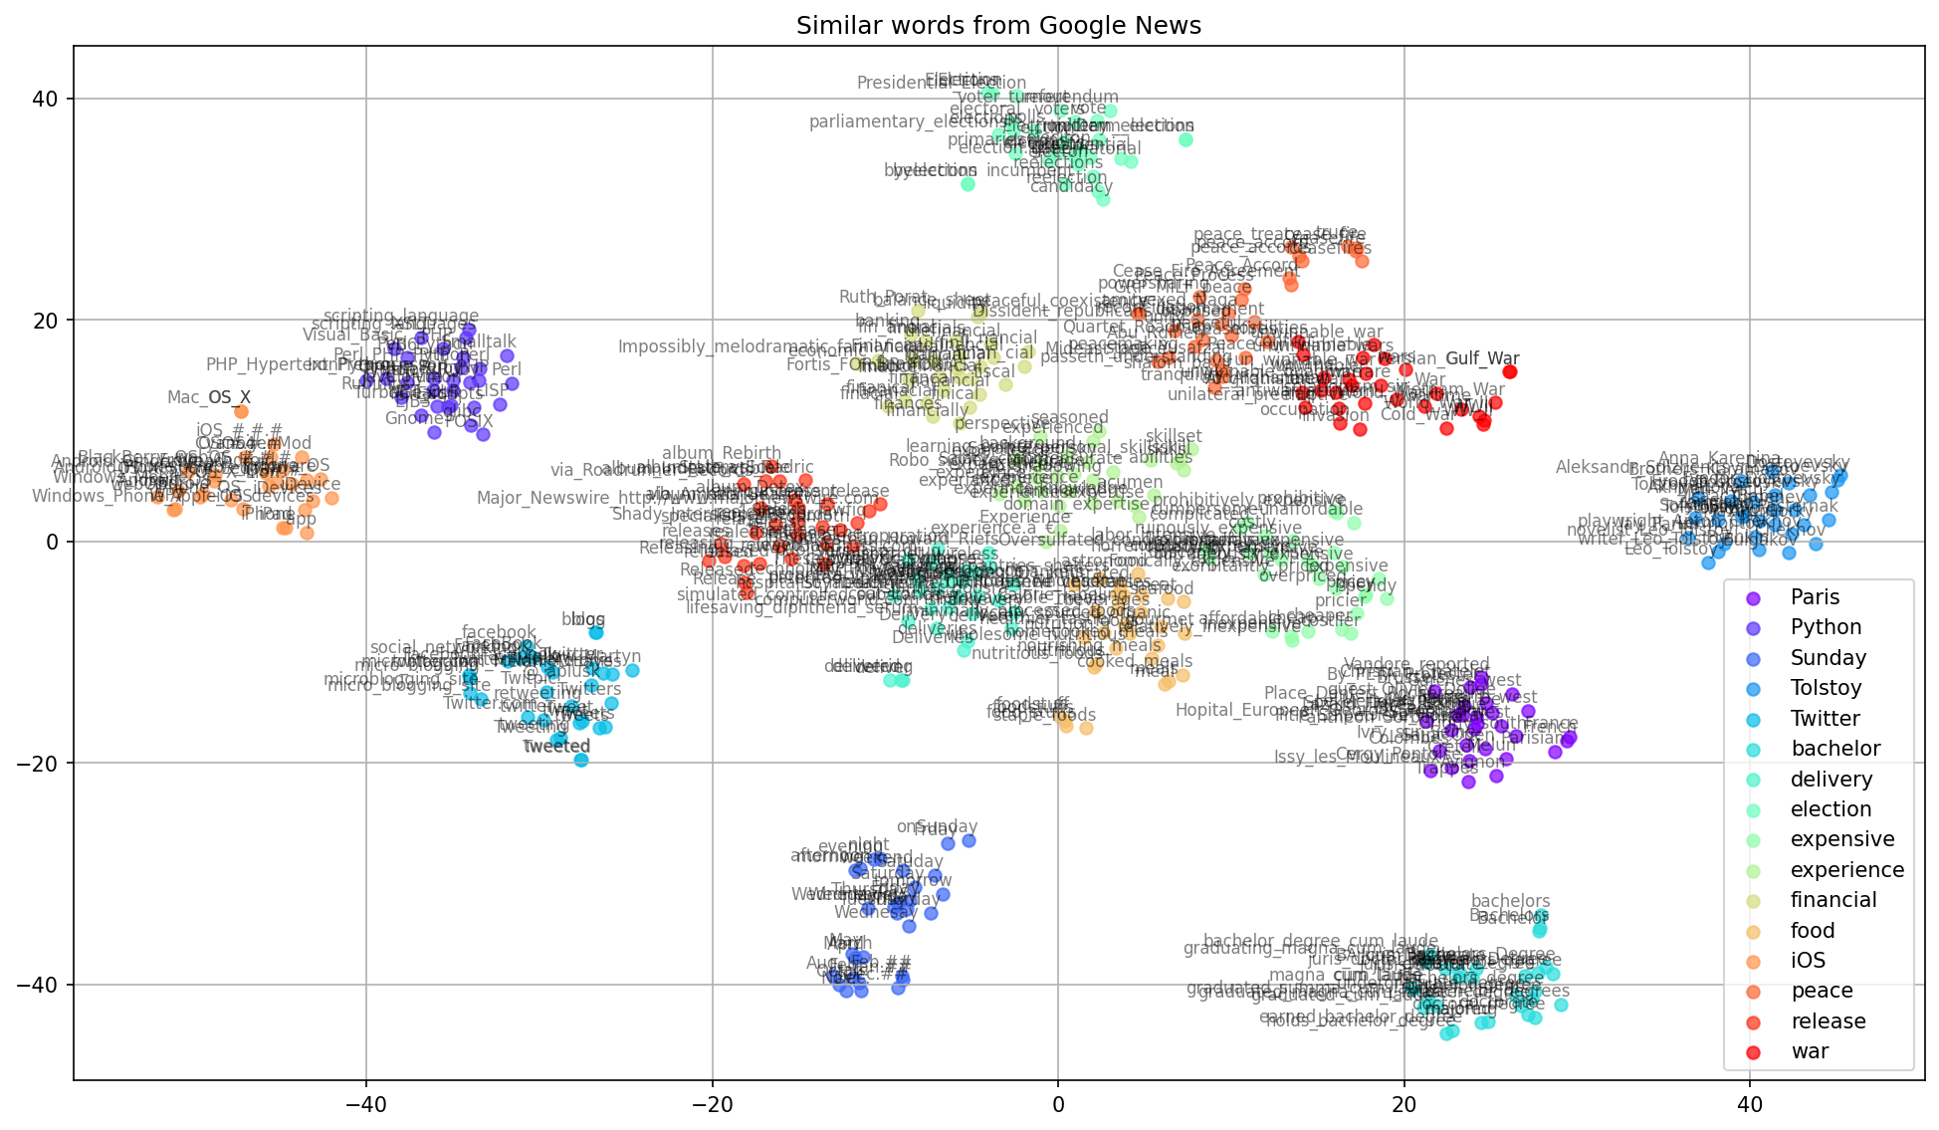
Word Embedding
These are the techniques to represent words in vector/numerical representations which can be interpreted by NLP models.
Different word embeddings techniques:
WordNet
One-hot encoding
TF-IDF
Word2Vec
GloVe

Slide 6
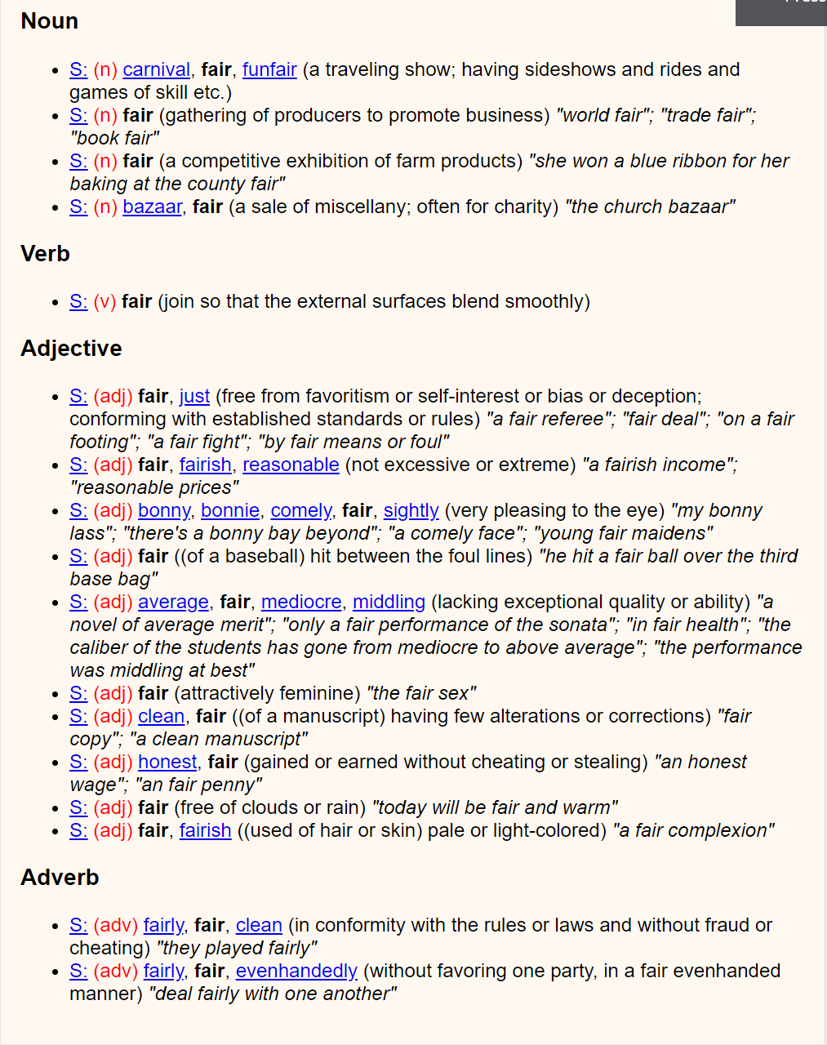
WordNet
It is a regular dictionary, but very large in size and we call it “Lexical Database”.
The interesting part of this dictionary is that it does not provide the meaning of a word instead it groups similar kind of words like “Happy” and “Joyful”.
It keeps word in groups that are connected with each other in different manner make it like a web.
[Ref: WordNet]

Slide 7
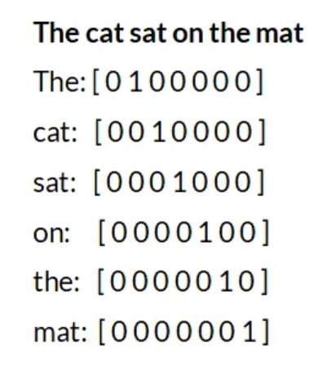
One-hot Encoding
It is just like we are showing categories with the help of binary vectors.
For Example:
Let’s assume we have a category of fruits that includes apples, bananas, and oranges.
We might say that apples are in position 1, bananas are in position 2, and oranges are in position 3.Then, we assign a value of 1 to the position that corresponds to the fruit, and 0 to all the other positions.
[1, 0, 0] -> apples [0, 1, 0] -> bananas [0, 0, 1] -> oranges

Slide 8
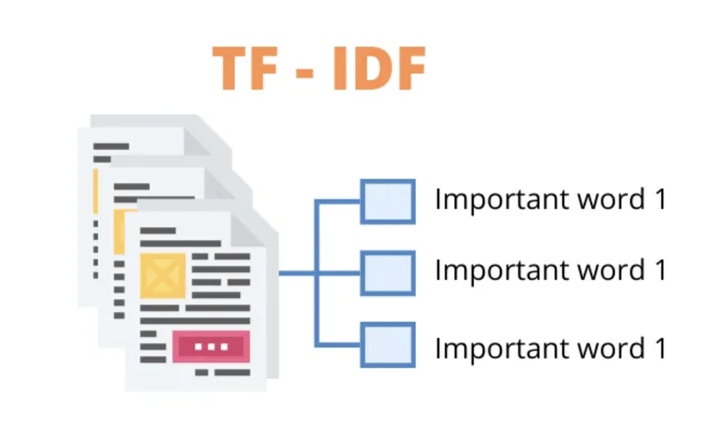
TF-IDF
TF-IDF is a way of measuring how important a word is in a document compared to how important it is in all the other documents.
Lets take a analogy:
"Term Frequency" refers to how often the word "cats" appears in a particular document. The more often it appears, the more important it is in that document.
"Inverse Document Frequency" refers to how rare the word "cats" is across all the documents . If "cats" is a really common word that appears in lots of documents, it's not as important as a more rare word like "Persian cats".
It is a complete statistical model.
[Ref: AnalyticVidya.com]

Slide 9
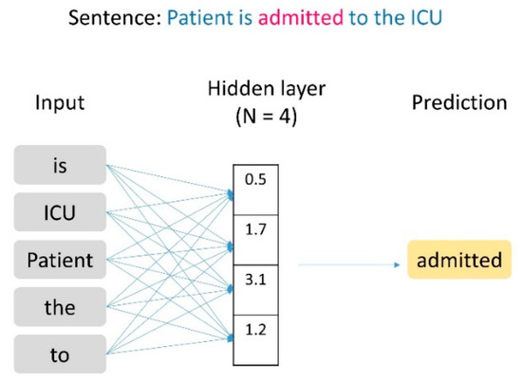
Word2Vec
It uses neural network to generate a “dense vector representation”, which means that it gives each word a special code that's made up of a bunch of numbers.
The interesting thing about this representation is that these codes are organized in a "continuous space", which means that words that are related to each other are located near each other in this space.
[Ref: Word2vec Word Embedding-Based Artificial Intelligence Model by Antonio]

Slide 10
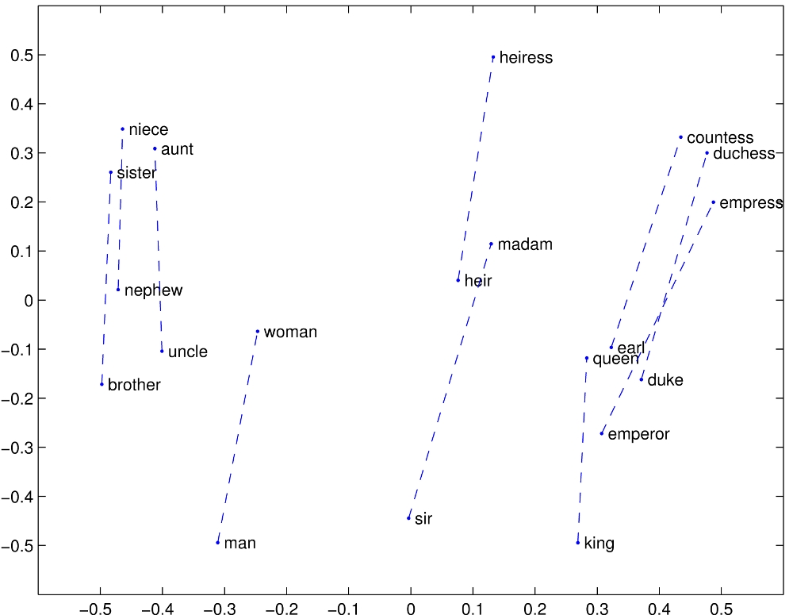
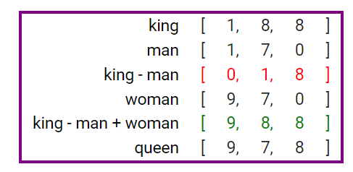
GloVe
GloVe is an unsupervised learning algorithm for obtaining vector representations for words. Training is performed on aggregated global word-word co-occurrence statistics from a corpus, and the resulting representations showcase interesting linear substructures of the word vector space.
[Ref: GloVe]

Slide 11
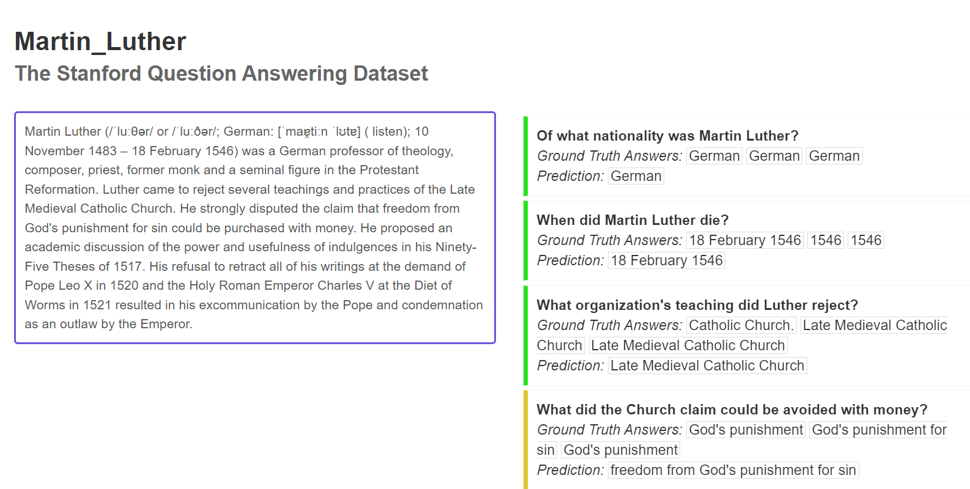
SQuAD Dataset
Stanford Question Answering Dataset (SQuAD) is a reading comprehension dataset, consisting of questions posed by crowd workers on a set of Wikipedia articles, where the answer to every question is a segment of text, or span, from the corresponding reading passage, or the question might be unanswerable.

Slide 12
NLP Models for Question Answering
There are several models for question answering using neural networks, transformers and attention models:
BiDAF -> Bi Directional Attention Flow
BERT -> Bidirectional Encoder Representations from Transform

Slide 13
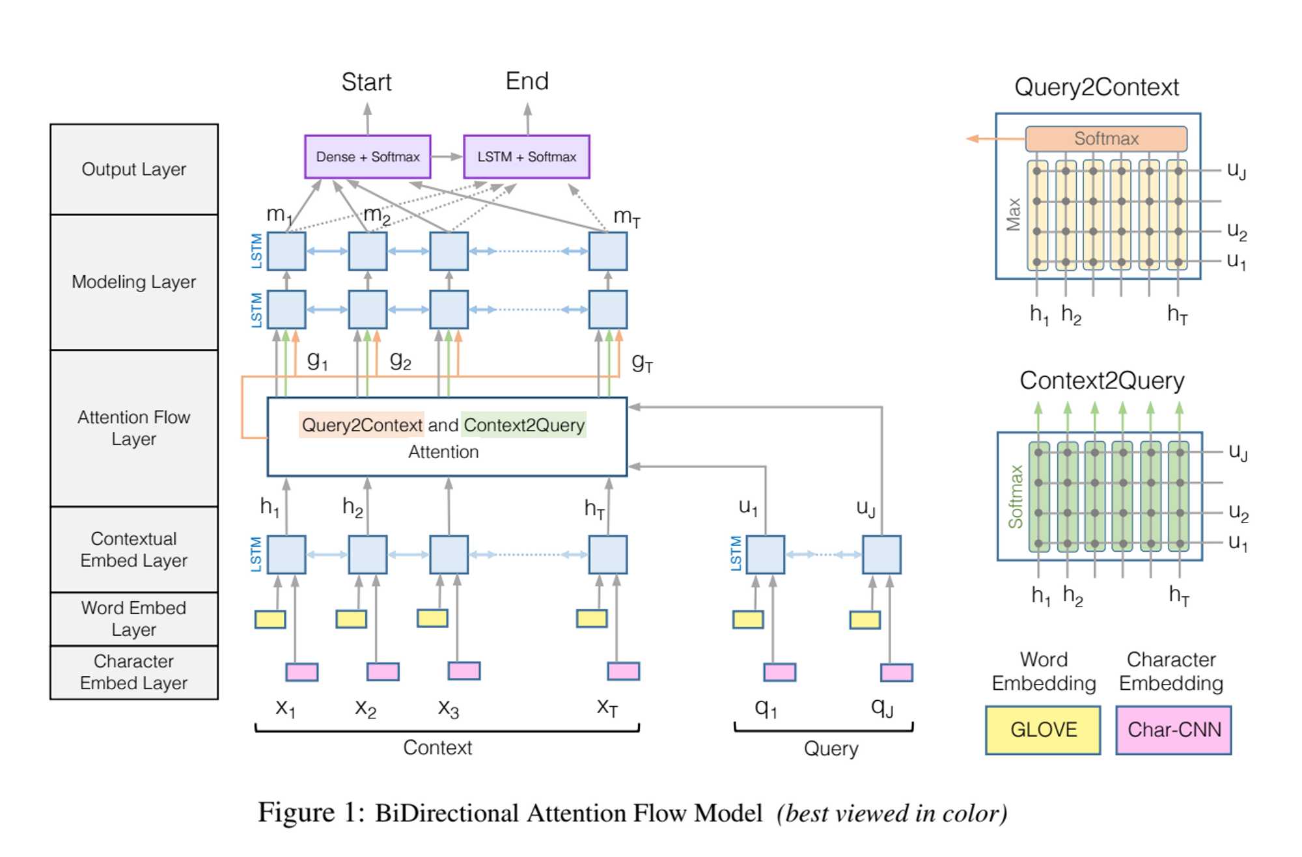
BiDAF Model
This model is basically performing a reading comprehension thing. It reads the passage and the question and tries to find the answer of that.
But the computer can do this really fast and automatically, By using bidirectional attention mechanisms, Bi-Directional Attention Flow can better understand how the words in the text relate to each other and how they answer the question. This helps improve the computer's ability to understand human language and answer questions like a person would.
[Ref: BiDAF]

Slide 14
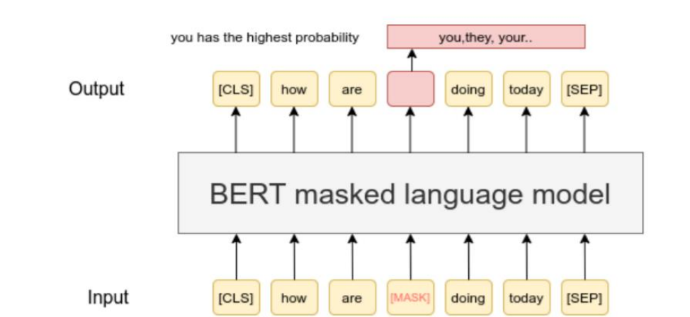
BERT Model
This model learns from reading a lot of texts. It does this by using something called the Transformer architecture, which is a special type of computer program that can understand relationships between words and phrases.
Once BERT has read a lot of text and learned about language, it creates a "pre-trained language model". This is like a set of instructions that tells the robot how to understand human language.
BERT is like a teacher that helps robots learn how to understand human language better, so they can help us in more ways!
[Ref: https://quantpedia.com/bert-model-bidirectional-encoder-representations-
fromtransformers]

Slide 15
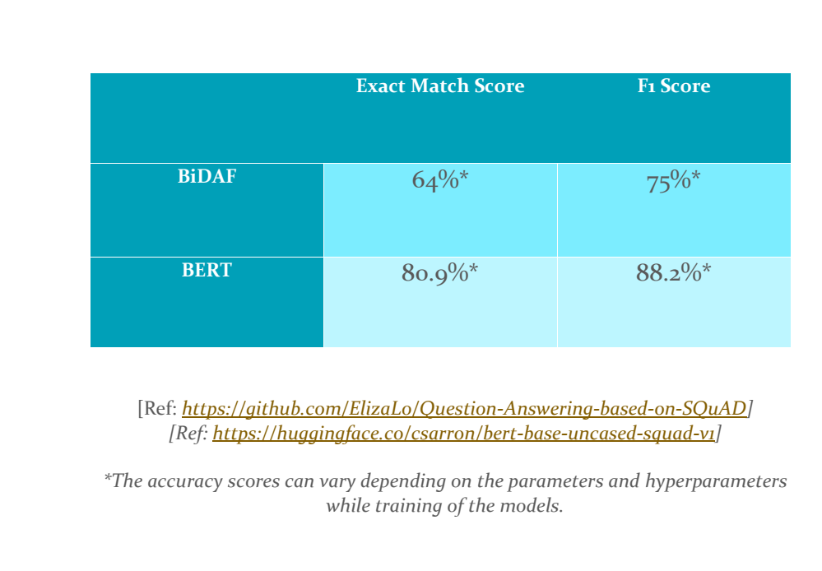
Conclusion

Slide 16
Future Work
We can implement the BERT word embedding in the initial layers of the BiDAF model to make it mode accurate.
Improving the baseline of the both models.

