Slide 1

s
PLACE RECOMMENDATION FOR TOURIST BASED ON TOURIST ATTRACTION

Slide 2
RS are software agents that elicit the interests and preferences of individual consumers and make recommendations accordingly.
They have the potential to support and improve the quality of the decisions consumers make while searching for and selecting products online.
Help people (customers, users) make decisions.
Recommendation is based on preferences, of an individual or a group or community.
For example Music, Movies, Place and Books recommendation. In eCommerce there is recommendation of items, in eLearning there is recommendation of contents.
WHAT IS RECOMMENDATION SYSTEM?

Slide 3
Content-Based (CB) – use personal preferences to match and filter items. E.g. what sort of books do I like?
Collaborative Filtering (CF) – match `like-minded’ people . E.g. if two people have similar ‘taste’ they can recommend items to each other.
TYPES OF RECOMMENDATION SYSTEMS

Slide 4

SOCIAL MEDIA DATA MINING

Slide 5

PLACE RECOMMENDATION
There is huge amount of data which arises out of the social media applications.
This data needs to be processed and used. For example, Facebook has a Check In system where people post the places they visit. By taking this as a motive we decided to build a Tourist recommendation system.
The recommendation can be done based on the ratings of the Tourists for that particular place.
Machine Learning algorithms play an important role in recommendation.
There are different algorithms like Collaborative Filtering using we will be using in our project.

Slide 6
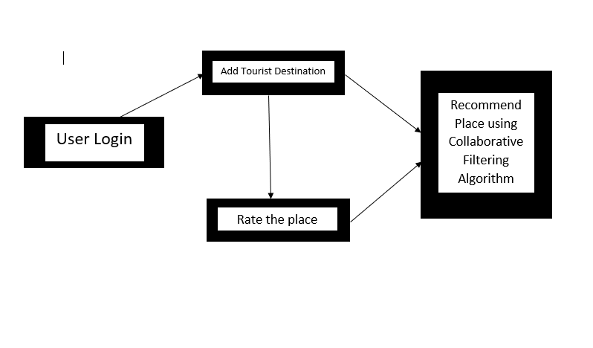
SYSTEM ARCHITECTURE

Slide 7
Combining information among collaborating entities to make recommendations and predictions.
Recommendations based on the content preferences of similar users.
User-User Collaborative Filtering
Item- Item Collaborative Filtering
Non Personalized Recommender System
COLLABORATIVE FILTERING

Slide 8
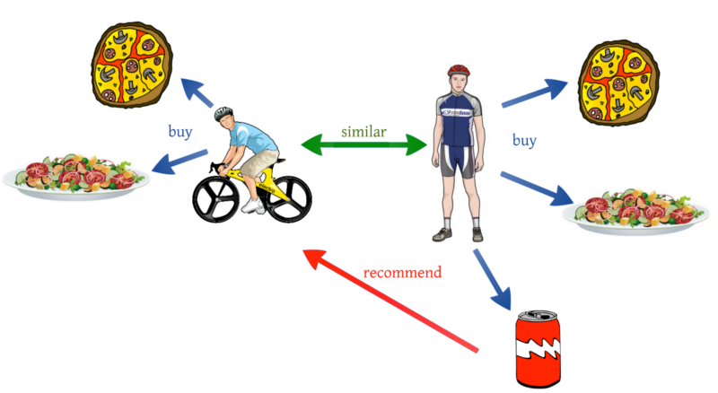
USER-USER COLLABORATIVE FILTERING
In the place recommendation, as discussed in previous slide the User-User Collaborative Filtering Algorithm makes the recommendation based on the similar likes of the people.

Slide 9
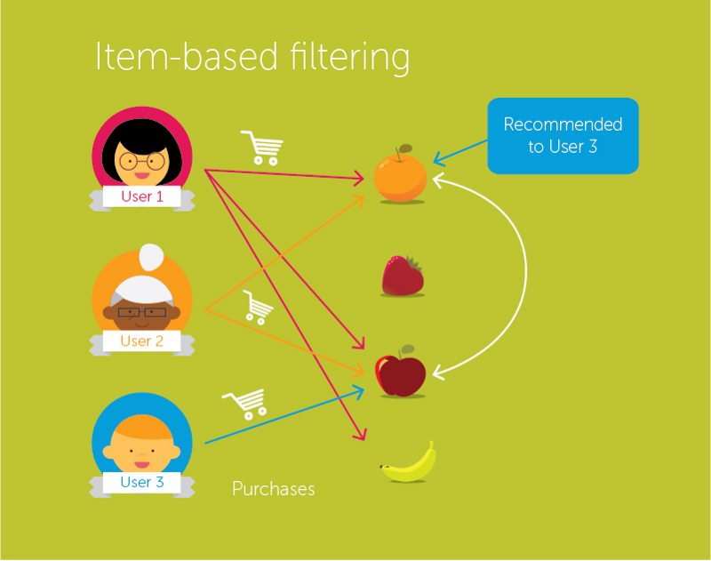
ITEM-ITEM COLLABORATIVE FILTERING
ITEM-ITEM collaborative filtering look for items that are similar to the articles that user has already rated and recommend most similar articles.

Slide 10
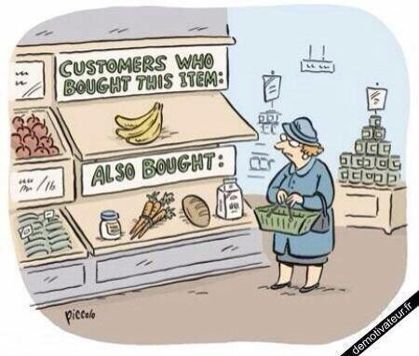
NON PERSONALIZED RECOMMENDER SYSTEM
It provides user with the most relevant information that the user is seeking on the basis of user’s preferences, interest, or observed behavior about item.

Slide 11

LOGIN PAGE
RESULTS

Slide 12
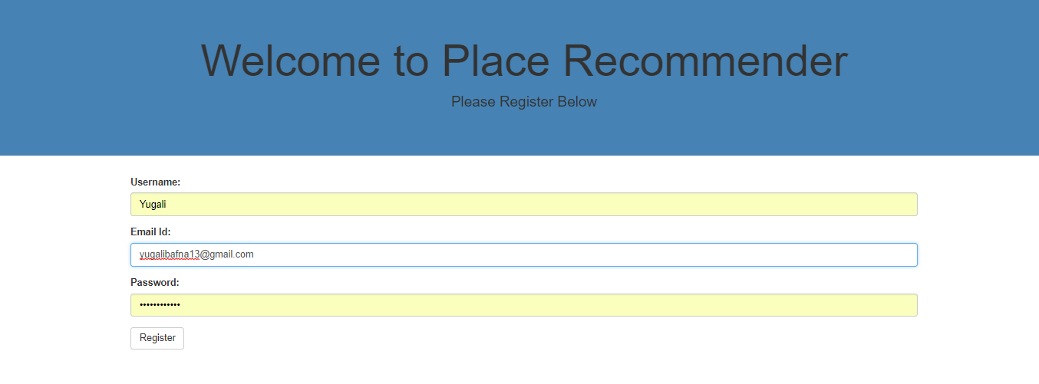
REGISTER PAGE
RESULTS

Slide 13
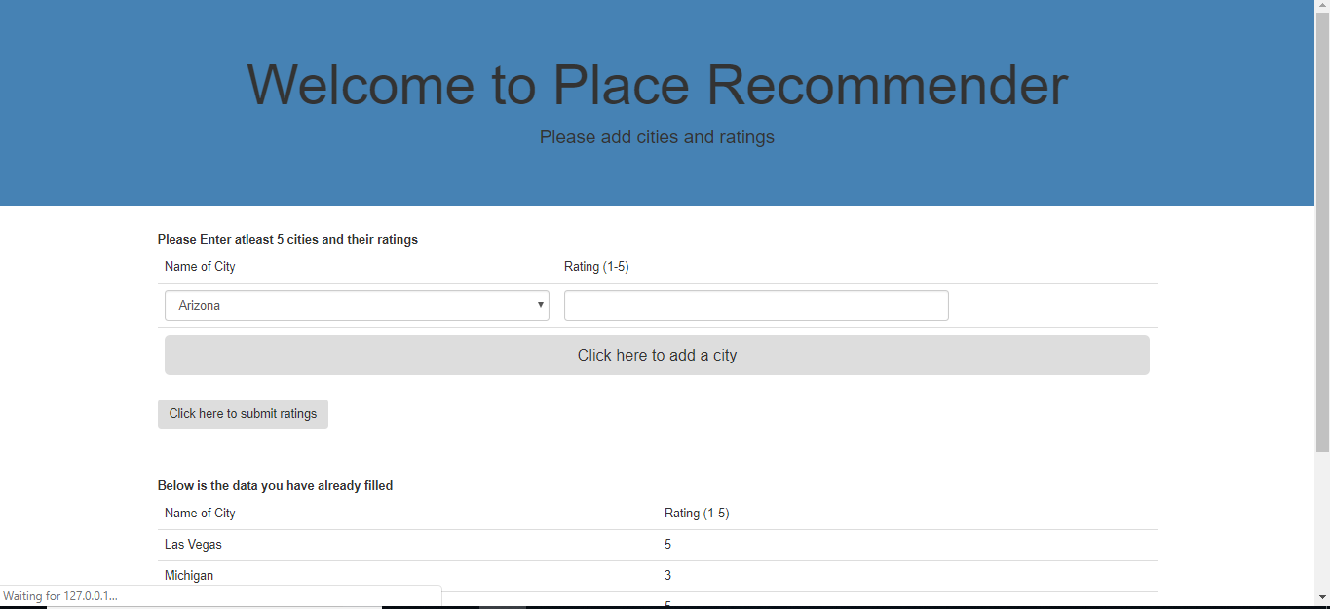
ADD THE PLACES
RESULTS

Slide 14
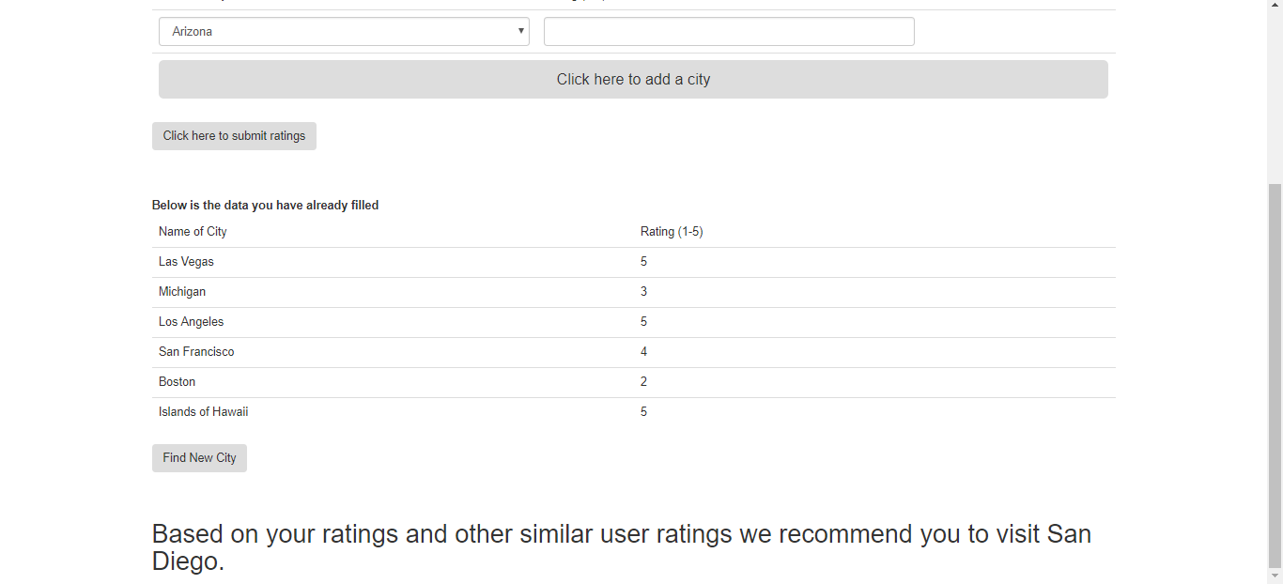
RECOMMENDATION
RESULTS

Slide 15
COMPARISON BETWEEN THE ALGORITHMS
SR.NO | USER-USER COLLABORATIVE ALGORITHM | ITEM-ITEM COLLABORATIVE FILTERING | NON PERSONALIZED RECOMMENDER SYSTEM
1. | User-User Collaborative Filtering Algorithm makes the recommendation based on the similar likes of the people. | Recommenders scale with the number of items or users they must deal with, so there are scenarios in which each type can perform better than the other. | Non Personalized recommender system recommends what is popular and relevant to all the users.
2. | Similarity estimates between users are more likely to converge over time | Similarity estimates between items are less likely to converge over time | Similarity estimates are not taken into consideration
3. | User based recommenders begin with the list of similar user’s preferences. | Item based recommenders begin with a list of a user's preferred items. | Non personalized based recommenders begin with a list of a user's preferred items.

Slide 16
COMPARISON BETWEEN THE ALGORITHMS
SR.NO | USER-USER COLLABORATIVE ALGORITHM | ITEM-ITEM COLLABORATIVE FILTERING | NON PERSONALIZED RECOMMENDER SYSTEM
4. | Accuracy of User-User Collaborative algorithm is greater compared to the other two as this algorithm looks for the similar likes of the user and recommends based on that. | This is based on the already rated item and recommends for the similar items. So, this has moderate accuracy compared to User-User collaborative algorithm. | Non Personalized system does not rely on similarity measure. It recommends based on the overall data. So, this is not that accurate compared to the other two.
5. | Accuracy: 95% | Accuracy: 92% | Accuracy: 90%

Slide 17

SIGNIFICANCE OF THE PROJECT
Tourism is a major economic and social significant that has been recognized in both developed and developing countries.
This project mainly aims in helping tourists find the most rated tourist places visited by their friends.
Recommendation algorithms help in accurately recommending the places.
This system will help the tourists find their appropriate destination for holiday.

Slide 18


Tourist place recommendation applications like MakeMyTrip, TripAdvisor etc. use the recommendation of tourists based on ratings given by travelers.
Today, we all know that Amazon a cross large and well-known company is using recommender system to recommend the most likely viewed items of the customer. This shows the impact of recommendation system.
Other examples are like Netflix the video streaming service which is using AI’s recommendation system which is saving around $1billion each year.
Then we have Spotify a music recommendation application, which uses Machine learning to handle the huge amount of music data arising day-by-day.
IMPLICATIONS

Slide 19
This system will be very useful for tourists to decide the most rated tourist destination for their holidays.
Recommendation algorithms such as collaborative filtering methods were studied which recommend places based on user’s interests.
User-user collaborative filtering algorithm recommend similar places to the tourist.
Item based collaborative filtering recommends places based on the preference of the tourists.
Non Personalized recommender system recommends frequently visited places by the tourists in comparison with other tourists.
Among all the three algorithms, user-user collaborative filtering has highest accuracy of 95%.
CONCLUSION

Slide 20

FUTURE SCOPE
Facebook is one of the most likely used application by every smartphone user. There is a huge data which is produced by this application.
People Check In at various locations which produces large amount of data which is only stored and never used again.
So, there should be some processing on the data. Processing can be done by using that data for recommending the highest rated places to the users.

Slide 21
REFERENCES
Cheng W, Yin G, Dong Y, Dong H, Zhang W (2016) Collaborative Filtering Recommendation on Users’ Interest Sequences. PLoS ONE 11(5): e0155739. https://doi.org/10.1371/journal.pone.0155739
Farhan Hassan Khan, Saba Bashir. Collaborative Filtering based Online Recommendation Systems: A Survey. International Conference on Information & Communication Technologies, At Karachi, Pakistan, Volume: 7th
Rana, C., & Jain, S. K. (2012). Building a Book Recommender system using time based content filtering. WSEAS Transactions on Computers, 11(2), 2224-2872.
Chu. W, Park. T.S. et al, (2010), "Personalized Recommendation on Dynamic Content Using Predictive Bilinear Models" Yahoo! Labs.,2821 Mission College Blvd, Santa Clara, CA95054
Sharma, R., Gopalani, D., & Meena, Y. (2017, February). Collaborative filtering-based recommender system: Approaches and research challenges. In Computational Intelligence & Communication Technology (CICT), 2017 3rd International Conference on (pp. 1-6). IEEE
Dang, T. A., & Viennet, E. (2013, January). Collaborative filtering in social networks: A community-based approach. In Computing, Management and Telecommunications (ComManTel), 2013 International Conference on (pp. 128-133). IEEE.

