Slide 1


CRUD Operations
Create · Read · Update · Delete
The four fundamental operations every data scientist uses to work with data in SQL
C
R
U
D
Ananda Rimal

Slide 2
What is CRUD?
Four operations that cover everything you can do to data in a table
Build a table and add new rows
Create
C
CREATE TABLE, INSERT INTO
Query and retrieve existing data
Read
R
SELECT
Modify values in existing rows
Update
U
UPDATE ... SET ... WHERE
Remove rows from a table
Delete
D
DELETE FROM ... WHERE
SQL for Data Scientists · CRUD Operations
2
Ananda Rimal

Slide 3

C
CREATE — Build the Table & Add Rows
CREATE TABLE defines structure. INSERT INTO adds data into it.
CREATE TABLE customers (
customer_id INTEGER PRIMARY KEY,
name TEXT,
city TEXT
);
INSERT INTO customers (customer_id, name, city)
VALUES (1, 'Anita Rai', 'Kathmandu');
Key Points
CREATE TABLE runs once — it defines column names and types.
INSERT INTO adds one or many rows.
Multiple rows can be added in a single statement, separated by commas.
SQL for Data Scientists · CRUD Operations
3
Ananda Rimal

Slide 4

R
READ — Query the Data
SELECT retrieves rows. Combine with WHERE, ORDER BY, LIMIT to filter and sort.
-- All rows
SELECT * FROM customers;
-- Filtered, sorted, limited
SELECT name, city
FROM customers
WHERE city = 'Kathmandu'
ORDER BY name ASC
LIMIT 5;
Key Points
WHERE filters which rows come back.
ORDER BY sorts the results (ASC / DESC).
LIMIT caps how many rows are returned.
This is the operation data scientists use most.
SQL for Data Scientists · CRUD Operations
4
Ananda Rimal

Slide 5


U
UPDATE — Modify Existing Rows
Changes values in rows that already exist.
UPDATE customers
SET city = 'Bhaktapur'
WHERE customer_id = 1;
Key Points
SET specifies the new value(s).
WHERE chooses which rows change.
Always run a SELECT with the same WHERE first, to preview which rows will be affected.
⚠ Without WHERE, EVERY row is updated:
UPDATE customers SET city = 'Unknown'; -- updates ALL rows!
SQL for Data Scientists · CRUD Operations
5
Ananda Rimal

Slide 6


D
DELETE — Remove Rows
Permanently removes rows from a table.
DELETE FROM customers
WHERE customer_id = 3;
Key Points
DELETE FROM removes entire rows (not columns).
The table structure stays — only the data disappears.
In real systems, this is often "soft deleted" (a flag) instead of a hard DELETE.
⚠ Same rule as UPDATE:
DELETE FROM customers; -- deletes ALL rows in the table!
No WHERE = every row is gone. There is no "undo" once committed.
SQL for Data Scientists · CRUD Operations
6
Ananda Rimal

Slide 7
Summary
Create
Read
Update
Delete
SQL
SQL
SQL
SQL
CREATE TABLE / INSERT INTO
SELECT ... WHERE ... ORDER BY
UPDATE ... SET ... WHERE
DELETE FROM ... WHERE
Danger
Danger
Danger
Danger
Duplicate primary keys
None — read-only
No WHERE = updates every row
No WHERE = deletes every row
Your Turn: Insert a customer → Update their city → Read only customers in your city → Delete the customer you added.
SQL for Data Scientists · CRUD Operations
7
Ananda Rimal

Slide 8
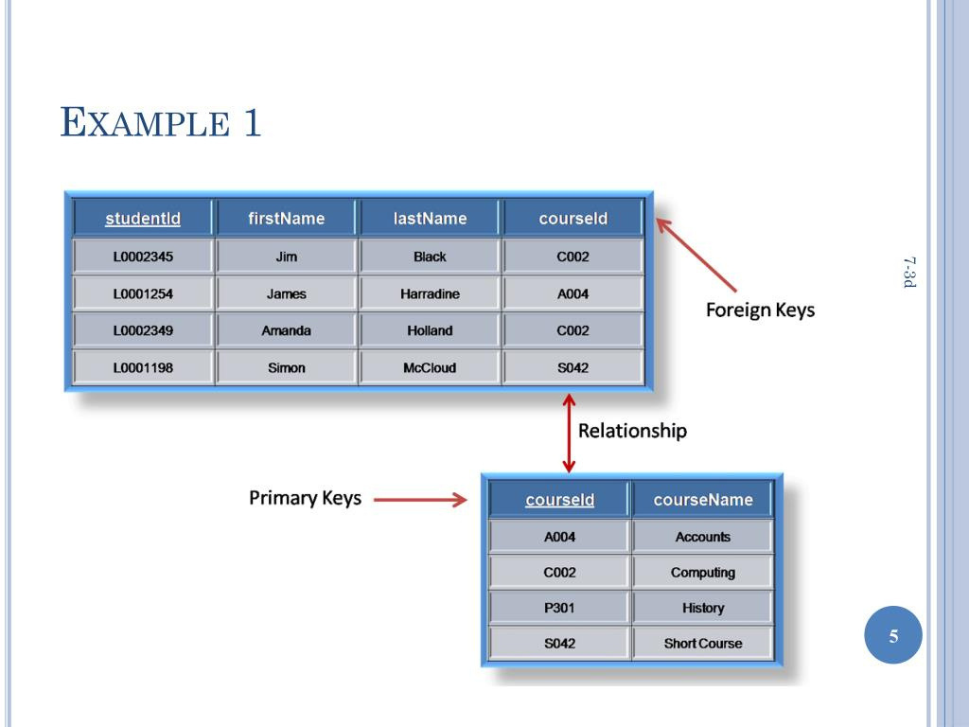
Ananda Rimal

Slide 9
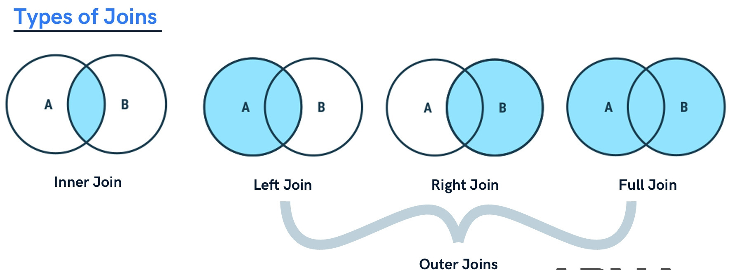
Ananda Rimal

Slide 10
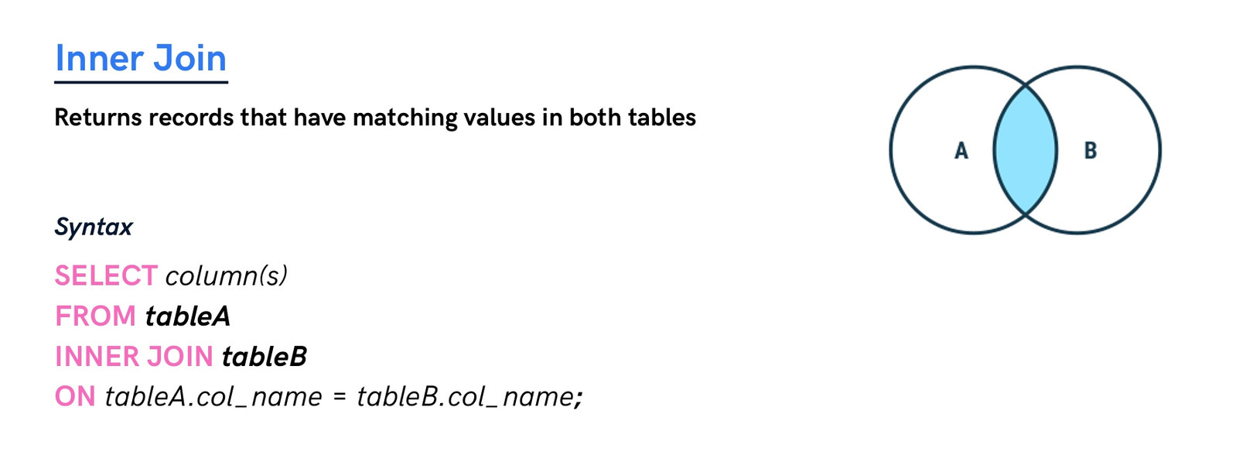
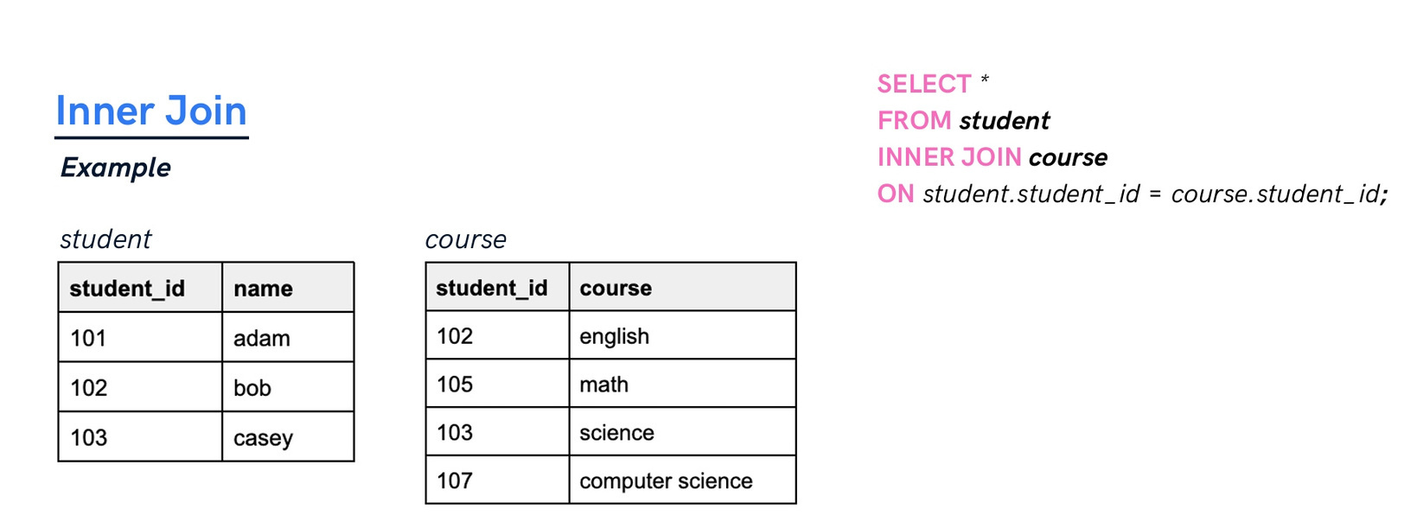
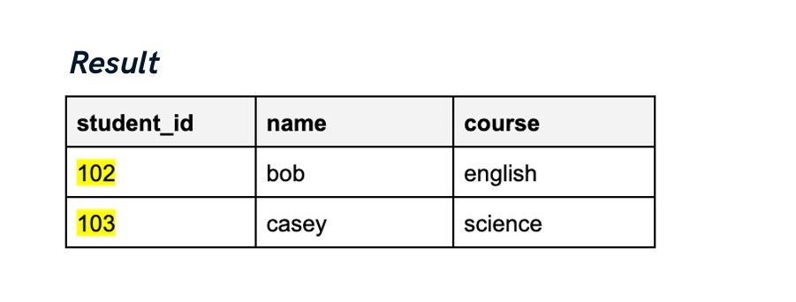
Ananda Rimal

Slide 11
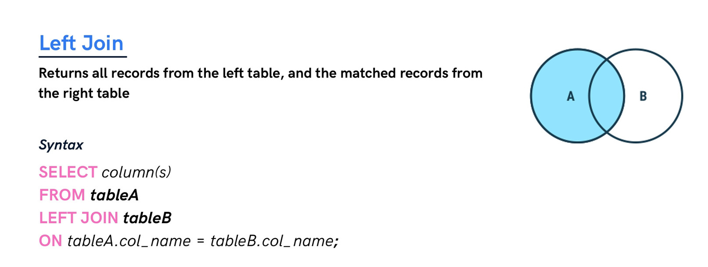
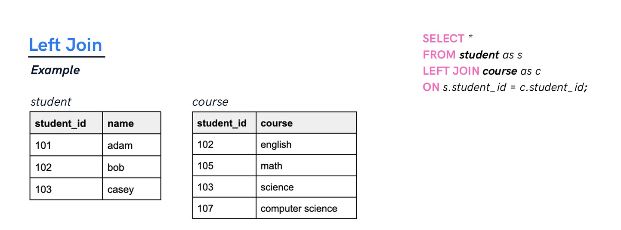
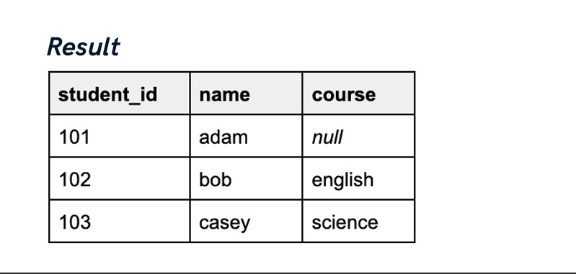
Ananda Rimal

Slide 12
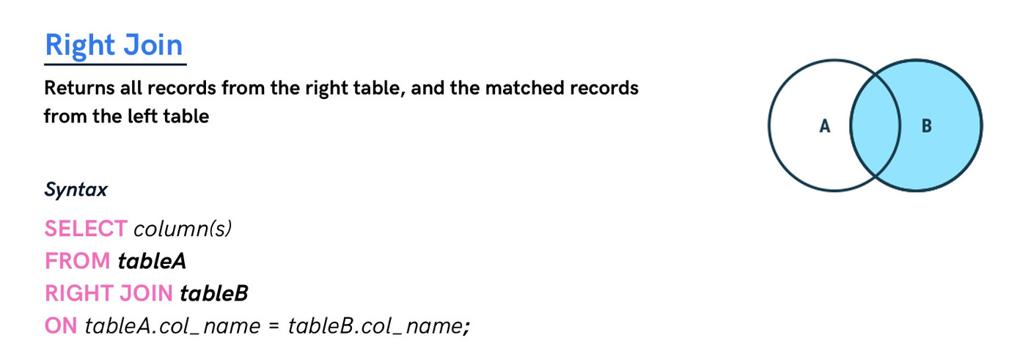
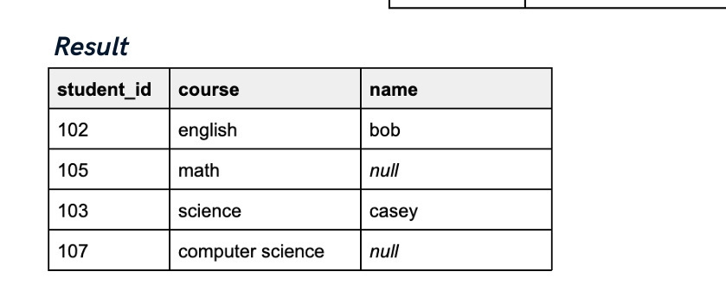
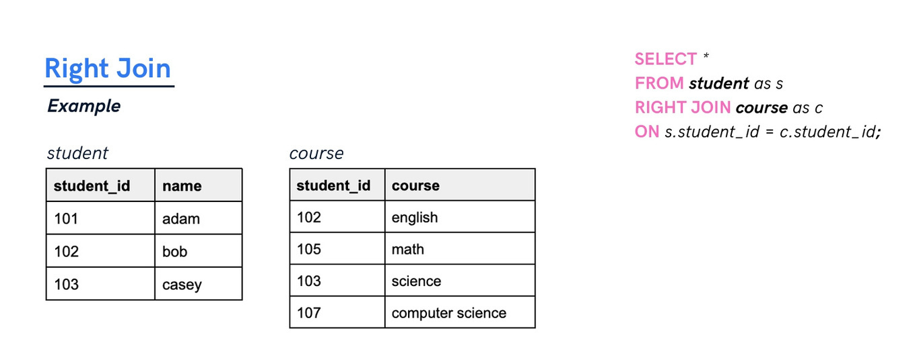
Ananda Rimal

Slide 13
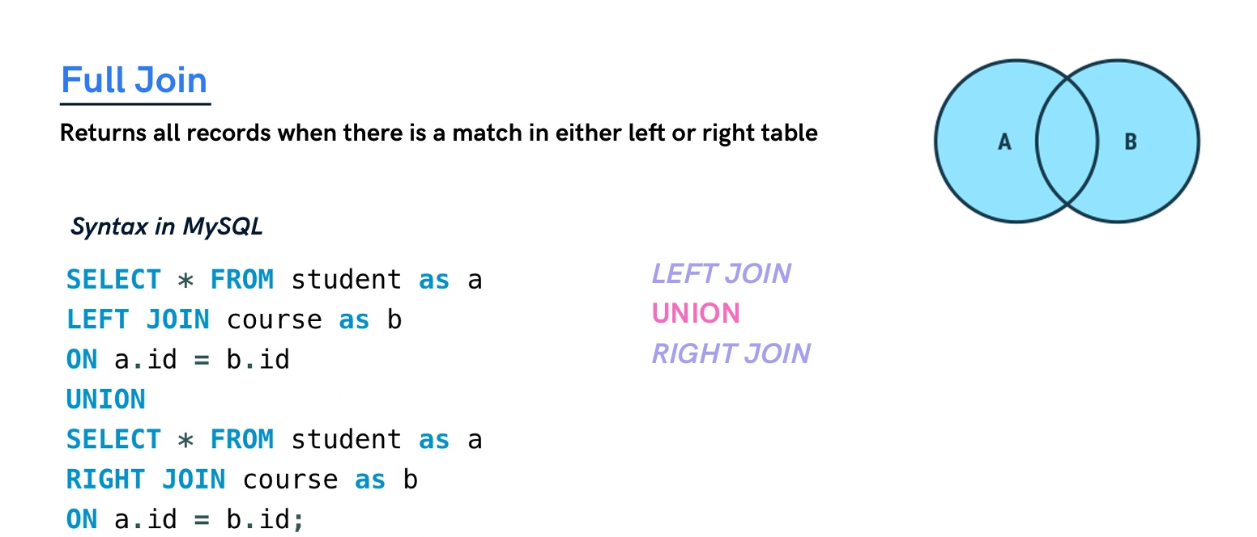
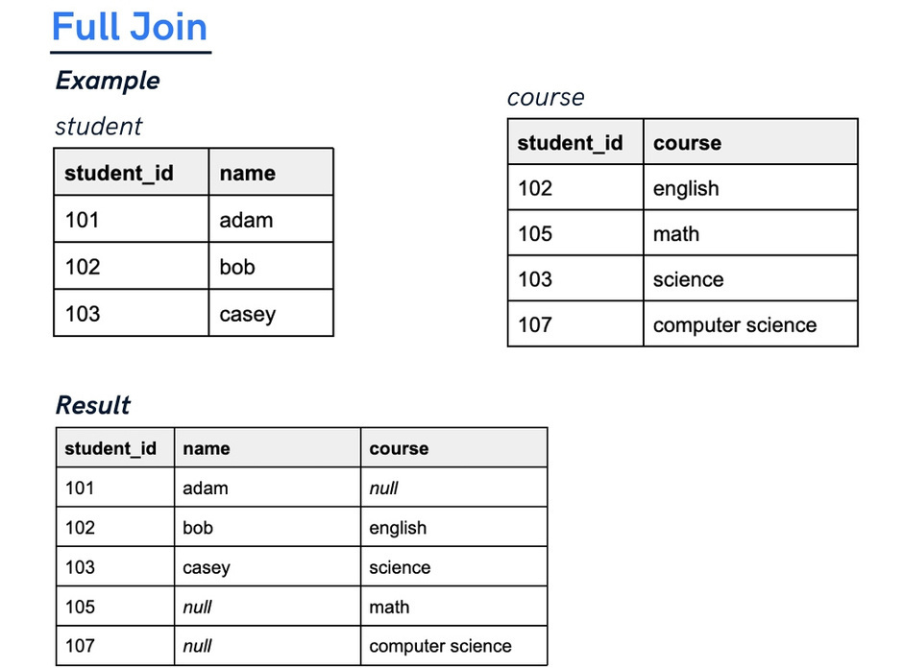
Ananda Rimal

Slide 14

Ananda Rimal

Slide 15
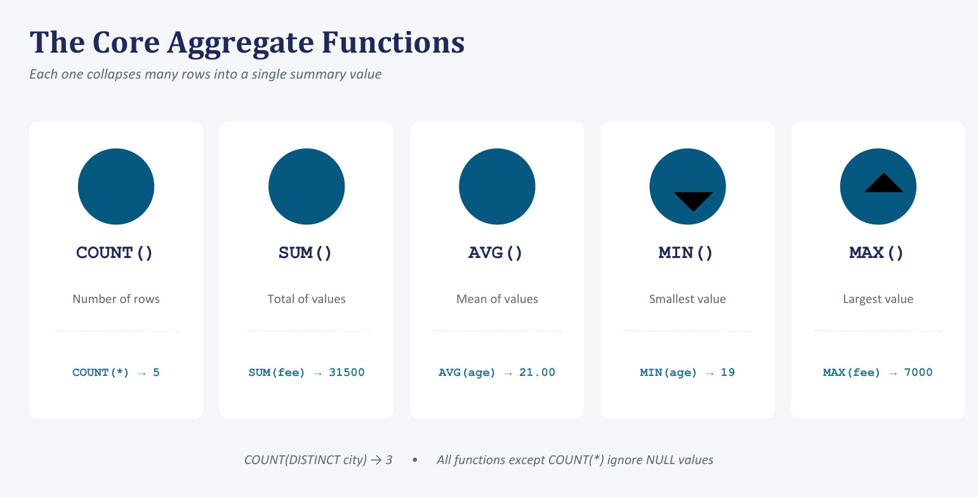
Ananda Rimal

Slide 16
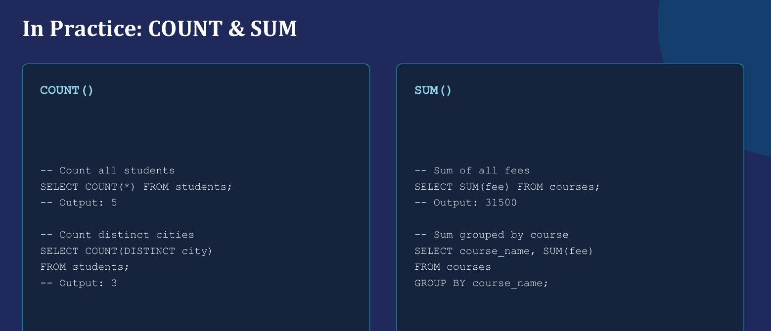
Ananda Rimal

Slide 17
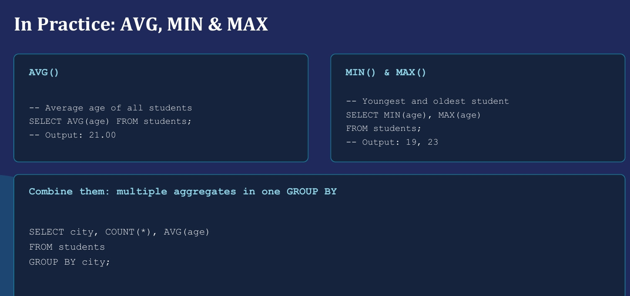
Ananda Rimal

