Slide 1


Basic Details of the Team and Problem Statement
Ministry/Organization Name/Student Innovation: AICTE
PS Code: SIH1467
Problem Statement Title: Smart Education
Team Name: TECH TITANS
Team Leader Name: SANTHOSH S
Institute Code (AISHE): 4107
Institute Name: DHANALAKSHMI COLLEGE OF ENGINEERING
Theme Name: LEARN HUB

Slide 2
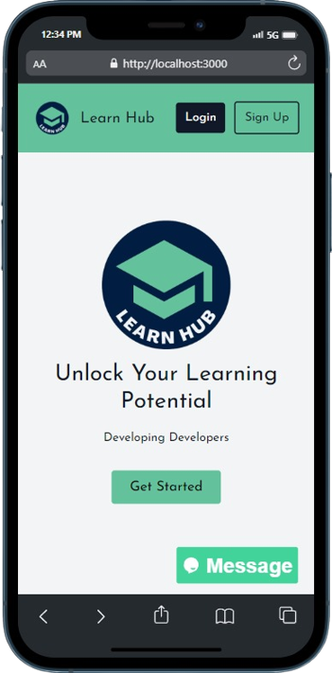
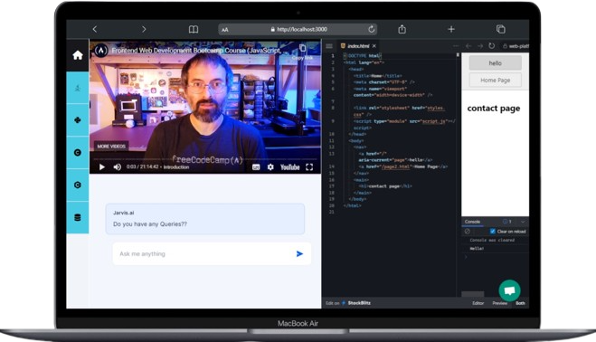
Idea/Approach Details
Describe your idea/Solution/Prototype here:
Learn Hub is created to provide a integrated service to the user where the user can have Video lectures , Chatbot and Compilers on the same dashboard.
Learn Hub provides a user-friendly web-based learning platform with AI-driven personalized support.
It includes programming language compilers, chatbot, and learning materials for a convenient learning experience.
The platform prioritizes data security through secure authentication and supports Progressive Web App (PWA) for easy access across devices.
Describe your Technology stack here:
NODE JS & EJS
TAILWINDCSS & BOOTSTRAP
GOOGLE OAUTH AND MFA AUTH
GPT 3.5 API
NOTIFICATION API
DATABASE

Slide 3
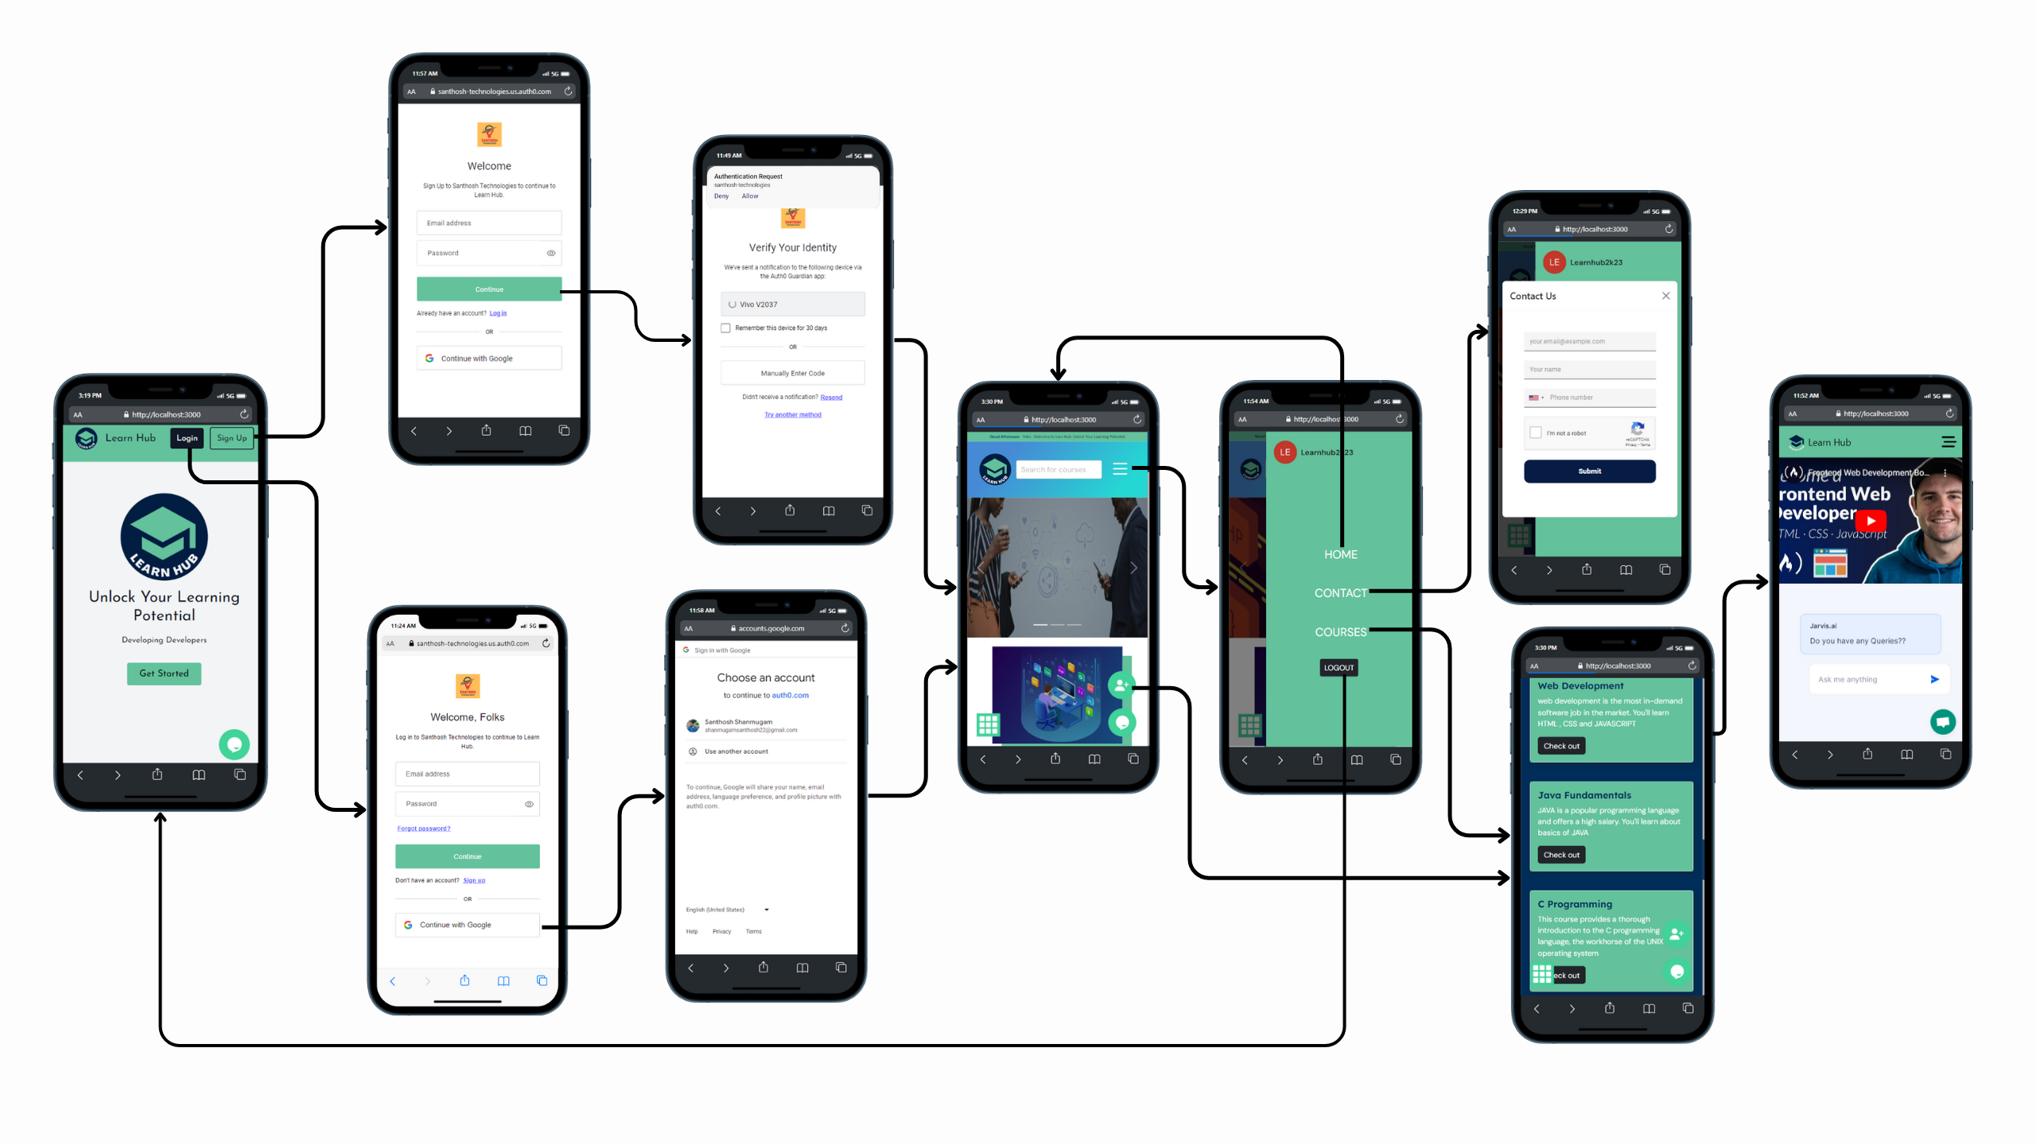
Idea/Approach Details
Describe your Use Cases here
Describe your Dependencies / Show stopper here
Users can contact a dedicated technical support team for prompt assistance with any concerns or questions
We implement Multi-Factor Authentication (MFA) for added security.
We utilize live screen sharing for collaborative and direct interaction with the technical team for errors.

Slide 4
Team Member Details
Team Leader Name: SANTHOSH.S
Branch : B.E Stream : CSE Year : III
Team Member 1 Name: PRATHIKSHA.P.C
Branch : B.E Stream : CSE Year : III
Team Member 2 Name: NISHANTHI K
Branch : B.E Stream : CSE Year : III
Team Member 3 Name: SRIRAM.L
Branch : B.E Stream : CSE Year : III
Team Member 4 Name: LILAN SHANKAR.S.R
Branch : B.E Stream : CSE Year : III
Team Member 5 Name: THILLAI KANNAN.S
Branch : B.E Stream : CSE Year : III
Team Mentor 1 Name: MARIAMMAL R
Category : Academic Expertise : Software Testing Domain Experience : 5 years
Team Mentor 2 Name:
Category : Expertise : Domain Experience :

