Slide 1
DHA – A Paperless Ticketing System
Students Details –
Yugant Kachroo
17001003064
Sakshi Dhar
18001003511
Mentor
Mr. Piyush

Slide 2
Introduction
Time and convenience have great importance in human life. Traditional ticketing system is not much efficient.
Paper tickets with barcodes are used as entry and exit pass for rail transport.
Drawbacks:-
Inconvenience for safe keeping of paper tickets
Wastage of paper
Time consuming
We can tackle this problem by a paperless ticketing system using face recognition by identifying and analysing
the shape of a person’s face. Each face has approximately 80 unique nodal points which
distinguishes one from another. As face is one of the easiest ways to distinguish the individual identity of
person, we are planning to use Face recognition to implement a Paperless ticketing system

Slide 3
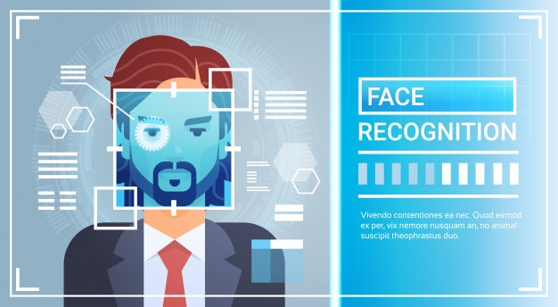
Motivation
There are static user authentication system but it has the following drawbacks:-
A person has to individually stand in front of camera to get access and wastes 1 min (approx.)
It can’t cover a large entrance
It can be easily surpassed as with single authorization more than 1-2 people can enter if move rapidly.

Slide 4
Objective
With the static authentication having those drawbacks, the need of the hour is to do the same process of authentication in a much optimized way, which can be done via dynamic user authentication system.
It can easily detect a group of people until the faces are hidden and can cover a large entrance.
Data recorded is also being used to train the model without pausing (Manual or frequent)
Upper Body Detection would also be used for more accuracy for detection only.
Advantages:-
Convenient
Eco-friendly
Time saving

Slide 5
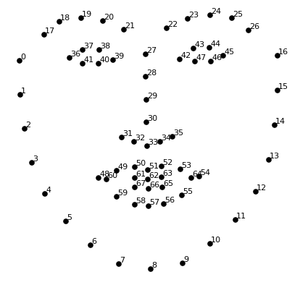
Working
We will try to warp each picture so that the eyes and lips are always in the sample place in the image. This will make it a lot easier for us to compare faces in the next steps.
To do this, we are going to use an algorithm called face landmark estimation.
The basic idea is we will come up with 68 specific points (called landmarks) that exist on every face — the top of the chin, the outside edge of each eye, the inner edge of each eyebrow, etc.

Slide 6
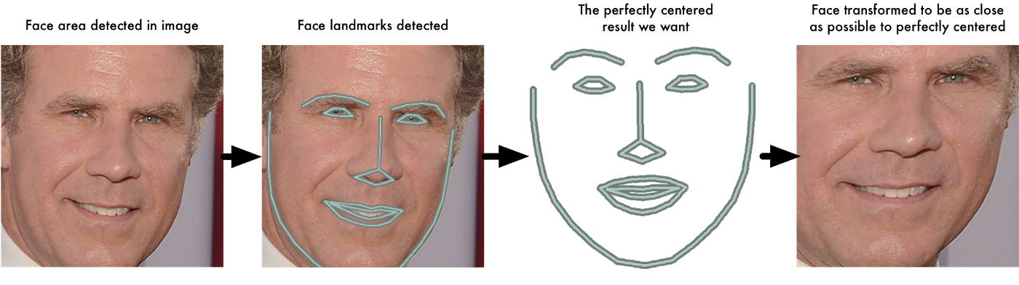
Now that we know were the eyes and mouth are, we’ll simply rotate, scale and shear the image so that the eyes and mouth are centered as best as possible. We are only going to use basic image transformations like rotation and scale that preserve parallel lines

Slide 7
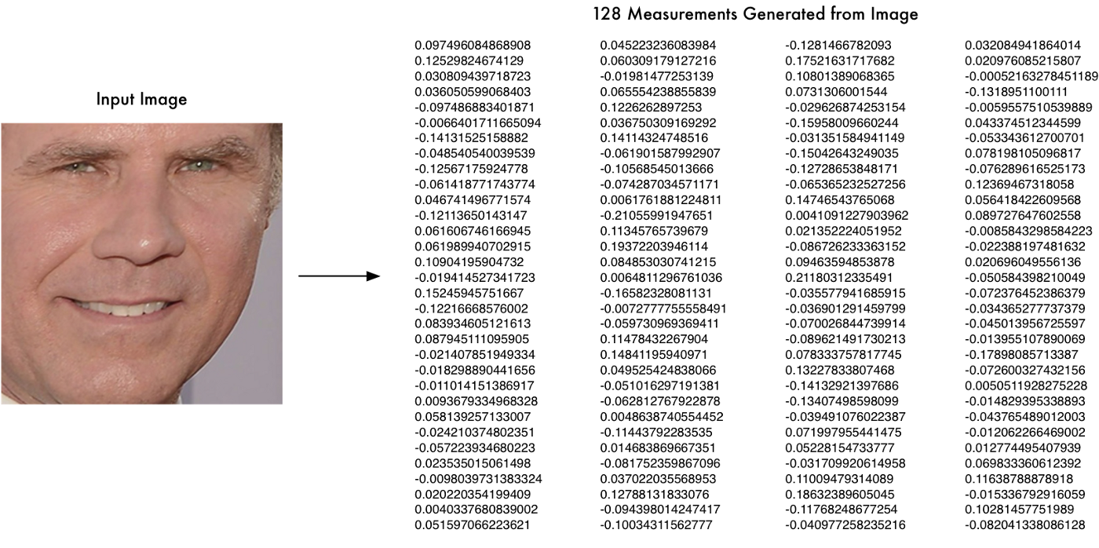
Encoding is an important part and we will do this by running our face images through the pre-trained network to get the 128 measurements for each face. Here’s the measurements for our test image

Slide 8
Now, we just need to connect our Face recognition model with Django (Python Web Framework) which will make connection of Backend and Frontend easy to maintain & use with a more secure database.
We can maintain every Person’s Profile with Unique ID no. with logs model of 7 columns “Person, Entry Station, Entry Time, Entry Pic, Exit Station, Exit Time, Exit Pic”
Suppose a Person1 enters in a station, Django will create a Row with
Person = Person1 (One-to-One field with person’s profile)
Entry details would be saved, initially Exit details would be empty/null
When the Person1 exits from any station, Django will GET the Row existing for the Person1 and will update the Exit details.
Sample Logs Generated
Person | Person ID | Entry Station | Entry Time | Entry Image | Exit Station | Exit Time | Exit Image
Yugant | 7 | New Delhi | 9:00 am | URL | Empty | Empty | Empty
Sakshi | 10 | Faridabad | 1:10 pm | URL | Empty | Empty | Empty
Gaurav | 25 | Noida | 4:12 pm | URL | Empty | Empty | Empty
Mohit | 13 | Faridabad | 9:10 am | URL | Gurgaon | 10:20 am | URL
Rakesh | 33 | Gurgaon | 9:02 pm | URL | Faridabad | 10:35 pm | URL
Rekha | 29 | Noida | 10:10 am | URL | New Delhi | 11:30 am | URL

Slide 9
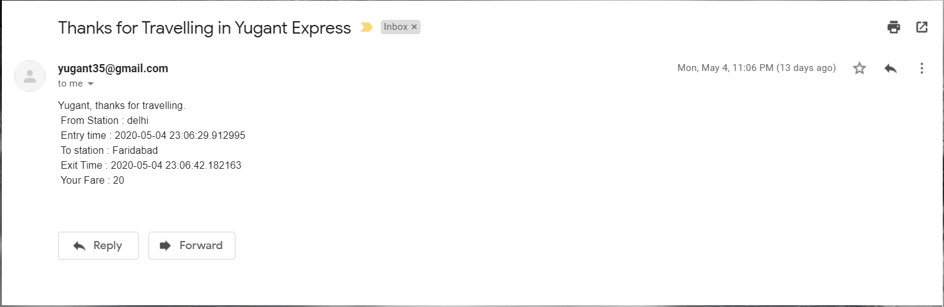
The traveler then receives an email about their trip with details like station name, entry and exit time and fare. In this way the traveler will have the logs of his/her travel history.

Slide 10






Technology Stack
Python Face Recognition Library (Pre Trained Model to Detect Faces) with 99.38% accuracy or any other Face Recognition method
Python Open CV
Django Framework
MySQL, Postgres (or any other database)
For Frontend – HTML, CSS, Bootstrap, JavaScript, jQuery
Why Django?
Easy Integration with Python Modules
Most secured option
Can easily handle Huge Data
Desirable Frontend - GUI
DJANGO REST FRAMEWORK for other UI (if needed)

Slide 11
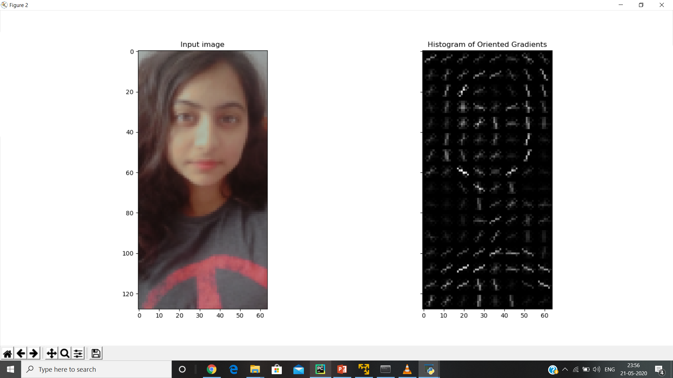

Slide 12
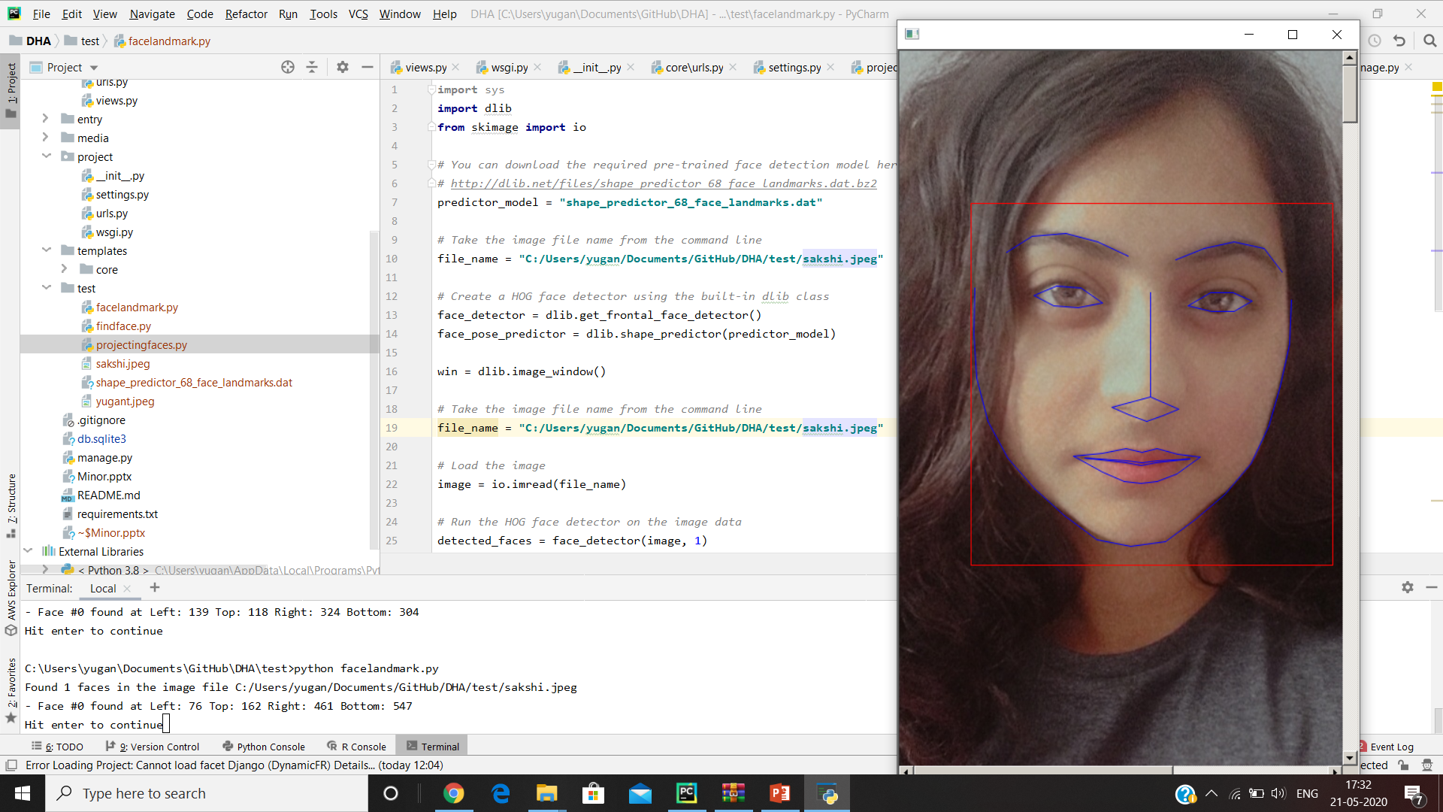

Slide 13
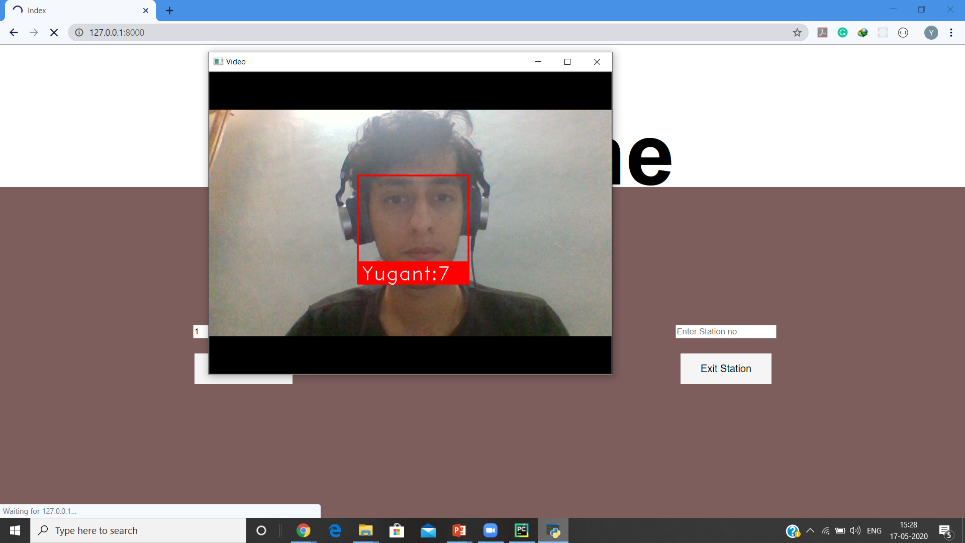

Slide 14
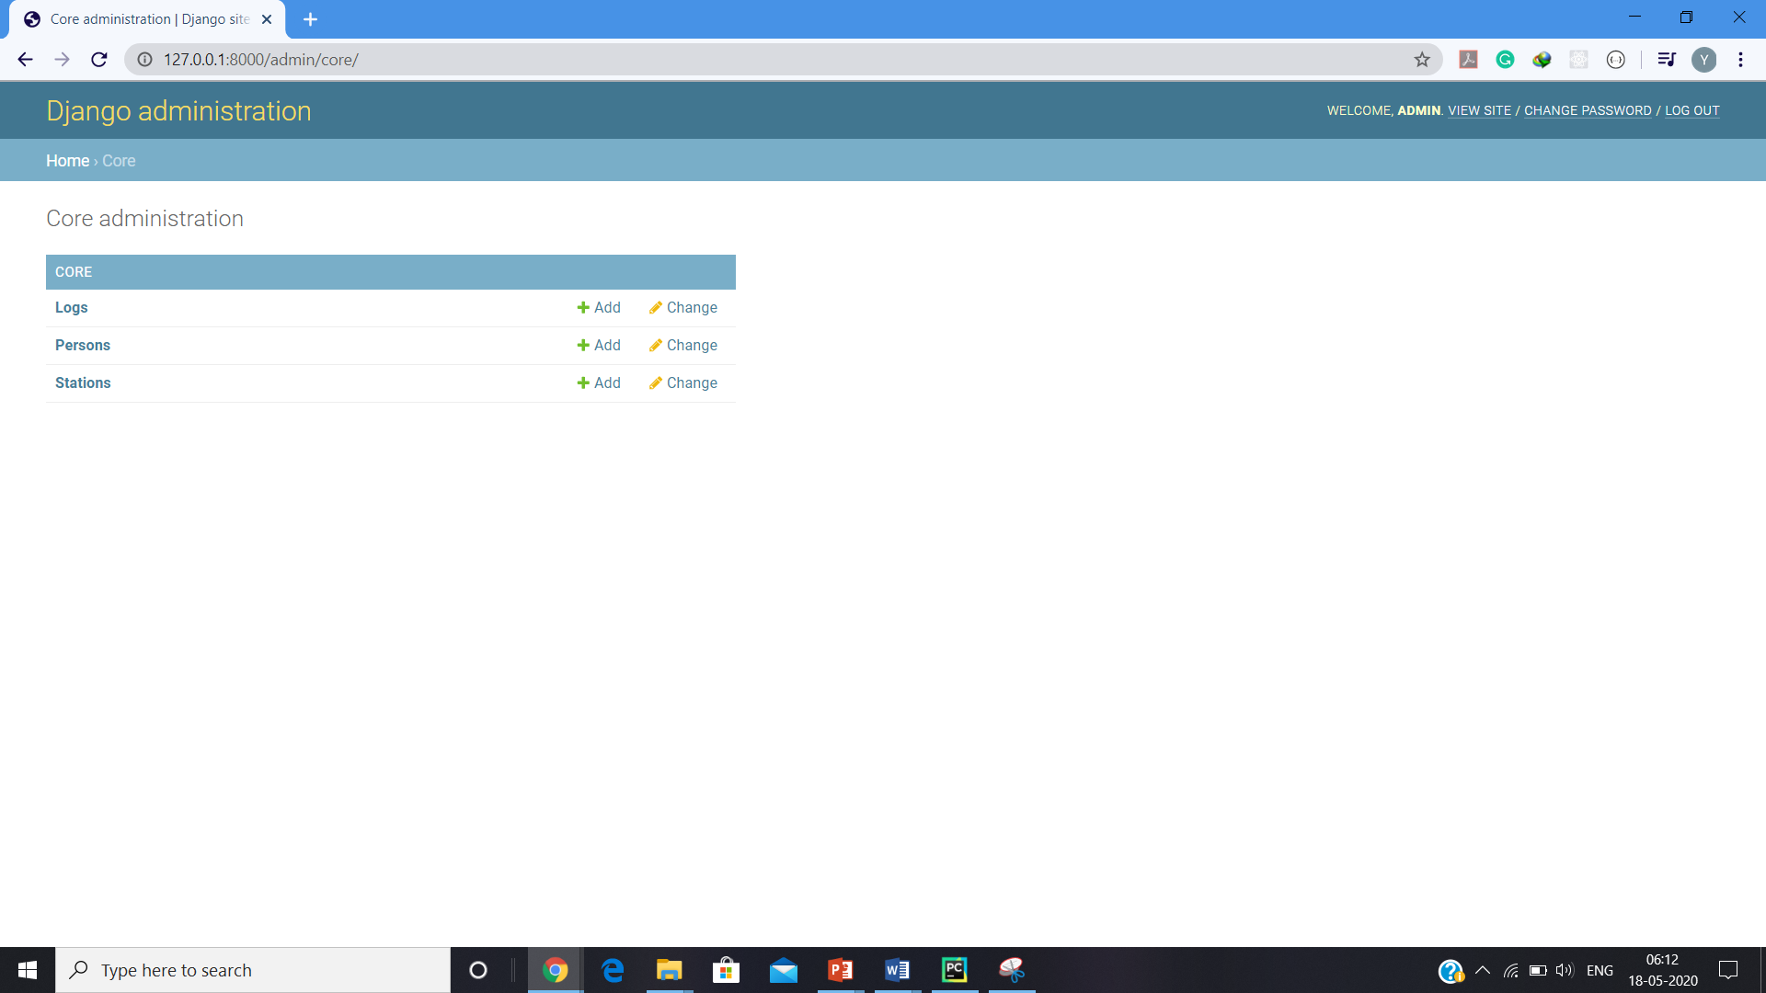

Slide 15
THANK YOU !

