Slide 1

AIRBNB ACTIVITY ACROSS NEW YORK

Slide 2
Table of Contents
Project Overview
Tools & Technologies Used
Dataset Description
Data Preprocessing
Exploratory Data Analysis (EDA)
Power BI Dashboard Highlights
Key Findings & Insights
Conclusion & Recommendations

Slide 3
TOOLS & TECHNOLOGIES USED
PROJECT OVERVIEW
This project analyzes Airbnb listings in New York City to uncover key trends in pricing, guest engagement, and neighborhood popularity. Using data cleaning, exploratory data analysis (EDA), and interactive visualizations in Python and Power BI, the project aims to provide insights for hosts and travelers alike. It explores room type preferences, seasonal booking patterns, and geographic hotspots to better understand the NYC Airbnb market dynamics.
Python (Pandas, Matplotlib, Seaborn, WordCloud)
Power BI (Interactive dashboards and charts)
Jupyter Notebook
VS Code
CSV (Dataset format)

Slide 4
DATASET DESCRIPTION
Source: Inside Airbnb – Get the Data
Format: CSV files containing listing and review data for New York City
listings.csv — Contains metadata about ~37,000 Airbnb listings in NYC
reviews_comments.csv — Contains ~971,000 reviews posted by guests
Key Columns from listings.csv:
id – Unique listing ID
name – Title of the listing
host_id – Unique host identifier
neighbourhood_group – NYC borough (e.g., Manhattan, Brooklyn)

Slide 5
price – Nightly price of the listing
number_of_reviews – Total reviews received
availability_365 – Number of days available in a year
latitude, longitude – Geolocation coordinates
room_type – Type of room offered (e.g., Entire home/apt, Private room)
Key Columns from reviews_comments.csv:
listing_id – ID linking the review to a specific listing
date – Date of the review
reviewer_id – Unique ID of the reviewer
comments – Textual review left by the guest

Slide 6
DATA PREPROCESSING
Handling Missing Values:
Rows with missing values in critical columns such as name, host_name, price, last_review, and reviews_per_month in the listings dataset were dropped to maintain data quality.
In the reviews dataset, entries with null values in reviewer_name or comments were also removed to retain only valid and complete reviews.
Column Removal:
Unnecessary columns (license) were dropped as they were not required for analysis or modeling.
Data Type Conversion:
last_review was converted to datetime format for time-based analysis.
price was converted from float to integer for uniformity in calculations.
Duplicate Check:
A duplicate check was performed using listing IDs and key attributes.No duplicate records were found in either dataset, ensuring data uniqueness.

Slide 7
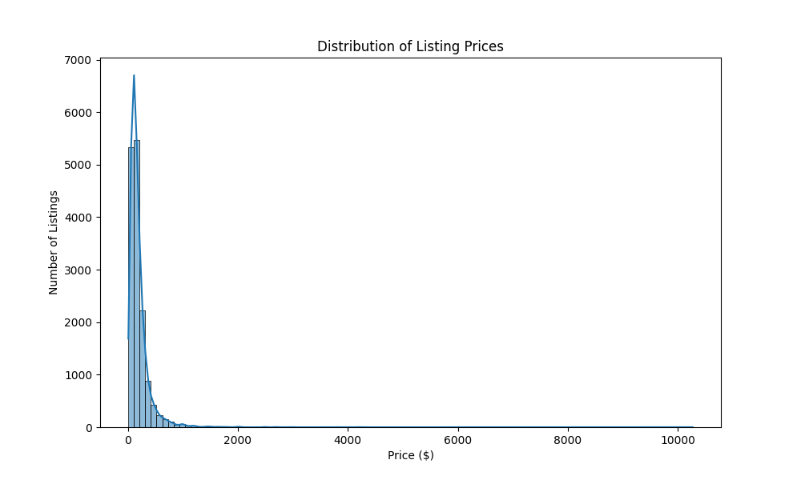
EXPLORATORY DATA ANALYSIS (EDA)
.
Distribution of Listing Prices
Right-Skewed Distribution: Most listings are priced under $500, with a long tail extending beyond $1000. This is common in platforms like Airbnb where luxury or premium listings exist.
High Frequency around $100–$200: This price range appears to be the sweet spot where most listings are concentrated, likely due to competitive pricing and affordability.
Figure 1.1: Distribution of listing prices on Airbnb

Slide 8
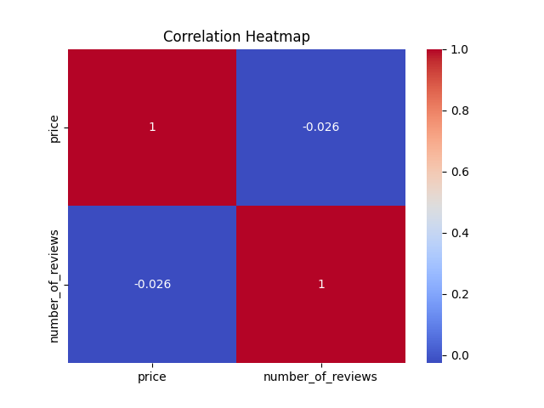
Analyzing the Relationship Between Price and Review Count
The correlation between price and number_of_reviews is very weak negative correlation (-0.026), indicating almost no linear relationship. This means changes in price don’t significantly impact the number of reviews, and vice versa.
Figure 1.2 :Correlation Heatmap between Price and Number of Reviews

Slide 9
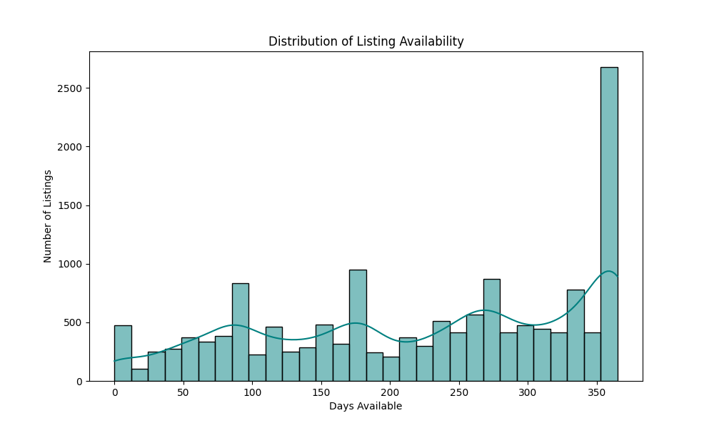
Listing Availability
Peak at 365 Days: Most listings are available for the full year (365 days), indicating a prevalence of full-time rentals.
Smaller Peaks at Intervals: There are visible spikes at regular intervals (e.g., around 90, 180, 270 days), possibly due to seasonal availability or hosts making listings available for only part of the year.
Figure 1.3: Distribution of listing availability across the year

Slide 10
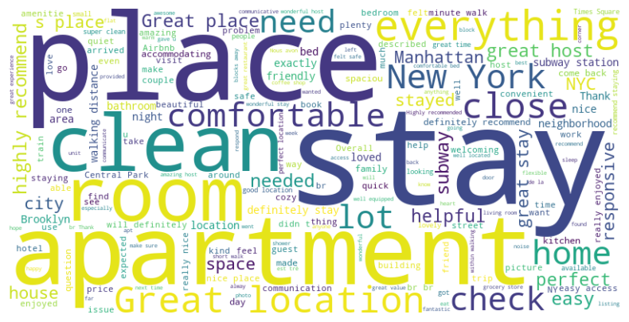
Word Cloud of Reviews
Top positive words like “Clean”, “Stay”, “Place”, and “Apartment” highlight guest satisfaction with cleanliness and accommodations.Phrases like “Great location”, “Comfortable”, and “Responsive” show appreciation for convenience and host interaction.
Frequent mentions of “New York”, “Manhattan”, and “Brooklyn” show that guests prefer places in the city that are easy to reach and well-connected.
Overall sentiment is highly positive, with minimal negative terms, reflecting strong guest satisfaction across listings.
Figure 1.4: Word cloud of guest reviews

Slide 11
POWER BI DASHBOARD HIGHLIGHTS
Price Trends: Manhattan has the highest prices, especially for Hotel room, while entire homes ,shared and private rooms are cheaper across all boroughs.
Guest Engagement: Top listings by engagement are mostly located in Manhattan, with lofts and modern suites being the most interacted with.
Listing Volume: Entire homes/apartments make up the majority (57.8%) of listings, followed by private rooms (41.1%).
Neighborhood Popularity: Manhattan and Brooklyn dominate in both number of listings and total reviews, indicating high tourist demand.
Monthly Trend: Listing volume peaks in May, suggesting a seasonal surge in supply or interest.
Top Hosts: “Alex and Zena” and “Alfred” are the most reviewed hosts in the past year, with over 600 reviews each.
Review Insights: Reviews are concentrated in Manhattan and Brooklyn, with private rooms in Brooklyn showing significant engagement.

Slide 12
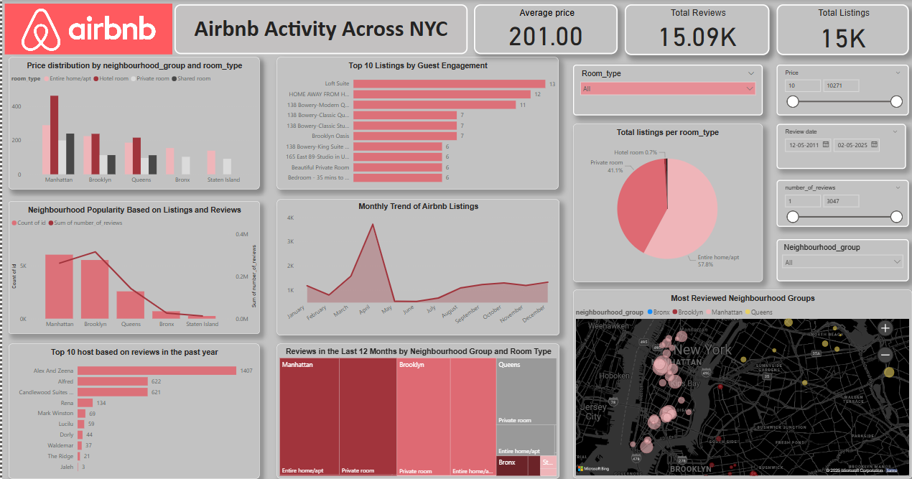
Geo-mapping of Listings : Most-reviewed neighborhoods are heavily clustered around Manhattan and central Brooklyn, aligning with tourist hotspots.
Figure 2.1: Airbnb NYC Dashboard in Power BI

Slide 13
KEY FINDINGS & INSIGHTS
Most listings are in Manhattan and Brooklyn
Entire homes have higher prices and review counts
Listings spike during May–June
Certain hosts consistently receive high engagement
CONCLUSION & RECOMMENDATIONS
Hosts in high-demand areas (Manhattan/Brooklyn) can optimize pricing for greater visibility
Private room listings may benefit from enhanced descriptions/photos to compete
Airbnb can promote listings in underrepresented boroughs (e.g., Bronx, Staten Island)
Analyze seasonality further to offer promotional campaigns in off-peak months

