Slide 1
IMDB Movie Analysis
By Yugashini.S

Slide 2
PROJECT DESCRIPTION
The IMDb Movie Analysis project involves analyzing a dataset of movies from IMDB (Internet Movie Database) to understand key factors that influence a movie’s success and to gain valuable insights. This analysis helps directors and producers make better decisions for their future projects. By examining various factors, such as imdb_ratings, genres,and Language,gross earnings,director’s name,budget, this study provides insights into their impact on a movie's success.
APPROACH
My approach towards the project is first I collected the data(IMDB_movies dataset) and go through the Process of Preprocessing of data to ensure that the data is cleaned and suitable for the analysis.
Data preprocessing involves various process such as handling of missing values,removing unwanted rows and columns,handling duplicate values.
Firstly I removed the unwanted columns which is not useful for our project, Secondly I find out the blank cells and rows by highlighting the blanks option through conditional formatting and removed it.Thirdly,I deleted the duplicate values through the data tab.After I cleaned that data it is ready to gain insights with the help of excel functions,Visualizations and statistics.

Slide 3
TECH-STACK USED
I have used Microsoft Excel Version 21 for this IMDB movie analysis project because itis faster, more reliable, and easier to use.It includes better collaboration features via OneDrive and SharePoint, improved security, and new tools to simplify work with data.
INSIGHTS
Below sections provide the insights gained through the analysis with excel functions.
A. Movie Genre Analysis:
To determine the most common genres of movies in the dataset. Then, for each genre, calculate descriptive statistics (mean, median, mode, range, variance, standard deviation) of the IMDB scores.

Slide 4
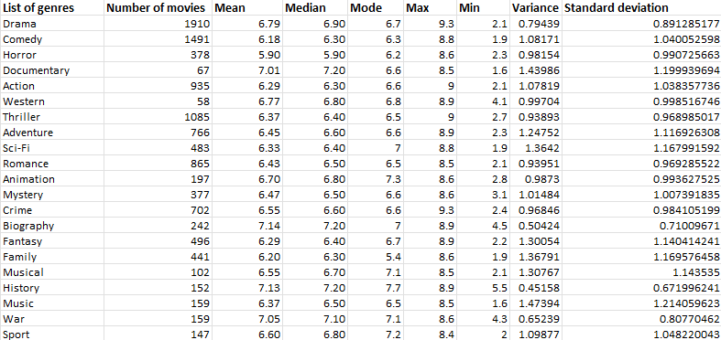
It shows the distribution of movies and their impact on imdb ratings through statistics (mean,median,mode,max,min,variance and standard deviation.
Here,we can understand that specific genre contributed to success of movies (imdb ratings),for example,Drama,comedy,thriller,Action are the most common genres.
Formula used =countif function,average+if function same for all median,variance,standard deviation,maximum,minimum.

Slide 5
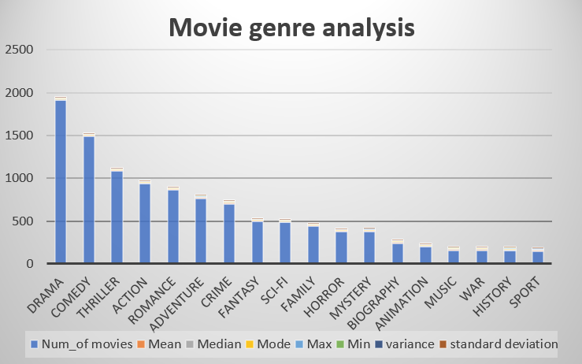

Slide 6
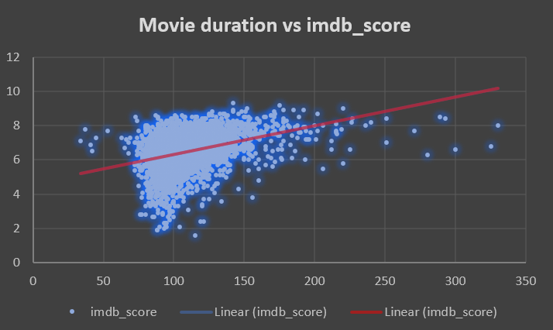

B. Movie Duration Analysis:
To analyze the distribution of movie durations and identify the relationship between movie duration and IMDB score.
Here,we can get that duration between range(100-150) leads to higher ratings.

Slide 7
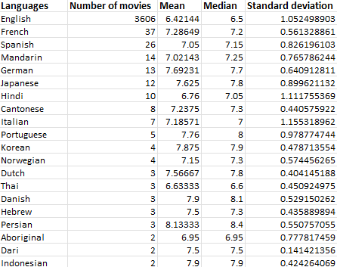
C. Language Analysis:
To determine the most common languages used in movies and analyze their impact on the IMDB score using descriptive statistics.
Through this,I observed that English,French,Spanish,Mandarin,
German,Japanese,Hindi are the most common languages used.

Slide 8
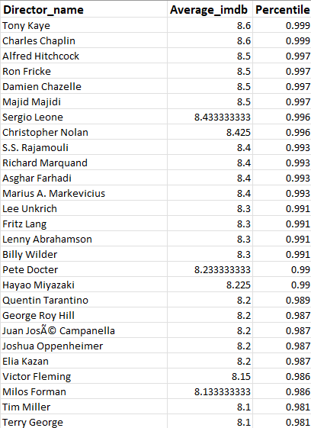
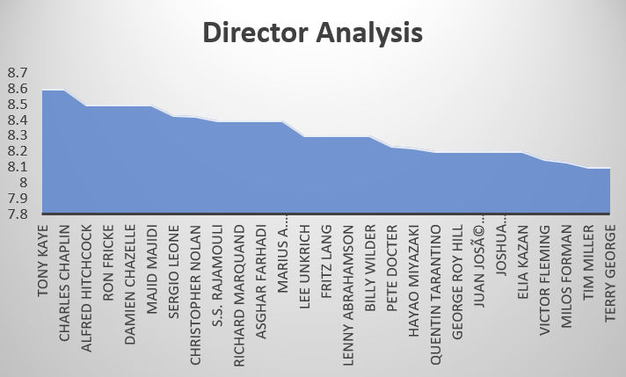
D. Director Analysis:
To Identify the top directors based on their average IMDB score and analyze their contribution to the success of movies using percentile calculations.
Based on the average obtained by statistics for the imdb_score for each director,I observed that
Tony kaye,Charler chaplin,Alfred Hitchcock,Ron Fricke,Damien Chazelle,Majid Majidi are top 6 directors.
Formula used average and Percentilerank_inc.

Slide 9
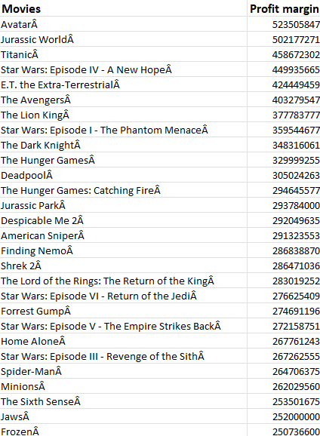

E. Budget Analysis:
To analyze the correlation between movie budgets and gross earnings, and identify the movies with the highest profit margin.
I identified the correlation coefficient between budegets and gross earnings is 0.223115594 which is weak Positive correlation.
AvatarA,Jurassic WorldÂ ,TitanicÂ ,Star Wars: Episode IV - A New HopeÂ ,E.T. the Extra-TerrestrialÂ ,The AvengersÂ ,The Lion KingÂ ,Star Wars: Episode I - The Phantom MenaceÂ ,The Dark KnightÂ, The Hunger GamesÂ ,DeadpoolÂ are top movies which get huge profits.
Formula used is correl and for profit margin simple subtraction.

Slide 10
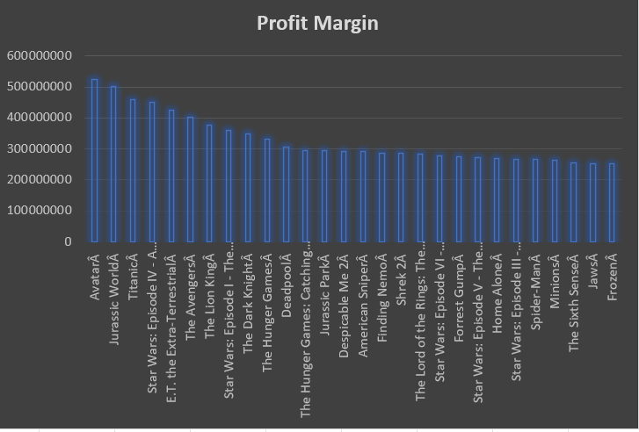
The chart clearly shows the Movies with highest Profit

Slide 11
Result
Through this project, I provide information that helps directors and investors make informed decisions. For example, if the drama genre has the highest ratings, they can focus more on drama-related movies in high-rated languages.
This project also enhanced my knowledge of Excel, statistics, and data analysis, giving me a better perspective.
Hyperlink of the dataset
https://docs.google.com/spreadsheets/d/1Fsyxzd4CdWONzpdtdCWBbR7IMCOIcgxv/edit?usp=drive_link&ouid=114293071387875296860&rtpof=true&sd=true

