Slide 1
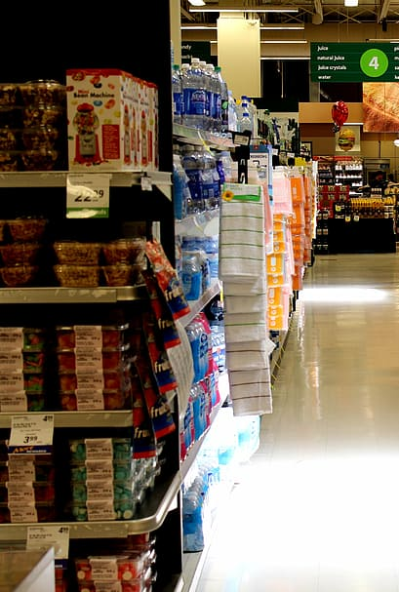
Omni Retail Project Report Multichannel Sales Performance & Customer Analytics

Slide 2
agenda
Project Overview
Tools & Technologies Used
Dataset Description
Data Preprocessing
Exploratory Data Analysis (EDA)
Key Findings & Insights
Conclusion & Recommendations

Slide 3
Project Overview
This project focuses on analyzing Omni Retail's multichannel sales, customer, product, and campaign data. The aim is to uncover key performance trends, customer behavior, and marketing effectiveness using data analytics and visualization tools. By leveraging both Python and Power BI, the analysis provides actionable insights to improve revenue, margins, and customer engagement.
TOOLS & TECHNOLOGIES USED
Python (Pandas, NumPy, Matplotlib, Seaborn)
Power BI
Jupyter Notebook
VS Code
CSV (Dataset format)

Slide 4
DATASET DESCRIPTION
The analysis is based on four structured datasets that together cover the end-to-end business process:
Sales, Customer, Product, and Marketing Campaign data.
1. Sales Data
This dataset captures all sales transactions made either online or offline.
It includes:
Order_ID: Unique identifier for each transaction
Product_ID: Links to the product sold
Store_ID: Offline store identifier (if applicable)
Channel: Mode of sale (Online or Offline)
Date: Date of transaction
Quantity_Sold: Number of units sold
Unit_Price: Selling price per unit
Discount: Discount applied
Customer_ID: Unique identifier for the customer
Revenue: Final revenue generated

Slide 5
2. Customer Data
This dataset gives demographic and behavioral details of customers:
Customer_ID: Unique user ID to join with Sales
Gender, Age, Location: Demographics
Signup_Date: When the user joined
Preferred_Channel: Most used channel by customer
Loyalty_Status: Categorized as Loyal, New, At Risk, etc.
3. Product Data
Details about each product in the catalog:
Product_ID: Primary key
Category: High-level classification (e.g., Electronics, Clothing)
Sub_Category: Sub-group within category
Brand: Product brand
Cost_Price: Procurement/manufacturing cost
Launch_Date: Product launch date

Slide 6
4. Marketing Campaign Data
Tracks various campaign efforts:
Campaign_ID: Unique identifier
Start_Date, End_Date: Campaign timeline
Channel: Medium used (Online or Offline)
Spend: Total budget spent
Targeted_Category: Category being promoted
Revenue_Attributed: Sales revenue credited to this campaign

Slide 7
DATA PREPROCESSING
Preprocessing Key steps:
1. Data Merging
All four datasets were merged using common keys:
Customer_ID joined Sales ↔ Customer
Product_ID joined Sales ↔ Product
Channel & Category used to join Sales ↔ Marketing
2. Data Cleaning
Missing values: Checked and handled null values
Duplicates: Removed exact duplicate rows
3. Feature Engineering
Customer Age Group: Derived from Age (e.g., 18–25, 26–35, etc.)
Profit: Revenue - (Cost_Price * Quantity_Sold)
CLV (Customer Lifetime Value): Total revenue per unique customer
Channel switcher flag – who converted from one to another channel (0,1)

Slide 8
4. Outlier Treatment
Used Boxplots and IQR method to detect extreme values in:
Revenue
Unit_Price, Discount,
Age,
Spend
Profit
Quantity_Sold
Charts were used to validate decisions before filtering
5. Data Type Formatting
Converted columns to appropriate types (e.g., int, float, category, datetime) for memory and performance efficiency

Slide 9
Exploratory Data Analysis (EDA)
Key Insights
1. Profitability Challenges
Avg Profit Margin: -52.87 suggests negative profitability overall — costs or discounting outweigh revenue in most segments.
Clothing and Home categories show negative profits in offline channels, requiring urgent cost or pricing strategy reevaluation.
2. Top Performing Products
Product ID 2008 (Toys) is the top performer with the highest profit (12.4K) and best profit margin (4.2K).
Toys and Electronics dominate the Top 10 products by profit and margin, implying strong product-market fit.
3. Customer Segmentation & Revenue
Old-aged customers contribute the most revenue (47K from females and 43K from males).
Young and adult age groups generate less revenue, signaling potential for engagement and growth.
Female customers contribute more across all age segments.

Slide 10
4. Channel Performance
Online channels are more profitable across all categories, especially Toys (38.5K profit online vs. 3.5K offline).
Old-aged and middle-aged groups prefer offline, while younger segments lean toward online — critical for targeting and UX design.
5. Customer Loyalty
Only 33.5% of customers are loyal, while 30.91% are at risk, highlighting an opportunity for retention campaigns.
The new customer base is 35.58%, suggesting strong acquisition but weak conversion to loyal users.
6. Campaign Performance
Campaigns 5088 and 5017 deliver the highest ROI, while others show lower returns, indicating where to reallocate marketing spend.
Campaigns with high spend but low attributed revenue (e.g., 5004, 5033) are inefficient.
7. Category-Channel Profitability Matrix
Toys (Online) are highly profitable.
Home category incurs losses on both channels.
Clothing struggles offline (1.9K profit), but shows potential online (6K profit).

Slide 11
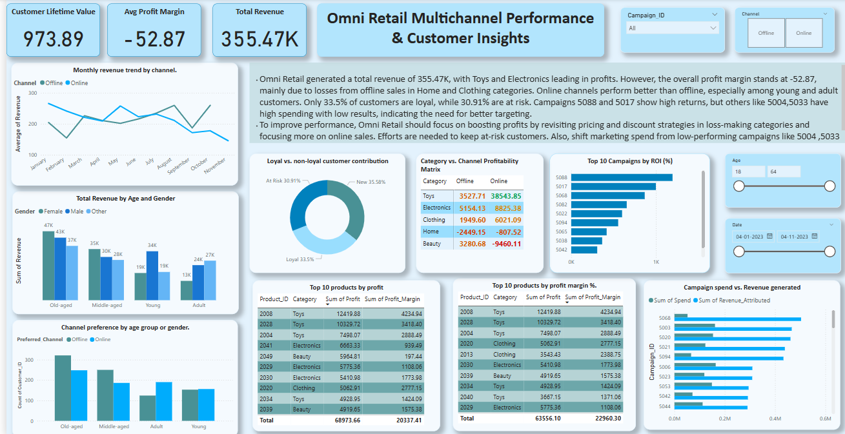
Figure 1.1.Dashboard snippet

Slide 12
Key Findings & Insights
.
Online channels outperform offline in both revenue and margin
Major losses from Home and Clothing in offline sales
Young and adult customers prefer online; older customers prefer offline
Best campaigns: 5088 and 5017; Worst: 5004 and 5033
Loyalty status: 33.5% loyal, 30.9% at risk
CONCLUSION & RECOMMENDATIONS
Revise pricing/discount strategies to improve the overall profit margin.
Focus on online marketing for young and adult segments
Reallocate marketing budget toward high-ROI campaigns like 5088 and 5017
Retarget lapsed or at-risk customers with loyalty programs or personalized offers.
Improve Home category offerings, especially in offline channels.

