Slide 1
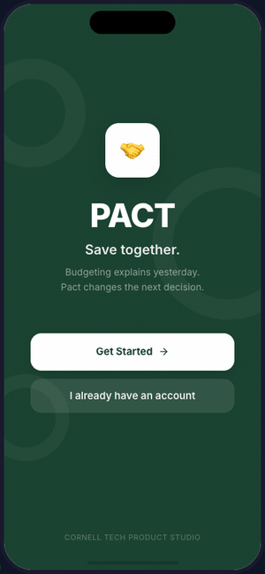
PACT
Save together.
Social savings through playful accountability
Cornell Tech Product Studio | Maker Day 2 | October 2026

Slide 2
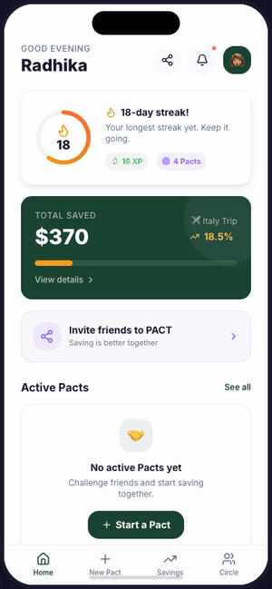
THE PROBLEM
Radhika | 35 seconds
$300+/month on food delivery for the average 25-year-old
The problem isn't awareness. Budgeting apps already tell you what you spent.
Good intentions disappear at the moment of temptation.
Current solution: a group chat that lasts 3 days.
"So we built something better."
Welcome
Home Dashboard

Slide 3
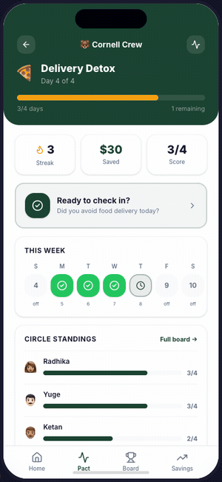
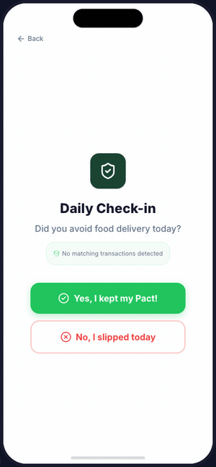
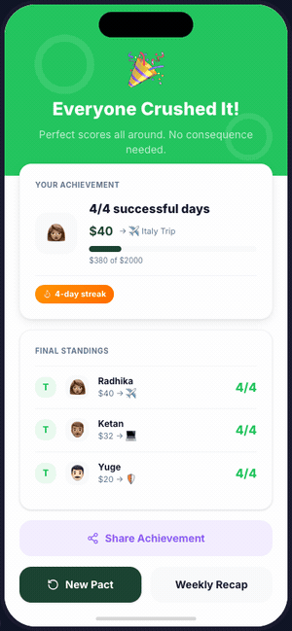
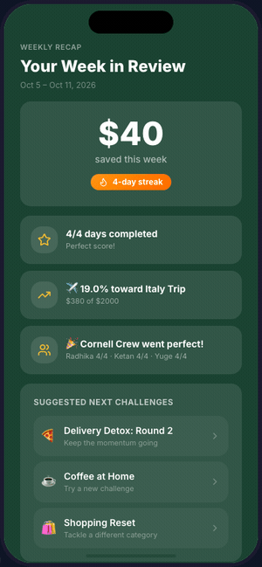
PACT IN ACTION
Ketan | 90 seconds
Demo Journey
1. Streak, savings, trending consequences
2. Same rules, personal savings amounts
3. One question, 10 seconds
4. Celebrate or face consequences
5. Savings recap, start next challenge
Commit > Check in > Celebrate > Repeat
Home
Active Pact
Check-in
Results
Recap

Slide 4
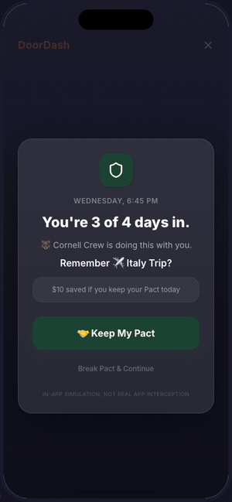
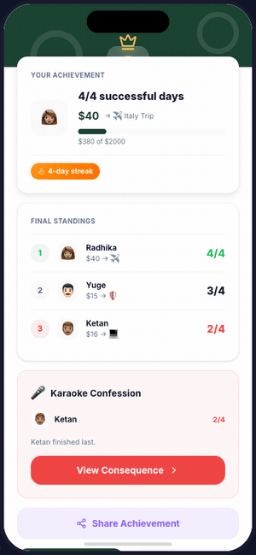
WHY CHOOSE PACT?
Yuge | 55 seconds
Next-best alternative: a group chat
Structure
Gamification
Stakes
Savings
Same rules, clear duration,
defined eligible days
Streaks, XP, daily check-ins
that create a habit
Playful consequences that
are fun, not punitive
Every successful day moves
money toward your goal
App Friction
Trade-off: download an app + 10 sec/day. Follow-through increases 65%.
Consequences

Slide 5
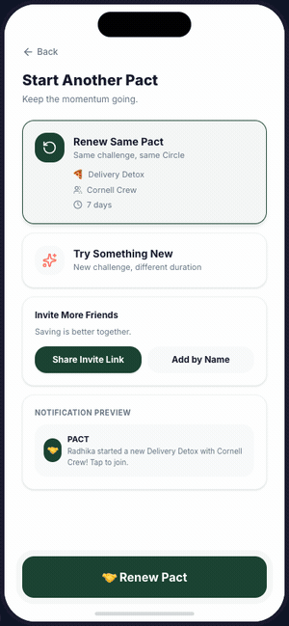
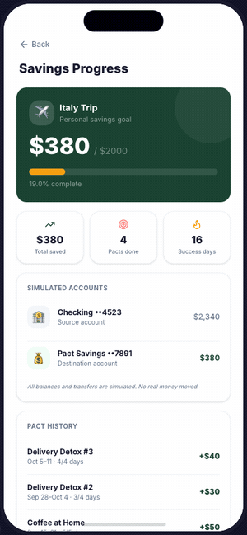
WHY USERS RETURN
Radhika | 35 seconds
The Repeat Loop
Finish a 7-day challenge → see savings grow
Streak is alive, friends ready for another round
App suggests next: Coffee at Home, Shopping Reset
Each cycle: streak grows, XP accumulates, goal closer
Consequence content is shareable → viral acquisition
1 download → invite 3 → loser posts → followers try
Weekly Recap
Renew Pact
Savings

Slide 6
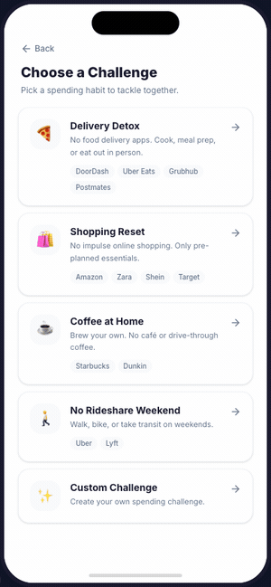
CAN WE BUILD A BUSINESS?
Ketan | 55 seconds
Technical
Operational
Financial
Core loop: standard mobile eng
Circle activation is main risk
Freemium + bank partnerships
15 screens, 20 demo states
Need 3-5 friends to join
$2.40 ARPU/month
Bank integration via Plaid
Starting: Cornell student groups
LTV/CAC: 3.2x base case
Riskiest Assumption: Will 3-5 friends download and complete a 7-day challenge together?
Create Pact Flow

Slide 7
THE ASK
Yuge | 30 seconds
What we need next:
1. 5 concept-test interviews (20 min) to validate circle activation
2. 1 live pilot: 3 friend groups using PACT for 2 weeks
3. Partner intros: campus orgs, financial wellness programs
4. Technical mentorship: Plaid integration, iOS development

Slide 8
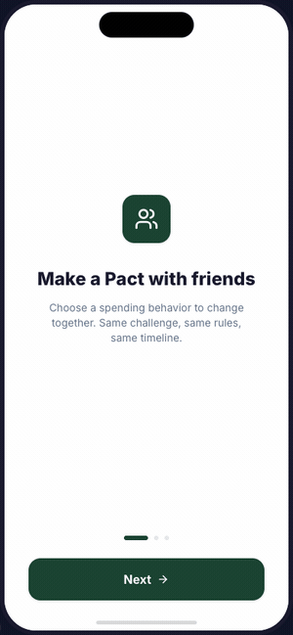
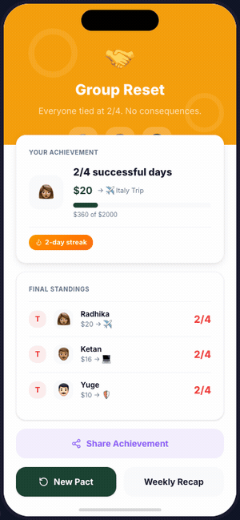
COMPLETE PRODUCT DEMO
15 screens | 20 interactive states | Animated walkthrough
Welcome
Onboarding
Home
Create Pact
Active Pact
App Friction
Check-in
All Perfect
Last Place
All Tied
Recap
Savings
Renew

