Slide 1
Footbinding
A National Fetish

Slide 2

Footbinding
“Golden Lotus” – A three inch foot
Process begins from ages 5 – 7
Two year process
Risk of Sepsis and Death
Upward Marriage and the sexualization of the foot

Slide 3
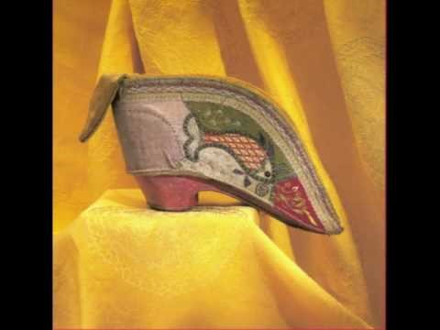
In Her Own Words
Notes:
http://youtu.be/U3hqKDHzYWc

Slide 4
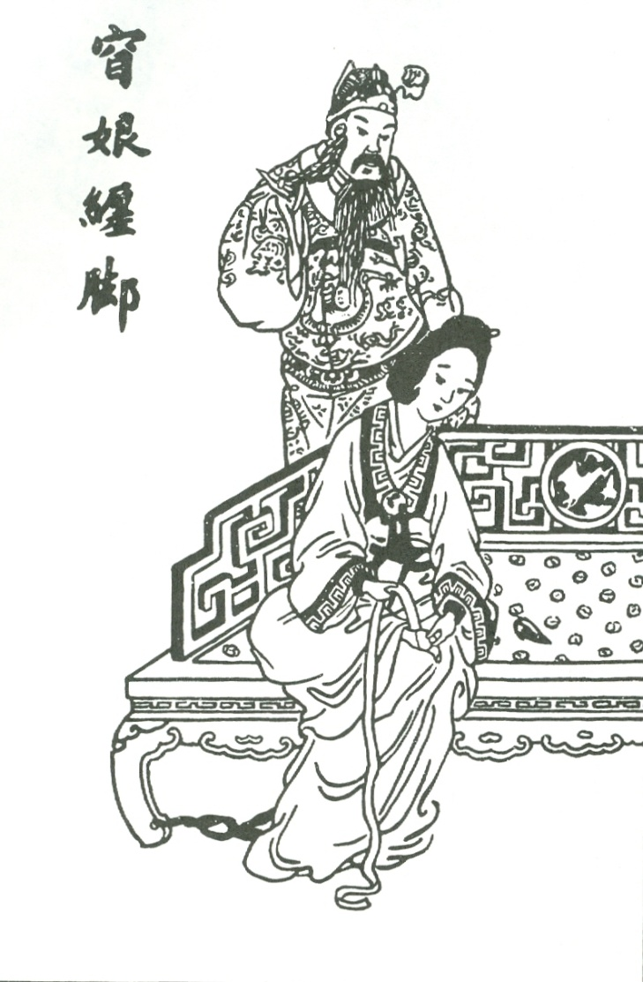
Origins
Origins lost to history
Only legends remain
  Fox Fairy (Xia)
  Yang Guifei (Tang)
  Yao Niang (Five Dynasties)
Literature and paintings indicate practice is widespread by the Northern Song
Yao Niang Binds her Feet

Slide 5
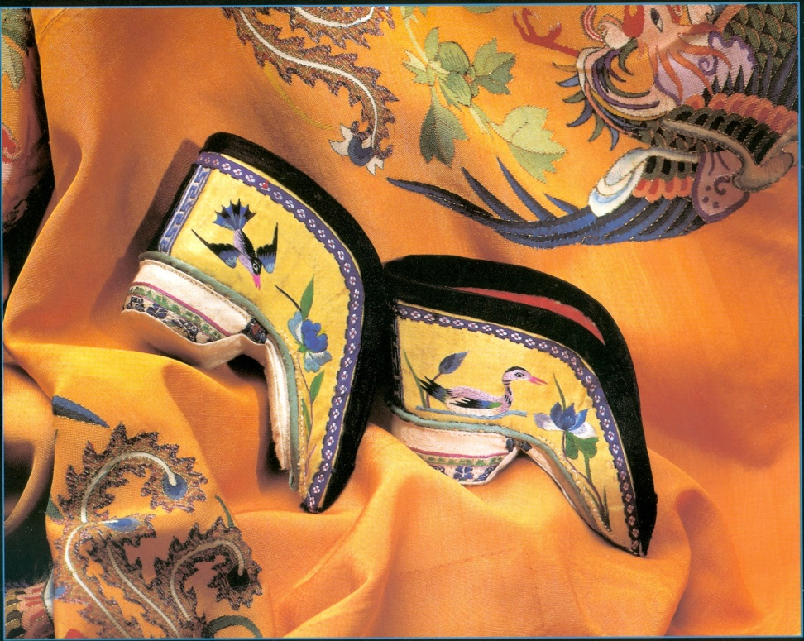
History
By Ming dynasty, spreads
throughout China
  Measurement of beauty
  and status symbol
  Marker of hierarchy
  Chance for upward marriage
By the end of the dynasty, custom spread to lower class women
Essentially a Han practice
  Hakka and other minorities did not bind feet

Slide 6
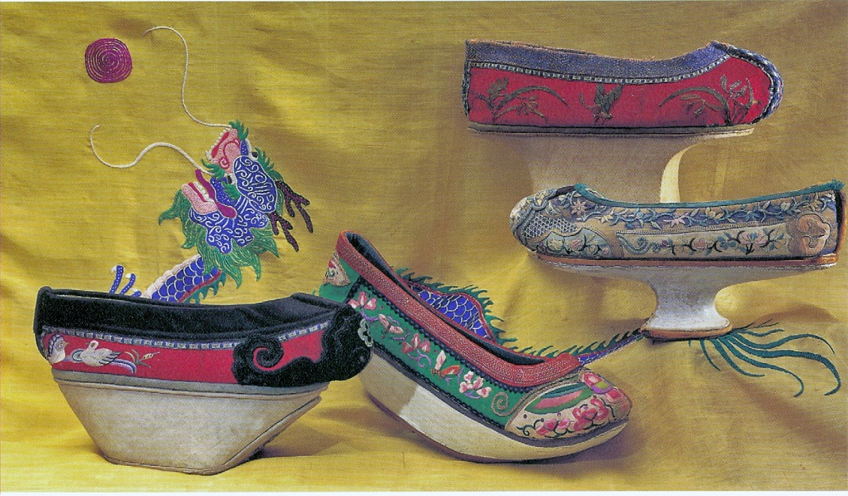
Footbinding and the Qing Dynasty
Qing (Manchu) Dynasty bans footbinding
  Like the queue, attempt to force assimilation into Manchu culture
  Ban fails among Han Women
Manchu women attempt to mimic “Lotus gait” with special shoes

Slide 7
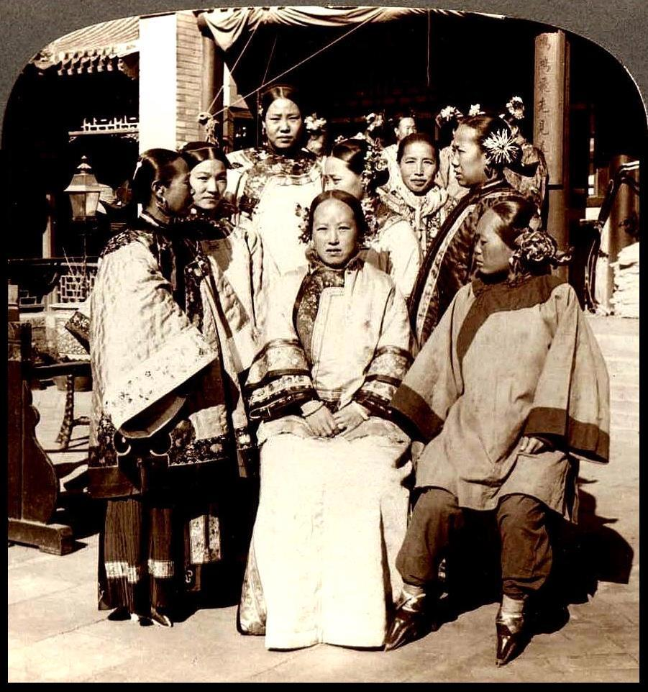
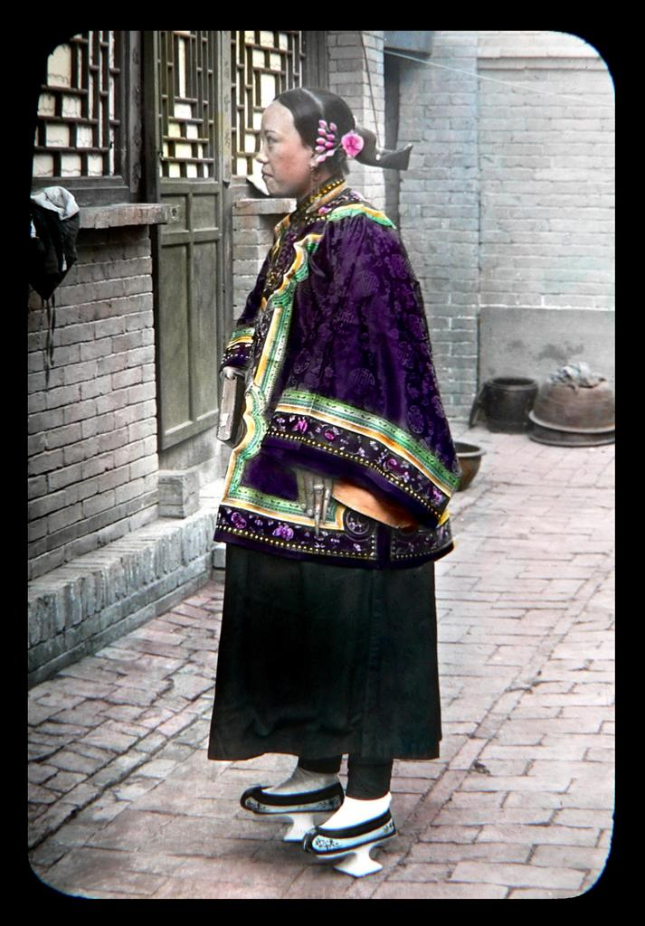
Manchu Women

Slide 8
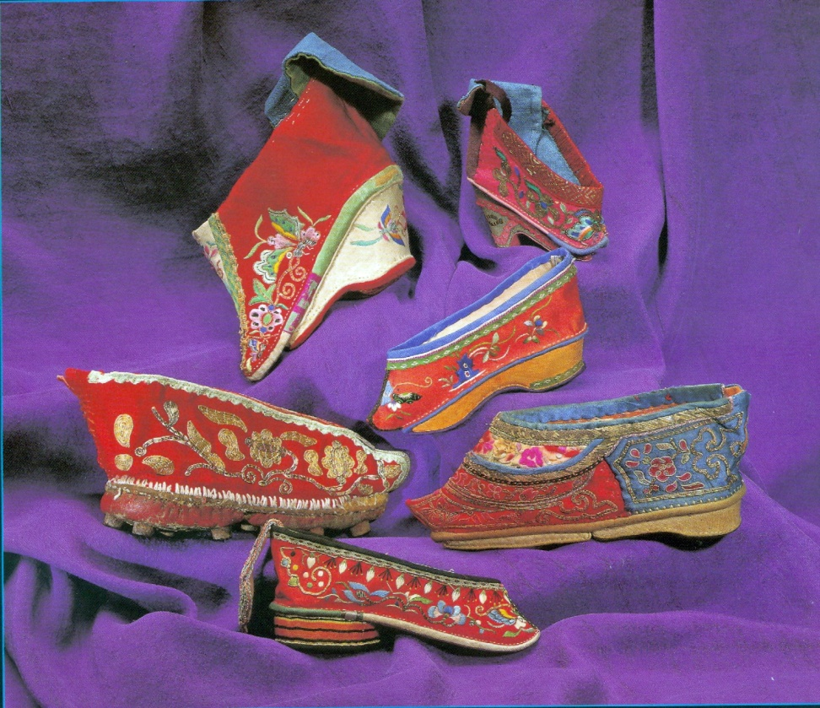
A National Fetish
Linkage to marriage and
male sexuality accounts for
longevity
Bindings create taboo
Taboo sexualizes foot
  Parallel to female breast in
  West
Becomes widespread fetish
  Even shoe becomes object of masturbatory fantasy
  Unbound foot becomes sex object during intercourse
“A plain face is given by heaven, but poorly bound feet is a sign of laziness.”

Slide 9
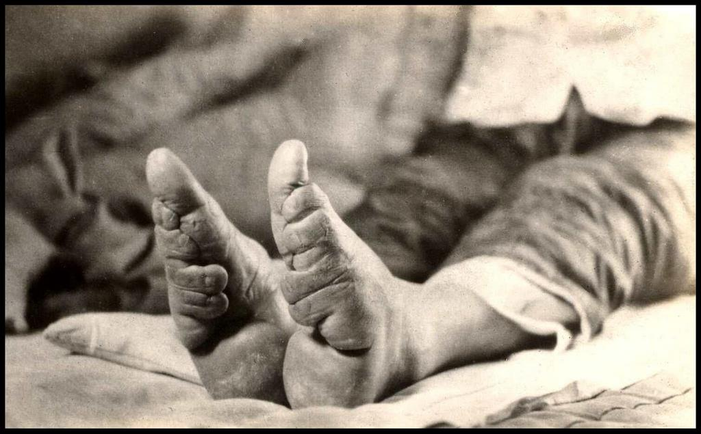
Anti-Footbinding Movement
19th century reformist
scholars criticize foot-
binding
  Patriarchal oppression and
  Subjugation of women
  Host demonstration exposing
  unbound feet; draws 1000s
Joined by Christian Missionaries
Republican China bans footbinding, imposing stiff fines
  Women continue to bind feet in secret

Slide 10
Judgements
Cultural Relativism?
History of Body Modifications
  Lip plates, head bindings, male circumcision, and female genital mutilations, piercings and tattoos

Slide 11
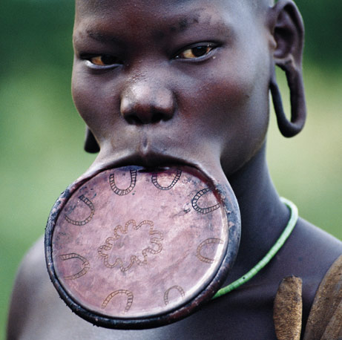

Slide 12
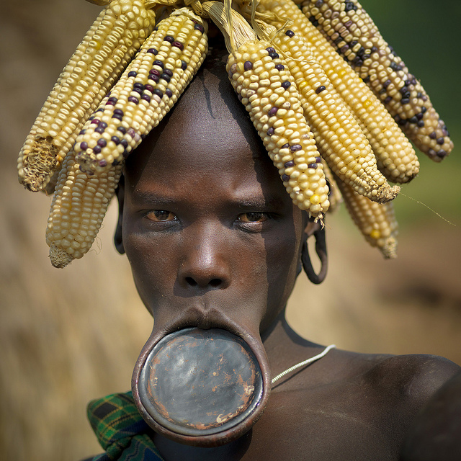

Slide 13
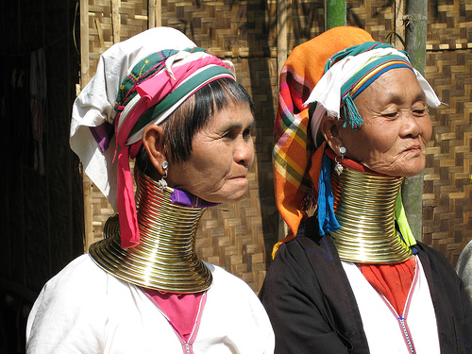

Slide 14
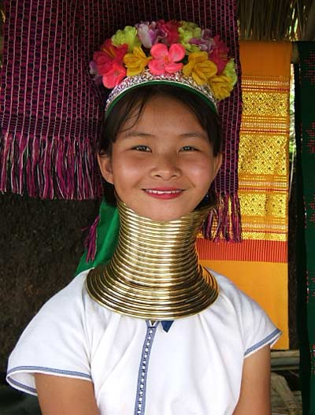

Slide 15
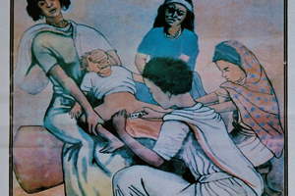
Notes:
An estimated 100 to 140 million girls and women in the world are victims of Female Genital Mutilation (FGM). In addition to life-long traumas, they often suffer from potentially fatal infections, bleeding and complications during childbirth. The harmful practice is among the main reasons for the high maternal mortality rates in Africa and Asia.
FGM is mostly performed by laypersons using primitive tools such as knives, glass cullets or razor blades to remove the clitoris, often with partial or complete excision of the labia majora. The most severe form of genital mutilation includes cutting the labia minora. The intervention is carried out without anesthesia.
This inhumane tradition is practiced in 28 countries of Africa and parts of Asia and the Middle East. The girls on whom the operation is performed are often under 14 years old. Through the cutting, they are supposed to enter into adulthood in a "clean" condition. Women on whom FGM has not been performed are often not considered as adequate wives by the respective ethnic groups.
Since the UN General Assembly of December 1993, Female Genital Mutilation is considered to be a specific form of violence against girls and women and thus an act of human rights violation, as confirmed by the International Conference on Population and Development in 1994 in Cairo at which its abolition was demanded.

Slide 16
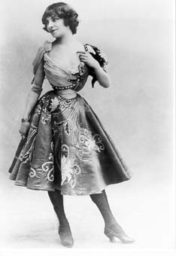
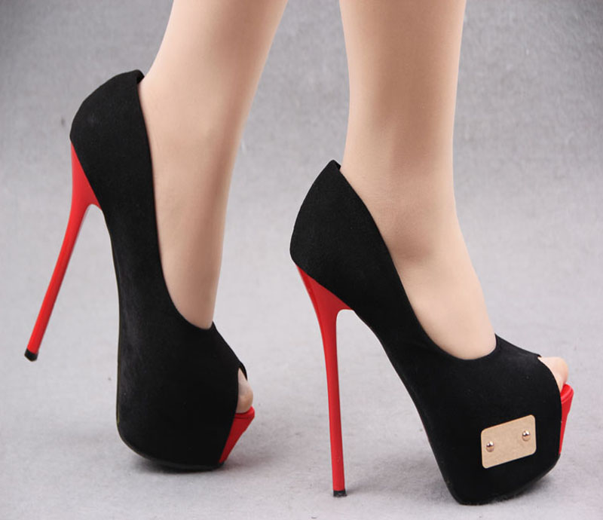
Judgements
Cultural Relativism?
History of Body Modifications
  Lip plates, head bindings, genital mutilations
Western aesthetic body modifications
  Corsets
  Breast augmentations
  High heels most parallel to footbindings
Notes:
http://exhibits.hsl.virginia.edu/clothes/
http://www.washingtonpost.com/national/health-science/high-heeled-shoes-may-look-good-but-theyre-bad-for-your-feet/2013/06/17/54945c14-c22d-11e2-914f-a7aba60512a7_story.html

Slide 17
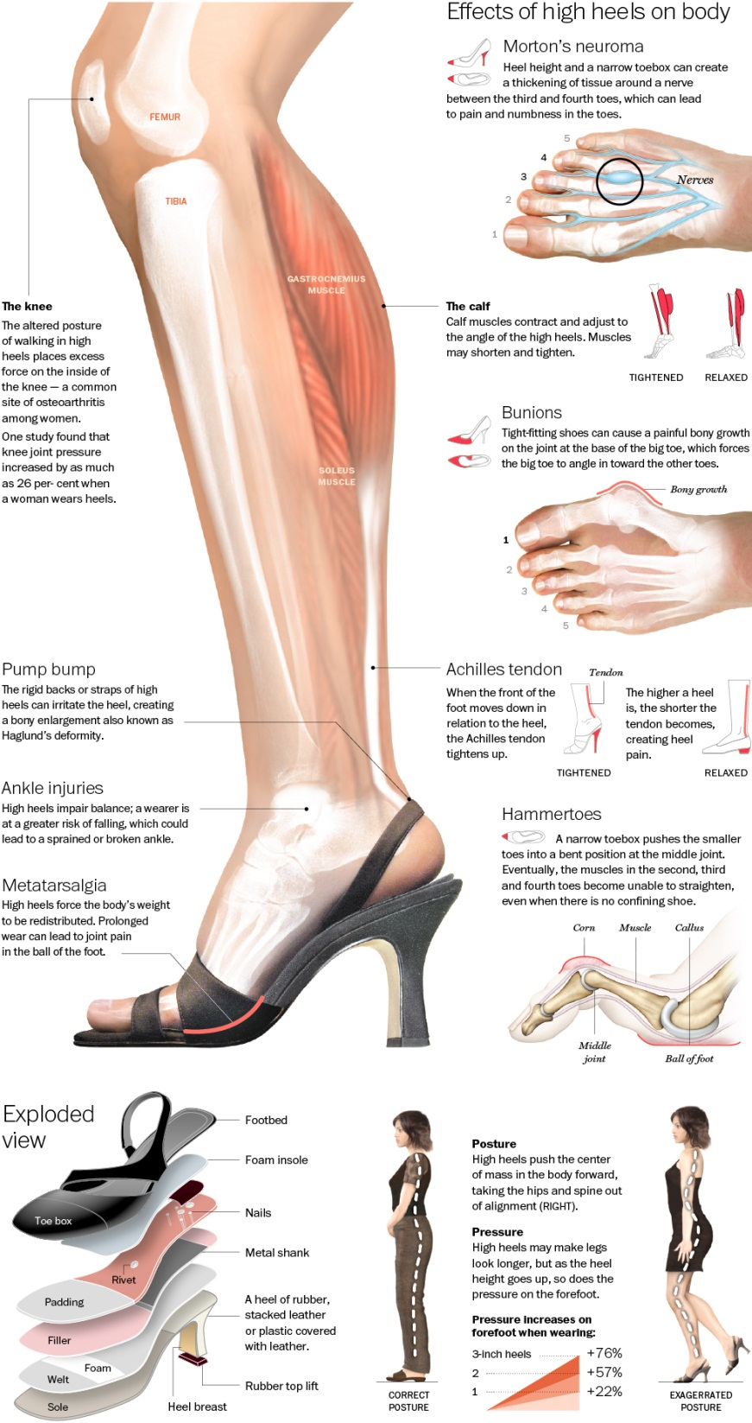
Effects of high heels on the body
Morton’s neuroma
Excessive force on inside of knee
Calf muscles shorten and tighten
Bunions = boney growth
Pump bump
Ankle injuries
Metatarsalgia – pain in ball of foot
Hammertoe – 3rd and 4th toe unable to straighten
Accentuates posterior for male gaze
Notes:
http://visual.ly/true-effect-high-heels?utm_source=visually_embed

Slide 18
Judgements
Cultural Relativism?
History of Body Modifications
  Lip plates, head bindings, genital mutilations
Western aesthetic body modifications
  Corsets
  Breast augmentations
  High heels most parallel to footbindings
Only different by degree
Notes:
http://exhibits.hsl.virginia.edu/clothes/
http://www.washingtonpost.com/national/health-science/high-heeled-shoes-may-look-good-but-theyre-bad-for-your-feet/2013/06/17/54945c14-c22d-11e2-914f-a7aba60512a7_story.html

