Slide 1
MINI PROJECT PRESENTATION
FinMentor AI
AI-Powered Personalized Financial Literacy Platform
Yugesh A
242237
B.Sc. Computer Science (Data Science and Analytics)
Guide: Mr. Prajith Vishwa R, M.Sc. AI and DS
Department of Computer Science · Subbalakshmi Lakshmipathy College of Science, Madurai · 2026–2027

Slide 2
Abstract & Objectives
Objectives
Abstract
1
Connect real transaction data to financial education
FinMentor AI is a web-based platform that turns a user's own bank transactions into a personalized financial-learning journey. A rule-based engine scores financial health, a recommendation engine ranks ten lessons by the user's weakest areas, and a server-side AI (Groq, Llama 3.3 70B) adds personalized insights and mentor chat.
2
Rank lessons by each user's own weaknesses
3
Validate understanding through quizzes
4
Offer contextual AI mentoring as an educational tool, not financial advice
"Don't just tell users how they spend. Teach them why it matters."
FinMentor AI | Yugesh A | 242237
2

Slide 3
Existing System & Limitations
Existing System
Generic Content
No Prioritization
One-size-fits-all, not tailored to individual data.
No guidance on what to learn first.
Books, articles, videos and online courses give general knowledge, unrelated to the learner's own spending.
Budgeting apps and statement analytics show charts, but offer no structured lessons or learning paths.
Data–Education Gap
Low Engagement
Apps show data but do not teach concepts.
Hard to relate material to one's own situation.
No Progress Validation
Manual Assessment
No check of understanding before moving on.
Needs a financial counsellor's effort.
FinMentor AI | Yugesh A | 242237
3

Slide 4
Proposed System & Advantages
1
2
3
4
5
Import
›
Analyse
›
Roadmap
›
Learn & Quiz
›
Mentor & Track
CSV, Excel or manual entry; 50+ category mappings
Rule-based profile and 0–100 health score
10 lessons ranked by the user's weaknesses
Lesson, AI insight + action, 2-question quiz
AI chat and literacy score progress
Key advantages
Personalized Roadmap
Transparent Analysis
Server-Side AI
Progress Validation
Lesson order follows the user's weaknesses, not a fixed curriculum.
Deterministic rule-based engine; no AI in the scoring.
The Groq API key never reaches the browser.
Quiz results persist in Firestore; passing unlocks the next lesson.
FinMentor AI | Yugesh A | 242237
4

Slide 5
Hardware & Software Requirements
Hardware
Software
Component | Minimum
Processor | Intel Core i5 (7th Gen)
RAM | 8 GB (16 GB recommended)
Storage | 20 GB free disk space
Display | 1366 × 768 or higher
Internet | Stable broadband
Browser | Chrome / Edge / Firefox 120+
Category | Technology
Language | TypeScript 5.8 (strict)
Runtime | Node.js 20 LTS or higher
Framework | React 19, TanStack Start 1.x
Build | Vite 8, Nitro 3 (SSR)
Styling | Tailwind CSS v4, shadcn/ui
Cloud | Firebase Auth, Cloud Firestore
AI / LLM | Groq, llama-3.3-70b-versatile
Parsing | PapaParse, SheetJS
Tools | VS Code, Git + GitHub, npm
FinMentor AI | Yugesh A | 242237
5

Slide 6
Functional & Non-Functional Requirements
Functional
Non-Functional
Email/password sign-up and login
Import via CSV, Excel or manual entry
Financial profile and 0–100 health score
Ranked 10-lesson personalized roadmap
AI insight and action per lesson
2-question quiz; pass unlocks next lesson
AI mentor with profile and last 10 messages
Progress page with literacy score
Performance
Analysis runs client-side in milliseconds
Security
Groq API key stays on the server
Availability
Firebase SLA 99.95% plus Groq uptime
Usability
Responsive UI for desktop and mobile
Maintainability
Strict TypeScript, separated engines
Privacy
Only aggregate metrics sent to the AI
FinMentor AI | Yugesh A | 242237
6

Slide 7
Software Description
TypeScript 5.8
React 19 + TanStack Start
Vite 8 + Nitro 3
Strict typing across Transaction, FinancialProfile, Lesson and UserProgress models.
Component UI, SSR, type-safe file-based routing and server functions.
Fast builds and the server engine; Cloudflare Workers by default.
Tailwind v4 + shadcn/ui
Firebase Auth + Firestore
Groq + Llama 3.3 70B
Utility-first styling with accessible Radix-based components.
Session management and per-user data keyed by UID.
Low-latency lesson personalization and mentor chat, server-side only.
PapaParse (CSV) and SheetJS (Excel) both feed one shared normalizeRows function for category mapping, amount validation and date parsing.
FinMentor AI | Yugesh A | 242237
7

Slide 8
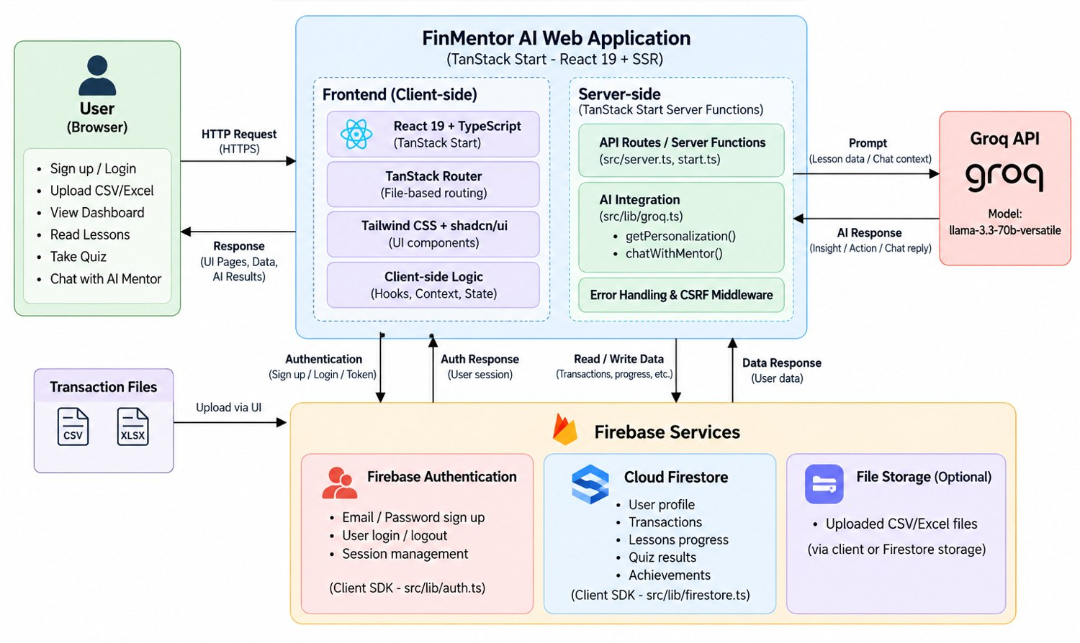
System Architecture
Client
React 19, TanStack Router, Tailwind UI
Server functions
getPersonalization and chatWithMentor call Groq; CSRF middleware
Firebase
Auth for sessions, Firestore for user data
FinMentor AI | Yugesh A | 242237
8

Slide 9
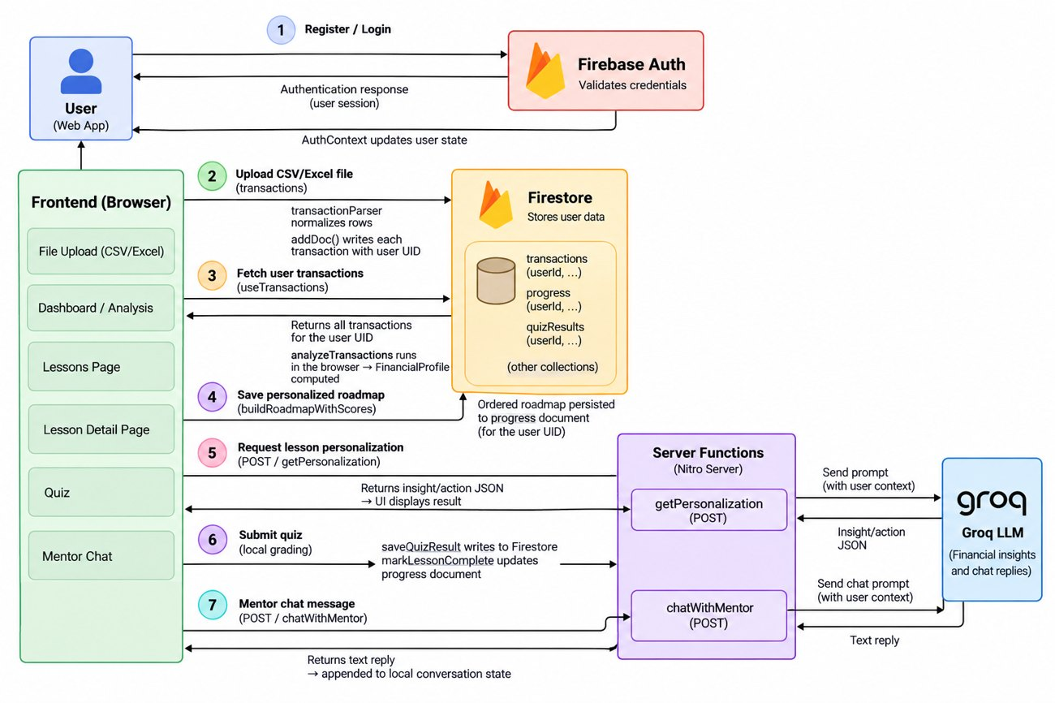
Data Flow
1
Register / log in
2
Upload CSV / Excel
3
Fetch transactions
4
Save personalized roadmap
5
Request lesson personalization
6
Submit quiz
7
Mentor chat message
FinMentor AI | Yugesh A | 242237
9

Slide 10
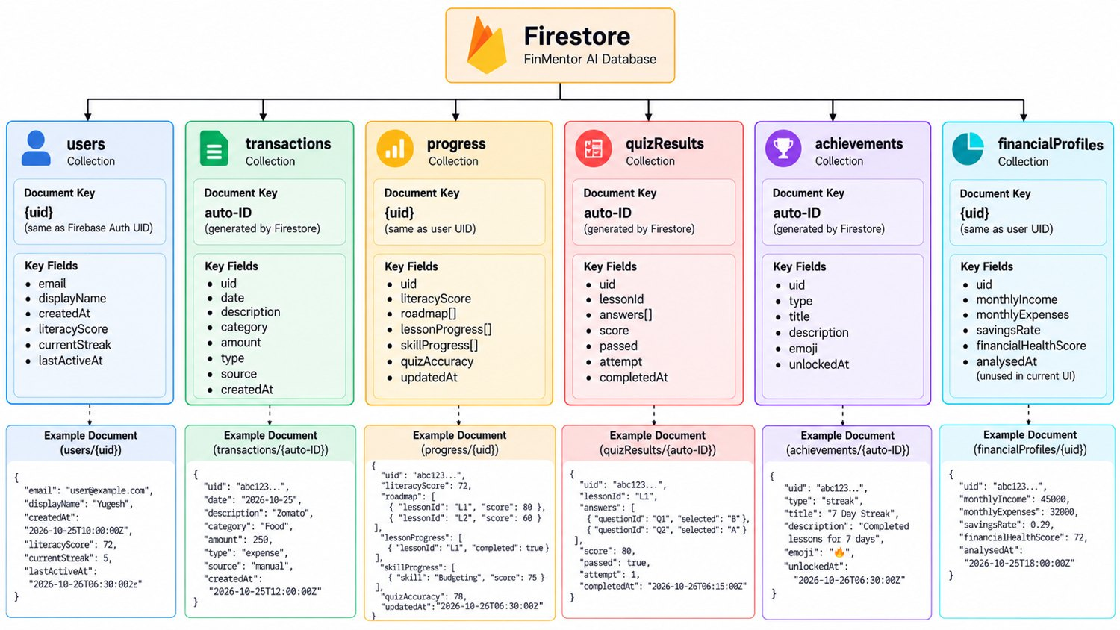
Firestore Data Model
6
collections
UID
keyed per user
Raw
data stays in user's own collection
FinMentor AI | Yugesh A | 242237
10

Slide 11
Modules & Scoring Logic
1
2
3
4
5
Authentication
Analysis & Recommendation
Lesson & AI Insight
AI Mentor Chat
Progress Tracking
Firebase login; protected /app routes
Profile, health score, ranked roadmap
Content, Groq insight + action, quiz
Profile and last 10 messages as context
Literacy score, skill bars, badges
FinMentor AI | Yugesh A | 242237
11

Slide 12
Module 1: Authentication
Controls who can enter the app and keeps each user's data separate.
1
How it works
Firebase
Register with display name, email and a password of 8+ characters
Firebase Auth creates the account; a users document is bootstrapped in Firestore (literacy score and streak start at 0)
Login persists the session; AuthContext subscribes to onAuthStateChanged
ProtectedRoute wraps every /app route and redirects unauthenticated users to login
Email / password auth
Key files
src/lib/auth.ts
src/contexts/AuthContext.tsx
src/routes/auth/login.tsx
src/routes/auth/signup.tsx
FinMentor AI | Yugesh A | 242237
12

Slide 13
Module 2: Financial Analysis & Recommendation Engine
The analytical core: a deterministic, rule-based engine with no AI in the scoring.
2
How it works
10 lessons
analysisEngine computes income, expenses, savings rate, cash flow, category breakdown, emergency fund and investment rate
Health score (0 to 100) across five dimensions: savings 30, debt/EMI 20, emergency fund 20, investment 15, subscriptions 15
Plain-language observations tagged as warning, info or positive
recommendationEngine gives each of 10 topics a 0 to 200 priority using an additive-penalty model; advanced topics are readiness-gated
Ranked per user
Key files
src/engine/analysisEngine.ts
src/engine/recommendationEngine.ts
FinMentor AI | Yugesh A | 242237
13

Slide 14
Module 3: Lesson Content & AI Personalization
Delivers the ten lessons and adds a personal AI insight to each one.
3
How it works
Server-side
10 static lessons: budgeting, saving, emergency fund, debt, investing, goals, insurance, digital safety, spending psychology, financial independence
Each lesson has content, key takeaways and a 2-question quiz
Opening a lesson calls the getPersonalization server function with the profile summary
Groq returns a 2 to 3 sentence insight plus one concrete action for the week; AI text is rendered as escaped text, never raw HTML
API key never in browser
Key files
src/routes/app/lessons_.$lessonId.tsx
src/lib/groq.ts
src/data/lessons.ts
FinMentor AI | Yugesh A | 242237
14

Slide 15
Module 4: AI Mentor Chat
Conversational support that knows the learner's finances and progress.
4
How it works
Llama 3.3 70B
System prompt embeds the derived profile, completed lessons and current lesson
The last 10 messages are sent as conversation context
The mentor is warm and encouraging, stays educational and redirects off-topic questions politely
chatWithMentor runs as a server function; chat lives in React state and resets on reload
via Groq API
Key files
src/routes/app/mentor.tsx
src/lib/groq.ts (chatWithMentor)
FinMentor AI | Yugesh A | 242237
15

Slide 16
Module 5: Progress & Achievement Tracking
Shows how far the learner has come and validates understanding.
5
How it works
0 to 100
Each lesson is locked, unlocked, in progress or completed; passing a quiz unlocks the next lesson
Literacy score (0 to 100): lesson completion 60, quiz accuracy 20, streak 10, achievements 10
Progress page shows per-topic skill bars, lesson history and achievement badges
Results are persisted in Cloud Firestore per user
Literacy score
Key files
src/routes/app/progress.tsx
src/hooks/useProgress.ts
computeLiteracyScore()
FinMentor AI | Yugesh A | 242237
16

Slide 17
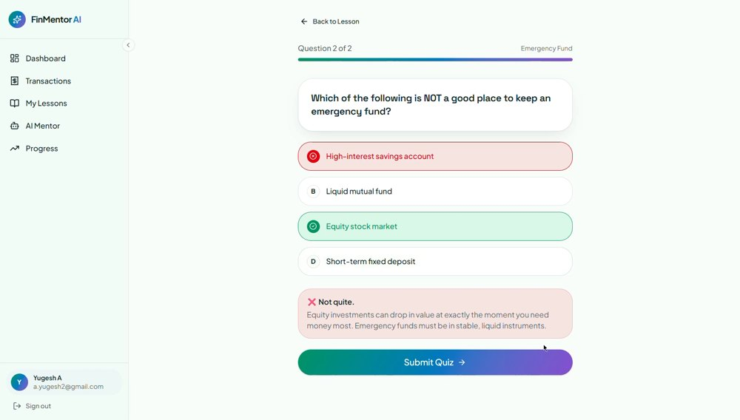
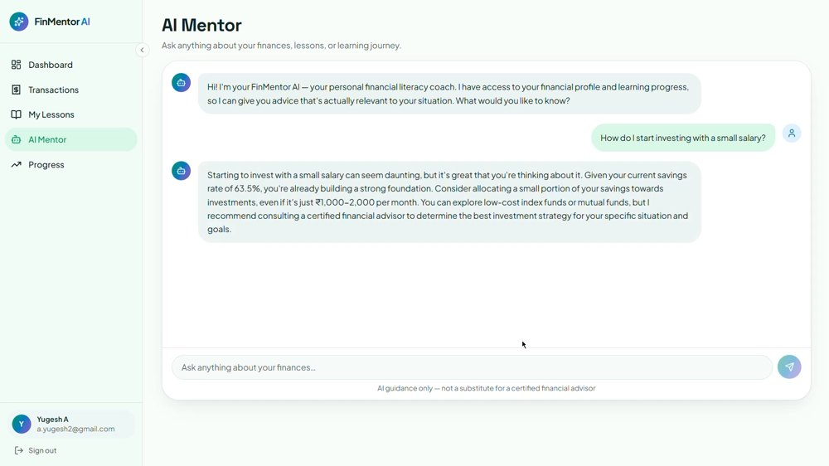
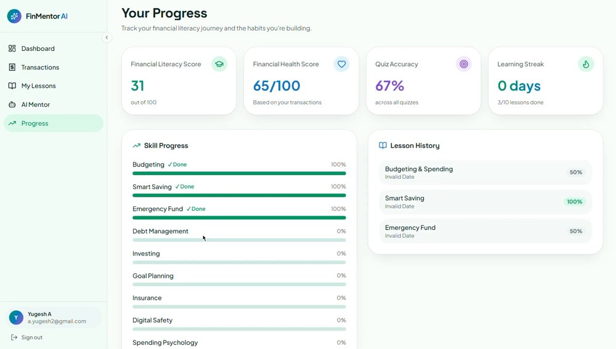
Screens: Quiz, Mentor & Progress
Quiz
AI Mentor
Progress
Two multiple-choice questions with instant feedback and explanations; passing unlocks the next lesson.
Context-aware chat with starter questions, using the financial profile and lesson history.
Literacy score, per-topic skill bars, lesson history and achievement badges.
FinMentor AI | Yugesh A | 242237
21

Slide 18
Conclusion
1
Transparent analysis
The rule-based engine scores financial health with no AI, so results are deterministic, explainable and free of hallucination.
2
Personalized roadmaps
The additive-penalty recommendation engine produces different lesson orders for different financial profiles.
3
Secure AI integration
Groq calls run as TanStack Start server functions, so the API key never reaches the browser; CSRF middleware protects the endpoints.
4
Working prototype
Combines TypeScript, React 19, TanStack Start, Firebase and LLMs to close the gap between financial data and financial education.
FinMentor AI | Yugesh A | 242237
22

Slide 19
Future Enhancements
1
Firestore security rules
2
AI endpoint auth & rate limits
3
AI response caching
Least-privilege per-UID rules, tested with the Emulator Suite.
Verify Firebase ID tokens; per-user daily token budgets.
Cache insights per user, lesson and profile hash to cut API calls.
4
Achievements & streaks
5
Safe lesson renderer
6
Automated testing
Wire unlock and streak logic into markLessonComplete.
Replace dangerouslySetInnerHTML with sanitized react-markdown.
Unit tests for engines and parser; Playwright end-to-end tests.
7
Analysis accuracy
8
Dependency upkeep
9
Persistent mentor chat
Bucket transactions into 30-day windows for true monthly figures.
Replace xlsx 0.18.5, prune unused packages, add npm audit to CI.
Store conversations in Firestore across sessions.
FinMentor AI | Yugesh A | 242237
23

Slide 20
Bibliography
1.
TanStack. TanStack Start Documentation.
6.
PapaParse. PapaParse Documentation.
https://tanstack.com/start/latest
https://www.papaparse.com/docs
2.
TanStack. TanStack Router Documentation.
7.
SheetJS. SheetJS Community Edition Documentation.
https://tanstack.com/router/latest
https://sheetjs.com/
3.
Groq. Groq API Documentation.
8.
Nitro. Nitro Server Engine Documentation.
https://console.groq.com/docs/openai
https://nitro.build/
4.
Firebase. Firebase Authentication Documentation.
9.
OWASP Foundation. OWASP Top 10: 2021.
https://firebase.google.com/docs/auth
https://owasp.org/www-project-top-ten/
5.
Firebase. Cloud Firestore Documentation.
10.
Firebase. Firebase Security Rules Documentation.
https://firebase.google.com/docs/firestore
https://firebase.google.com/docs/rules
FinMentor AI | Yugesh A | 242237
24

Slide 21
Thank You
Questions Welcome

