Slide 1
Gap Detection using PCD

Slide 2
GAP DETECTION USING PCD
Problem statement :
The measurement of gaps between automobile parts is a critical task in ensuring the quality, functionality, and aesthetic appeal of vehicles. Traditional gap measurement methods are manual, labor-intensive, and prone to errors. This project aims to develop an automated system for accurately measuring gap widths using point cloud data captured by a 3D camera.
Objective
The primary objectives of the T4 Inspection System project are as follows:
  Data Acquisition: Capturing high-resolution point cloud data of the automobile parts with minimal noise and artifacts.
  Data Processing: Filtering and segmenting the point cloud data to isolate the regions of interest (i.e., the gaps between parts).
  Real-time Processing: Developing an efficient algorithm that can perform measurements in real-time or near-real-time for practical application in a manufacturing environment.
  Integration: Seamlessly integrating the system into existing manufacturing workflows and ensuring compatibility with other quality control processes.
  Efficiency Improvement: Streamline the inspection process to minimize manual checks, reduce inspection time, and enhance production efficiency.

Slide 3
PIPELINE
Step 1 - Reading and Analyzing PCD Data
Objective: Understand the structure and components of the Point Cloud Data (PCD).
Action: Read the PCD file.
Step 2 - Identifying 2D Regions of Interest (ROI)
Objective: Locate the specific areas within the PCD that are critical for analysis.
Action: Train Yolov8 model to predict the gap regions.
Step 3 – Cropping Point Cloud Data
Objective: Selecting required Point cloud data for gap analysis
Action: Crop PCD using min_x, max_x, min_y , max_y.
Step 4 – Drawing Lines along y-axis for different y values
Objective: To find uneven gap width.
Action: The gap is calculated using average of gap in all the defined lines.
Step 5 – Projecting those lines on xz-plane
Objective: Gap width is the difference between start point of next segment and end point of current segment
Action: Calculate the Euclidean distance between consecutive segments and name it as gap.

Slide 4
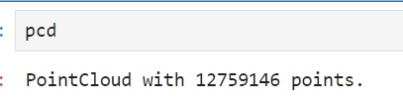
Reading and Analyzing PCD Data
Install and import open3d
pip install open3d
import open3d as o3d
Read the ply file using open3d
Eg: pcd = o3d.io.read_point-cloud(“file_name.ply”)

Slide 5
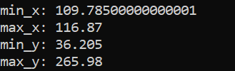
Identifying 2D Regions of Interest (ROI)
Annotate the train images using labelme
Train yolov8 model using those annotated masks and images
Validate the model using validate set
Save the model and checkpoints (last.pt, best.pt)
Use the model to predict the 2D ROI
Obtain min_x, max_x, min_y, max_y

Slide 6
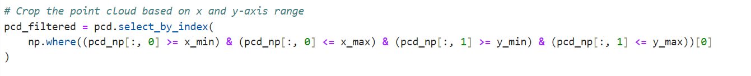
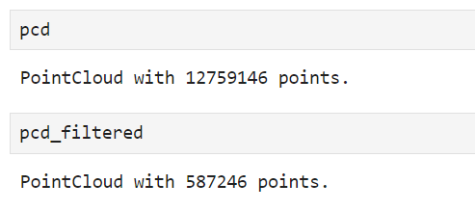
Cropping Point Cloud Data

Slide 7
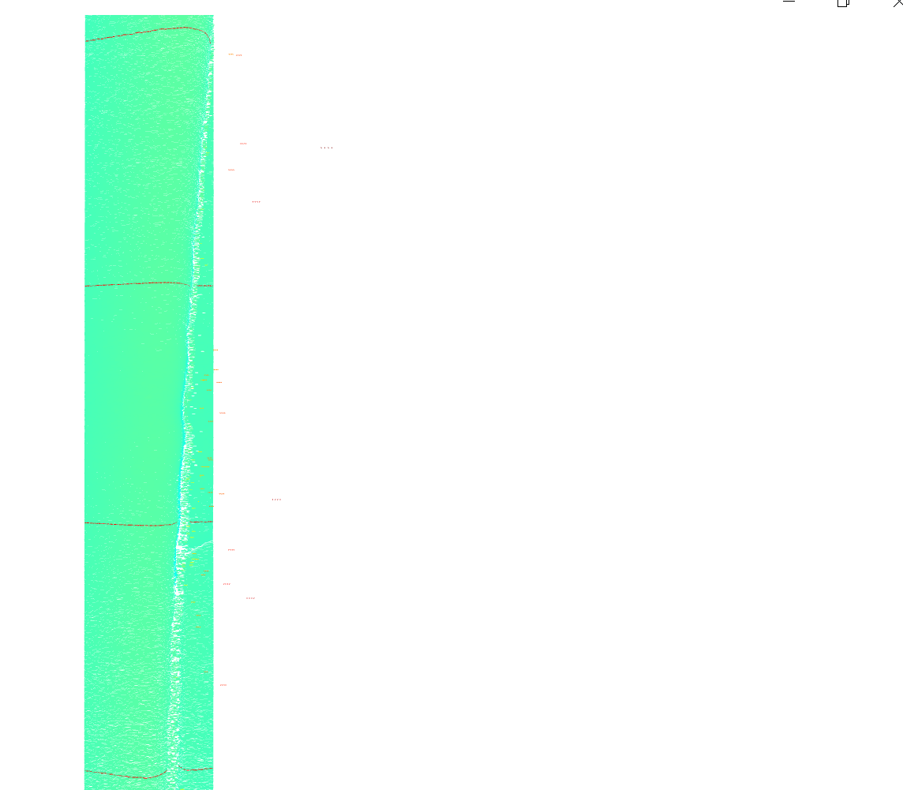
Drawing Lines along Y-axis for different y values
Declare the interval at which the lines should be drawn
In our case, I have drawn lines at every 10% interval.
min_y is the staring line and max_y is the ending line
The difference of y_max and y_min is multiplied by 0.1,0.2,….0.9 and is added to y_min to get the point at which we need to draw the line.
Tolerance of 0.03 is used in order to make sure that points are available at given y-value
min_y + (max_y-min_y)*0.4
min_y + (max_y-min_y)*0.3
min_y + (max_y-min_y)*0.2
min_y + (max_y-min_y)*0.1

Slide 8
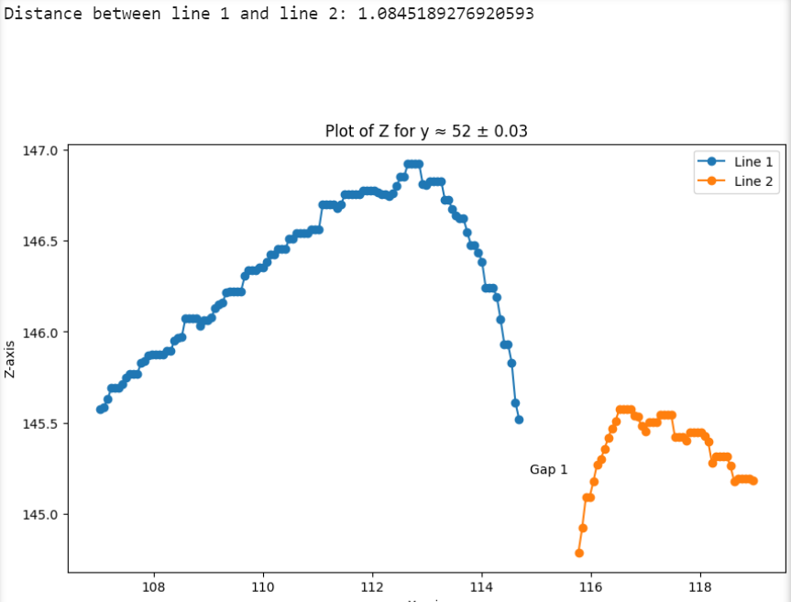
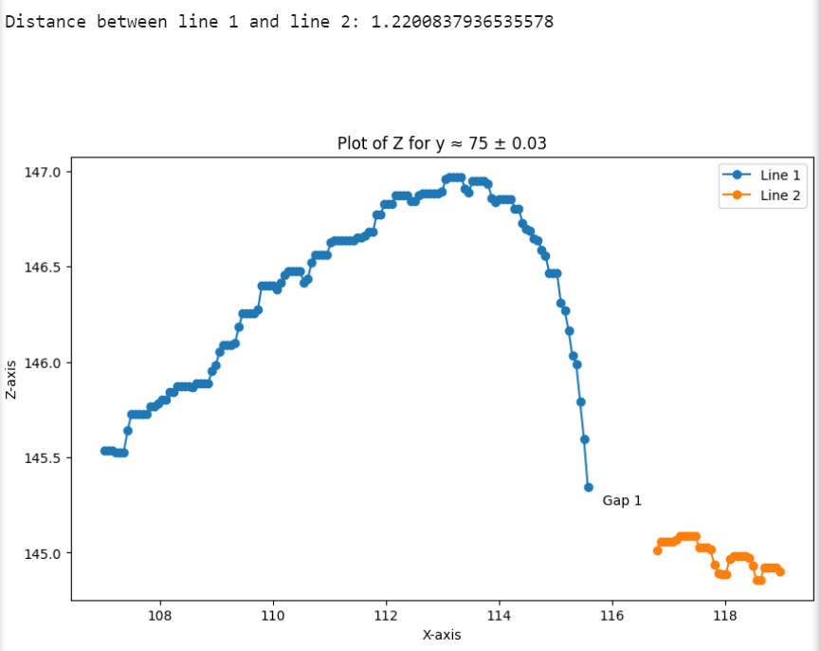
Plotting the line in XZ-plane

Slide 9
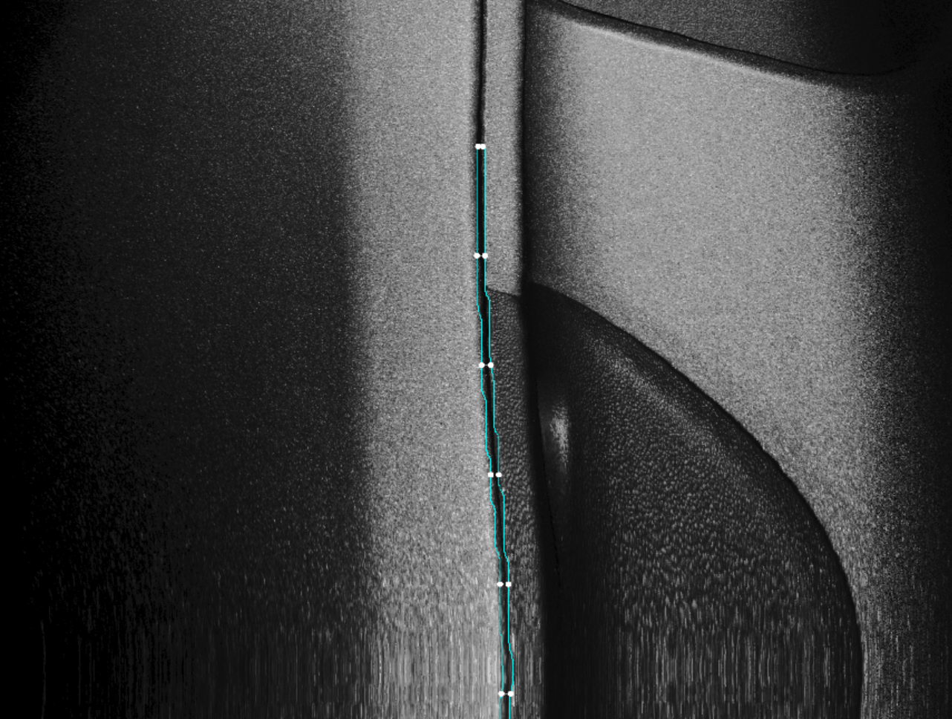
ROI Predicted by YOLO

Slide 10
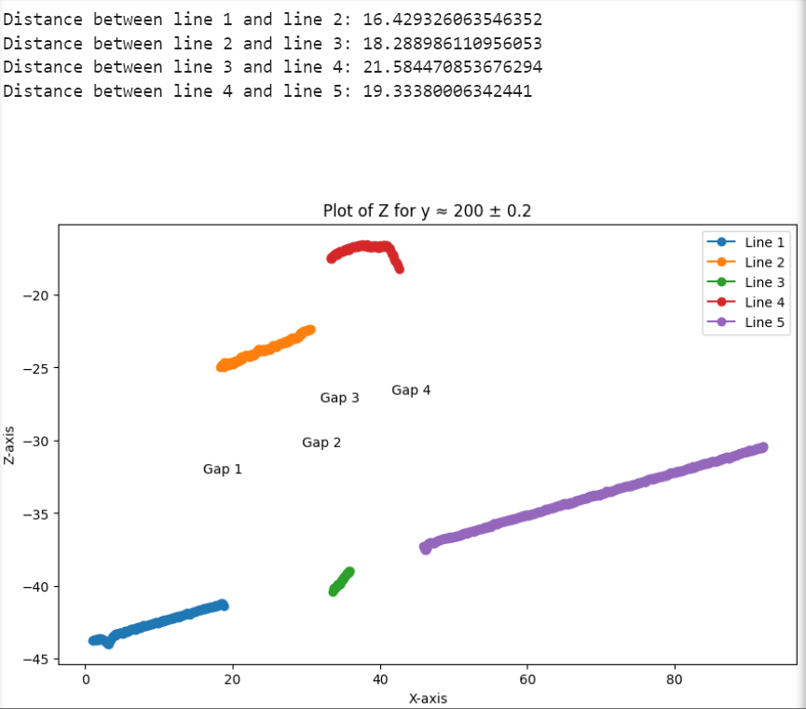
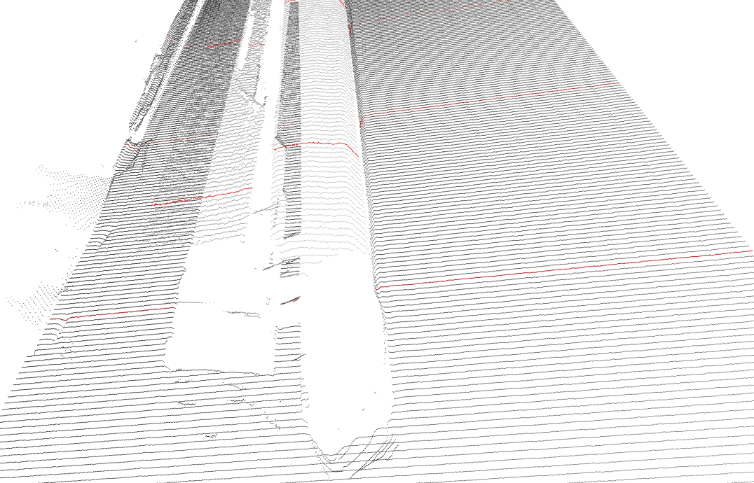
Testing Using Sample Data

Slide 11
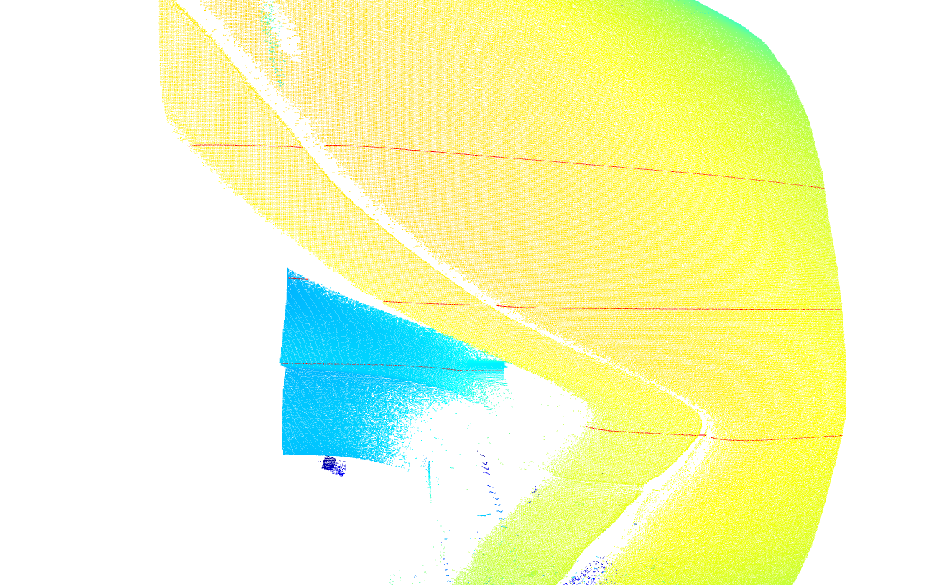

Slide 12
Thank you

