Slide 1
Land Use Land Cover Classification using SAR Images and Deep Learning Technique

Slide 2
Data Acquisition
The SAR data needed for the classification purpose is available on both European Space Agency and
Alaska Search Facility websites and we used Sentinel 1 SAR image datasets for the same.

Slide 3
Pre-processing
Radiometric calibration.
Debursting
Thermal Noise removal
Speckle filter.
Terrain Correction

Slide 4
Supervised classification

Slide 6
Deep learning using u-net

Slide 7
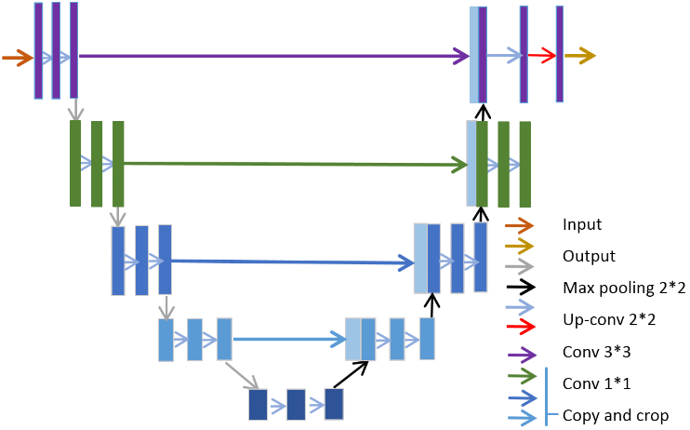
U-NET model
Accuracy – 85.4 %

