Slide 1

Technical Paper Presentation
Track Number: 1B, Paper ID: 412
A Feature-Based Recommendation System for Mobile Number Portability
Yugma Patel, Vrukshal Patel, Mohammad S. Obaidat, Nilesh Kumar Jadav, Rajesh Gupta, Sudeep Tanwar.

Slide 2
Presentation Outline
Introduction
Problems faced during MNP
Proposed architecture
Data Acquisition
Data Preprocessing
Clustering
Rank Assignment
Performance evaluation
MNP Recommendation system interface
Conclusion
References

Slide 3
Introduction
Internet has opened doors for endless opportunities for every individual across the globe.
During the time of Covid-19 pandemic businesses shifted to work-from-home, education shifted to e-learning requiring individuals to have reliable and affordable internet connections [4].
Mobile number portability is a service using which mobile number users can change their telecom company without changing their phone number.
Retaining the same mobile number is important.
Highest number of MNP requests recorded in 2021 [5].
[4] “need of strong internet during covid-19 pandemic.” https://blogs.worldbank.org/voices/covid-19-reinforces-needconnectivity, 2020. Accessed: 2021-11-25.
[5] Number of MNP requests in India from 2011 to 2021. https://www.trai.gov.in/release-publication/reports/telecom-subscriptions-reports (2021), accessed:2021-12-26

Slide 4
Problems faced during MNP
Diversity of plans: There are various MNOs in India, and within these network operators, there is a wide range of plans available to the users.
Wide range of benefits available to the customer : MNOs provide many benefits such as OTT subscriptions, post data consumption speed, data roll-over about which the user is unaware.
Difference in network strength of different MNOs across the nation: The network strength of a particular MNO differs with the area in which the user resides. It is one of the prime reasons for which users choose to port their number to a different MNO. Difference of mobile data speed across different states [2].
[2] Difference of mobile data speed across different states. https://myspeed.trai.gov.in/ (2021), accessed: 2021-11-20

Slide 5
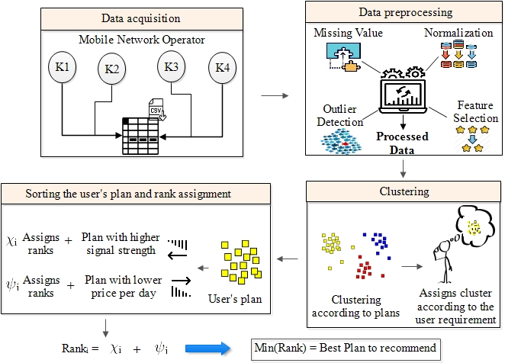
Proposed Architecture

Slide 6
Data Acquisition
We have acquired prepaid mobile plans from the official website of different MNOs to form a dataset.
There are trivial plans on the website that only provide one feature like data, talk time etc. Therefore, to maintain the uniformity of the dataset, we have not used such plans in our dataset.
Additionally, most users do not want recommendations for such plans as they only have one feature. Thus, the inclusion of such plans would be irrelevant.

Slide 7
Data Preprocessing
Missing Values
Normalization
Feature selection
Outlier detection

Slide 8
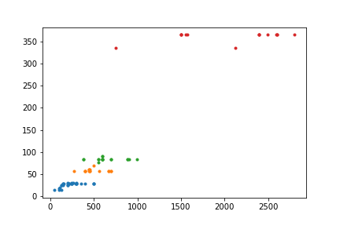
Clustering
A user cannot spend more than his budget on buying a plan
So, using the price and validity of the plans as input parameters, we have divided the plans into 4 clusters using a k-medoids clustering algorithm
We assign one of the four clusters to a user and only recommend plans from the given cluster.

Slide 9
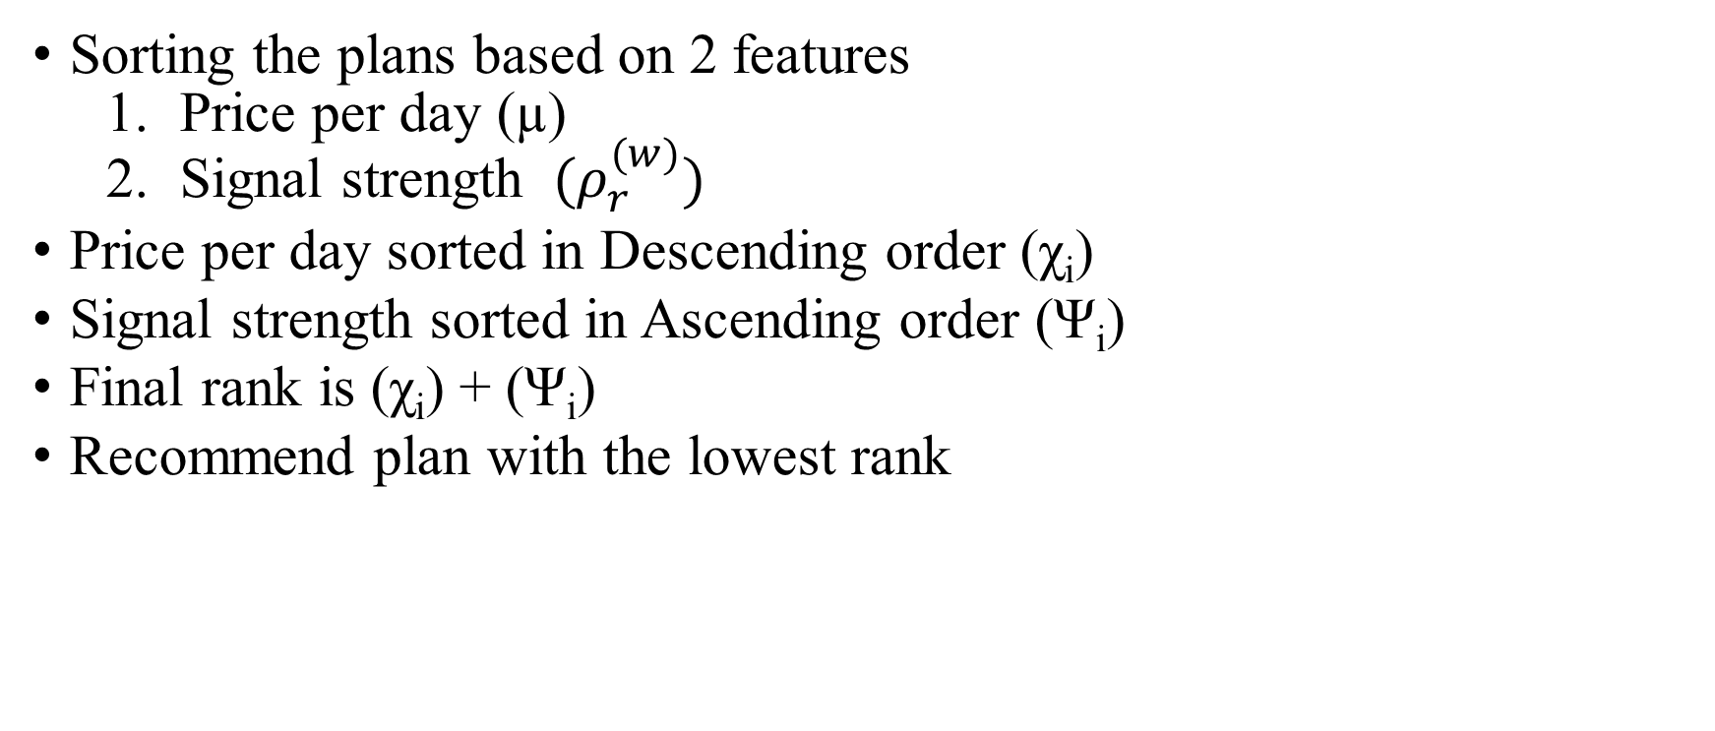
Rank Assignment
Sorting the plans based on 2 features
Price per day (µ)
Signal strength ${ (ρ}_{r}^{(w)})$
Price per day sorted in Descending order (χ_{i})
Signal strength sorted in Ascending order (Ψ_{i})
Final rank is (χ_{i}) + (Ψ_{i})
Recommend plan with the lowest rank

Slide 10
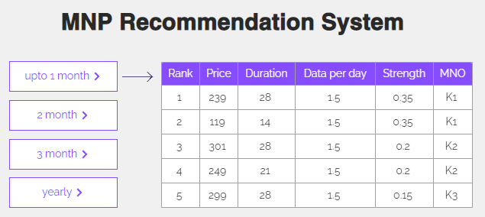
MNP Recommendation system interface
Figure: User interface in which the user selects the duration required for their plans.
Figure: User Interface for the recommendation system

Slide 11
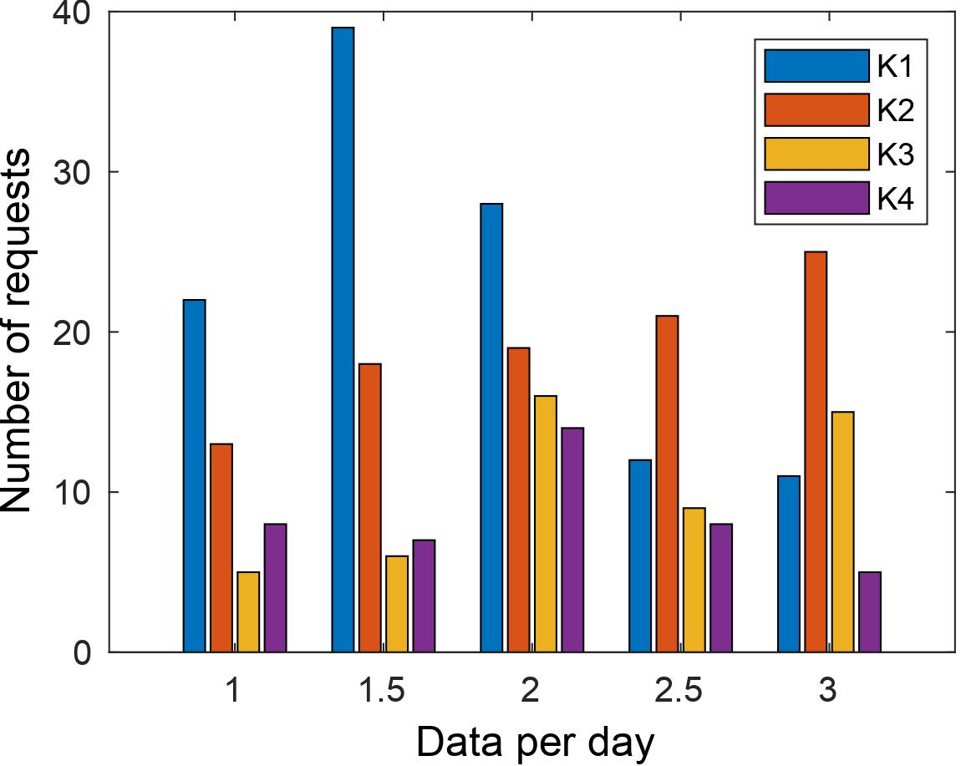
Performance evaluation
K1 is recommended for the highest amount of times when the daily data requirement is 1, 1.5, and 2 GB.
When the daily data requirement is 2.5 or 3 GB, the K2 operator is recommended multiple times.
Figure: Recommendation of different MNO’s for differing data per day.

Slide 12
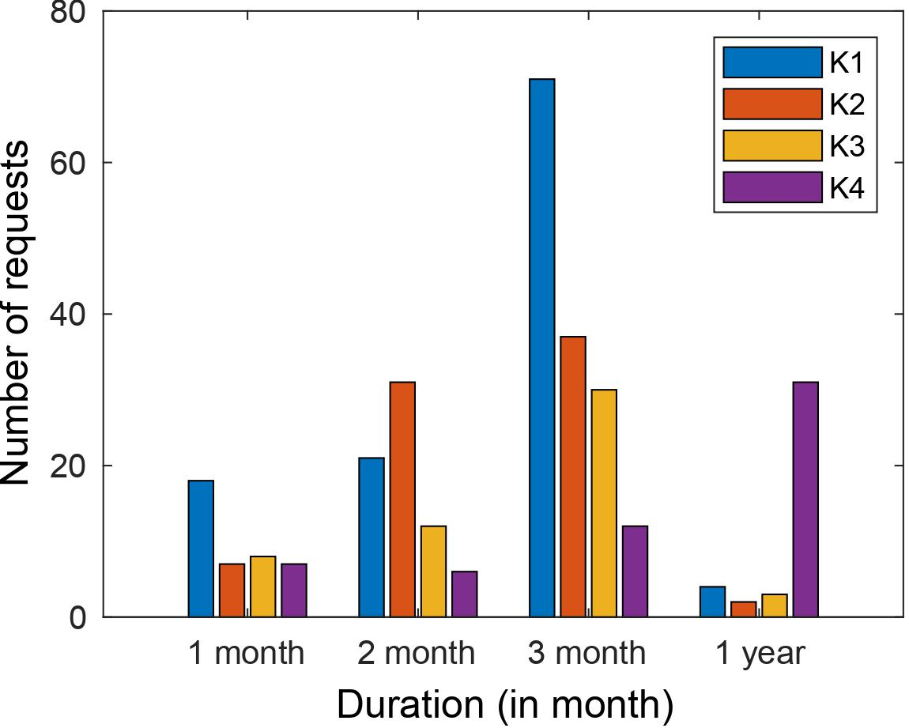
Performance evaluation
Nearly half of the people chose a validity of 3 months, and hence, K1 is recommended multiple times when the validity is one and three months.
K4 is recommended almost always in the case of yearly plans because K4 provides very low prices for yearly plans.
This signifies that the recommendation of a plan depends on the duration of the plan required by the user.
Figure: Recommendation of different MNO’s for differing validity of plans.

Slide 13
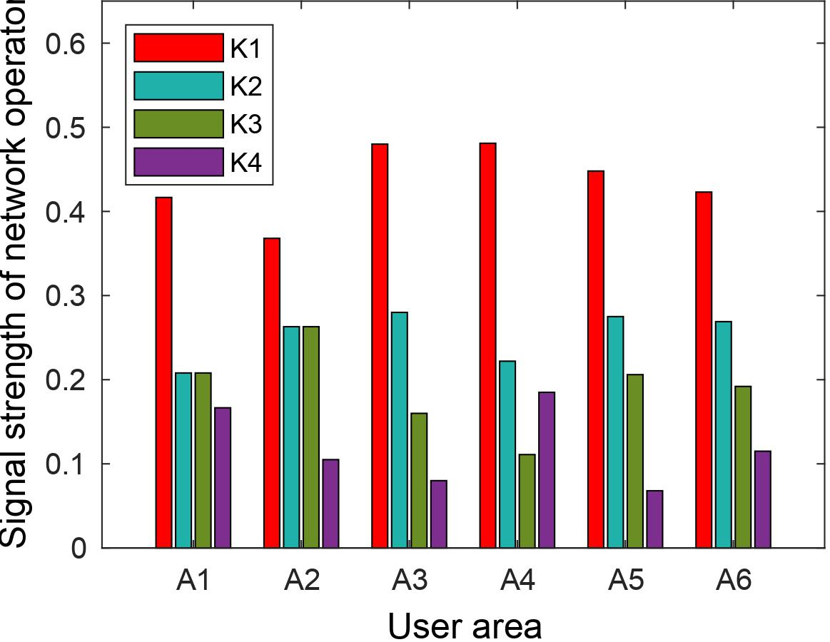
Performance evaluation
As one can observe clearly, K1 provides the best network strength across all areas with a significant margin compared with other operators.
K2 and K3 provide almost similar network strength across all the areas.
On the other hand, K4 provided inferior signal strength that is not suitable for a qualified plan for the user.
Figure: The signal strength of different operators in all the areas.

Slide 14
Conclusion
Choosing a suitable plan with the best possible network operator is a difficult task due to the variety of plans and differing network strength of MNOs.
One plan is not the optimal choice for everyone because requirement differs from user to user, making it challenging to decide on the best-personalized plan for users.
Thus, this paper proposed a clustering-based recommendation system that chooses plans that satisfy users’ requirements and provide users with the best possible network connectivity.
We have observed from the graphs that no single MNO satisfies all of the criteria for a perfect MNO.
The proposed recommendation system remedies this problem of identifying the most suitable plan and MNO for the users.
In the future, we will make the proposed system universal and also incorporate machine learning algorithms for higher accuracy.

Slide 15
References
[1] Need of strong internet during covid-19 pandemic. https://blogs.worldbank.org/voices/covid-19-reinforces-need-connectivity (2020), accessed: 2021-11-25
[2] Difference of mobile data speed across different states. https://myspeed.trai.gov.in/ (2021), accessed: 2021-11-20
[3] Increase in 5g services by 2027. https://www.financialexpress.com/industry/technology/5g-in-india-26-of-mobile-subscribers-in-india-to-use-5gnetwork-by-2026-end-says-report/2274389/ (2021), accessed: 2021-12-26
[4] Increase in OTT subscriptions. https://www.exchange4media.com/digitalnews/disney-hotstar-adds-almost-1173-million-paid-subscribers-in-q3-114968.html (2021), accessed: 2021-11-24
[5] Number of MNP requests in india from 2011 to 2021. https://www.trai.gov.in/release-publication/reports/telecom-subscriptions-reports (2021), accessed:2021-12-26
[6] Number of mobile phone purchases in 2021. https://bit.ly/3uA4XWg (2021), accessed:2021-11-24
[7] Achyuth, K., Kutty, S.N., Bharathi, B.: Recommender system for prepaid mobile recharging using apis. In: 2015 International Conference on Innovations in Information,Embedded and Communication Systems (ICIIECS). pp. 1–5. IEEE (2015)
[8] Kanika, Rani, K., Sangeeta, Preeti: Visual analytics for comparing the impact of outliers in k-means and k-medoids algorithm. In: 2019 Amity International Conference on Artificial Intelligence (AICAI). pp. 93–97 (2019). https://doi.org/10.1109/AICAI.2019.8701355
[9] Kaur, G., Sambyal, R.: exploring predictive switching factors for mobile number portability. Vikalpa 41(1), 74–95 (2016). https://doi.org/10.1177/0256090916631638
[10] Kumaravel, V., Kandasamy, C.: Impact of mobile number portability on mobile users switchover behavior-indian mobile market. Researchers World 2(4), 200(2011)

Slide 16
References
[11] Ouyang, Y., Yang, A., Zeng, S., Meng, F.: Mnp inside out: A game theory assisted machine learning model to detect subscriber churn behaviors under china’s mobile number portability policy. In: 2019 IEEE International
Conference on Big Data (Big Data). pp. 1878–1886 (2019). https://doi.org/10.1109/BigData47090.2019.9006459
[12] Patel, K., Mistry, C., Mehta, D., Thakker, U., Tanwar, S., Gupta, R., Kumar, N.: A survey on artificial intelligence techniques for chronic diseases: Open issues and challenges. Artificial Intelligence Review pp. 1–44 (11 2021).
https://doi.org/10.1007/s10462-021-10084-2
[13] Paulrajan, R., Rajkumar, H.: Service Quality and Customers preference of Cellular Mobile Service Providers. Journal of technology management & innovation 6, 38 – 45 (00 2011), http://www.scielo.cl/scielo.php?script=sci_arttext& pid=S0718-27242011000100004&nrm=iso

