Slide 1
Genome Informatics
Comparison of VCF files
Jovica Jovićević 3218/2020

Slide 2
Assignment
Perform variant calling on designated FASTA and BAM files using GATK 4 HaplotypeCaller and FreeBayes tools
Commpare the results and find:
  True positives
  False positives
  Fale negatives
  Precision
  Recall
  F-score

Slide 3
Variant calling
GATK 4 HaplotypeCaller
Developed by Broad Institute
Arguments
  Input alignments (BAM)
  Reference file (FASTA)
  Requires presence of FAI and DICT files
Truth set
FreeBayes
Arguments
  Input alignments (BAM)
  Reference file (FASTA)
Test set

Slide 4
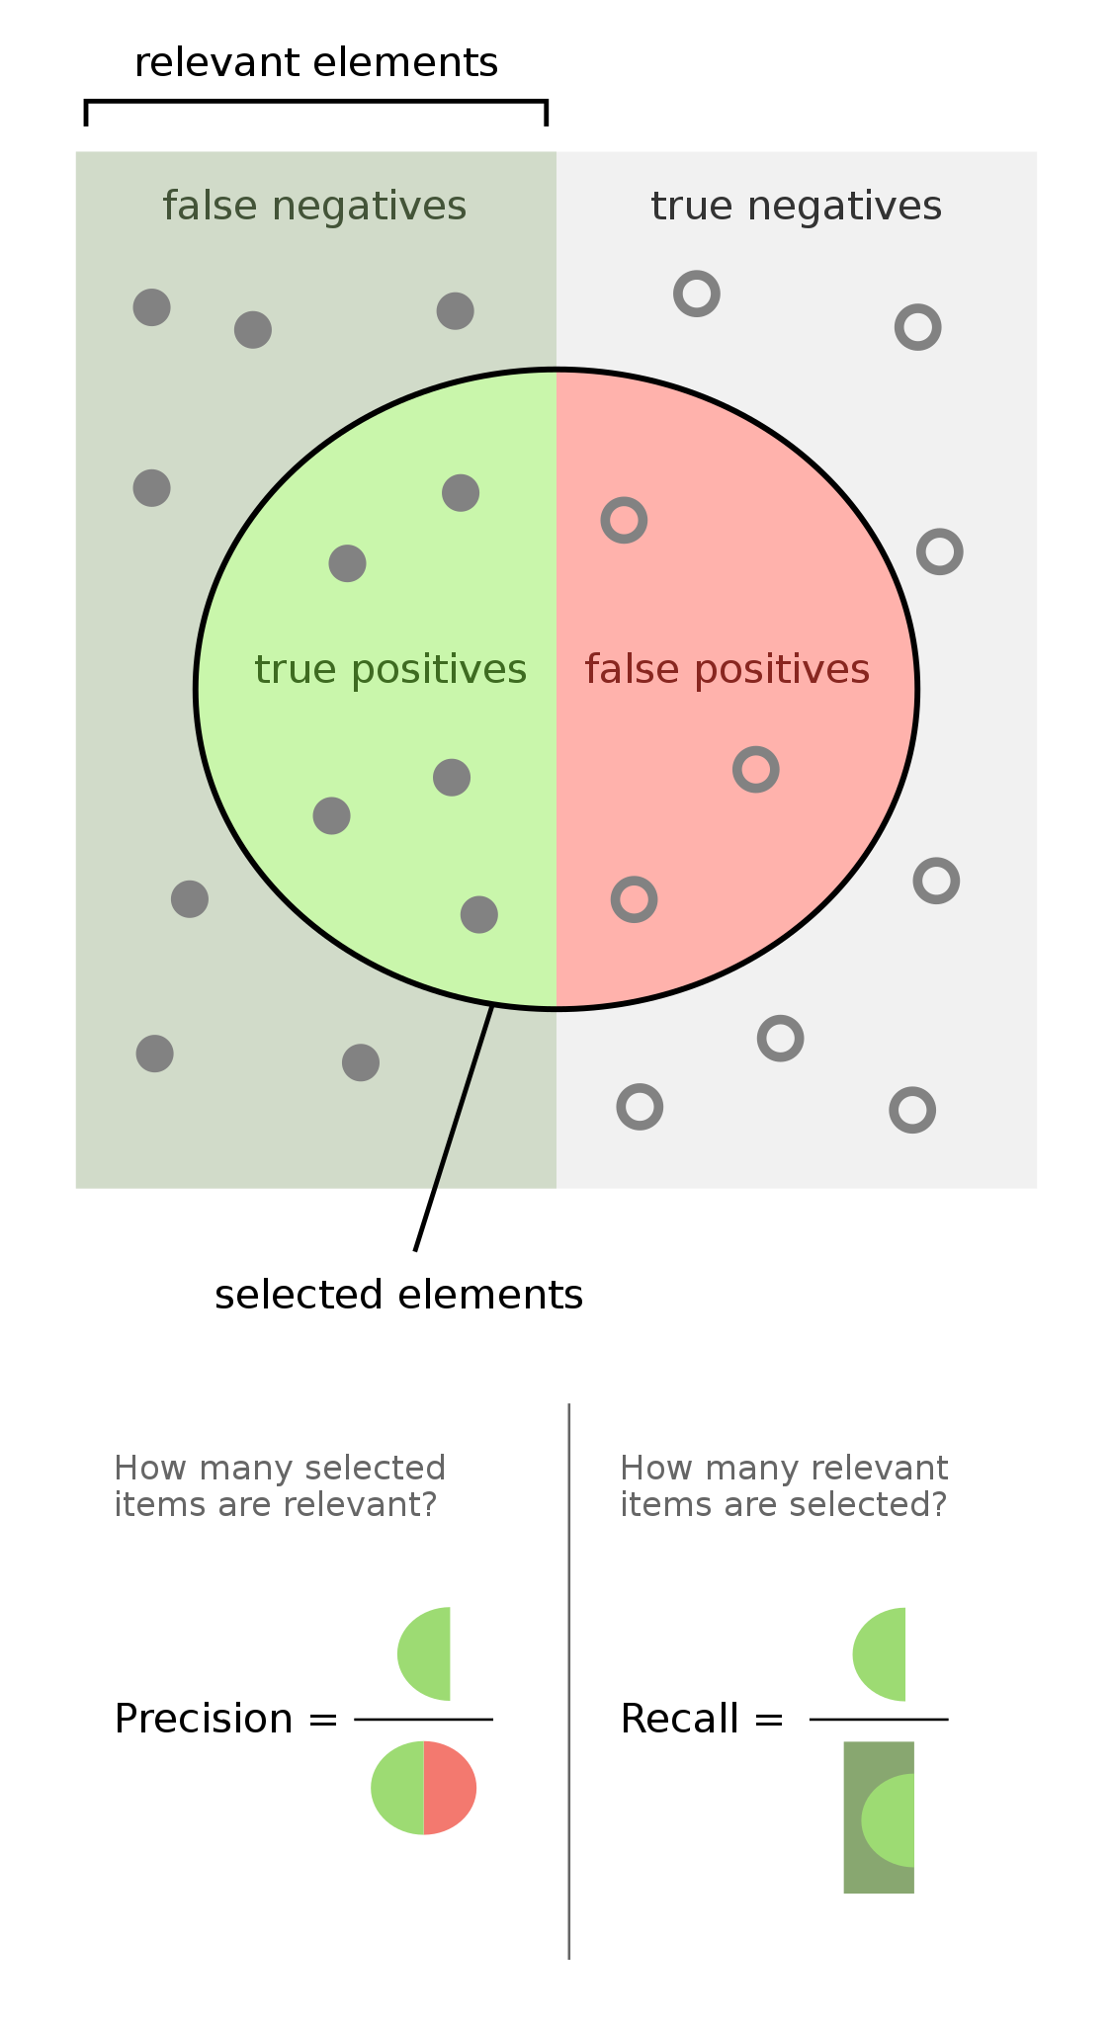
VCF comparison
Precision:
Recall:
F-measure:

Slide 5
Simple algorithm
Comparing following:
  CHROM – the name of the sequence on which the variation is being called
  POS – position within sequence
  REF – reference
  ALT – alternative alleles

Slide 6

Simple algorithm
Reading files – pysam Python module
pysam.VarantFile

Slide 7
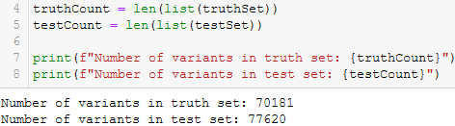
Simple algorithm
Counting number of variants in each file

Slide 8
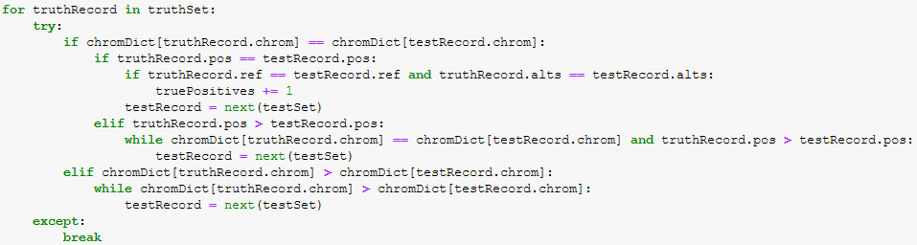
Simple algorithm
Checking if variants are ordered – they are
Comparing variants

Slide 9
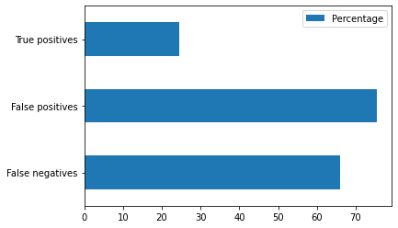
Simple algorithm – results
TP: 18955
FP: 58655
FN: 51226
Precision: 0.244203
Recall: 0.270087
F-measure: 0.256494

Slide 10
Simple algorithm – results
Big discrepancy
Analysis too basic
Truth set:
  1 889158 . G C
  1 889159 . A C
Test set:
  1 889158 . GA CC

Slide 11
BCFtools
Developed by Samtools
bcftools isec
Input – two VCF files that are to be compared
Output:
  Four VCF files in which results are kept
  TXT file containing info about results

Slide 12
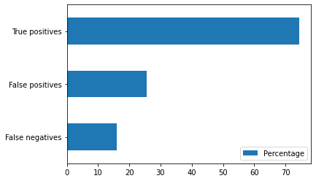
BCFtools – results
TP: 57835
FP: 19785
FN: 12346
Precision: 0.745104
Recall: 0.824083
F-measure: 0.782606

Slide 13
BCFtools – results
A lot more correlation between files
Much better results

Slide 14
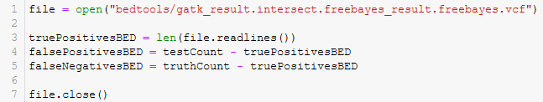
BEDTools
Set of tools used for a wide range of genomics analysis tasks
bedtools intersect
Input - two VCF files that are to be compared
Output – intersecting variants in VCF file without header

Slide 15
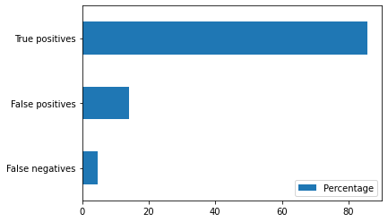
BEDTools – results
TP: 66587
FP: 11033
FN: 3594
Precision: 0.857859
Recall: 0.94879
F-measure: 0.901036

Slide 16
BEDTools – results
More correlations found

Slide 17
VBT
Developed by Seven Bridges
Based on vcfeval
Set of tools that is used for aligner/variant calling benchmarking
Input:
  Baseline and called VCF files that are to be compared
  Reference FASTA file
Output:
  Four VCF files in which results are kept
  TXT file with analysis summary

Slide 18
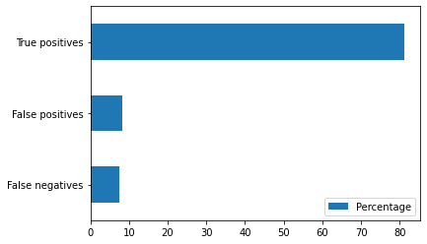
VBT – results
TP: 63096
FP: 6486
FN: 5735
Precision: 0.9068
Recall: 0.9182
F-measure: 0.9125

Slide 19
VBT – results
Highest precision and f-measure
Takes reference file into account
Recognizes that there are different number of true positives in each file

Slide 20
Thank You

