Slide 1

AIE1903_AD / GROUP 5
HD Map
Change Detection
Maintenance & Planning
under Uncertain Observations
王子墨125090703
黄子明125090241
梅子衡125090486
崔映庭125090088
潘铭洋125090517
Notes:
Good morning. We are Group 5. Our project studies HD map change detection, maintenance and planning under uncertain observations. We connect road observations to two decisions: how the vehicle should respond now, and whether the map should change.
Source: AIE1903_ProjectProposal_group5.pdf, pp. 1–4. Project design; statements do not imply completed implementation. Artwork is conceptual, not an experimental result.

Slide 2
Presentation Outline
PART 1
Introduction and Related Work
PART 2
Our Work
Module 1 Perception and Reliability
Module 2 Planning
Module 3 Map Maintenance
Module 4 Extension and Fall Back
Task framing comes before the four modules.
PART 3
Evidence and Evaluation
PART 4
Schedule and Team

Slide 3

PART 1
01 Introduction
and Related Work
Notes:
Target: 5 seconds.
Hello everyone. Today, I will introduce our project on HD map reliability and driving decisions.
Conceptual background illustration generated for this presentation.

Slide 4
PART 1
1.1 Motivation
HD maps describe lanes and road connections.
Road changes
Lane layouts or markings may differ from the stored map.
Observation errors
A vehicle can hide a lane marking that still exists.
How reliable is the map
when observations disagree?
Notes:
Target: 40 seconds.
HD maps provide information about lanes and road connections. However, roads can change, and the map may no longer match the real environment.
A mismatch can also come from an observation error. For example, a truck may hide a lane marking that still exists.
Our main question is: how can we assess map reliability before updating the map and making driving decisions?
Sources:
Lambert & Hays (2021): https://datasets-benchmarks-proceedings.neurips.cc/paper_files/paper/2021/hash/6f4922f45568161a8cdf4ad2299f6d23-Abstract-round2.html
Zhang et al. (2025): https://doi.org/10.3390/machines13121080

Slide 5
PART 1
1.2 Project Overview
From annotated observations to driving decisions
Team | Stage | Output
1 + 2 | Data annotation | Road features and vehicle tracks
3 | Reliability assessment | Reliability decision and evidence
4 | Map updating | Updated map and visual comparison
5 | Behavior planning | Route and next driving action
Scope: local lane markings and an offline action demo
Notes:
Target: 35 seconds.
Our project connects four stages.
First, we label road features and the trajectories of nearby vehicles. Second, we compare these observations with the existing map and assess the evidence. Third, we update supported map elements and visualize the map before and after the update. Finally, we use the updated map and current observations to plan actions, such as turning or stopping, in an offline demonstration.
Project scope comes from the team's confirmed five-member workflow. This is a proposal overview, not a completed result. The detailed architecture follows in Part 2.

Slide 6
PART 1
1.3 Related Work
Study | Idea adopted
TbV Lambert & Hays (2021) | Task and data for map–observation comparison
Zhang et al. (2025) | Observation uncertainty in change assessment
ArgoTweak Wild et al. (2025) | Structured annotations for individual map edits
Paden et al. (2016) | Route, behavior and motion planning levels
Our focus: one integrated, reproducible workflow
Notes:
Target: 40 seconds.
Four studies support our design.
TbV provides a dataset for map change detection. Zhang and colleagues explain how uncertain observations affect change assessment. ArgoTweak provides structured annotations for map updates. Paden and colleagues explain the different levels of planning.
We adapt these ideas into one reproducible workflow, connecting road observations with map assessment, updating, and driving decisions.
Next, my teammate will explain our implementation.
Sources:
Lambert & Hays (2021): https://datasets-benchmarks-proceedings.neurips.cc/paper_files/paper/2021/hash/6f4922f45568161a8cdf4ad2299f6d23-Abstract-round2.html
Zhang et al. (2025): https://doi.org/10.3390/machines13121080
Wild et al. (2025): https://openaccess.thecvf.com/content/ICCV2025/html/Wild_ArgoTweak_Towards_Self-Updating_HD_Maps_through_Structured_Priors_ICCV_2025_paper.html
Paden et al. (2016): https://doi.org/10.1109/TIV.2016.2578706
Open-access manuscript: https://arxiv.org/abs/1604.07446

Slide 7

PART 2
Our Work
Overall Architecture and Implementation Details
Notes:
Conceptual background illustration generated for this presentation.

Slide 8
Problem, Data and Scope
PART 2
01
02
03
The problem
Data roles
Minimum viable scope
Road observations can disagree with an HD map.
Occlusion and alignment errors can also create apparent changes.
nuScenes: current occupancy and observation consistency.
TbV / ArgoTweak: structural changes, after verifying map roles and labels.
An offline, traceable workflow with conservative planning and versioned map decisions.
Report controlled perturbations separately.
Project design from the proposal. Current repository evidence covers scene-0980.
08
Notes:
Road changes can be confused with occlusion or alignment errors. We use nuScenes for current occupancy and observation consistency. Structural-change evaluation requires verified map versions and labels. Our minimum viable workflow is offline, and controlled perturbations are reported separately.
Source: AIE1903_ProjectProposal_group5.pdf, pp. 1–4. Project design; statements do not imply completed implementation.

Slide 9
Our Work: Three Modules, Four Questions
PART 2
01
Perception and Reliability
What has changed?
How reliable is the evidence?
02
Planning
How should the vehicle respond?
03
Map Maintenance
Should the map be updated?
Map decisions, visualization and evaluation evidence are consolidated across the workflow.
09
Notes:
We have three modules. Perception and Reliability asks what changed and how reliable the evidence is. Planning asks how the vehicle should respond. Map Maintenance asks whether to update the map. also consolidates evaluation evidence from the whole team.
Source: AIE1903_ProjectProposal_group5.pdf, pp. 1–4. Project design; statements do not imply completed implementation.

Slide 10

PART 2
2.1 Minimum Viable Version
Map Change Reliability
Road Change Detection

Slide 11
PART 2
2.1 Minimum Viable Version
Behavior
Route

Slide 12
PART 2
2.2 Module Specifications

Slide 13

PART 2 / MODULE 01
Perception and Reliability
What has changed?
How reliable is the evidence?
Notes:
First, Perception and Reliability.
Source: AIE1903_ProjectProposal_group5.pdf, pp. 1–4. Project design; statements do not imply completed implementation. Artwork is conceptual, not an experimental result.
Conceptual background illustration generated for this presentation.

Slide 14

PART 2
2.2 Module Specifications
Perception
Camera images, LiDAR, ego poses, calibration, and prior HD maps

Slide 15
PART 2
2.2 Module Specifications
Perception
Road element perception
Frame map change detection
Vehicle detection and tracking

Slide 16
PART 2
2.2 Module Specifications
Perception
Caution!
1. Sensors errors
2. Estimated Change & Behavior
3. Associations ≠ causality

Slide 17
Current Evidence in scene-0980
PART 2
MOD 1
29
13
175
change candidates
vehicle tracks
candidate–behavior pairs
23 occupancy + 6 lane marking
221 trajectory samples
5 associated / 81 not / 89 uncertain
All 29 candidates remain UNVERIFIED as map changes.
The observation window spans 0–19.85 s. Current outputs show evidence consistency and spatial association. Independent labels are still needed for accuracy metrics.
17
Notes:
Scene-0980 contains twenty-nine candidates, thirteen vehicle tracks and one hundred and seventy-five association pairs. Five pairs are associated, eighty-one are not, and eighty-nine are uncertain. These are output counts. All candidates remain unverified as map changes, and the twenty-second window cannot establish long-term persistence.
Source: AIE1903_ProjectProposal_group5.pdf, pp. 1–4. Repository Yugongshit/AIE1903-map-update66, commit 6c5d134380725999425e0d6626773fef2aef3e56, AIE1903 原始资料/perception/outputs and pipeline. scene-0980 results.

Slide 18
PART 2
2.2 Module Specifications
Perception
Reliability Assessment

Slide 19
Local HD Map Reliability Assessment
PART 2
MOD 1
01 Quality gate
Check visibility, occlusion, sensor coverage and coordinate alignment.
02 Mismatch test
Compare geometric residuals against an unchanged baseline.
Use a robust test with thresholds selected on development data.
03 Decision
No significant mismatch / Suspected map change
Needs further verification / Insufficient evidence
Proposed module. Evidence scores support review but do not establish permanence.
19
Notes:
My proposed reliability module first checks coverage, occlusion and alignment. It then compares geometric residuals against an unchanged baseline. The output distinguishes no significant mismatch, suspected change, further verification and insufficient evidence. Thresholds come from development data. This qualified decision supports downstream planning and maintenance.
Source: AIE1903_ProjectProposal_group5.pdf, pp. 1–4. Project design; statements do not imply completed implementation.

Slide 20

PART 2 / MODULE 02
Planning
How should the vehicle respond?
Notes:
Next is Planning.
Source: AIE1903_ProjectProposal_group5.pdf, pp. 1–4. Project design; statements do not imply completed implementation. Artwork is conceptual, not an experimental result.
Conceptual background illustration generated for this presentation.

Slide 21
Reliability-Aware Local Planning
PART 2
MOD 2
01
02
03
Inputs
Route search
Behavior output
Directed lane graph
Local reliability decisions
Verified occupancy and ego state
A* search with nonnegative uncertainty penalties.
Block an edge only with independent evidence of impassability.
Return a feasible route and a conservative keep / stop decision.
If no feasible route remains, stop or wait.
Proposed module. Dynamic interactions and closed-loop simulation are extensions.
21
Notes:
Our proposed planner uses A-star on a directed lane graph, with nonnegative penalties for uncertain sections. An edge is blocked only when independent evidence shows it is impassable. Given verified occupancy and the ego state, the minimum viable behavior is to continue on a feasible route, or stop and wait. Dynamic interactions are a later extension.
Source: AIE1903_ProjectProposal_group5.pdf, pp. 1–4. Project design; statements do not imply completed implementation.

Slide 22
Planning Comparisons and Handoff
PART 2
MOD 2
Comparison | Shared conditions | Records for evaluation
Prior-map baseline | Same scene, start and goal | Route, length, feasibility
Reliability-aware planning | Same graph and obstacle evidence | Route changes, cost, keep / stop
Controlled map perturbation | Known perturbation, held-out scene | Response to a known mismatch
Pass scene ID, map version, time window, route and behavior records to Evaluation & Evidence.
22
Notes:
We compare prior-map and reliability-aware planning under the same scene, start and goal. We record route differences, feasibility and behavior, and pass them to Huang with scene and version references. Controlled perturbations remain a separate comparison.
Source: AIE1903_ProjectProposal_group5.pdf, pp. 1–4. Project design; statements do not imply completed implementation.

Slide 23

PART 2 / MODULE 03
Map Maintenance
Should the map be updated?
Notes:
I am . My part decides which map layer should receive the evidence, and keeps that decision traceable.
Source: AIE1903_ProjectProposal_group5.pdf, pp. 1–4. Project design; statements do not imply completed implementation. Artwork is conceptual, not an experimental result.
Conceptual background illustration generated for this presentation.

Slide 24
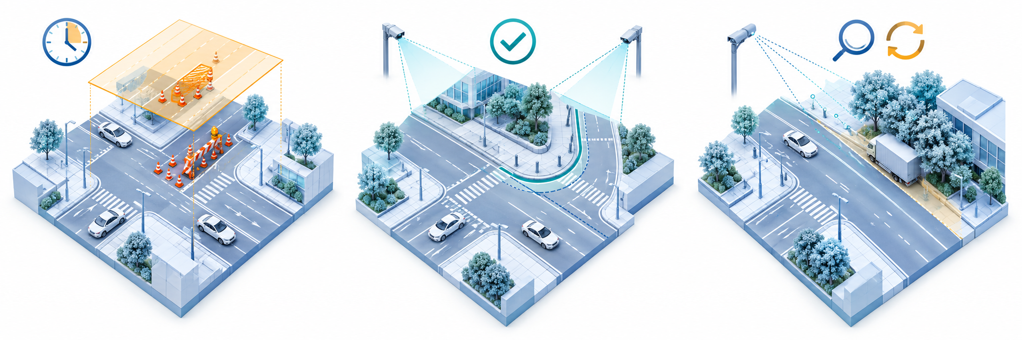
Map Maintenance Decisions
PART 2
MOD 3
Temporary event layer
Base-map update
Verify again
Verified current occupancy
Independent revisits
+ consistent geometry
Single pass or
conflicting observations
Align scene, time and map version. Current occupancy may be recorded before persistence is resolved.
24
Notes:
Based on the group proposal and supplied AIE1903 deck. AI-generated conceptual illustration, not an experiment or completed implementation. Maintenance and integrated evaluation remain proposed work. Temporary overlays, supported structural edits and unresolved cases are separate decisions, not an automatic progression. Independent revisits and geometric consistency are the key ideas consolidated from the removed persistence slide.

Slide 25
Temporary Events and Base-Map Updates
PART 2
MOD 3
 | Temporary event layer | Versioned base map
Purpose | Record current occupancy. | Represent supported structural change.
Record | Event ID, geometry, first / last seen, validity, evidence and review. | Element ID, old / new geometry, map version, visit history and evidence.
Action | Re-observe, extend, expire or close after verification. | Insert, modify or deactivate. Keep history for rollback.
Condition | Verify current occupancy. Long-term status may remain unresolved. | Independent revisits and consistent, reliable geometry.
Expiry does not prove clearance. Adjacent frames do not establish persistence.
25
Notes:
Source: supplied group proposal and deck. Proposed maintenance design. Consolidated persistence checks: record first / last seen and independent visits. Match element IDs, distance, direction and overlap. Use reliable geometry and thresholds selected on development data. A single continuous recording cannot establish long-term change. Event expiry is not evidence of obstacle clearance. Base-map edits retain evidence, versions and rollback history. The removed numerical candidate example is intentionally omitted.

Slide 26

Map Visualization and Decision Review
PART 2
MOD 3
Compare the same scene, extent and coordinate frame. Link each decision to its evidence and map version.
Prior base map
Temporary event overlay
Supported structural update
Concept illustration. Integrated before / after map editing remains planned.
26
Notes:
Source: AIE1903.pptx supplied by the group. AIE1903_ProjectProposal_group5.pdf, pp. 1–4. Maintenance and integrated evaluation are proposed work. Statements do not imply completed implementation.
AI-generated conceptual map comparison. The temporary overlay and structural edit are alternative outcomes, not an automatic progression. This image is not a measured experiment.

Slide 27
PART 2 / MODULE 04
Extension and Fall Back
Next steps and limitations
Notes:
I am . My part decides which map layer should receive the evidence, and keeps that decision traceable.
Source: AIE1903_ProjectProposal_group5.pdf, pp. 1–4. Project design; statements do not imply completed implementation. Artwork is conceptual, not an experimental result.
Conceptual background illustration generated for this presentation.

Slide 28
PART 2
Extension
Extend the offline system into a dynamic, interactive autonomous driving system:
• Closed-Loop Simulation:
Dynamic replanning and simulated vehicle execution.
• Dynamic Decision-Making:
Other vehicles’ movements for more advanced planning, including obstacle avoidance, car-following, and yielding.
• Continuous Map Updates:
Fuse independent observations from different times and vehicles

Slide 29
PART 2
Fall Back
• Perception Challenges:
Use nuScenes ground-truth annotations
• Limited Real-World Map Change Data:
Create verifiable change scenarios through controlled map perturbations.
• Unstable Reliability Models:
Use rule-based assessments
• Planning Limitations:
Retain basic route search and conservative decisions; recommend stopping or waiting if no feasible route can be found.
• Map Update or Simulation Constraints:
Use a separate temporary map layer and offline data replay

Slide 30

PART 3
Evidence and Evaluation
What will your final demo or analysis show?

Slide 31
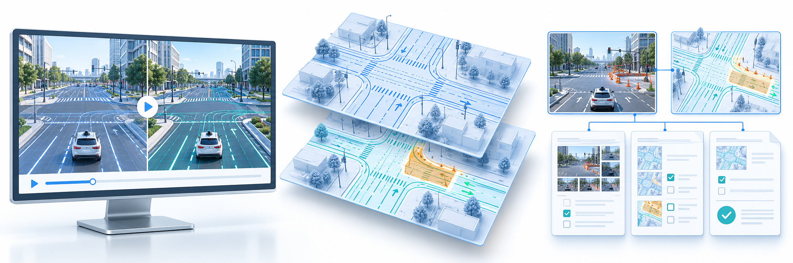
Our Final Evidence
PART 3
Our final evidence will be a replayable demo and an evaluation report.
Replayable demo
Before / after maps
Traceable records
Real observations and controlled tests reported separately. Illustrations show the planned evidence.
31
Notes:
Based on the group proposal and supplied AIE1903 deck. AI-generated conceptual illustration, not an experiment or completed implementation. Maintenance and integrated evaluation remain proposed work. Evidence package: scene comparisons with independent labels and matched conditions, before/after maps with temporary events and structural edits, and decision records linking metrics, version history and failure cases.

Slide 32
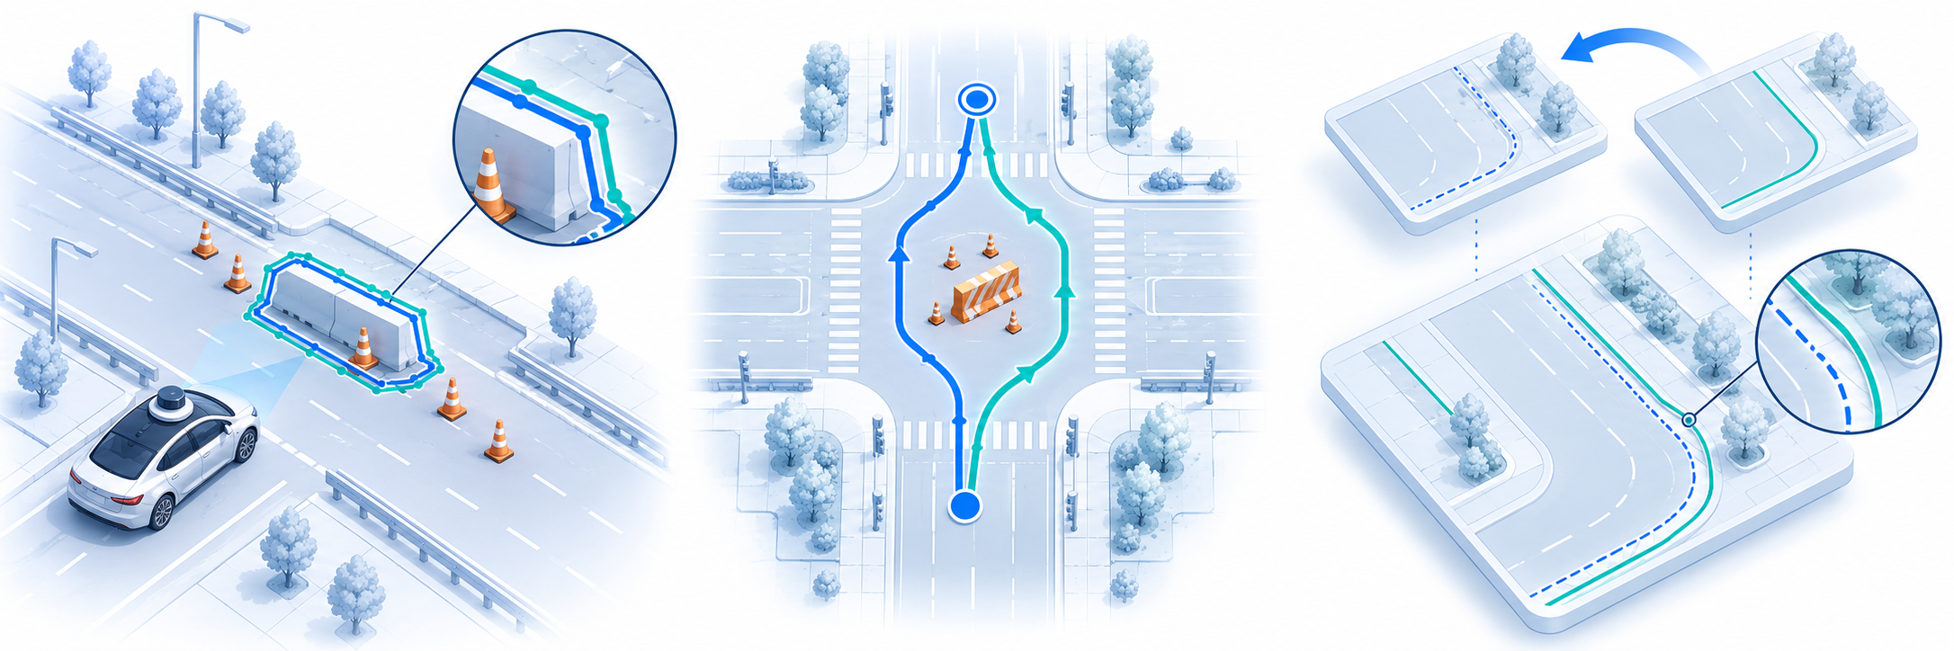
What the Evidence Will Demonstrate
PART 3
Perception / reliability
Planning
Map maintenance
Detection vs. labels
Precision / recall / coverage
Matched start and goal
Route and behavior differences
Update correctness / delay
False edits / rollback
Within evaluated scenes. Report unresolved cases and failure analysis across all three modules.
32
Notes:
Based on the group proposal and supplied AIE1903 deck. AI-generated conceptual illustration, not an experiment or completed implementation. Maintenance and integrated evaluation remain proposed work. Evaluation details retained from the original table: use independent labels and scene splits for perception and reliability, including unresolved rate. For planning, match start/goal and obstacle evidence and report route feasibility and behavioral differences. For maintenance, use known map changes or controlled cases, measure correctness, timing, false edits and rollback. Traceable observations and decision history support analysis of missed changes, false alarms and uncertainty. No measured outcomes are asserted by this conceptual image.

Slide 33
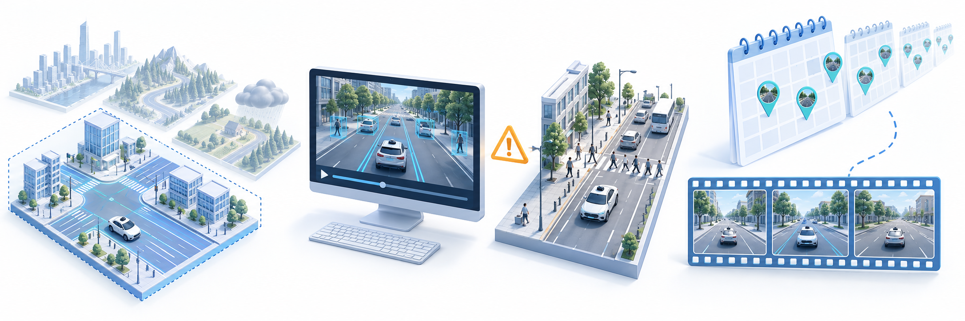
What the Evidence Will Not Demonstrate
PART 3
Generalization
Live-driving safety
Permanent change
Test scenes alone
do not cover unseen conditions
Offline replay
does not certify deployment
A short recording
does not prove persistence
Broader claims require additional evidence and validation. Conceptual illustrations.
33
Notes:
Based on the group proposal and supplied AIE1903 deck. AI-generated conceptual illustration, not an experiment or completed implementation. Maintenance and integrated evaluation remain proposed work.

Slide 34
PART 4
Schedule and Team

Slide 35
Six-Week Schedule
PLAN
Team Member | Week 1 Setup | Week 2 Baselines | Week 3 Prototypes | Week 4 Integration | Week 5 Evaluation | Week 6 Delivery
Cui Yingting | Select scenes Check sensor data | Align sensors Build perception and change baselines | Detect and track vehicles Share outputs | Integrate scene perception outputs | Evaluate detection and tracking Analyze errors | Data, code, results and cases
Wang Zimo | Define windows, behaviors, rules and metrics | Verification and behavior baselines | Verify changes Associate vehicle behavior | Integrate results and evidence | Test verification, tracks, behaviors and associations | Results, cases and limitations
Mei Ziheng | Reliability metrics and interfaces | Reliability baseline Development-set thresholds | Reliability classes Supporting evidence | Reliability by map version and observation window | Classification and observation quality tests | Metrics, rules, evidence and results
Pan Mingyang | Planning interfaces Behavior and feasibility rules | A* costs Behavior states Evaluation design | Python prototypes A*, behavior and feasibility | Updated maps Reliability BEV and logs | Controlled tests Map and reliability effects | Code, failure cases, demo and report
Huang Ziming | Map structure Versions, validity and interfaces | Change duration Update and version baselines | Update records Before-and-after map views | Share maps Check version consistency | Update quality, traceability and shared access tests | Versioned maps Sharing demo Results and guide
Milestones: W2 interface samples. W4 integrated scene. W6 demonstration and report.
All tasks are planned. Week 1 begins at project kickoff.
02
Notes:
Cui Yingting
Week 1: Select representative scenes; check four inputs, timestamps, calibration information, and coordinate systems.
Week 2: Build sensor alignment, road element perception, and single-frame map change detection baselines.
Week 3: Integrate vehicle detection and tracking; send standardized records to verification and reliability modules.
Week 4: Provide complete perception results for the same scene; resolve end-to-end integration issues.
Week 5: Evaluate map change detection, vehicle detection, and tracking; analyze missed detections and false positives.
Week 6: Compile the data inventory, perception code, evaluation results, and representative cases.
Wang Zimo
Week 1: Define multi-frame windows, behavior categories, change association rules, and evaluation criteria.
Week 2: Build multi-frame verification and behavior recognition baselines using the shared trajectory interface.
Week 3: Integrate perception outputs; verify changes and link map changes with vehicle behavior using supporting evidence.
Week 4: Integrate cross-frame verification outputs, behavior results, and supporting evidence.
Week 5: Evaluate verification, trajectories, and behaviors; analyze errors in associations between changes and behaviors.
Week 6: Compile verification and behavior analysis results, demonstration cases, and limitations.
Mei Ziheng
Week 1: Define consistency, observation quality, and uncertainty metrics; standardize the reliability output interface.
Week 2: Build reliability scoring and classification baselines; set thresholds only on the development set.
Week 3: Integrate observations and verification evidence; output reliability classifications and supporting reasons.
Week 4: Provide updating and planning with reliability tied to map versions and observation windows.
Week 5: Evaluate classification performance and stability across different observation quality levels.
Week 6: Compile metrics, classification rules, evidence explanations, and evaluation results.
Pan Mingyang
Week 1: Finalize planning design and interfaces; define local route, behavior, and feasibility rules.
Week 2: Define A* costs, behavior states, and controlled evaluation; check logic using interface samples.
Week 3: Begin implementing prototypes for A*, behavior rules, and feasibility checks.
Week 4: Integrate reliability and updated maps; produce planning BEV visualizations and JSON/CSV logs.
Week 5: Conduct controlled experiments comparing the effects of map updates and reliability information on planning.
Week 6: Compile planning code, failure cases, a reproducible demonstration, and the evaluation report.
Huang Ziming
Week 1: Design the shared map structure; define version identifiers, validity periods, and update interfaces.
Week 2: Build baselines for short-term/persistent change assessment, reliability-guided updates, and version management.
Week 3: Integrate verification and reliability results; implement update records and before-and-after visualizations.
Week 4: Provide updated maps to planning; integrate version consistency checks and shared outputs.
Week 5: Evaluate update quality, incorrect updates, and version traceability; check the shared reading interface.
Week 6: Compile versioned maps, a shared interface demonstration, update evaluations, and usage instructions.
Members work in parallel. Early interface samples support module testing only. End-to-end integration and formal evaluation use actual module outputs generated from the four raw input types.
Milestone Acceptance Criteria
Week 2: All five modules produce agreed interface samples. Week 4: One scene runs from raw inputs through map updating and planning. Week 6: Deliver a reproducible demonstration, module evaluations, failure cases, and the team report.
Planning covers design and interfaces in Weeks 1 and 2, Python prototyping from Week 3, and experiments in Week 5. Split formal test data by original scene; tune thresholds only on the development set. Evaluation annotations are excluded from runtime inputs.
Source: supplied Team Roles and Six Week Plan Word document. The slide summarizes the six-week plan. These notes retain the full weekly tasks and evaluation requirements.

Slide 36
Team Roles
TEAM
Cui Yingting
Sensor Perception and Map Change Detection
Align sensors, perceive road elements, detect map changes and track vehicles.
Wang Zimo
Multi-Frame Verification and Behavior Analysis
Verify changes across frames and link vehicle behavior to map changes.
Mei Ziheng
Local HD Map Reliability Assessment
Assess consistency, observation quality, uncertainty and local reliability.
Pan Mingyang
Local Route and Behavior Planning
Design A* route updates, behavior rules, feasibility checks and evaluation.
Huang Ziming
Shared Map Updating and Visualization
Assess change duration, update shared maps and manage versions and visualization.
Inputs: Photos, radar, lidar and HD maps. The team derives change records, trajectories and reliability.
01
Notes:
Team responsibilities and planned deliverables
Cui
Yingting
Sensor Perception and Map Change Detection
Select representative data and align sensors; perceive road elements, detect single-frame map changes and vehicles, produce vehicle tracks, and evaluate perception and map change detection performance.
Aligned data, road elements, single-frame change candidates, vehicle detections and trajectories, and module evaluation results.
Wang
Zimo
Multi-Frame Verification and Behavior Analysis
Verify map changes across frames, recognize behavior using shared vehicle trajectories, associate map changes with vehicle behavior, and evaluate trajectories and behaviors.
Multi-frame verification evidence, behavior recognition results, change and behavior association records, and trajectory and behavior evaluations.
Mei
Ziheng
Local HD Map Reliability Assessment
Analyze map-observation consistency, assess observation quality, and model uncertainty. Classify local map reliability and provide supporting evidence for map updating and planning.
Consistency and quality metrics, uncertainty descriptions, reliability classifications, supporting evidence, and evaluation results.
Pan
Mingyang
Local Route and Behavior Planning
Design the planning scheme and module interfaces for map changes and uncertainty, including A* route updates, behavior rules, and feasibility checks. Plan BEV visualizations, result logging, and controlled evaluation.
Planning scheme and interfaces; route and behavior rules; later Python prototype, BEV visualizations, JSON/CSV logs, and experimental results.
Huang
Ziming
Shared Map Updating and Visualization
Design the shared map structure, assess short-term and long-term changes, update maps using reliability information, manage versions, visualize and share updates, and evaluate map updating performance.
Shared map structure, update strategies, versioned maps and visualizations, a shared interface for other vehicles' planning, and update evaluations.
Module Interfaces and Responsibility Boundaries
Cui Yingting provides shared detection and tracking outputs. Wang Zimo reuses these trajectories for multi-frame verification and behavior analysis, avoiding duplicate tracking pipelines. Mei Ziheng combines observations and verification evidence to provide local reliability assessments to Huang Ziming and Pan Mingyang.
Huang Ziming handles map updates, versions, and shared map visualization. Pan Mingyang uses updated maps and visualizes routes, behaviors, and feasibility. Reliability results are tied to map versions and observation windows. All modules share timestamps, coordinate systems, object or change IDs, and evidence references.
Multi-frame verification supports a change within the observed period. Huang Ziming uses observation duration and reliability to assess update validity. Insufficient observations retain the status "persistent change candidate" or "insufficient evidence"; a short sequence alone cannot establish a permanent change.
Source: supplied Team Roles and Six Week Plan Word document. Style reference: supplied AIE1903_A_Split deck, Team Roles slide.

Slide 37
Thank you
Questions & discussion
AIE1903_AD · Group 5
Notes:
Thank you. We welcome your questions.
Source: AIE1903_ProjectProposal_group5.pdf, pp. 1–4. Project design; statements do not imply completed implementation.

