Slide 1

PART 2 / MODULE 03
Map Maintenance
Should the map be updated?
Notes:
Slide 1 — about 5 seconds
中文：接下来介绍地图维护：我们要判断，观测到的变化应该如何反映到地图中。
English: Map maintenance decides how observed changes should be reflected in the map.
Source: group proposal and supplied deck. Illustrations are conceptual. Planned maintenance and evaluation are not reported as completed experiments.

Slide 2
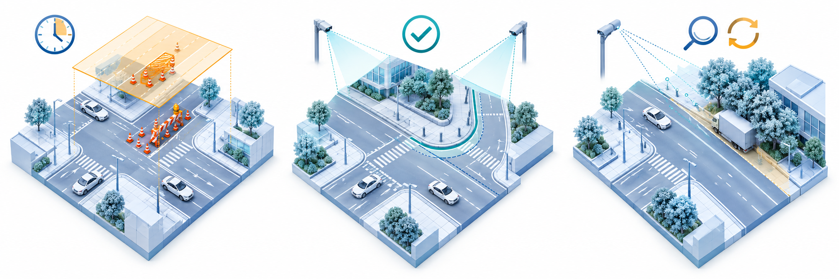
Map Maintenance Decisions
PART 2
MOD 3
Temporary event layer
Base-map update
Verify again
Verified event
Persistent change
Needs review
24
Notes:
Slide 2 — about 23 seconds
中文：已确认的当前占用进入临时事件层。只有独立重访和一致的几何共同支持结构变化时，我们才修改底图。单次经过或冲突观测需要继续验证。作出判断前，先按场景、时间和地图版本对齐证据。
English: Verified current occupancy goes into a temporary layer. We update the base map only when independent revisits and consistent geometry support a structural change. Single passes or conflicting observations need further review, after aligning the scene, time and map version.
Source: group proposal and supplied deck. Illustrations are conceptual. Planned maintenance and evaluation are not reported as completed experiments.

Slide 3
Temporary Events and Base-Map Updates
PART 2
MOD 3
 | Temporary event layer | Versioned base map
Purpose | Record current occupancy. | Represent supported structural change.
Record | Event ID, geometry, first / last seen, validity, evidence and review. | Element ID, old / new geometry, map version, visit history and evidence.
Action | Re-observe, extend, expire or close after verification. | Insert, modify or deactivate. Keep history for rollback.
Condition | Verify current occupancy. Long-term status may remain unresolved. | Independent revisits and consistent, reliable geometry.
25
Notes:
Slide 3 — about 19 seconds
中文：临时事件层记录事件时间、有效状态和证据。事件过期不代表障碍已经消失。底图修改则保留几何、重访与版本记录，支持审查和回滚。连续相邻帧也不能证明变化长期存在。
English: The temporary layer records event time, validity and evidence. Expiry does not prove clearance. Base-map edits retain geometry, visit history and version records for review and rollback. Adjacent frames do not establish long-term persistence.
Source: group proposal and supplied deck. Illustrations are conceptual. Planned maintenance and evaluation are not reported as completed experiments.

Slide 4

Map Visualization and Decision Review
PART 2
MOD 3
Compare the same scene, extent and coordinate frame. Link each decision to its evidence and map version.
Prior base map
Temporary event overlay
Supported structural update
26
Notes:
Slide 4 — about 16 seconds
中文：这三幅图对比原始底图、临时事件覆盖和结构修改。每项决策都关联到证据和地图版本。这里展示的是概念示意，完整的集成地图编辑仍是后续计划。
English: These three views compare the prior map, a temporary overlay and a structural edit. Each decision links to evidence and a map version. The images are conceptual, and integrated editing remains planned.
Source: group proposal and supplied deck. Illustrations are conceptual. Planned maintenance and evaluation are not reported as completed experiments.

Slide 5

PART 3
Evidence and Evaluation
What will your final demo or analysis show?
Notes:
Slide 5 — about 3 seconds
中文：下面说明我们最终会展示哪些证据。
English: We now turn to our final evidence.
Source: group proposal and supplied deck. Illustrations are conceptual. Planned maintenance and evaluation are not reported as completed experiments.

Slide 6
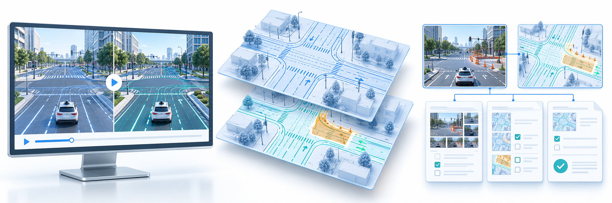
Our Final Evidence
PART 3
Our final evidence will be a replayable demo and an evaluation report.
Replayable demo
Before / after maps
Traceable records
31
Notes:
Slide 6 — about 16 seconds
中文：我们的最终证据是一套可回放演示和评估报告，包括场景回放、更新前后的地图，以及可追溯的决策记录。真实观测和受控测试会分开报告。
English: Our final evidence will be a replayable demo and an evaluation report. This includes scene replay, before-and-after maps and traceable decisions. Real observations and controlled tests will be reported separately.
Source: group proposal and supplied deck. Illustrations are conceptual. Planned maintenance and evaluation are not reported as completed experiments.

Slide 7
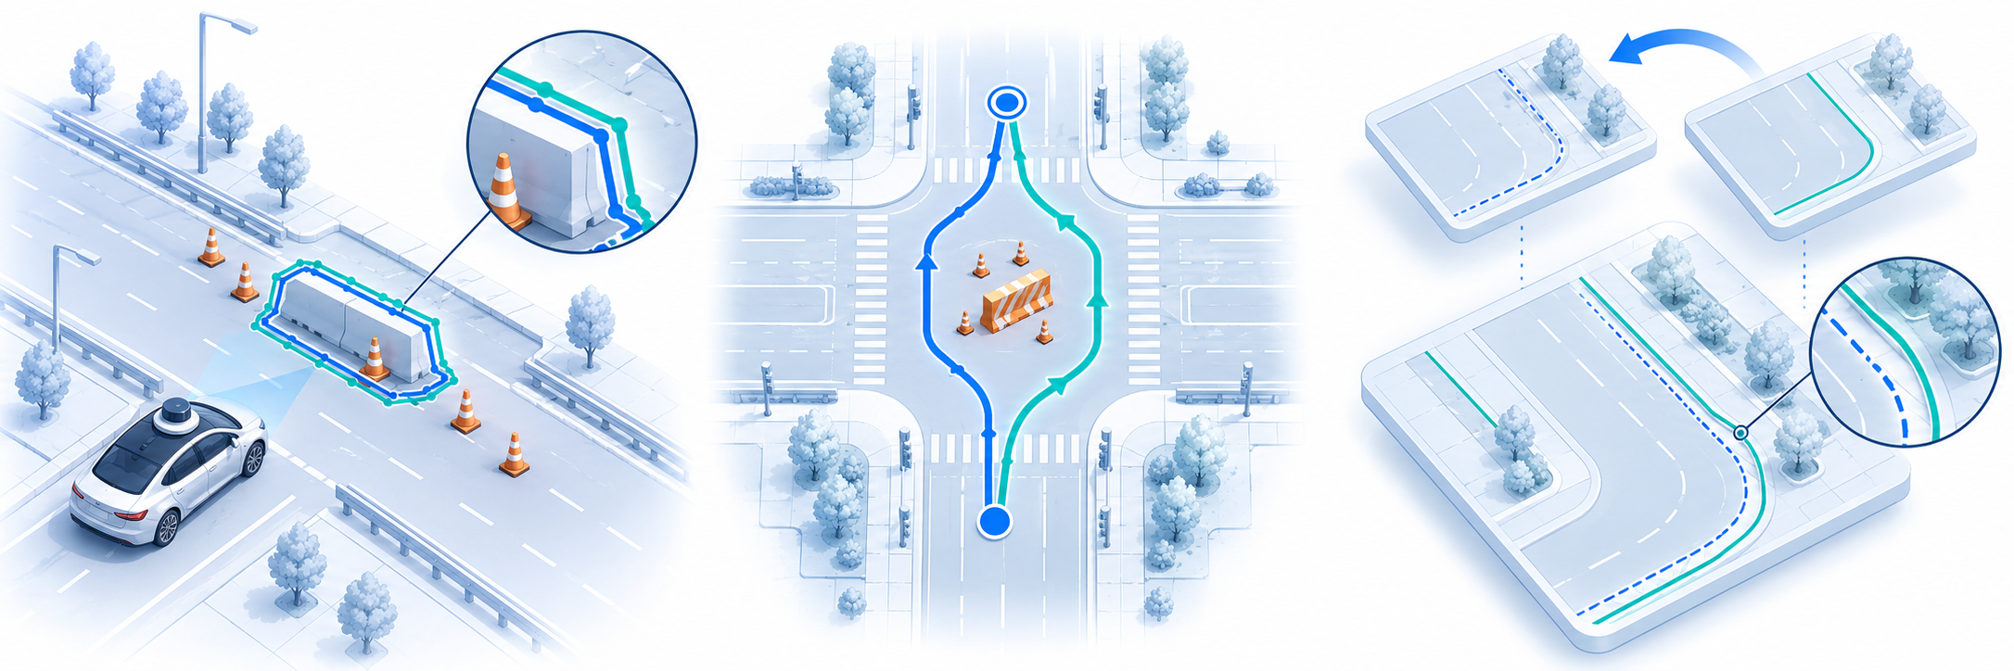
What the Evidence Will Demonstrate
PART 3
Perception / reliability
Planning
Map maintenance
Detection quality
Route comparison
Update quality
32
Notes:
Slide 7 — about 23 seconds
中文：检测质量通过独立标注评估精确率、召回率和覆盖率，也报告未解决情况。规划在相同起终点和障碍条件下，比较路线可行性与行为差异。地图维护则衡量更新正确性、延迟、错误修改和回滚，并分析评估场景中的失败案例。
English: We will measure detection precision, recall and coverage against independent labels, including unresolved cases. Planning comparisons use the same start, goal and obstacle conditions to assess route feasibility and behavior. Map maintenance measures correctness, delay, false edits and rollback. We will also analyze failures within the evaluated scenes.
Source: group proposal and supplied deck. Illustrations are conceptual. Planned maintenance and evaluation are not reported as completed experiments.

Slide 8

What the Evidence Will Not Demonstrate
PART 3
Generalization
Live-driving safety
Permanent change
Limited test scope
Safety unproven
Needs revisits
33
Notes:
Slide 8 — about 15 seconds
中文：这些结果不能证明系统能够泛化到所有未见场景，也不能证明实际交通中的驾驶安全。短录像同样不能证明永久地图变化，我们仍需要独立重访和更广泛的验证。
English: These results cannot establish generalization to unseen scenarios or certify safety in live traffic. A short recording cannot prove permanent map change. Independent revisits and broader validation are still needed.
Source: group proposal and supplied deck. Illustrations are conceptual. Planned maintenance and evaluation are not reported as completed experiments.

