Slide 1

PART 2 / MODULE 03
Map Maintenance
Should the map be updated?
Notes:
I am . My part decides which map layer should receive the evidence, and keeps that decision traceable.
Source: AIE1903_ProjectProposal_group5.pdf, pp. 1–4. Project design; statements do not imply completed implementation. Artwork is conceptual, not an experimental result.
Conceptual background illustration generated for this presentation.

Slide 2

Map Maintenance Decisions
PART 2
MOD 3
Temporary event layer
Base-map update
Verify again
Verified current occupancy
Independent revisits
+ consistent geometry
Single pass or
conflicting observations
24
Notes:
Based on the group proposal and supplied AIE1903 deck. AI-generated conceptual illustration, not an experiment or completed implementation. Maintenance and integrated evaluation remain proposed work. Temporary overlays, supported structural edits and unresolved cases are separate decisions, not an automatic progression. Independent revisits and geometric consistency are the key ideas consolidated from the removed persistence slide.
Removed from the slide at user request: Align scene, time and map version. Current occupancy may be recorded before persistence is resolved.

Slide 3
Temporary Events and Base-Map Updates
PART 2
MOD 3
 | Temporary event layer | Versioned base map
Purpose | Record current occupancy. | Represent supported structural change.
Record | Event ID, geometry, first / last seen, validity, evidence and review. | Element ID, old / new geometry, map version, visit history and evidence.
Action | Re-observe, extend, expire or close after verification. | Insert, modify or deactivate. Keep history for rollback.
Condition | Verify current occupancy. Long-term status may remain unresolved. | Independent revisits and consistent, reliable geometry.
25
Notes:
Source: supplied group proposal and deck. Proposed maintenance design. Consolidated persistence checks: record first / last seen and independent visits. Match element IDs, distance, direction and overlap. Use reliable geometry and thresholds selected on development data. A single continuous recording cannot establish long-term change. Event expiry is not evidence of obstacle clearance. Base-map edits retain evidence, versions and rollback history. The removed numerical candidate example is intentionally omitted.
Removed from the slide at user request: Expiry does not prove clearance. Adjacent frames do not establish persistence.

Slide 4

Map Visualization and Decision Review
PART 2
MOD 3
Compare the same scene, extent and coordinate frame. Link each decision to its evidence and map version.
Prior base map
Temporary event overlay
Supported structural update
26
Notes:
Source: AIE1903.pptx supplied by the group. AIE1903_ProjectProposal_group5.pdf, pp. 1–4. Maintenance and integrated evaluation are proposed work. Statements do not imply completed implementation.
AI-generated conceptual map comparison. The temporary overlay and structural edit are alternative outcomes, not an automatic progression. This image is not a measured experiment.
Removed from the slide at user request: Concept illustration. Integrated before / after map editing remains planned.

Slide 5

PART 3
Evidence and Evaluation
What will your final demo or analysis show?

Slide 6
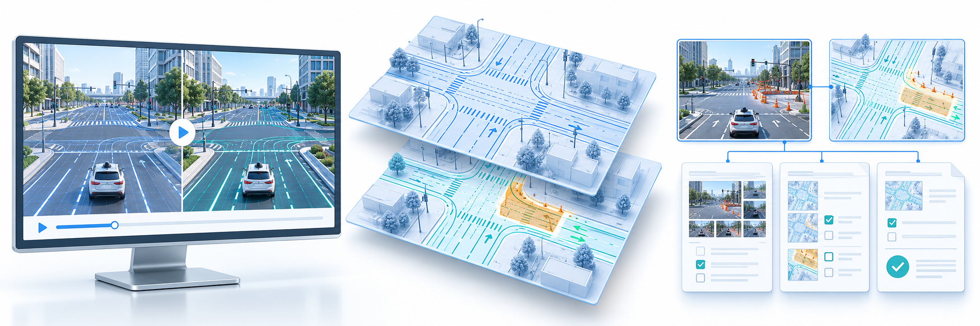
Our Final Evidence
PART 3
Our final evidence will be a replayable demo and an evaluation report.
Replayable demo
Before / after maps
Traceable records
31
Notes:
Based on the group proposal and supplied AIE1903 deck. AI-generated conceptual illustration, not an experiment or completed implementation. Maintenance and integrated evaluation remain proposed work. Evidence package: scene comparisons with independent labels and matched conditions, before/after maps with temporary events and structural edits, and decision records linking metrics, version history and failure cases.
Removed from the slide at user request: Real observations and controlled tests reported separately. Illustrations show the planned evidence.

Slide 7
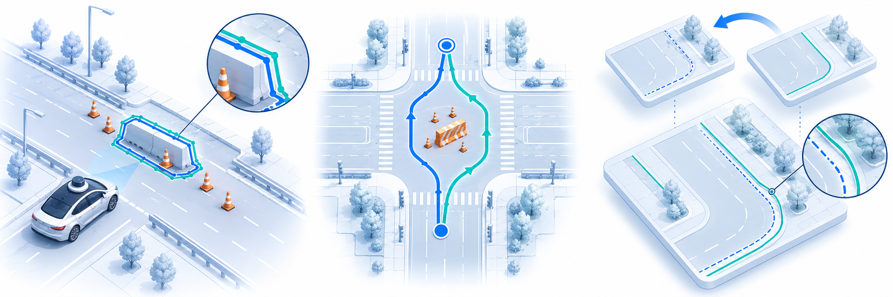
What the Evidence Will Demonstrate
PART 3
Perception / reliability
Planning
Map maintenance
Detection vs. labels
Precision / recall / coverage
Matched start and goal
Route and behavior differences
Update correctness / delay
False edits / rollback
32
Notes:
Based on the group proposal and supplied AIE1903 deck. AI-generated conceptual illustration, not an experiment or completed implementation. Maintenance and integrated evaluation remain proposed work. Evaluation details retained from the original table: use independent labels and scene splits for perception and reliability, including unresolved rate. For planning, match start/goal and obstacle evidence and report route feasibility and behavioral differences. For maintenance, use known map changes or controlled cases, measure correctness, timing, false edits and rollback. Traceable observations and decision history support analysis of missed changes, false alarms and uncertainty. No measured outcomes are asserted by this conceptual image.
Removed from the slide at user request: Within evaluated scenes. Report unresolved cases and failure analysis across all three modules.

Slide 8

What the Evidence Will Not Demonstrate
PART 3
Generalization
Live-driving safety
Permanent change
Test scenes alone
do not cover unseen conditions
Offline replay
does not certify deployment
A short recording
does not prove persistence
33
Notes:
Based on the group proposal and supplied AIE1903 deck. AI-generated conceptual illustration, not an experiment or completed implementation. Maintenance and integrated evaluation remain proposed work.
Removed from the slide at user request: Broader claims require additional evidence and validation. Conceptual illustrations.

