Slide 1

AIE1903_AD / GROUP 5
HD Map
Change Detection
Maintenance & Planning
under Uncertain Observations
Cui Yingting · Wang Zimo · Mei Ziheng
Pan Mingyang · Huang Ziming
School of Artificial Intelligence
The Chinese University of Hong Kong, Shenzhen
Notes:
Source: AIE1903_ProjectProposal_group5.pdf, pp. 1–4. Project title and team names follow the proposal. Cover artwork: AI-generated conceptual illustration adapted from the user-supplied image; not an actual nuScenes frame or experiment result. All title text is editable.

Slide 2
Project Overview
INTRO
01
Perception
What has changed?
02
Reliability
How reliable is the evidence?
03
Planning
How should the vehicle respond?
04
Map Maintenance
Should the map be updated?
Evaluation & Evidence consolidates map decisions and results from all modules.
02
Notes:
Source: AIE1903_ProjectProposal_group5.pdf, pp. 1–4. Overview summarizes the proposed workflow, not completion claims. Planning precedes the final map updating and Evaluation and Evidence stage.

Slide 3
CONTENTS
01
Perception
02
Reliability
What has changed?
How reliable is the evidence?
03
Planning
04
Map Maintenance
How should the vehicle respond?
Should the map be updated?
Notes:
Source: AIE1903_ProjectProposal_group5.pdf, pp. 1–4. Editable agenda. Sections follow the team project, with Evaluation and Evidence as the final aggregation stage.

Slide 4
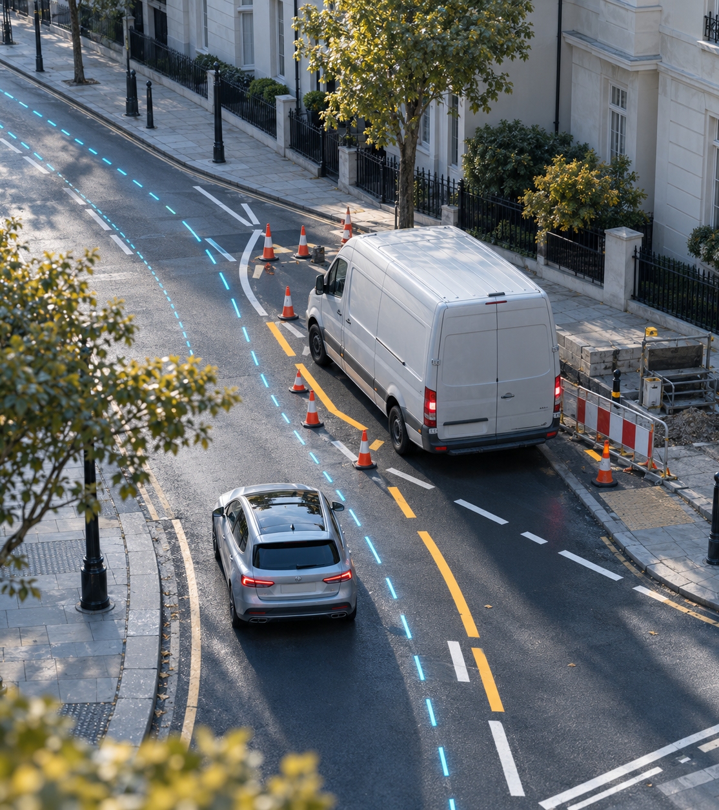
01
Perception
What has changed?
Notes:
Source: AIE1903_ProjectProposal_group5.pdf, pp. 1–4. Chapter subject: Project Context. Artwork: AI-generated conceptual illustration commissioned for this chapter and layout. It is not a dataset frame, a software screenshot, or a measured experiment result.

Slide 5
Road Changes & Observation Uncertainty
PART 1
Real road changes
Observation uncertainty
Add a verified change example
Add occlusion, missed-detection or alignment examples
05
Notes:
Source: AIE1903_ProjectProposal_group5.pdf, pp. 1–4. Template content for team review. Visible instructional text identifies editable content areas and must be replaced with approved material before presenting.

Slide 6
Research Question & Project Scope
PART 1
Research question
Minimum viable scope
Add the question and comparison being tested
Add local lane-marking and static-planning scope
06
Notes:
Source: AIE1903_ProjectProposal_group5.pdf, pp. 1–4. Template content for team review. Visible instructional text identifies editable content areas and must be replaced with approved material before presenting.

Slide 7
Data Sources & Map Roles
PART 1
01
02
03
nuScenes
TbV / ArgoTweak
Controlled cases
Driving observations, temporary occupancy and consistency experiments
Structural-change evaluation after verifying map versions and labels
Report synthetic map perturbations separately from real-change results
07
Notes:
Source: AIE1903_ProjectProposal_group5.pdf, pp. 1–4. Template content for team review. Visible instructional text identifies editable content areas and must be replaced with approved material before presenting.

Slide 8
Alignment, Visibility & Evidence
PART 1
Observation quality
Evidence requirements
Insert alignment and synchronization examples
Insert visibility, coverage and supporting-frame criteria
08
Notes:
Source: AIE1903_ProjectProposal_group5.pdf, pp. 1–4. Template content for team review. Visible instructional text identifies editable content areas and must be replaced with approved material before presenting.

Slide 9
Temporary, Structural & Unresolved Changes
PART 1
01
02
03
Temporary
Structural
Unresolved
Short-term occupancy and event-layer records
Geometry edits supported by reliability and persistence evidence
Insufficient evidence retained for further verification
09
Notes:
Source: AIE1903_ProjectProposal_group5.pdf, pp. 1–4. Template content for team review. Visible instructional text identifies editable content areas and must be replaced with approved material before presenting.

Slide 10
Baselines & Comparisons
PART 1
Comparison design
Add baselines, ablations and shared evaluation conditions
10
Notes:
Source: AIE1903_ProjectProposal_group5.pdf, pp. 1–4. Template content for team review. Visible instructional text identifies editable content areas and must be replaced with approved material before presenting.

Slide 11
Scope, Assumptions & Limitations
PART 1
Core scope
Assumptions and limitations
Summarize the offline prototype and required capabilities
Add data limitations and claims requiring further validation
11
Notes:
Source: AIE1903_ProjectProposal_group5.pdf, pp. 1–4. Template content for team review. Visible instructional text identifies editable content areas and must be replaced with approved material before presenting.

Slide 12
Shared Interfaces & Evidence References
PART 1
Module interface specification
Add scene IDs, element IDs, map versions, timestamps and evidence links
12
Notes:
Source: AIE1903_ProjectProposal_group5.pdf, pp. 1–4. Template content for team review. Visible instructional text identifies editable content areas and must be replaced with approved material before presenting.

Slide 13
Six-Week Milestones & Integration Plan
PART 1
01
02
03
Weeks 1–2
Weeks 3–4
Weeks 5–6
Verify data, map roles and interfaces; establish baselines
Implement modules and integrate one complete scene
Evaluate comparisons and failures; prepare demonstration and report
13
Notes:
Source: AIE1903_ProjectProposal_group5.pdf, pp. 1–4. Template content for team review. Visible instructional text identifies editable content areas and must be replaced with approved material before presenting.

Slide 14

02
Reliability
How reliable is the evidence?
Notes:
Source: AIE1903_ProjectProposal_group5.pdf, pp. 1–4. Chapter subject: Methods & Modules. Artwork: AI-generated conceptual illustration commissioned for this chapter and layout. It is not a dataset frame, a software screenshot, or a measured experiment result.

Slide 15
Perception & Change Candidates
PART 2
What has changed?
Input and method
Outputs and evidence
Cui Yingting · Add sensor processing and map-matching method
Add candidate geometry, IDs and example observations
15
Notes:
Source: AIE1903_ProjectProposal_group5.pdf, pp. 1–4. Template content for team review. Visible instructional text identifies editable content areas and must be replaced with approved material before presenting.

Slide 16
Multi-Frame Verification & Behavior
PART 2
How reliable is the evidence?
Verification and behavior rules
Results and unresolved cases
Wang Zimo · Add support counts and shared-track analysis
Add behavior intervals and change–vehicle associations
16
Notes:
Source: AIE1903_ProjectProposal_group5.pdf, pp. 1–4. Template content for team review. Visible instructional text identifies editable content areas and must be replaced with approved material before presenting.

Slide 17
Local HD Map Reliability Assessment
PART 2
How reliable is the evidence?
Quality gate and mismatch test
Reliability decisions
Mei Ziheng · Add coverage, residuals and decision thresholds
Add element-level decisions and supporting evidence
17
Notes:
Source: AIE1903_ProjectProposal_group5.pdf, pp. 1–4. Template content for team review. Visible instructional text identifies editable content areas and must be replaced with approved material before presenting.

Slide 18
Reliability-Aware Local Planning
PART 2
How should the vehicle respond?
Planner and feasibility checks
Planning comparisons
Pan Mingyang · Add lane graph, costs and static planning method
Add map-only and reliability-aware planning examples
18
Notes:
Source: AIE1903_ProjectProposal_group5.pdf, pp. 1–4. Template content for team review. Visible instructional text identifies editable content areas and must be replaced with approved material before presenting.

Slide 19

03
Planning
How should the vehicle respond?
Notes:
Source: AIE1903_ProjectProposal_group5.pdf, pp. 1–4. Chapter subject: Demonstration. Artwork: AI-generated conceptual illustration commissioned for this chapter and layout. It is not a dataset frame, a software screenshot, or a measured experiment result.

Slide 20
End-to-End Demonstration
PART 3
Scene replay / demonstration
Insert a video, BEV view or sequence of real module outputs
20
Notes:
Source: AIE1903_ProjectProposal_group5.pdf, pp. 1–4. Template content for team review. Visible instructional text identifies editable content areas and must be replaced with approved material before presenting.

Slide 21
Observations & Candidate Evidence
PART 3
What has changed?
Sensor / map observation
Candidate evidence
Insert a representative frame or aligned BEV view
Insert the matching candidate and evidence record
21
Notes:
Source: AIE1903_ProjectProposal_group5.pdf, pp. 1–4. Template content for team review. Visible instructional text identifies editable content areas and must be replaced with approved material before presenting.

Slide 22
Verification & Behavior Results
PART 3
How reliable is the evidence?
Multi-frame support
Vehicle behavior and association
Insert the verified observation sequence
Insert tracks, behavior intervals and association evidence
22
Notes:
Source: AIE1903_ProjectProposal_group5.pdf, pp. 1–4. Template content for team review. Visible instructional text identifies editable content areas and must be replaced with approved material before presenting.

Slide 23
Reliability & Planning Results
PART 3
How reliable is the evidence?
How should the vehicle respond?
Reliability assessment
Planning output
Insert quality gates and element-level decisions
Insert routes, feasible alternatives or rejection reasons
23
Notes:
Source: AIE1903_ProjectProposal_group5.pdf, pp. 1–4. Template content for team review. Visible instructional text identifies editable content areas and must be replaced with approved material before presenting.

Slide 24
Map Update: Before & After
PART 3
Should the map be updated?
Before update
After update
Insert the versioned prior map / event layer
Insert the supported change and its linked evidence
24
Notes:
Source: AIE1903_ProjectProposal_group5.pdf, pp. 1–4. Template content for team review. Visible instructional text identifies editable content areas and must be replaced with approved material before presenting.

Slide 25
Current Progress & Next Steps
PART 3
Verified progress
Next integration tasks
Add completed work and evidence for each claim
Add owner, dependency and completion criteria
25
Notes:
Source: AIE1903_ProjectProposal_group5.pdf, pp. 1–4. Template content for team review. Visible instructional text identifies editable content areas and must be replaced with approved material before presenting. Repository onboarding verified stages 3/5/6/7, 29 candidates, 13 vehicle tracks, 175 association pairs and 30 consistency/synthetic checks on scene-0980. These are development checks, not independent accuracy measurements. Independent evaluation remains AWAITING_INDEPENDENT_LABELS.

Slide 26

04
Map
Maintenance
Should the map be updated?
Huang Ziming
Notes:
Source: AIE1903_ProjectProposal_group5.pdf, pp. 1–4. Chapter subject: Evaluation & Evidence. Artwork: AI-generated conceptual illustration commissioned for this chapter and layout. It is not a dataset frame, a software screenshot, or a measured experiment result.

Slide 27
Map Updating & Evidence Aggregation
PART 4
Should the map be updated?
Versioned map and event layers
Final evidence package
Huang Ziming · Add update rules, decisions and history
Add upstream metrics, planning comparisons and failure cases
27
Notes:
Source: AIE1903_ProjectProposal_group5.pdf, pp. 1–4. Template content for team review. Visible instructional text identifies editable content areas and must be replaced with approved material before presenting. Huang Ziming owns map updating, visualization and final evaluation/evidence aggregation; module owners supply their own evaluation records.

Slide 28
Evaluation Protocol & Comparisons
PART 4
01
02
03
Reference labels
Data separation
Fair comparisons
Add independent labels, verified map versions and provenance
Keep original scenes and their perturbations in the same split
Use shared planning conditions; report real and controlled cases separately
28
Notes:
Source: AIE1903_ProjectProposal_group5.pdf, pp. 1–4. Template content for team review. Visible instructional text identifies editable content areas and must be replaced with approved material before presenting. Huang Ziming owns map updating, visualization and final evaluation/evidence aggregation; module owners supply their own evaluation records.

Slide 29
Metrics, Coverage & Failure Cases
PART 4
Consolidated module evaluation
Insert approved metrics, evaluable coverage, unresolved cases and failure examples
29
Notes:
Source: AIE1903_ProjectProposal_group5.pdf, pp. 1–4. Template content for team review. Visible instructional text identifies editable content areas and must be replaced with approved material before presenting. Huang Ziming owns map updating, visualization and final evaluation/evidence aggregation; module owners supply their own evaluation records.

Slide 30
Decision History, Rollback & Limitations
PART 4
Traceable decisions and rollback
Supported claims and open issues
Insert map versions, evidence references and rollback records
State which results are supported and which remain unverified
30
Notes:
Source: AIE1903_ProjectProposal_group5.pdf, pp. 1–4. Template content for team review. Visible instructional text identifies editable content areas and must be replaced with approved material before presenting. Huang Ziming owns map updating, visualization and final evaluation/evidence aggregation; module owners supply their own evaluation records.

Slide 31
Thank you
Questions & discussion
AIE1903_AD · Group 5
Cui Yingting · Wang Zimo · Mei Ziheng
Pan Mingyang · Huang Ziming
Notes:
Source: AIE1903_ProjectProposal_group5.pdf, pp. 1–4. Closing slide. Background is the same conceptual cover illustration.

Slide 32
Team Roles
APPENDIX
Cui Yingting
Sensor perception and map change detection
Wang Zimo
Multi-frame verification and behavior analysis
Mei Ziheng
Local HD map reliability assessment
Pan Mingyang
Local route and behavior planning
Huang Ziming
Map updating, visualization and Evaluation & Evidence
32
Notes:
Source: AIE1903_ProjectProposal_group5.pdf, pp. 1–4. Team responsibilities reproduced from proposal page 4. Huang Ziming consolidates upstream owners’ evaluation records after planning.

