Slide 1
Game of Theory
Group Number: 7
Group Name: Silveswords
Project Domain: behaviour game of theory and business model.
Group Members:
AU2040265 - Spandan Shah
AU2040181 - Yug Patel
AU2040021 - Dhanya Mehta

Slide 2
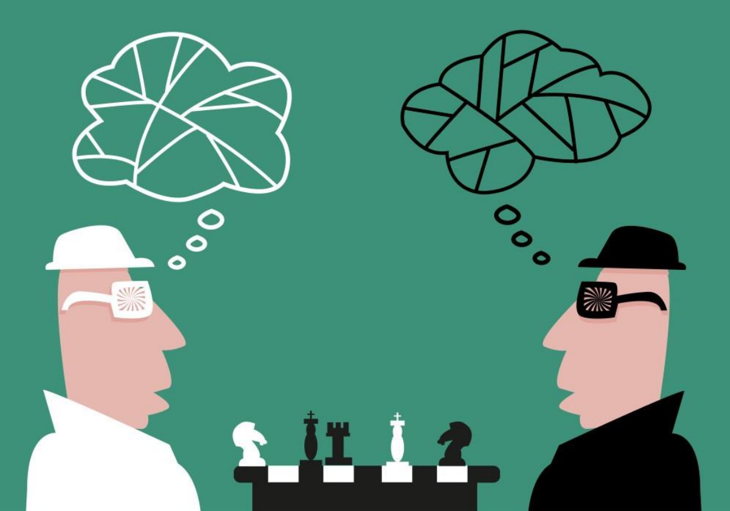

Slide 3
Introduction
To win in the respective games, one can make many possible choices, the mathematical study of these possibilities is called as the Game theory. According to Psychologists, In a competitive setting, one can make different choices against the opponent to win, this is to attempt to consider these choices, so it is also called the Theory of Social interaction. Although competitive games like, card games, board games and many other plays are the main focus of the game theory, but this can also be implemented to the strategy of military in a war. The main focus of this project is to demonstrate the use of Linear Algebra Matrix computations that are powerful tools to solve the problems of Strategic Problems and Game theory.

Slide 4
Background
Nash thus established the mathematical principles of Game Theory, a branch of mathematics that examines the rivalries between competitors with mixed interests.
Show that choices made by participants in a game do not reflect the benefit they expect to receive from making those choices.
In the 1980s experimenters started examining the conditions that cause divergence from rational choice.
Since the 1960s game theorists have contributed immensely compatible if the preferences are reported truthfully by all the agents.

Slide 5
Problem Statement
We will analyze the behavioral theory using nash equilibrium showing visual representation in matrix form .
Why competitors opening their brand outlets near to each other?”

Slide 6
Motivation
The mains concepts of the game theory are the Rationality and the Common Knowledge.
In this world full of messiness, Simplifying assumptions are must. By taking assumptions in most of the models of the world, life can be made easy.
The game made by us using python can help us understand the logic behind these assumptions, how these assumptions are made and the change in behaviour of people at every point can be analyzed and understood by the game made by us.

Slide 7
Literature Survey
We study and researched nash equilibrium where each player trying to achieve maximum dominant move by limited constraints and eventually will reached to a equilibrium or equal position and will try to acquire maximum position but will eventually reach to equilibrium.
Game of theory is all dependent on predefine move by the players and every move by the order, where each side action will depend on what the other side would do. (“the concept of strategic interdependence”).

Slide 8
Key to Approach the Problem
➢ Player: The player who is competing with the opponent, can make different possible decisions or choices that can be made, respective of the situation.
➢ Game: The situation or the problem which can be solved by different choices and can affect the whole situation and the players of the game.
➢ Risk: If made a negative choice, what is at stake of the player or what could be lost.
➢ Reward: If made a positive or right choice, what can be gained by the player.

Slide 9
➢ The Nash Equilibrium: This tries to predict the choices of a player or multiple players that are making choices at the same time. The main focus of this prediction is to increase the player’s payoff to the maximum and to reduce the opponent’s payoff to the minimum. The resulting sum of the player’s choices by this becomes zero.
o Mathematically, we have two players A and B, each with their own choices A = n and B = m. We also have a function P, which can be calculated as A ✕ B. The
resulting matrix is known as the “Payoff Matrix”.

Slide 10
Key Subtopics
Behavioral Game Theory
It helps us analyze the strategic behaviour which is affected by interaction between the players using the game theory.
In this sub-topic, behaviour of players almost changes every time which is affected by so many factors.
Main reason to take the assumption:
Choices of players are not always rational and not always give the optimized result.
The main focus is on using Experimental data and utilizing the laboratory
Computational way and Theoretical way

Slide 11
Business strategic model
This is a traditional problem setting that continues to throw up exciting new applications in morden times.
In a strategic setting, game theory is a theoretical framework for conceiving social situations among competing players and producing optimal decision-making of independent and competing actors.
Matching is the process of allocating one set of resources or individuals to another set of resources or individuals.
Ex: Matching Buyers to selling in a market.

Slide 12
Game In Python
We have done the case study from the game to analyze the behaviour of players and strategy using nash Equilibrium.
The practical application of concepts like Hangman and Tic Tac Toe had been also studied by us.

Slide 13


Mathematical Model
How do we calculate the utility / pay-offs of Player A and Player B in the mixed strategy Nash equilibrium?
The general mathematical formulation is given as:
Consider the game:
with σr and σc are the mixed strategies for the row and column players here A and B respectively.
Then the utility/pay-off for the row player (A) is:

Slide 14



and utility/pay-off for the column player (B) is:
The probability of being in a given cell of (A or B) is:
The value of the cell is:

Slide 15
Numerical Results
Utility to A will be:
0.67*0.33*4 +0.33*0.67*0+0.33*0.67*0+0.33*0.67*2 =1.3266
and for B it will be:
0.33*0.67*2 + 0.67*0.33*0 + 0.33*0.67*0+0.67*0.33*4 = 1.3266

Slide 16
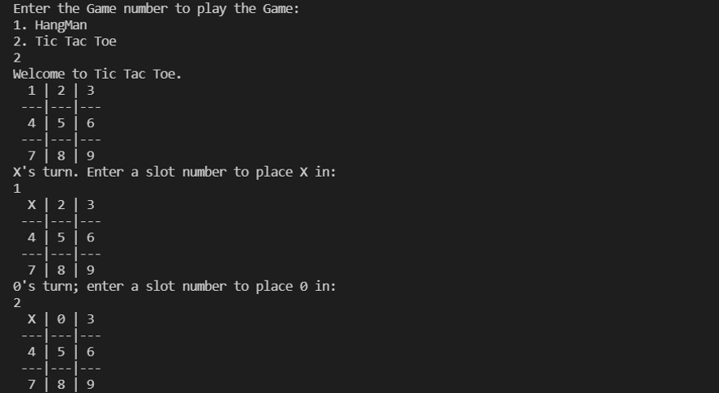
Result of Code

Slide 17
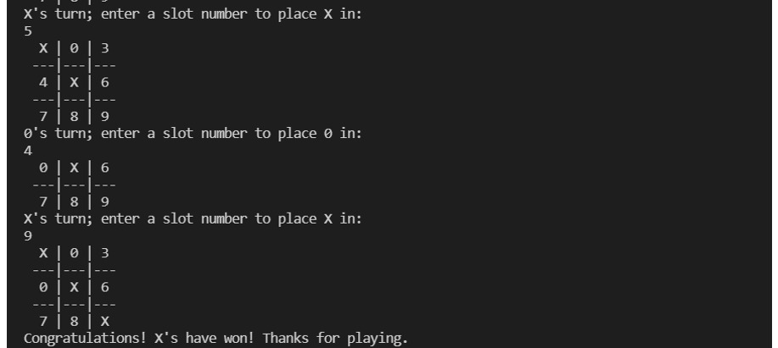

Slide 18
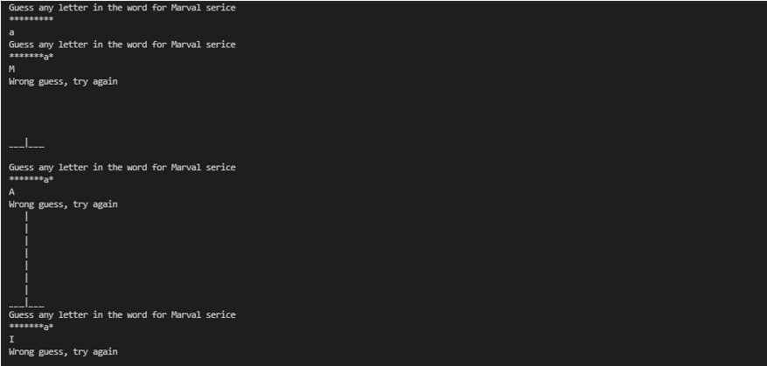
HangMan

Slide 19
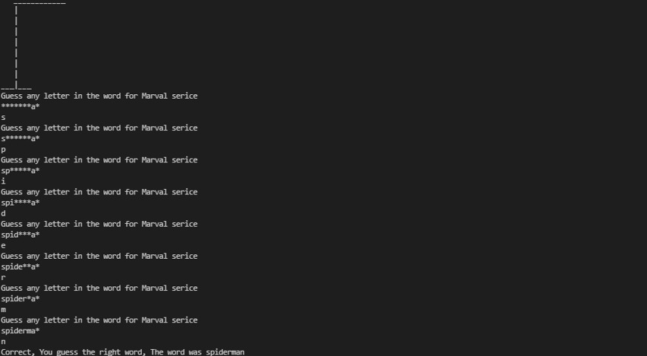

Slide 20
References
Osborne, M. J., & Rubinstein, A. (1994). A course in game theory. MIT press.
Colman, A. M. (2003). Cooperation, psychological game theory, and limitations of rationality in social interaction. Behavioral and Brain Sciences, 26(02), 139-153.
Dufwenberg, M., & Kirchsteiger, G. (2004). A theory of sequential reciprocity. Games and economic behavior, 47(2), 268-298.
Izquierdo, L.R. (2008). Advancing Learning and Evolutionary Game Theory with an Application to Social Dilemmas. Munich Personal RePEc Archive, Paper #8664, pp.199, retrieved from https://mpra.ub.uni-muenchen.de/8664/1/MPRA_paper_8664.pdf
Sandler, T, and Arce M, Daniel. (2003). Terrorism and Game Theory. vol. 34, issue 3, International Simulation and Gaming Association (ISAGA).

Slide 21
Contributions
All the member had done different topic of the project and are below:
Dhanya Mehta:
Working on behavioral game of theory: in which it explained how player makes decision in real life and trying to attaining dominating position.
Explaining nash equilibrium and its constraints and real-life applications and case study of Hangman.

Slide 22
2. Spandan Shah
Discussing about how game of theory works in understanding business models and how brands in competitive world follows game of theory as a strategic model
Also answering questions like “Why brand outlets which are selling same product/ competitor are always seen near to each other!”
Ppts presentation.
3. Yug Patel
Contributing code of case study like Hangman and Tic Tac Toe where will show practical life application of game of theory.
Literature survey and research.

