Slide 1

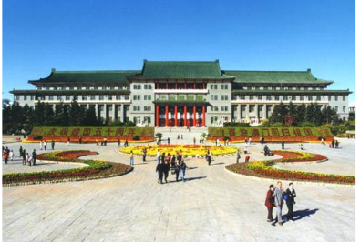
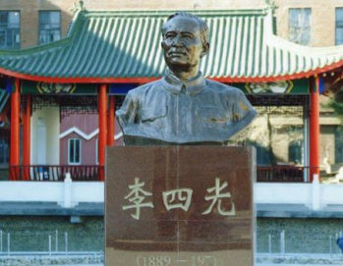
Involution: Inverting the Inherence of Convolution for Visual Recognition

Slide 2
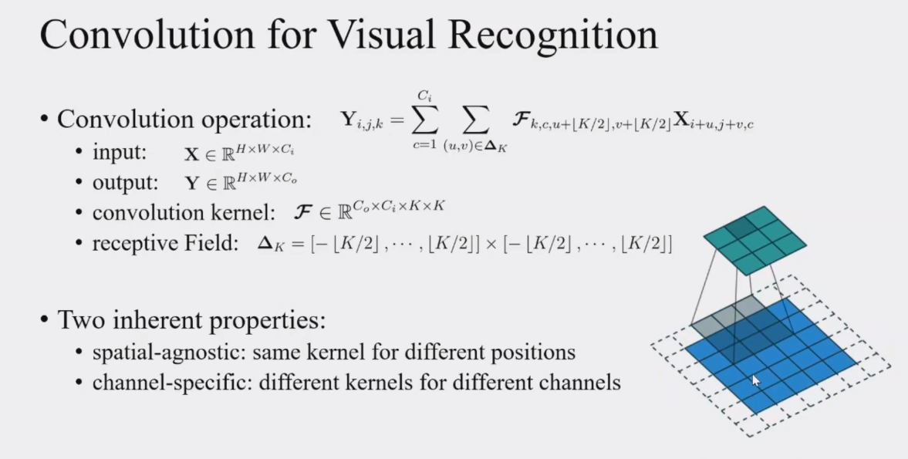
Involution: Inverting the Inherence of Convolution for Visual Recognition

Slide 3
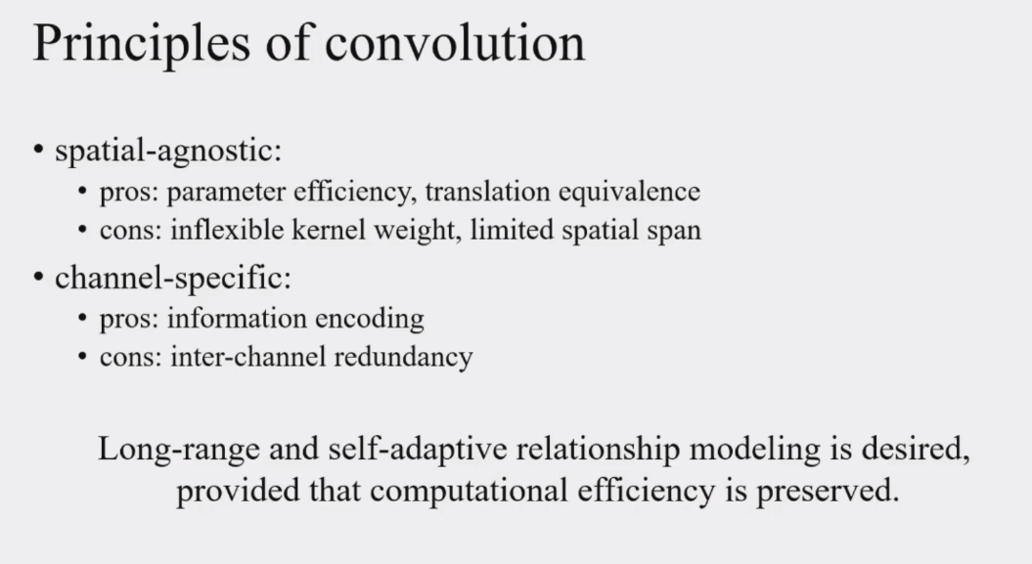
Involution: Inverting the Inherence of Convolution for Visual Recognition

Slide 4
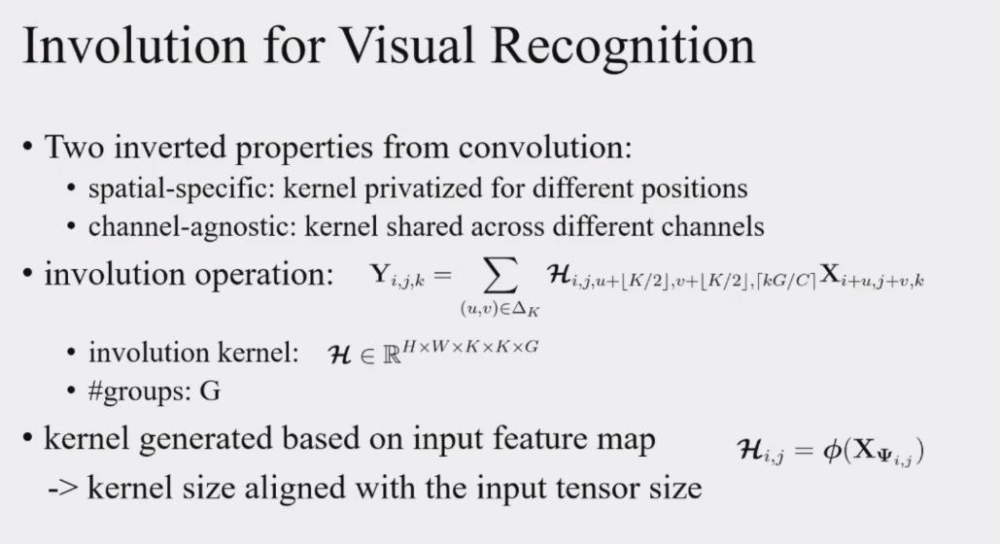
Involution: Inverting the Inherence of Convolution for Visual Recognition

Slide 5
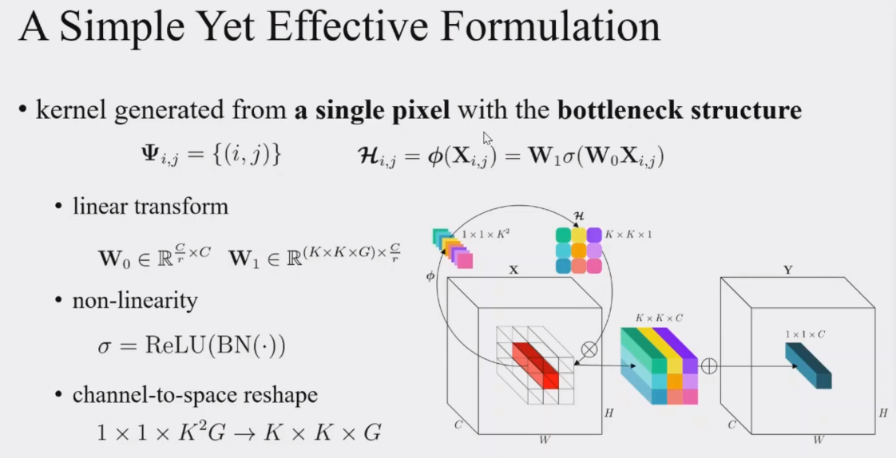
Involution: Inverting the Inherence of Convolution for Visual Recognition

Slide 6
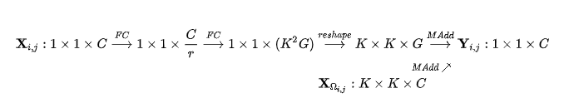
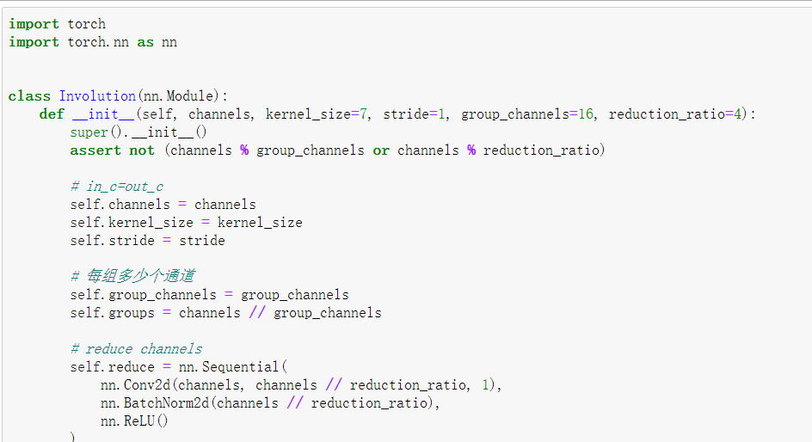
Involution: Inverting the Inherence of Convolution for Visual Recognition

Slide 7
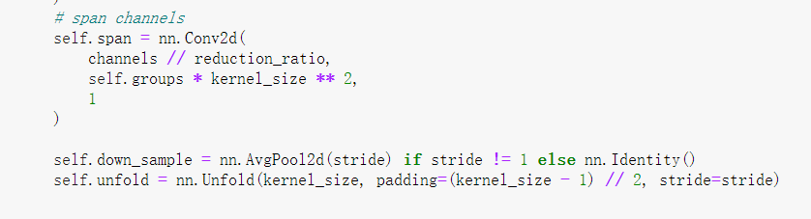
Involution: Inverting the Inherence of Convolution for Visual Recognition

Slide 8
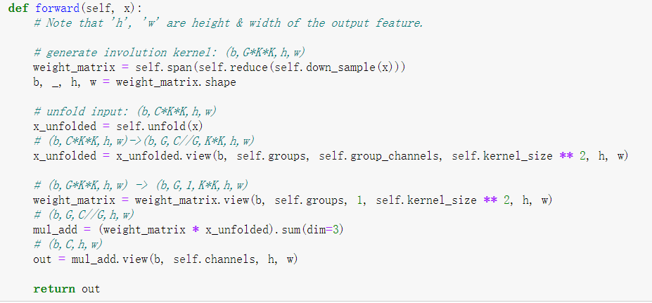
Involution: Inverting the Inherence of Convolution for Visual Recognition

Slide 9
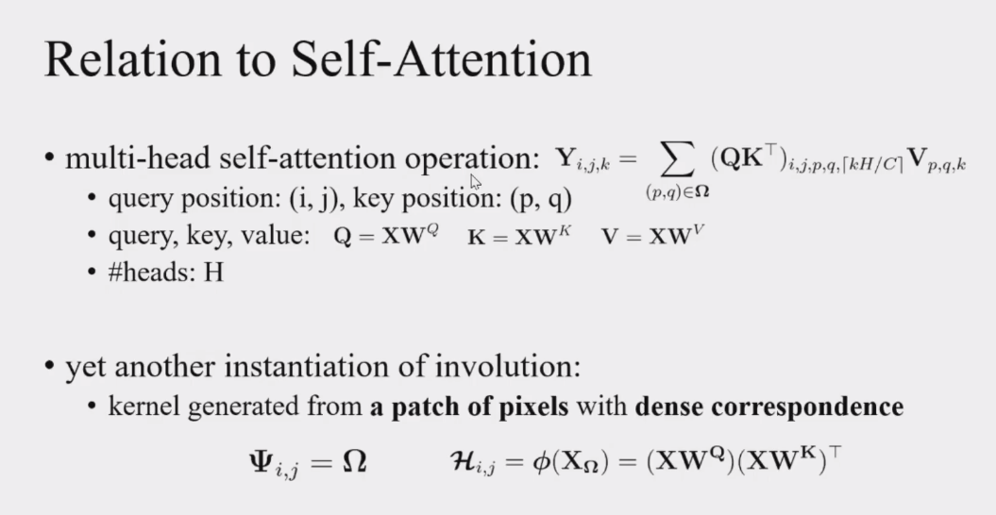
Involution: Inverting the Inherence of Convolution for Visual Recognition

Slide 10



Involution: Inverting the Inherence of Convolution for Visual Recognition
1.self-attention中不同的head对应到involution中不同的group(在通道上划分的组)；
2.self-attention中每个位置的关系矩阵 ，对应到involution中每个位置的kernel

Slide 11

Involution: Inverting the Inherence of Convolution for Visual Recognition
另外 对应于attention matrix multiplication前对 做的线性变换，self-attention操作后一般也会接另一个线性变换和残差连接，这个结构正好就对应于我们用involution替换resnet bottleneck结构中的 convolution，前后也有两个 convolution做线性变换

Slide 12
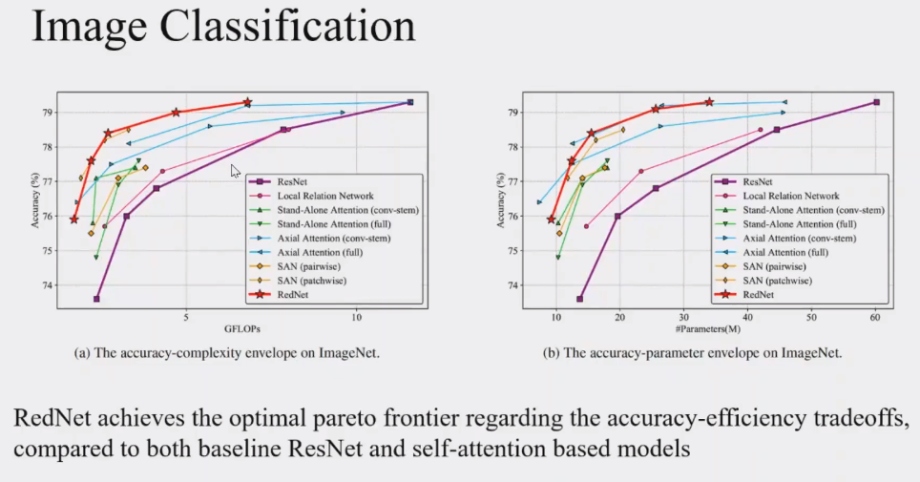
Involution: Inverting the Inherence of Convolution for Visual Recognition

Slide 13
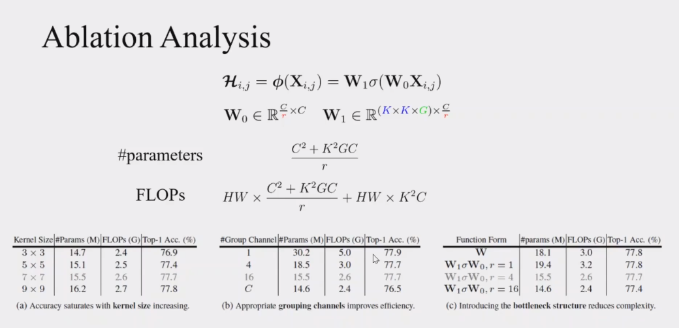
Involution: Inverting the Inherence of Convolution for Visual Recognition

Slide 14
Involution: Inverting the Inherence of Convolution for Visual Recognition
谢谢大家

