Slide 1



ENGINEERING DESIGN AND INNOVATION (EDI) PROJECT PRESENTATION FOR MID SEMESTER ASSESSMENT- SEPTEMBER 2026
EDI1 PROJECT TITLE:- DRIFT: CONTRACT-AWARE API REGRESSION SENTINEL AND
A BEHAVIORAL COMPATIBILITY DETECTION TOOL FOR REST APIS
DIV : L EDI_GROUP NO : 4 DAY: THURSDAY DATE: 24/09/2026
PRESENTED BY –
1) PRUTHVI GANGAPURE (12415034 )
2) PRATHAMESH YEWALE (12413969)
3) TANISHQ CHAVAN (12415035 )
4) YUG VYAS ( 12414125)
DEPARTMENT OF COMPUTER ENGINEERING
VISHWAKARMA INSTITUTE OF TECHNOLOGY, PUNE
PROJECT GUIDE:
PROF. (SMT) SANGITA LADE

Slide 2

LITERATURE REVIEW
DOI/URL:
10.1016/j.compbiomed.2023.107539
Title: Every Build You Break: Developer-Oriented Assistance for Build Failure Resolution
Published in: Empirical Software Engineering, 2020
1 | Objectives | - Help developers understand and resolve CI build failures faster. - Reduce the manual effort of reading large and noisy build logs. - Provide concise failure summaries and recommend relevant solutions. - Integrate diagnosis support directly into a CI environment.
2 | Methodology | Developed BART (Build Abstraction and Recovery Tool) as a Jenkins plugin. - Analyzed failed Maven build logs to identify relevant error information. - Generated short, developer-readable summaries of build failures. - Retrieved related Stack Overflow discussions and solution recommendations based on the detected failure.
3 | Results | - BART helped developers identify the important part of a failed build log more quickly. - The tool improved access to relevant troubleshooting information during failure diagnosis. - The evaluation showed that developer-oriented summaries and suggested solutions are useful for resolving broken builds.
4 | Advantages | - Reduces information overload from lengthy raw CI logs. - Provides actionable support instead of only showing an error message. - Integrates with Jenkins, so assistance appears within the developer workflow. - Directly supports Drift’s future features: log inspector, failure explanation, and AI-based repair suggestion.
5 | Limitations | - Primarily designed for Maven-based projects and Jenkins integration. - Depends on the quality and availability of relevant Stack Overflow solutions. - Focuses mainly on build-log diagnosis, not complete visual pipeline observability. - Does not provide a real-time interactive pipeline graph or targeted stage replay like Drift.

Slide 3
LITERATURE REVIEW
DOI/URL:
10.1016/j.compbiomed.2023.107539
Title: A Tale of CI Build Failures: An Open Source and a Financial Organization Perspective
).
Published in: IEEE International Conference on Software Maintenance and Evolution (ICSME), 2017
1 | Objectives | - Understand why Continuous Integration builds fail in real software projects. - Compare build failures in open-source projects and a financial organization. - Identify failure categories and their practical impact on developers. - Study how developers diagnose and repair CI build failures.
2 | Methodology | - Conducted an empirical study of failed CI builds from open-source and industrial contexts. - Examined build logs, project artifacts, and developer activities related to failures. - Classified failures into categories such as test failures, compilation errors, dependency problems, configuration issues, and infrastructure-related failures. - Compared the characteristics of failures between the two settings.
3 | Results | - CI failures have multiple root causes; test, dependency, compilation, and configuration issues are common. - Failure diagnosis requires considerable developer effort because log information is often complex and scattered. - Open-source and industrial projects show both common and context-specific failure patterns.
4 | Advantages | - Provides strong empirical evidence for the need for CI failure-analysis tools. - Gives useful failure categories for designing Drift’s classifier: code, config, environment, infrastructure, and flaky test. - Includes both industry and open-source perspectives.Protects patient privacy by not exchanging raw EEG data. Enables collaborative training across multiple hospitals. Combines spatial (CNN) and temporal (LSTM) analysis for improved diagnostic accuracy.
5 | Limitations | - Focuses on studying failures rather than building a complete real-time solution. - Does not provide an interactive pipeline visualization system. - The failure taxonomy may require adaptation for newer CI/CD tools and cloud-native pipelines. - Does not directly implement automatic replay or remediation.

Slide 4
LITERATURE REVIEW
DOI/URL:
10.1016/j.compbiomed.2023.107539
Title:Build Failure Prediction
Published in: Automated Software Engineering, 2022
1 | Objectives | - Predict whether an upcoming CI build will pass or fail before the build completes. - Reduce time and computational cost caused by running failing builds. - Learn both short-term and long-term patterns from historical CI build outcomes. - Improve prediction performance over traditional machine-learning methods.
2 | Methodology | - Proposed DL-CIBuild, an LSTM-based recurrent neural-network model. - Used historical sequences of CI build outcomes as input data. - Applied a Genetic Algorithm to optimize LSTM hyperparameters. - Evaluated online and cross-project prediction scenarios using 91,330 CI builds from 10 long-lived Travis CI projects.
3 | Results | - The LSTM-based model outperformed traditional machine-learning baselines in build-outcome prediction. - The model showed robustness to concept drift, where project behavior changes over time. - Genetic Algorithm tuning performed better than the compared hyperparameter-optimization approaches. - The approach was less sensitive to training-set size than baseline methods.
4 | Advantages | - Supports proactive CI/CD intelligence instead of only reactive failure analysis. - Learns temporal patterns from previous pipeline runs. - Uses a large benchmark of 91,330 builds, increasing the credibility of evaluation. - Directly supports Drift’s future ML Failure Classification and predictive alerting roadmap.
5 | Limitations | - Predicts build outcome but does not explain the exact root cause of failure. - Requires enough clean historical pipeline data for training. - LSTM model training and tuning increase computational complexity. - The study is based on Travis CI projects, so results may vary for GitHub Actions, GitLab CI, Jenkins, or other platforms.

Slide 5
LITERATURE REVIEW
DOI/URL:
10.1016/j.compbiomed.2023.107539
Title: Test Failure Triage
Published in: International Conference on Software Engineering (ICSE), 2022
1 | Objectives | - Reduce the effort needed to diagnose large numbers of CI test failures. - Group test failures caused by the same underlying fault. - Improve root-cause triage for broken CI builds. - Use code changes to improve test-failure classification.
2 | Methodology | - Performed a large-scale empirical study of 163,371 broken builds caused by test failures in Java projects. - Proposed BuildSheriff, a change-aware test-failure triage method. - Used information about changed code and failing tests to cluster failures with the same root cause. - Evaluated the approach on 200 broken CI builds against existing triage methods.
3 | Results | - BuildSheriff significantly improved test-failure triage effectiveness compared with state-of-the-art approaches. - Grouping failures by root cause can reduce duplicate debugging effort. - The study confirmed that many individual test failures may originate from only a small number of underlying defects.
4 | Advantages | - Reduces repeated manual investigation of similar test failures. - Uses code-change information, making diagnosis more context-aware. - Evaluated on a large number of real broken CI builds. - Strong support for Drift’s Classify stage and root-cause grouping functionality.
5 | Limitations | - Mainly focuses on test failures, not compilation, dependency, deployment, or infrastructure failures. - Requires access to reliable code-change and test-execution data. - Does not provide interactive visualization of the whole pipeline. - Does not directly provide automated repair or targeted replay.

Slide 6
LITERATURE REVIEW
DOI/URL:
https://doi.org/10.1145/3180155.3180164
Title: Flaky-Test Detection
Published in: International Conference on Software Engineering (ICSE), 2018
1 | Objectives | - Automatically identify flaky tests in software projects. - Distinguish a real regression from a nondeterministic test failure. - Reduce wasted developer time caused by unreliable tests. - Improve trust in automated testing and CI results.
2 | Methodology | - Introduced DeFlaker, a tool for detecting tests that pass and fail without relevant source-code changes. - Analyzed test coverage and code changes across multiple test executions. - Checked whether a failing test executed code affected by the recent commit. - Classified a test as potentially flaky when its failure could not be explained by relevant code changes.
3 | Results | - DeFlaker detected flaky tests more effectively than simple repeated-execution strategies in the evaluated projects. - The approach helped identify failures that were unlikely to be caused by recent code modifications. - It reduced the risk of treating flaky failures as genuine regressions.
4 | Advantages | - Helps developers avoid spending time debugging nondeterministic failures. - Uses code coverage to make flaky-test detection more informed. - Improves CI reliability and confidence in pipeline results. - Directly supports Drift’s planned flaky failure category and auto-quarantine feature.
5 | Limitations | - Requires code-coverage collection, which can add execution overhead. - Some flaky tests may remain undetected if coverage information is incomplete. - The tool detects flakiness but does not automatically repair the flaky test. - It focuses on tests rather than infrastructure, dependency, or deployment instability.

Slide 7

MOTIVATION
D
DRIFT
Problem Statement
  CI/CD pipelines are black boxes — failures stay buried in scrolling logs
  No visual context is given for pipeline stages, dependencies
  Existing tools are text-heavy and reactive, or visualize structure without explaining root cause
  Developers cannot tell a flaky failure from a real regression without manual, repeated investigation
20%+
of developer time is lost debugging broken builds
A visual, intelligent layer between raw pipeline logs and the developer is the missing piece.
03 / 11
Notes:
3

Slide 8
GOALS
D
DRIFT
Objectives
1
Interactive Canvas
2
Context-Aware Inspector
Design a real-time visual canvas covering all 6 pipeline stages
Surface logs, diffs, artifacts & metadata per stage on hover/click
3
Replay Engine
4
Smart Classification
Re-run a failed stage with modified inputs without a full restart
Auto-categorize failures as flaky, env, code, config, or infra
5
Real-Time State
6
Secure Multi-Tenancy
Stream live pipeline status to the client over WebSockets
Provide role-based, org-scoped access for teams
04 / 11
Notes:
4

Slide 9
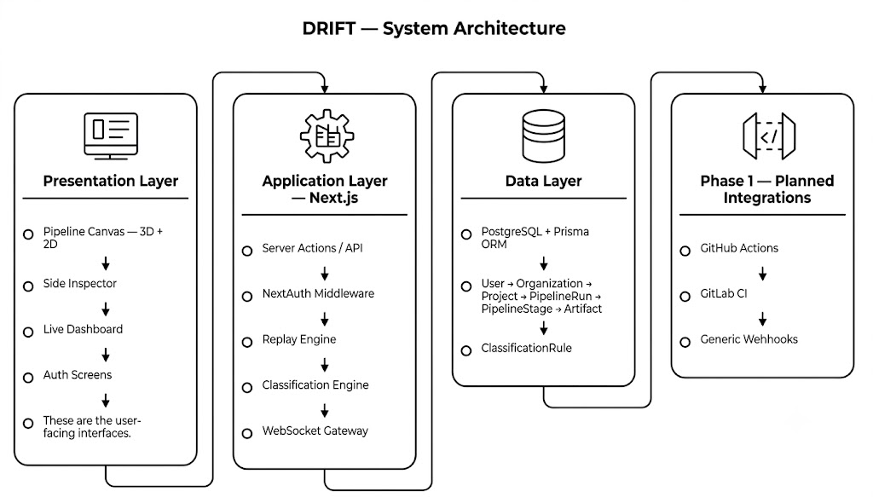
ARCHITECTURE
D
DRIFT
System Diagram
05 / 11
Notes:
5

Slide 10
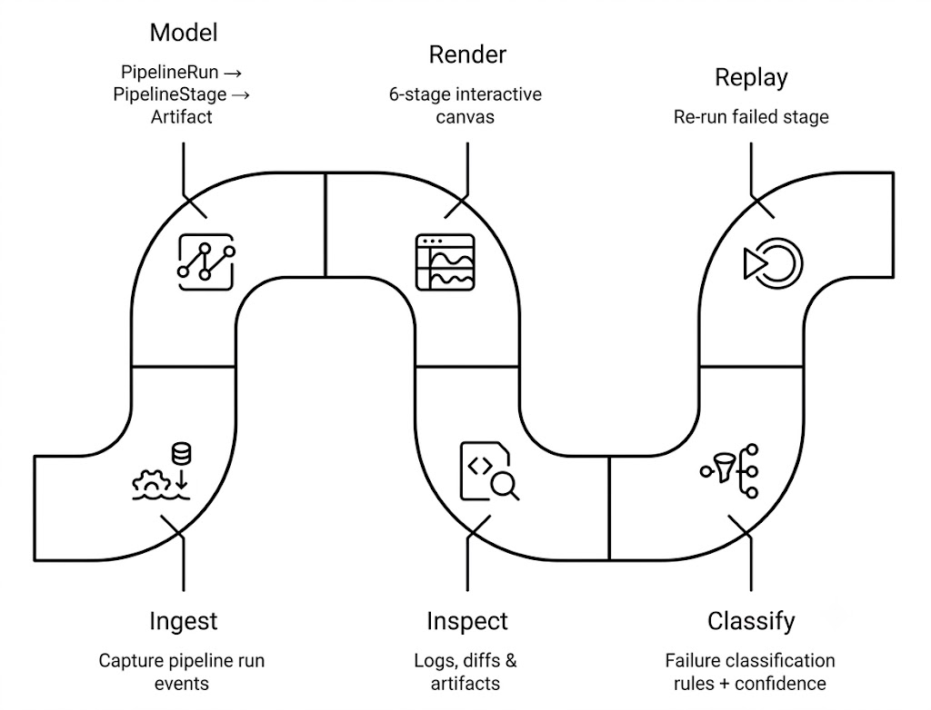
APPROACH
Methodology & Process
D
DRIFT
06 / 11
Notes:
6

Slide 11
IMPLEMENTATION
D
DRIFT
Technology Stack
FW
Framework
AN
Animation
Next.js 14 (App Router, Server Components)
Framer Motion + GSAP + Lenis smooth scroll
DB
Database
3D
3D
PostgreSQL + Prisma ORM
React Three Fiber + Drei
AU
Auth
ST
State
NextAuth.js (credentials + OAuth ready)
Zustand (client) + Server Actions application state handling
UI
UI
CH
Charts
Radix UI + Tailwind CSS
Recharts
QA
Testing
FM
Forms
Vitest
React Hook Form + Zod
07 / 11
Notes:
7

Slide 12
STATUS
D
DRIFT
50% Implementation
50% COMPLETE
COMPLETED
  Full auth flow (register, login, session, protected routes)
  Prisma schema + migrations + seed data
  Pipeline canvas with 6 stages + side inspector panel
  Pipeline controls (trigger, pause, retry, cancel)
  3D hero scene with particle system
  Theme provider (light/dark/system) + responsive shell
  ESLint + Prettier + Husky + lint-staged CI pipeline
!
Remaining 50%
  Real CI ingestion (GitHub/GitLab webhooks) — pipeline data is currently seeded
  Artifact storage (S3/R2) with signed URLs
  Real-time stage updates over WebSocket
  Rule-based, then ML-based, failure classification
  Test coverage beyond current unit baseline
08 / 11
Notes:
8

Slide 13
NEXT STEPS
D
DRIFT
Future Scope
Week 1
GitHub Actions webhook receiver + pipeline run ingestion service
Week 2
GitLab CI webhook + API polling; generic webhook with secret verification
Week 3
Artifact storage (S3/R2) with signed URLs; real-time stage updates via WebSocket
Week 4
Rule-based failure classification live; raise unit/integration test coverage to >80%
Beyond Week 4: ML-based classification, custom dashboards, team notifications, and the Drift AI Copilot follow in Phase 2/3 of the product roadmap.
09 / 11
Notes:
9

Slide 14
D
DRIFT
WRAP-UP
Conclusion
  Drift turns opaque CI/CD pipelines into an interactive, visual, intelligent system for developers
  At the halfway mark: auth, data model, the 6-stage canvas, and the 3D hero experience are complete
  The remaining work — real CI ingestion, live updates, and failure classification — is scoped and scheduled
  Literature confirms visualization and ML classification are each proven separately; Drift's contribution is unifying them in one workflow
  Expected impact: less time reading logs, faster root-cause identification, and shorter MTTR
"See your pipelines. Understand your failures. Ship with confidence."
10 / 11
Notes:
10

Slide 15
SOURCES
D
DRIFT
References
1
Révész, Á., & Pataki, N. (2022). Visualisation of Jenkins Pipelines. Acta Cybernetica, 25, 877–895.
2
Oberhauser, R. VR-GitEvo+CI/CD: Visualizing the Evolution of Git Repositories and CI/CD Pipelines in Virtual Reality. Aalen University.
3
Samoud, A., Aissat, S., Bordeleau, F., & Tizghadam, A. (2026). A Model-Driven Digital Twin for the Systematic Improvement of DevOps Pipelines. arXiv:2604.02077.
4
Understanding CI/CD Workflow Runs Through Interactive and Animated Visualizations. ICPC 2026, Early Research Achievements track.
5
Patel, D. (2023). A Study on Justifying Platform-Independent CI/CD Pipelines. McMaster University (Master's thesis).
6
Buildkite. Visualize your CI/CD pipeline on a canvas. Buildkite Engineering Blog.
7
Brunner, T., Bacchelli, A., & Petrulio, F. (2022). Automatic Flaky Test Detection with Machine Learning at Mozilla. University of Zurich (Bachelor's thesis).
8
Evaluation of Machine Learning Models in Predicting Software Flakiness. University of Oulu repository.
11 / 11
Notes:
11

