Slide 1


Terminologies
Face still: gray-scale image contains face
Face image: gray-scale image contains a normalized image of only one person’s face.
Face set:
 | Person 1 | Person 2 | …
Feature 1
Feature 2
…

Slide 2
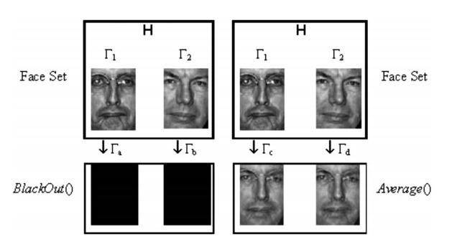
Terminologies
Face recognition: match best face images of known face database
Face de-identification: generated face cannot be uniquely determined.

Slide 3
Terminologies
loss() function: information loss resulted from de-identification
e.g. entropy, percentage of changed pixels
Preserved Face De-Identification:
under equal privacy preservation, lower the loss, better the de-identification
K-anonymity:
k
Face set, H
De-identified face set, H_{d}

Slide 4
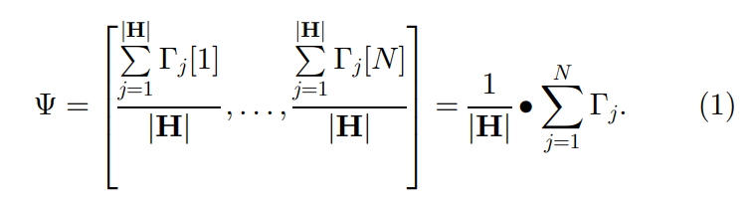
Core function
average():

Slide 5
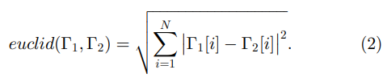
Core function
loss():

Slide 6
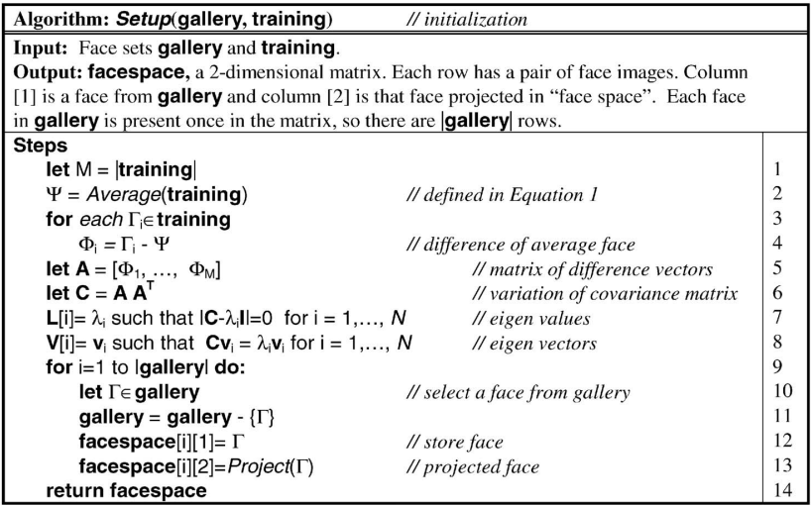
Algorithms

Slide 7
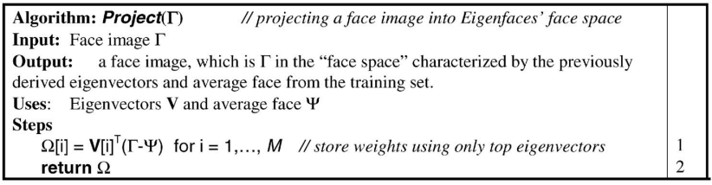
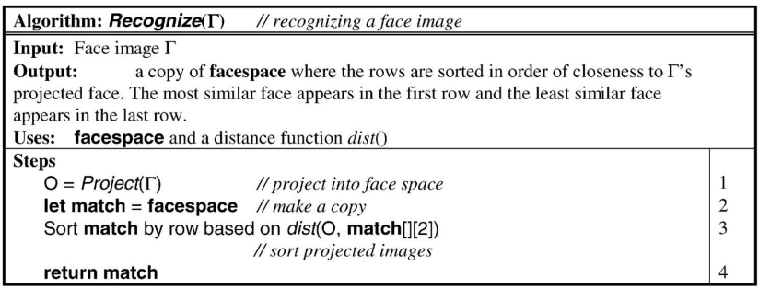
Algorithms

Slide 8
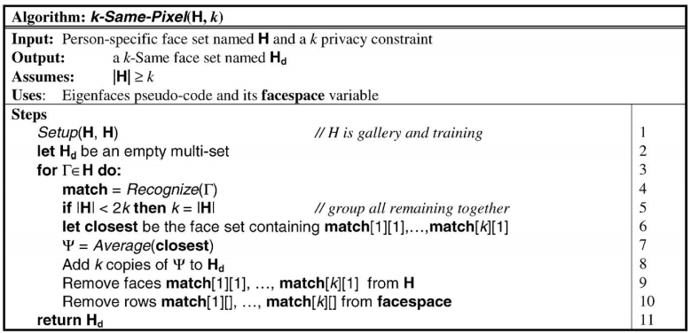
Algorithms

