Slide 1
Chapter 5: Other Relational Languages
Query-by-Example (QBE)
Datalog

Slide 2
Query-by-Example (QBE)
Basic Structure
Queries on One Relation
Queries on Several Relations
The Condition Box
The Result Relation
Ordering the Display of Tuples
Aggregate Operations
Modification of the Database

Slide 3
QBE — Basic Structure
A graphical query language which is based (roughly) on the domain relational calculus
Two dimensional syntax – system creates templates of relations that are requested by users
Queries are expressed “by example”

Slide 4
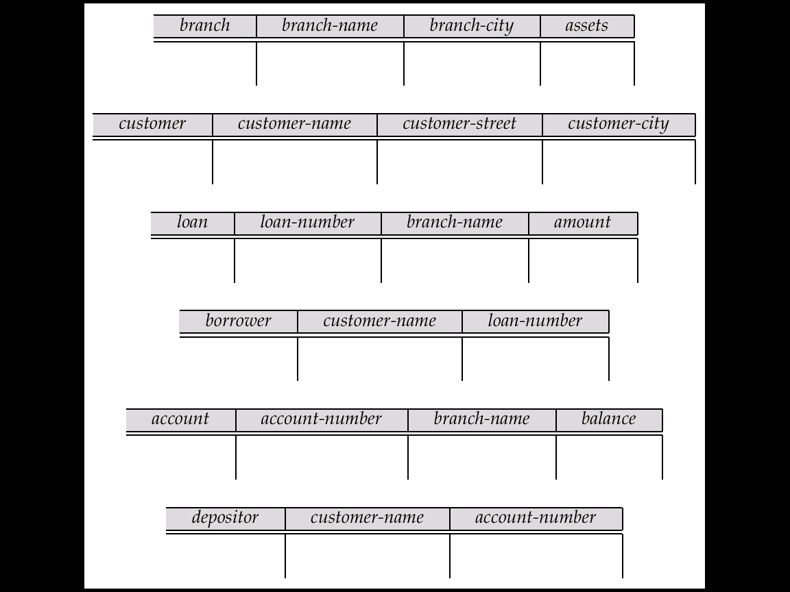
QBE Skeleton Tables for the Bank Example

Slide 5
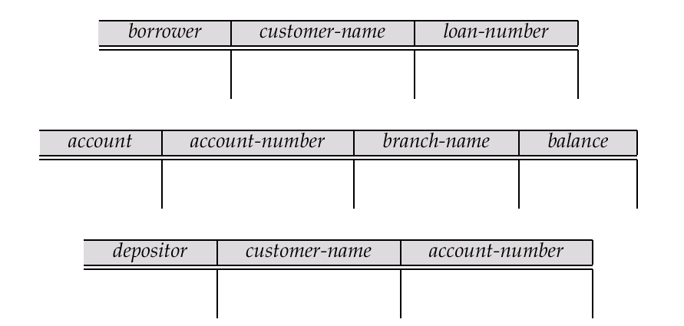
QBE Skeleton Tables (Cont.)

Slide 6
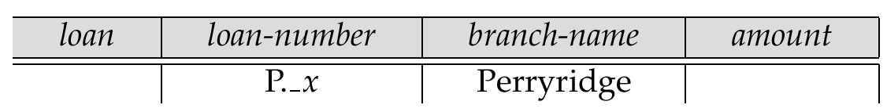
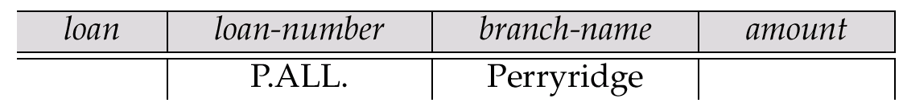
Queries on One Relation
Find all loan numbers at the Perryridge branch.
  _x is a variable (optional; can be omitted in above query)
  P. means print (display)
  duplicates are removed by default
  To retain duplicates use P.ALL

Slide 7
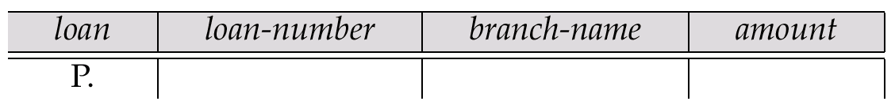
Queries on One Relation (Cont.)
Display full details of all loans
  Method 1:
  Method 2: Shorthand notation
P._x
P._y
P._z

Slide 8
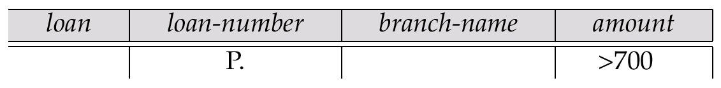
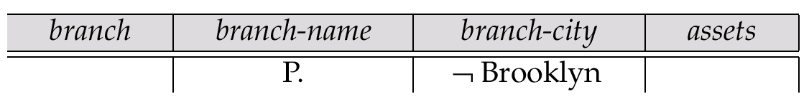
Queries on One Relation (Cont.)
Find the loan number of all loans with a loan amount of more than $700
Find names of all branches that are not located in Brooklyn

Slide 9
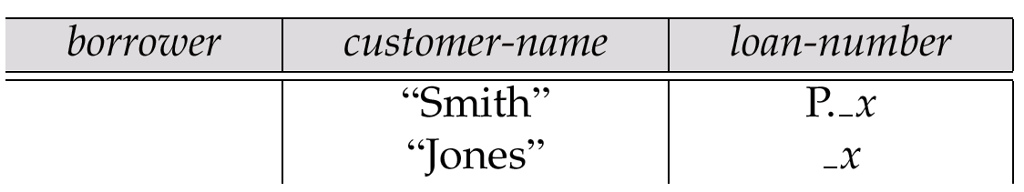
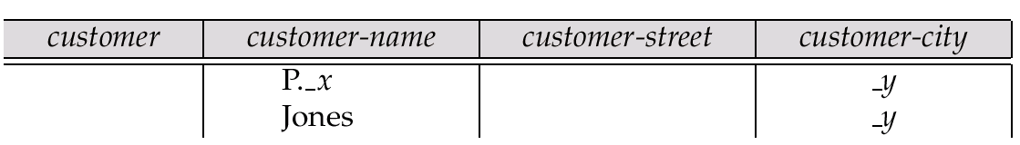
Queries on One Relation (Cont.)
Find the loan numbers of all loans made jointly to Smith and Jones.
Find all customers who live in the same city as Jones

Slide 10
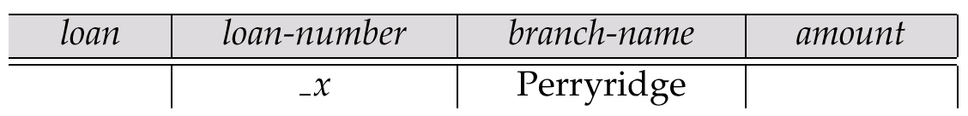
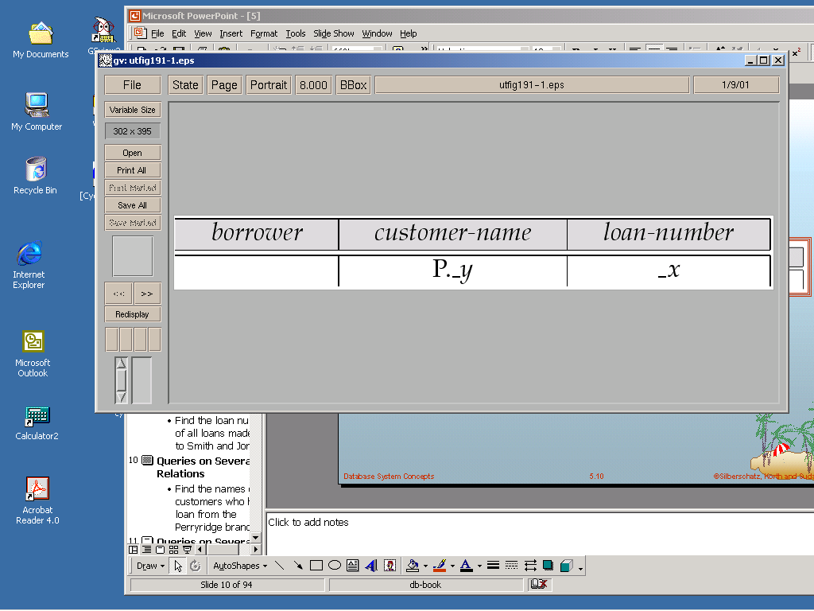
Queries on Several Relations
Find the names of all customers who have a loan from the Perryridge branch.

Slide 11
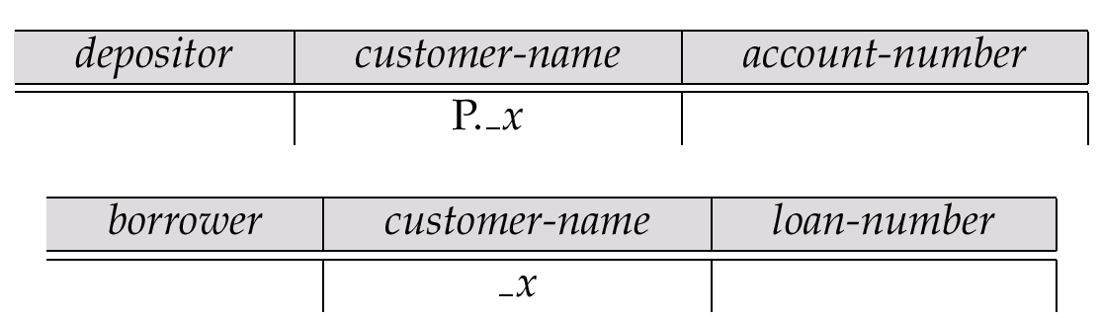
Queries on Several Relations (Cont.)
Find the names of all customers who have both an account and a loan at the bank.

Slide 12
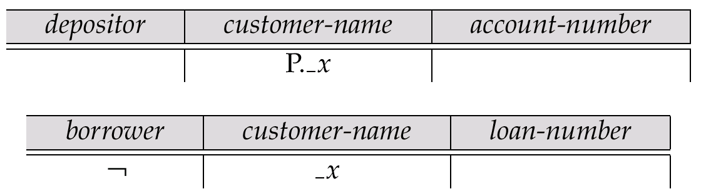
Negation in QBE
Find the names of all customers who have an account at the bank, but do not have a loan from the bank.
¬ means “there does not exist”

Slide 13
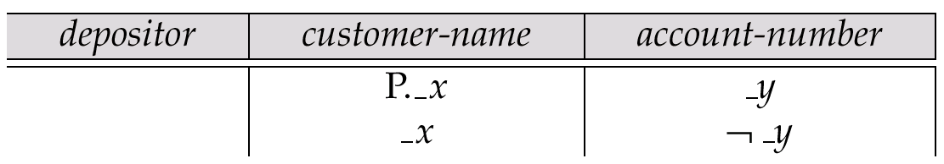
Negation in QBE (Cont.)
Find all customers who have at least two accounts.
¬ means “not equal to”

Slide 14
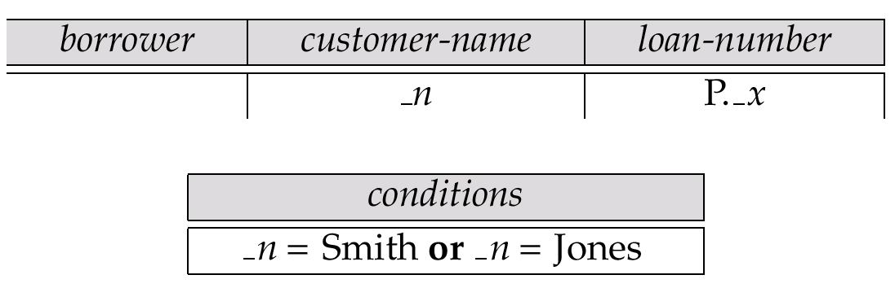
The Condition Box
Allows the expression of constraints on domain variables that are either inconvenient or impossible to express within the skeleton tables.
Complex conditions can be used in condition boxes
E.g. Find the loan numbers of all loans made to Smith, to Jones, or to both jointly

Slide 15
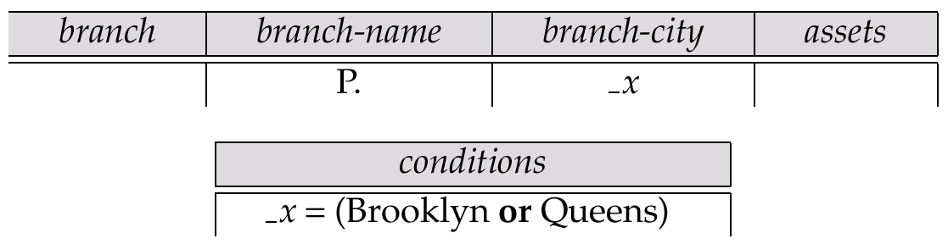
Condition Box (Cont.)
QBE supports an interesting syntax for expressing alternative values

Slide 16
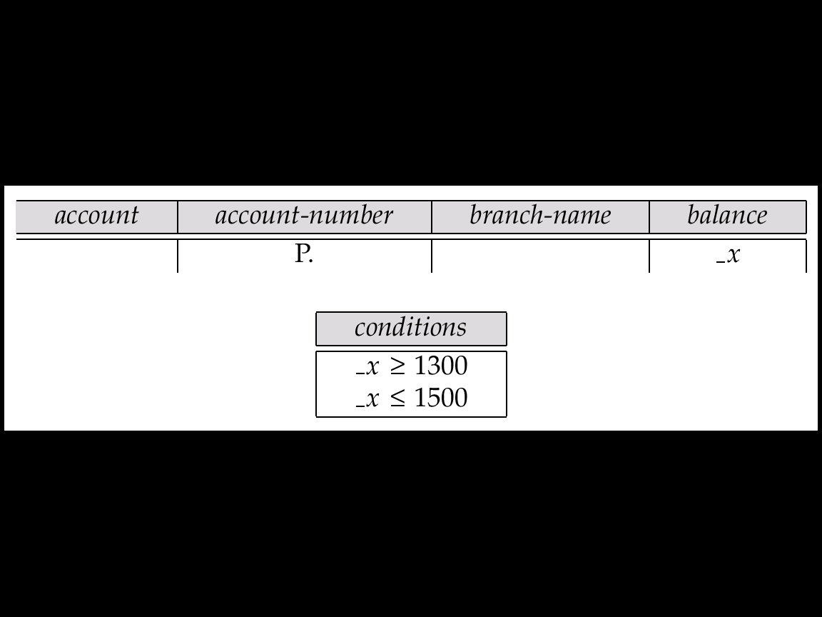
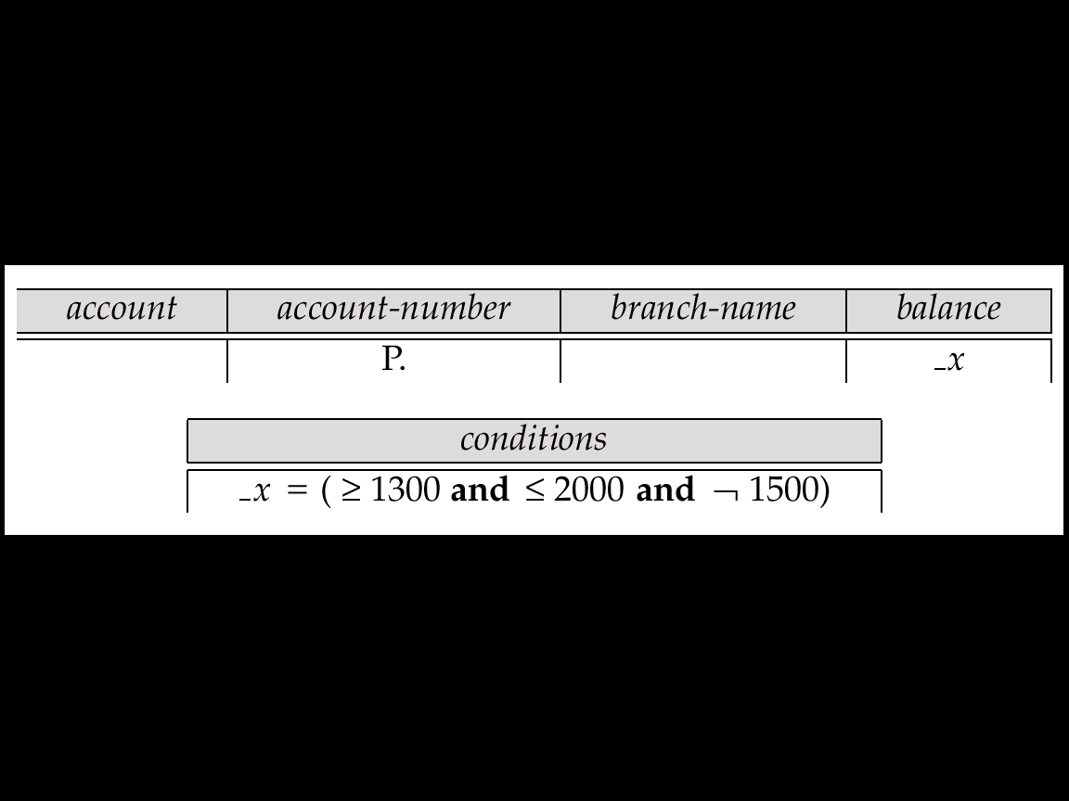
Condition Box (Cont.)
Find all account numbers with a balance between $1,300 and $1,500
Find all account numbers with a balance between $1,300 and $2,000 but not exactly $1,500.

Slide 17
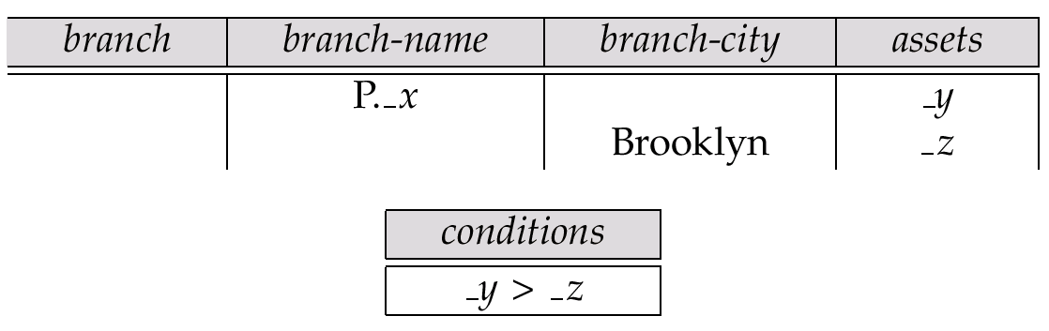
Condition Box (Cont.)
Find all branches that have assets greater than those of at least one branch located in Brooklyn

Slide 18
The Result Relation
Find the customer-name, account-number, and balance for alll customers who have an account at the Perryridge branch.
  We need to:
    Join depositor and account.
    Project customer-name, account-number and balance.
  To accomplish this we:
    Create a skeleton table, called result, with attributes customer-name, account-number, and balance.
    Write the query.

Slide 19
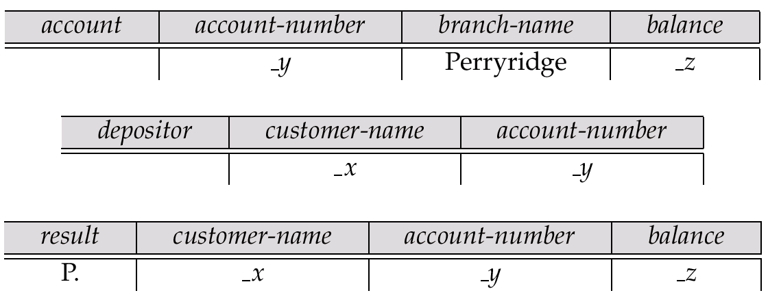
The Result Relation (Cont.)
The resulting query is:

Slide 20
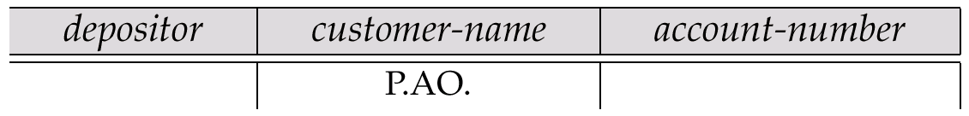
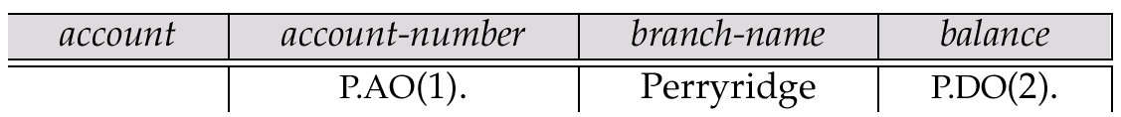
Ordering the Display of Tuples
AO = ascending order; DO = descending order.
E.g. list in ascending alphabetical order all customers who have an account at the bank
When sorting on multiple attributes, the sorting order is specified by including with each sort operator (AO or DO) an integer surrounded by parentheses.
E.g. List all account numbers at the Perryridge branch in ascending alphabetic order with their respective account balances in descending order.

Slide 21
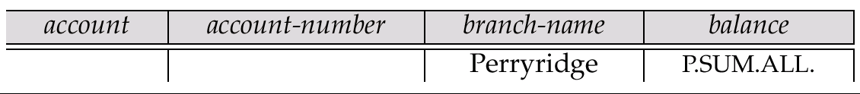
Aggregate Operations
The aggregate operators are AVG, MAX, MIN, SUM, and CNT
The above operators must be postfixed with “ALL” (e.g., SUM.ALL.or AVG.ALL._x) to ensure that duplicates are not eliminated.
E.g. Find the total balance of all the accounts maintained at the Perryridge branch.

Slide 22
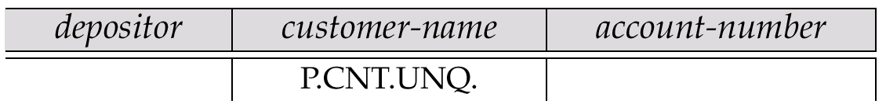
Aggregate Operations (Cont.)
UNQ is used to specify that we want to eliminate duplicates
Find the total number of customers having an account at the bank.

Slide 23
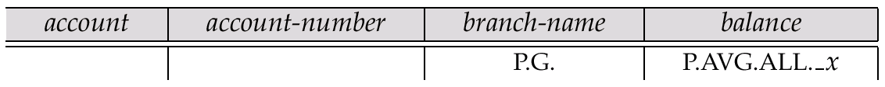
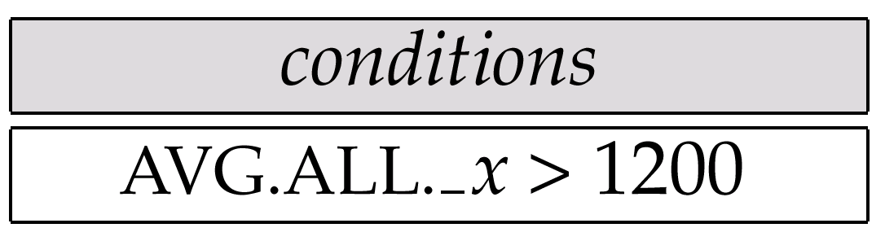
Query Examples
Find the average balance at each branch.
The “G” in “P.G” is analogous to SQL’s group by construct
The “ALL” in the “P.AVG.ALL” entry in the balance column ensures that all balances are considered
To find the average account balance at only those branches where the average account balance is more than $1,200, we simply add the condition box:

Slide 24
Query Example
Find all customers who have an account at all branches located in Brooklyn.
  Approach: for each customer, find the number of branches in Brooklyn at which they have accounts, and compare with total number of branches in Brooklyn
  QBE does not provide subquery functionality, so both above tasks have to be combined in a single query.
    Can be done for this query, but it cannot be done always, since certain queries that require subqueries and cannot be expressed in QBE.
In the query on the next page
  CNT.UNQ.ALL._w specifies the number of distinct branches in Brooklyn. Note: The variable _w is not connected to other variables in the query
  CNT.UNQ.ALL._z specifies the number of distinct branches in Brooklyn at which customer x has an account.

Slide 25
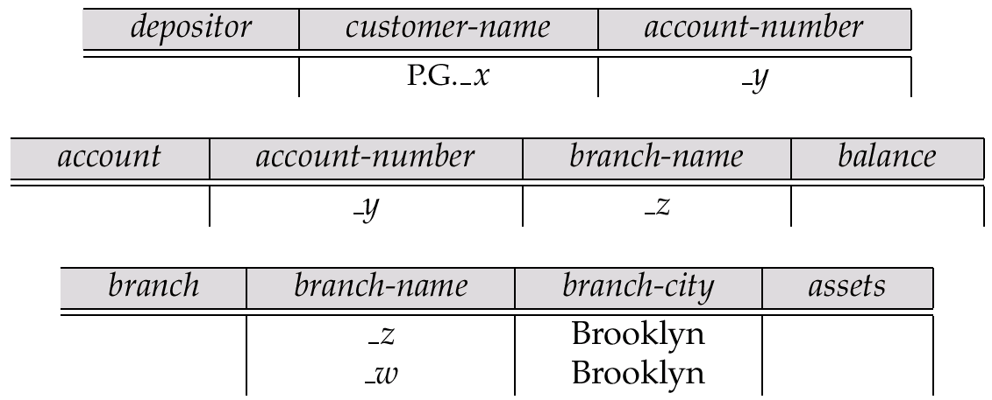
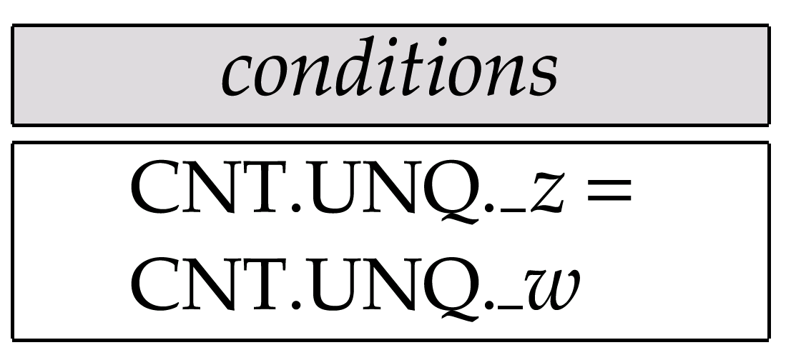
Query Example (Cont.)

Slide 26
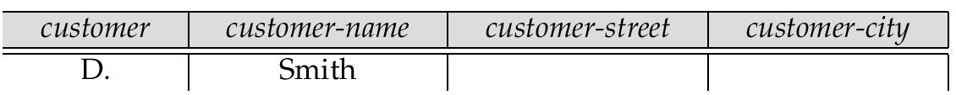
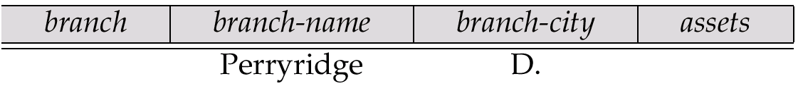
Modification of the Database – Deletion
Deletion of tuples from a relation is expressed by use of a D. command. In the case where we delete information in only some of the columns, null values, specified by –, are inserted.
Delete customer Smith
Delete the branch-city value of the branch whose name is “Perryridge”.

Slide 27
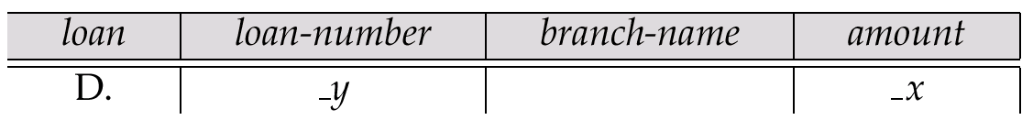
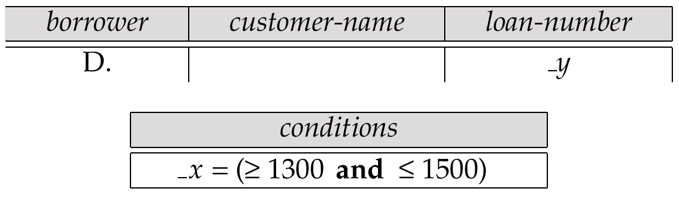
Deletion Query Examples
Delete all loans with a loan amount between $1300 and $1500.
  For consistency, we have to delete information from loan and borrower tables

Slide 28
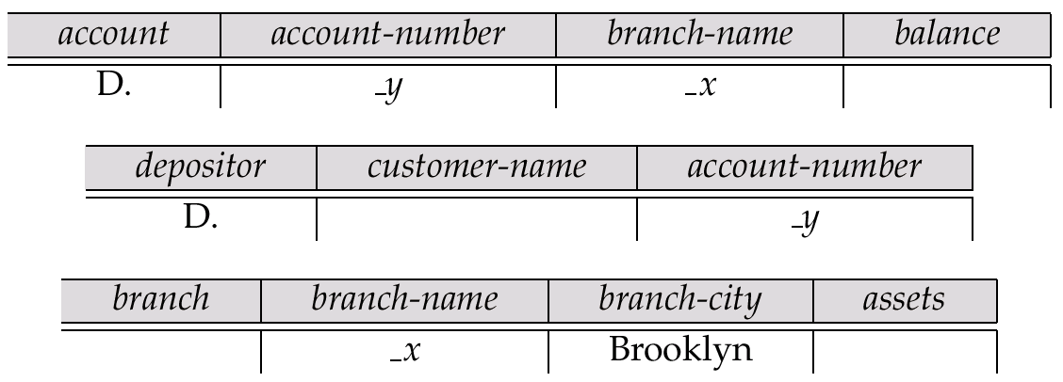
Deletion Query Examples (Cont.)
Delete all accounts at branches located in Brooklyn.

Slide 29
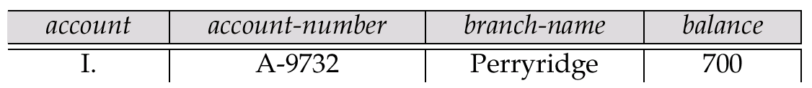
Modification of the Database – Insertion
Insertion is done by placing the I. operator in the query expression.
Insert the fact that account A-9732 at the Perryridge branch has a balance of $700.

Slide 30
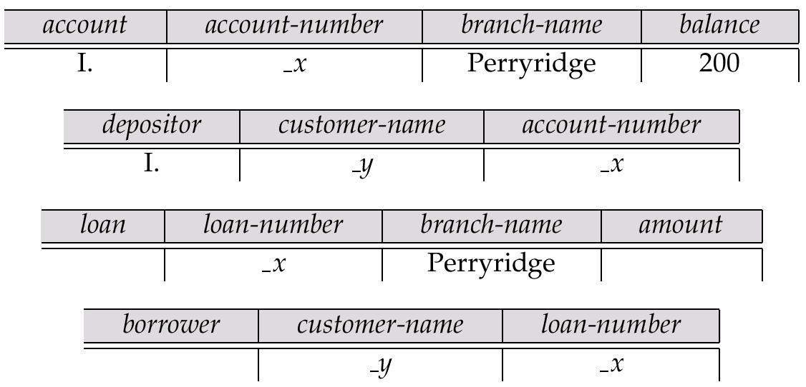
Modification of the Database – Insertion (Cont.)
Provide as a gift for all loan customers of the Perryridge branch, a new $200 savings account for every loan account they have, with the loan number serving as the account number for the new savings account.

Slide 31
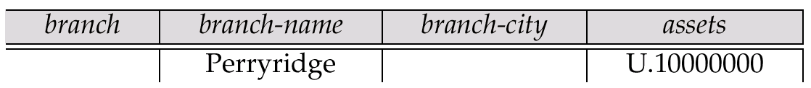
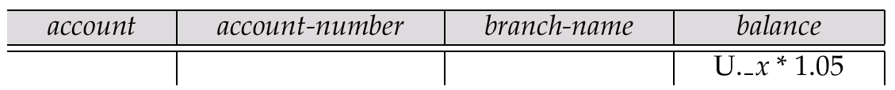
Modification of the Database – Updates
Use the U. operator to change a value in a tuple without changing all values in the tuple. QBE does not allow users to update the primary key fields.
Update the asset value of the Perryridge branch to $10,000,000.
Increase all balances by 5 percent.

Slide 32
Microsoft Access QBE
Microsoft Access supports a variant of QBE called Graphical Query By Example (GQBE)
GQBE differs from QBE in the following ways
  Attributes of relations are listed vertically, one below the other, instead of horizontally
  Instead of using variables, lines (links) between attributes are used to specify that their values should be the same.
    Links are added automatically on the basis of attribute name, and the user can then add or delete links
    By default, a link specifies an inner join, but can be modified to specify outer joins.
  Conditions, values to be printed, as well as group by attributes are all specified together in a box called the design grid

Slide 33
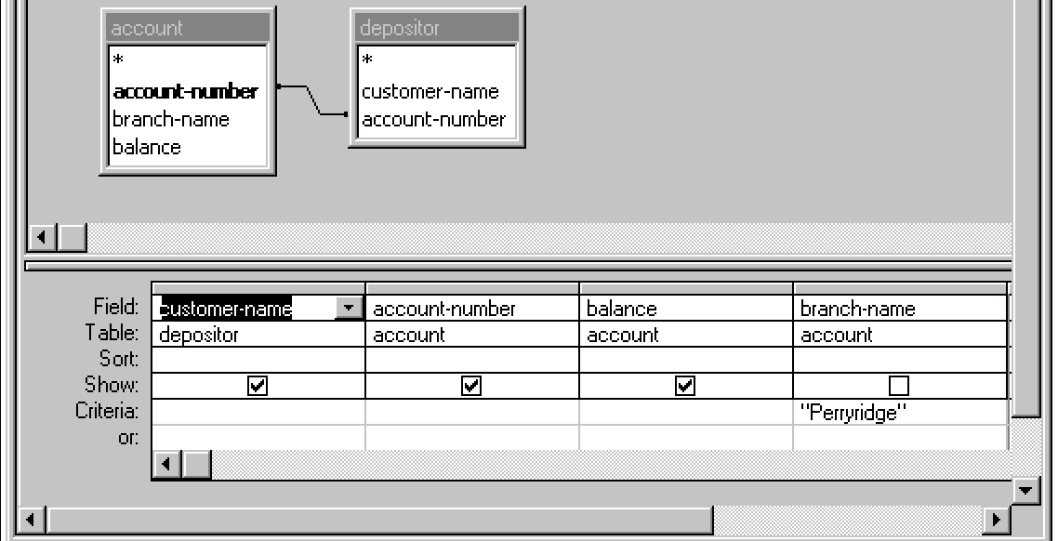
An Example Query in Microsoft Access QBE
Example query: Find the customer-name, account-number and balance for all accounts at the Perryridge branch

Slide 34
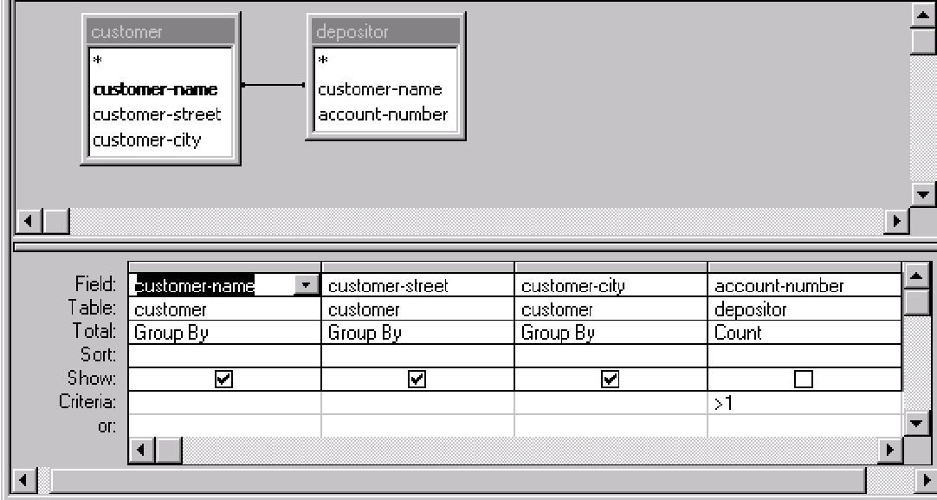
An Aggregation Query in Access QBE
Find the name, street and city of all customers who have more than one account at the bank

Slide 35
Aggregation in Access QBE
The row labeled Total specifies
  which attributes are group by attributes
  which attributes are to be aggregated upon (and the aggregate function).
  For attributes that are neither group by nor aggregated, we can still specify conditions by selecting where in the Total row and listing the conditions below
As in SQL, if group-by is used, only group by attributes and aggregate results can be output

Slide 36
Report Generators
Report generators are tools to generate human-readable summary reports from a database
  They integrate database querying with creation of formatted text and graphical charts
  Reports can be defined once and executed periodically to get current information from the database.
  Example of report (next page)
  Microsoft’s Object Linking and Embedding (OLE) provides a convenient way of embedding objects such as charts and tables generated from the database into other objects such as Word documents.

