Slide 1
Authorization
Forms of authorization on parts of the database:
Read - allows reading, but not modification of data.
Insert - allows insertion of new data, but not modification of existing data.
Update - allows modification, but not deletion of data.
Delete - allows deletion of data.
Forms of authorization to modify the database schema
Index - allows creation and deletion of indices.
Resources - allows creation of new relations.
Alteration - allows addition or deletion of attributes in a relation.
Drop - allows deletion of relations.

Slide 2
Authorization Specification in SQL
The grant statement is used to confer authorization
grant <privilege list>
on <relation name or view name> to <user list>
<user list> is:
  a user-id
  public, which allows all valid users the privilege granted
  A role (more on this later)
Granting a privilege on a view does not imply granting any privileges on the underlying relations.
The grantor of the privilege must already hold the privilege on the specified item (or be the database administrator).

Slide 3
Privileges in SQL
select: allows read access to relation,or the ability to query using the view
  Example: grant users U₁, U₂, and U₃ select authorization on the instructor relation:
grant select on instructor to U₁, U₂, U₃
insert: the ability to insert tuples
update: the ability to update using the SQL update statement
delete: the ability to delete tuples.
all privileges: used as a short form for all the allowable privileges

Slide 4
Revoking Authorization in SQL
The revoke statement is used to revoke authorization.
  revoke <privilege list>
  on <relation name or view name> from <user list>
Example:
  revoke select on branch from U₁, U₂, U₃
<privilege-list> may be all to revoke all privileges the revokee may hold.
If <revokee-list> includes public, all users lose the privilege except those granted it explicitly.
If the same privilege was granted twice to the same user by different grantees, the user may retain the privilege after the revocation.
All privileges that depend on the privilege being revoked are also revoked.

Slide 5
Roles
create role instructor;
grant instructor to Amit;
Privileges can be granted to roles:
  grant select on takes to instructor;
Roles can be granted to users, as well as to other roles
  create role teaching_assistant
  grant teaching_assistant to instructor;
    Instructor inherits all privileges of teaching_assistant
Chain of roles
  create role dean;
  grant instructor to dean;
  grant dean to Satoshi;

Slide 6
Authorization on Views
create view geo_instructor as
(select *
from instructor
where dept_name = ’Geology’);
grant select on geo_instructor to geo_staff
Suppose that a geo_staff member issues
  select *
  from geo_instructor;
What if
  geo_staff does not have permissions on instructor?
  creator of view did not have some permissions on instructor?

Slide 7
Other Authorization Features
references privilege to create foreign key
  grant reference (dept_name) on department to Mariano;
  why is this required?
transfer of privileges
  grant select on department to Amit with grant option;
  revoke select on department from Amit, Satoshi cascade;
  revoke select on department from Amit, Satoshi restrict;
Etc. read Section 4.6 for more details we have omitted here.

Slide 8
More Advanced SQL (from chp 5)
Accessing SQL From a Programming Language
  Dynamic SQL
    JDBC and ODBC
  Embedded SQL
SQL Data Types and Schemas
Functions and Procedural Constructs
Triggers
Advanced Aggregation Features
OLAP

Slide 9
JDBC and ODBC
API (application-program interface) for a program to interact with a database server
Application makes calls to
  Connect with the database server
  Send SQL commands to the database server
  Fetch tuples of result one-by-one into program variables
ODBC (Open Database Connectivity) works with C, C++, C#, and Visual Basic
JDBC (Java Database Connectivity) works with Java
HDBC-ODBC and others

Slide 10
JDBC
JDBC is a Java API for communicating with database systems supporting SQL.
JDBC supports a variety of features for querying and updating data, and for retrieving query results. Also for accessing metadata.
JDBC also supports metadata retrieval, such as querying about relations present in the database and the names and types of relation attributes.
Model for communicating with the database:
  Open a connection
  Create a “statement” object
  Execute queries using the Statement object to send queries and fetch results
  Exception mechanism to handle errors

Slide 11
ODBC
Open DataBase Connectivity(ODBC) standard
  standard for application program to communicate with a database server.
  application program interface (API) to
    open a connection with a database,
    send queries and updates,
    get back results.
Applications such as GUI, spreadsheets, etc. can use ODBC
Was defined originally for Basic and C, versions available for many languages.

Slide 12
Embedded SQL
The SQL standard defines embeddings of SQL in a variety of programming languages such as C, Java, and Cobol.
A language to which SQL queries are embedded is referred to as a host language, and the SQL structures permitted in the host language comprise embedded SQL.
The basic form of these languages follows that of the System R embedding of SQL into PL/I.
EXEC SQL statement is used to identify embedded SQL request to the preprocessor
EXEC SQL <embedded SQL statement > END_EXEC
Note: this varies by language (for example, the Java embedding uses # SQL { …. }; )

Slide 13
Example Query
From within a host language, find the ID and name of students who have completed more than the number of credits stored in variable credit_amount.
Specify the query in SQL and declare a cursor for it
EXEC SQL
declare c cursor for
select ID, name
from student
where tot_cred > :credit_amount
END_EXEC

Slide 14
Embedded SQL (Cont.)
The open statement causes the query to be evaluated
EXEC SQL open c END_EXEC
The fetch statement causes the values of one tuple in the query result to be placed on host language variables.
EXEC SQL fetch c into :si, :sn END_EXEC
Repeated calls to fetch get successive tuples in the query result
A variable called SQLSTATE in the SQL communication area (SQLCA) gets set to ‘02000’ to indicate no more data is available
The close statement causes the database system to delete the temporary relation that holds the result of the query.
EXEC SQL close c END_EXEC
Note: above details vary with language. For example, the Java embedding defines Java iterators to step through result tuples.

Slide 15
Updates Through Cursors
Can update tuples fetched by cursor by declaring that the cursor is for update
declare c cursor for
select *
from instructor
where dept_name = ‘Music’
for update
To update tuple at the current location of cursor c
update instructor
set salary = salary + 100
where current of c

Slide 16
Procedural Constructs in SQL

Slide 17
Procedural Extensions and Stored Procedures
SQL provides a module language
  Permits definition of procedures in SQL, with if-then-else statements, for and while loops, etc.
Stored Procedures
  Can store procedures in the database
  then execute them using the call statement
  permit external applications to operate on the database without knowing about internal details
Object-oriented aspects of these features are covered in Chapter 22 (Object Based Databases)

Slide 18
Triggers

Slide 19
Triggers
A trigger is a statement that is executed automatically by the system as a side effect of a modification to the database.
To design a trigger mechanism, we must:
  Specify the conditions under which the trigger is to be executed.
  Specify the actions to be taken when the trigger executes.
Triggers introduced to SQL standard in SQL:1999, but supported even earlier using non-standard syntax by most databases.
  Syntax illustrated here may not work exactly on your database system; check the system manuals

Slide 20
Trigger Example
E.g. time_slot_id is not a primary key of timeslot, so we cannot create a foreign key constraint from section to timeslot.
Alternative: use triggers on section and timeslot to enforce integrity constraints
create trigger timeslot_check1 after insert on section
referencing new row as nrow
for each row
when (nrow.time_slot_id not in (
select time_slot_id
from time_slot)) /* time_slot_id not present in time_slot */
begin
rollback
end;

Slide 21
Trigger Example Cont.
create trigger timeslot_check2 after delete on timeslot
referencing old row as orow
for each row
when (orow.time_slot_id not in (
select time_slot_id
from time_slot)
/* last tuple for time slot id deleted from time slot */
and orow.time_slot_id in (
select time_slot_id
from section)) /* and time_slot_id still referenced from section*/
begin
rollback
end;

Slide 22
Triggering Events and Actions in SQL
Triggering event can be insert, delete or update
Triggers on update can be restricted to specific attributes
  E.g., after update of takes on grade
Values of attributes before and after an update can be referenced
  referencing old row as : for deletes and updates
  referencing new row as : for inserts and updates
Triggers can be activated before an event, which can serve as extra constraints. E.g. convert blank grades to null.
create trigger setnull_trigger before update of takes
referencing new row as nrow
for each row
when (nrow.grade = ‘ ‘)
begin atomic
set nrow.grade = null;
end;

Slide 23
Trigger to Maintain credits_earned value
create trigger credits_earned after update of takes on (grade)
referencing new row as nrow
referencing old row as orow
for each row
when nrow.grade <> ’F’ and nrow.grade is not null
and (orow.grade = ’F’ or orow.grade is null)
begin atomic
update student
set tot_cred= tot_cred +
(select credits
from course
where course.course_id= nrow.course_id)
where student.id = nrow.id;
end;

Slide 24
Statement Level Triggers
Instead of executing a separate action for each affected row, a single action can be executed for all rows affected by a transaction
  Use for each statement instead of for each row
  Use referencing old table or referencing new table to refer to temporary tables (called transition tables) containing the affected rows
  Can be more efficient when dealing with SQL statements that update a large number of rows

Slide 25
When Not To Use Triggers
Triggers were used earlier for tasks such as
  maintaining summary data (e.g., total salary of each department)
  Replicating databases by recording changes to special relations (called change or delta relations) and having a separate process that applies the changes over to a replica
There are better ways of doing these now:
  Databases today provide built in materialized view facilities to maintain summary data
  Databases provide built-in support for replication
Encapsulation facilities can be used instead of triggers in many cases
  Define methods to update fields
  Carry out actions as part of the update methods instead of
  through a trigger

Slide 26
When Not To Use Triggers
Risk of unintended execution of triggers, for example, when
  loading data from a backup copy
  replicating updates at a remote site
  Trigger execution can be disabled before such actions.
Other risks with triggers:
  Error leading to failure of critical transactions that set off the trigger
  Cascading execution

Slide 27
Recursive Queries

Slide 28
The Power of Recursion
Recursive queries are powerful and can deal with trees and graphs effectively.
Recursive views are required to be monotonic. Thus they cannot be defined using difference or set aggregates in recursive rules.

Slide 29
OLAP**

Slide 30
Data Analysis and OLAP
Online Analytical Processing (OLAP)
  Interactive analysis of data, allowing data to be summarized and viewed in different ways in an online fashion (with negligible delay)
Data that can be modeled as dimension attributes and measure attributes are called multidimensional data.
  Measure attributes
    measure some value
    can be aggregated upon
    e.g., the attribute number of the sales relation
  Dimension attributes
    define the dimensions on which measure attributes (or aggregates thereof) are viewed
    e.g., attributes item_name, color, and size of the sales relation

Slide 31

Example sales relation
...
...
...
...
...
...
...
...

Slide 32
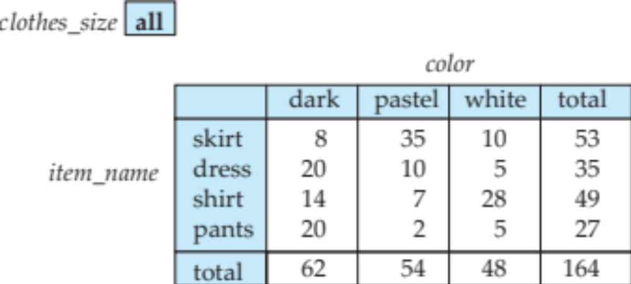
Cross Tabulation of sales by item_name and color
Relational representation of cross-tab that we saw earlier, but with null in place of all, can be computed by
select item_name, color, sum(number)
from sales
group by cube(item_name, color)
Same as group by (item_name, color), (item_name), (color), ()

Slide 33
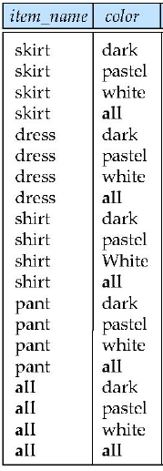

Relational Representation of Cross-tabs
Cross-tabs can be represented as relations
  We use the value all is used to represent aggregates.
  Notte:
  The SQL standard actually uses null values in place of all despite confusion with regular null values.

Slide 34

Data Cube
A data cube is a multidimensional generalization of a cross-tab
Can have n dimensions; we show 3 below
Cross-tabs can be used as views on a data cube

Slide 35
Extended Aggregation to Support OLAP
The cube operation computes union of group by’s on every subset of the specified attributes
Example relation for this section
sales(item_name, color, clothes_size, quantity)
E.g. consider the query
select item_name, color, size, sum(number)
from sales
group by cube(item_name, color, size)
This computes the union of eight different groupings of the sales relation:
{ (item_name, color, size), (item_name, color),
(item_name, size), (color, size),
(item_name), (color),
(size), ( ) }
where ( ) denotes an empty group by list.
For each grouping, the result contains the null value
for attributes not present in the grouping.

Slide 36





Data Cube: all possible combinations
Etc.
(item_name, color, Clothes_size)

Slide 37
Online Analytical Processing Operations
Can use the function decode() in the select clause to replace
such nulls by a value such as all
  E.g., replace item_name in first query by
  decode( grouping(item_name), 1, ‘all’, item_name)

Slide 38
Online Analytical Processing Operations
Pivoting: changing the dimensions used in a cross-tab is called
Slicing: creating a cross-tab for fixed values only
  Sometimes called dicing, particularly when values for multiple dimensions are fixed.
Rollup: moving from finer-granularity data to a coarser granularity
Drill down: The opposite operation - that of moving from coarser-granularity data to finer-granularity data

Slide 39
OLAP Implementation
The earliest OLAP systems used multidimensional arrays in memory to store data cubes, and are referred to as multidimensional OLAP (MOLAP) systems.
OLAP implementations using only relational database features are called relational OLAP (ROLAP) systems
Hybrid systems, which store some summaries in memory and store the base data and other summaries in a relational database, are called hybrid OLAP (HOLAP) systems.

Slide 40

Hierarchies on Dimensions
Hierarchy on dimension attributes: lets dimensions to be viewed at different levels of detail
  E.g., the dimension DateTime can be used to aggregate by hour of day, date, day of week, month, quarter or year

Slide 41
Rollups
If you have a relation:
Sales(region, state , city, sales)
Then
Select region, state, city, avg(sales)
from Sales
rollup by cube (region, state, city)
Will group by
(region, state, city), (region, state), (region), ()
select item_name, color, size, sum(number)

Slide 42
Index Creation
create table student
(ID varchar (5),
name varchar (20) not null,
dept_name varchar (20),
tot_cred numeric (3,0) default 0,
primary key (ID))
create index studentID_index on student(ID)
Indices are data structures used to speed up access to records with specified values for index attributes
  e.g. select *
  from student
  where ID = ‘12345’
  can be executed by using the index to find the required record, without looking at all records of student
  More on indices in Chapter 11

