Slide 1
Student(sid, name, addr, age, GPA)
sid | name | addr | age | GPA
301 | John | Ki#Bu!GK.$@q | 19 | 2.1
301 | Elaine | 301 Wilshire | 263 | 3.9
401 | James | 183 Westwood | 17 | -1.0
208 | Esther | 421 Wilshire | 20 | 3.1
Class(dept, cnum, sec, unit, title, instructor)
dept | cnum | sec | unit | title | instructor
CS | 112 | 01 | 03 | Modeling | Dick Muntz
CS | 143 | 01 | 04 | DB Systems | Carlo Zaniolo
EE | 143 | 01 | 134 | Signal | Dick Muntz
ME | 183 | 02 | 05 | Mechanics | Susan Tracey
Enroll(sid, dept, cnum, sec)
sid | dept | cnum | sec
301 | CS | 112 | 01
999 | CS | 143 | 01
401 | AT | 000 | 00
303 | EE | 143 | 01
303 | CS | 112 | 01

Slide 2
Key Constraints
Course(dept, cnum, sec, unit, instructor, title)
Course(dept, cnum, sec, unit, instructor, title)
Course(dept, cnum, sec, unit, instructor, title)
CREATE TABLE Course (
dept CHAR(2) NOT NULL,
cnum INT NOT NULL,
sec INT NOT NULL,
unit INT,
instructor VARCHAR(30),
title VARCHAR(30),
PRIMARY KEY(dept, cnum, sec),
UNIQUE(dept, cnum, instructor),
UNIQUE(dept, sec, title) )

Slide 3
Referential Integrity Constraint
CREATE TABLE Enroll (
sid INT REFERENCES Student(sid),
dept CHAR(2),
cnum INT,
sec INT,
FOREIGN KEY (dept, cnum, sec)
REFERENCES Class(dept, cnum, sec)
ON DELETE CASCADE
ON UPDATE SET NULL )
Notes
  Referencing attributes called FOREIGN KEY
  Referenced attributes must be PRIMARY KEY or UNIQUE

Slide 4
CHECK Constraints
CHECK(<condition>) in CREATE TABLE
Example: all CS classes are of 3 units or more.
  CREATE TABLE Class (
    dept CHAR(2),
    cnum INT,
    unit INT,
    title VARCHAR(50),
    instructor VARCHAR(30),
    CHECK (dept <> ’CS’ OR unit >= 3) )
  (dept=’CS’ → unit>3) ≡ (¬(dept=’CS’) ∨ unit>3)
Constraint is checked whenever a tuple is inserted/updated.
In SQL92, conditions can be more complex, e.g., with subqueries
  In practice, complex CHECK conditions are not supported

Slide 5
General Assertions
CREATE ASSERTION <assertion name>
CHECK (<condition>)
  Constraint on the entire relation or database
Example: Average GPA >3.0
    CREATE ASSERTION HighGPA
    CHECK (3.0 < (SELECT AVG(GPA) FROM Student))

Slide 6
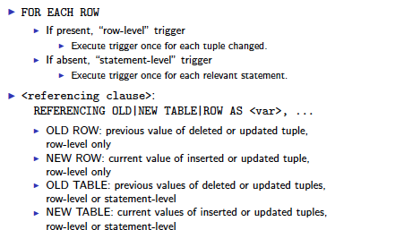
Triggers

Slide 7
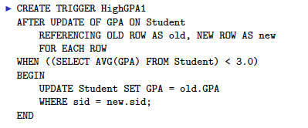
Event-Conditiion-Action Rules

Slide 8
Trigger: Event-Condition-Action rule
CREATE TRIGGER <name>
<event>
<referencing clause> // optional
WHEN (<condition>) // optional
<action>
<event>
  BEFORE | AFTER INSERT ON R
  BEFORE | AFTER DELETE ON R
  BEFORE | AFTER UPDATE [OF A1, A2, ..., An] ON R
<action>
  Any SQL statement
  Multiple statements should be enclosed with BEGIN … END and be separated by ;
<referencing clause>
  REFERENCING OLD|NEW TABLE|ROW AS <var>, ...
    FOR EACH ROW: row-level trigger
    FOR EACH STATEMENT (default): statement-level trigger

