Slide 1
CS143: Database Systems
SQL Notes

Slide 2
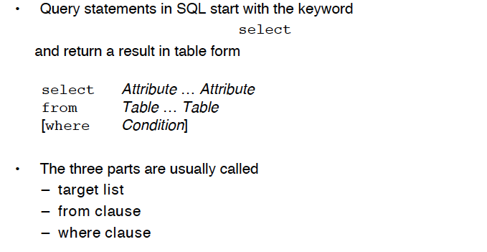
Select statement

Slide 3
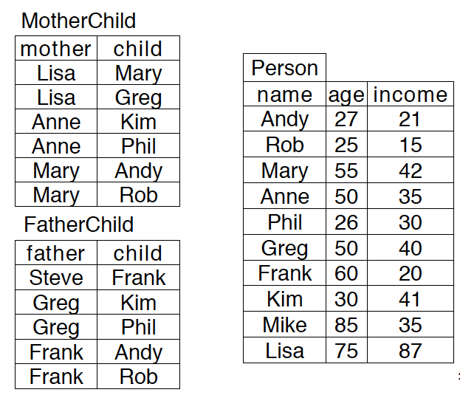



Slide 4
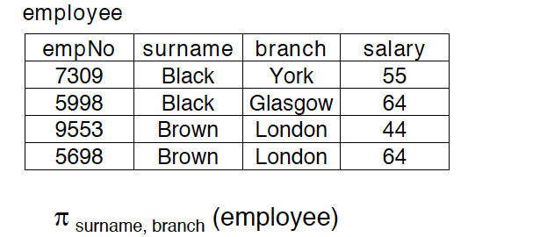



Slide 5
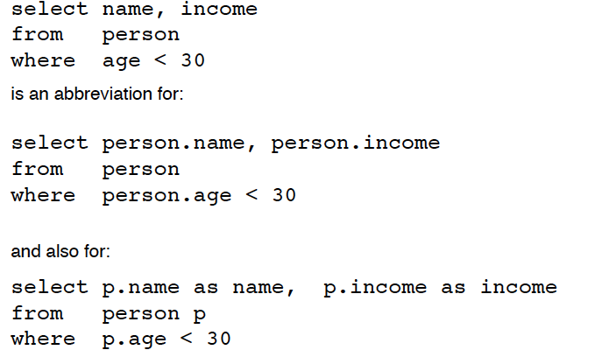
Naming and aliases
/* Same as “person as p” */

Slide 6
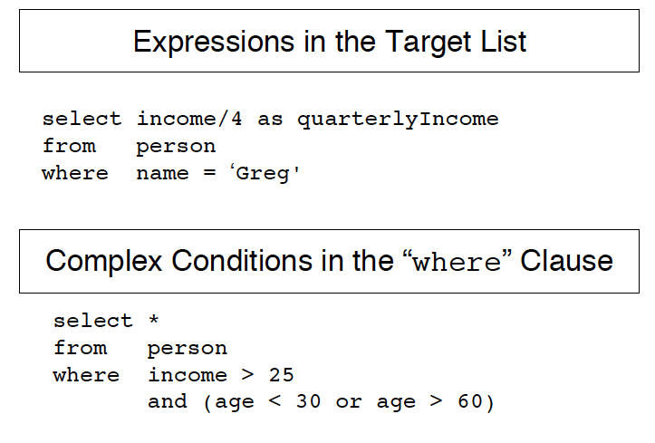
/* the star means all the columns */

Slide 7
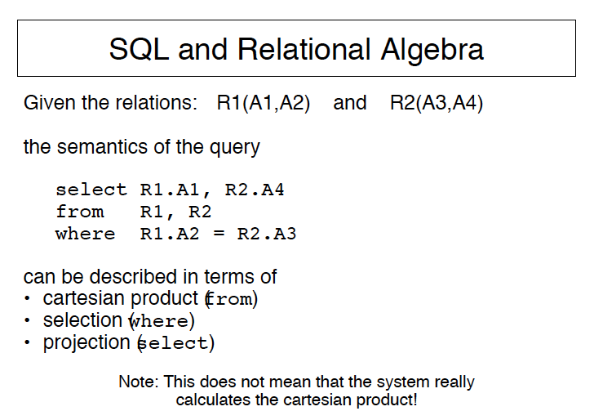

Slide 8
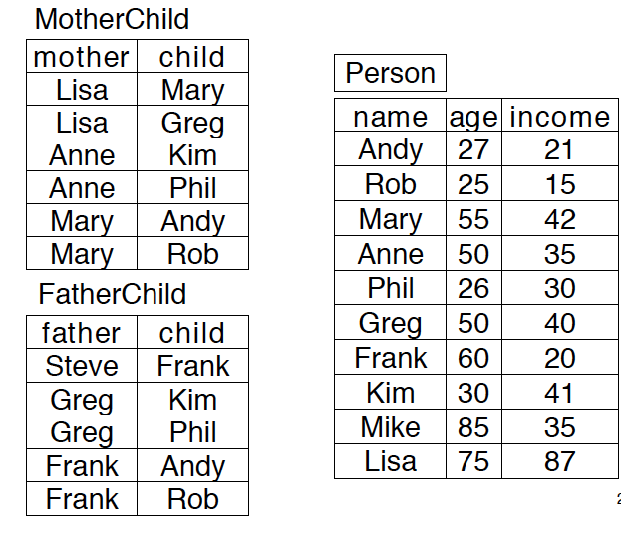

Slide 9


Slide 10


For each child show the father and mother
RA
SQL

Slide 11



Slide 12
Aliases: you should use `as’ and you must not forget commas!
select P1.name, P2.name
from MotherChild as M1, MotherChild as M2,
Person P1, Person P2
where M1.Child =P1.Name and
M2.Child =P2.Name and
M1.mother=M2.mother and
P1.name < P2.name

Slide 13
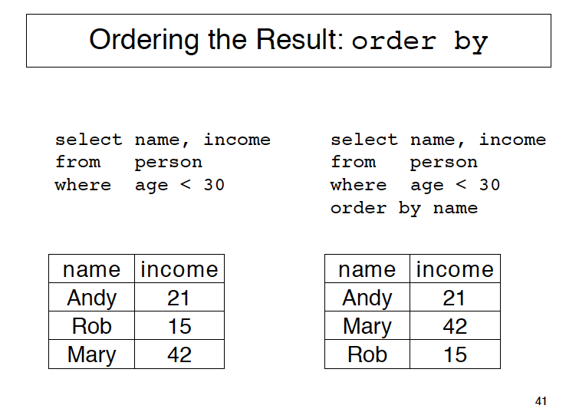

Slide 14
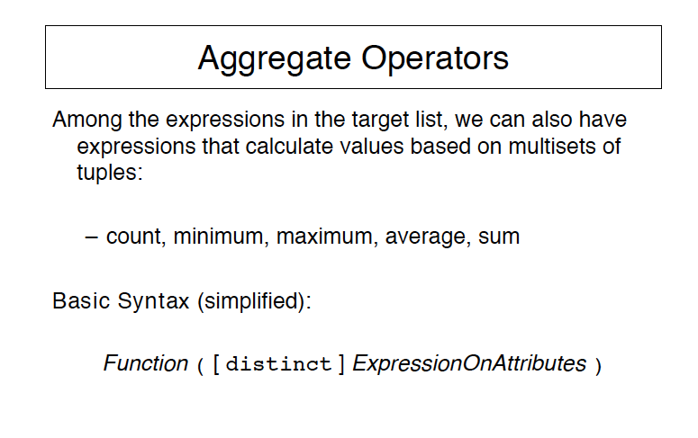

Slide 15
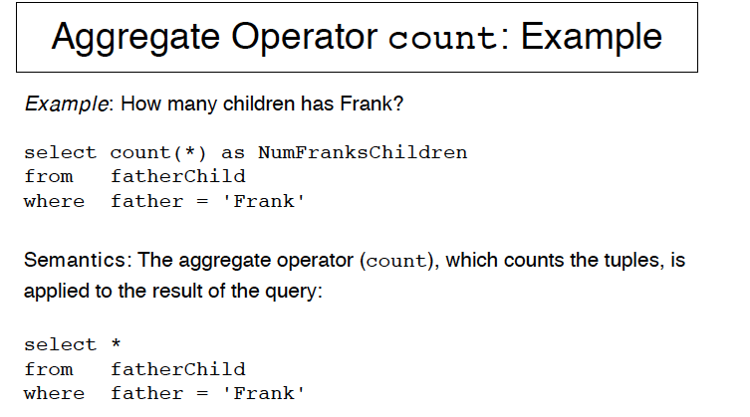
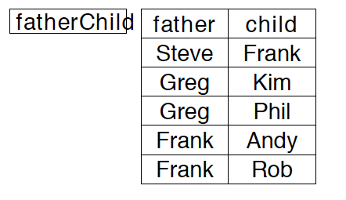

Slide 16
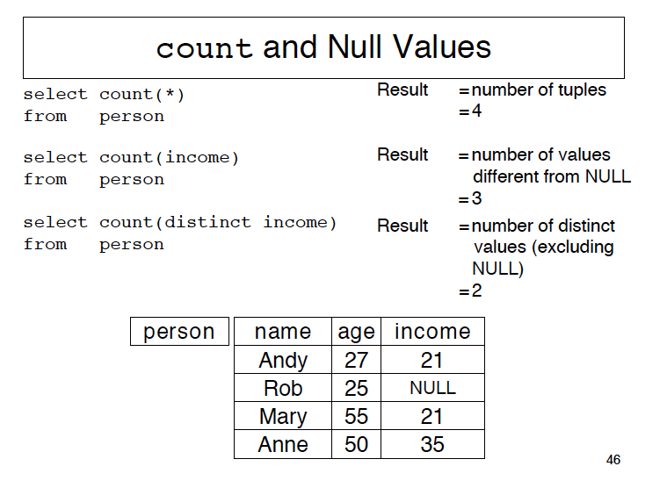

`

Slide 17
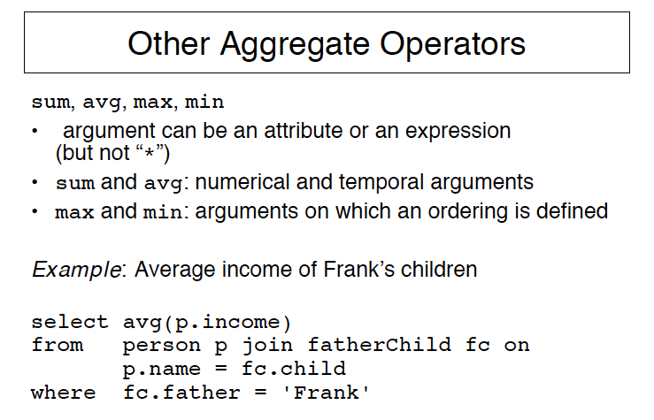

Slide 18
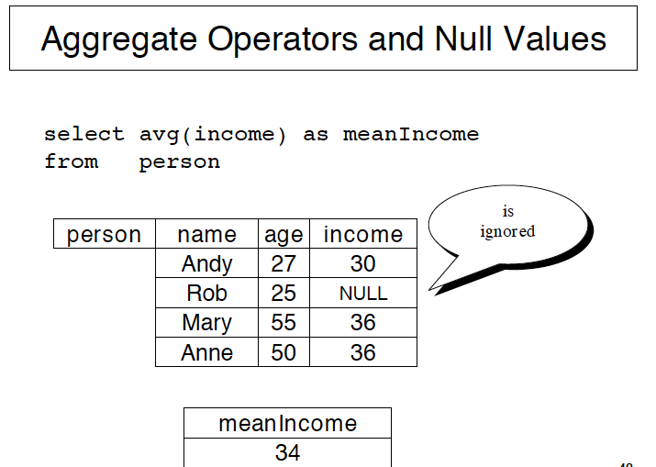

Slide 19
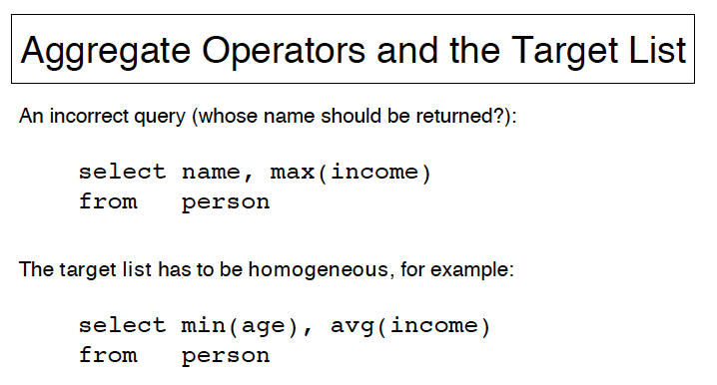

Slide 20
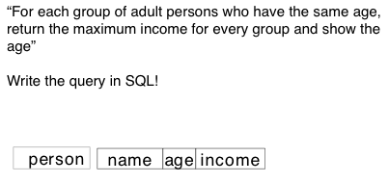


Slide 21
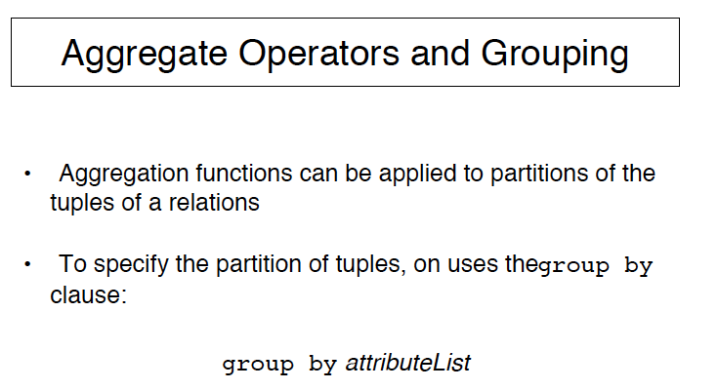

Slide 22
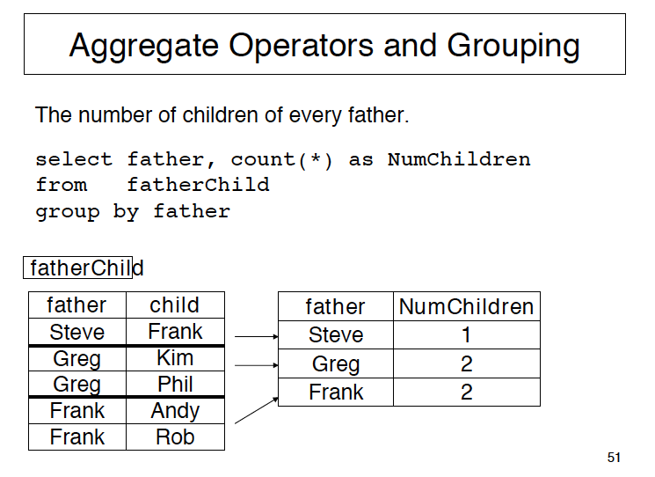

Slide 23


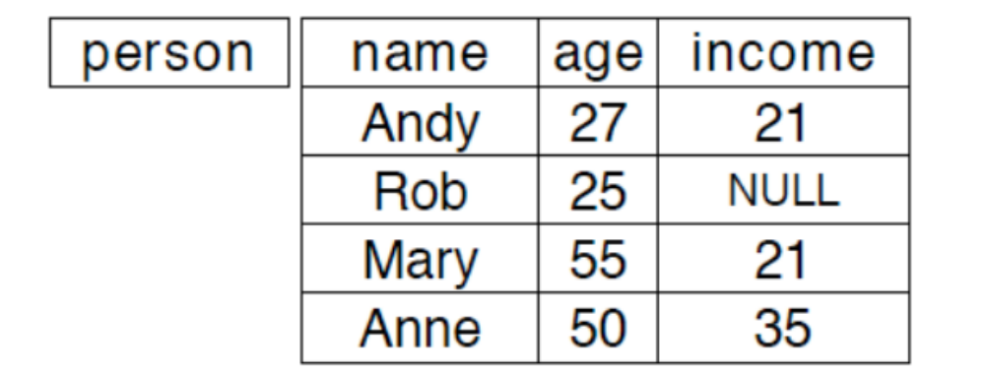

Slide 24
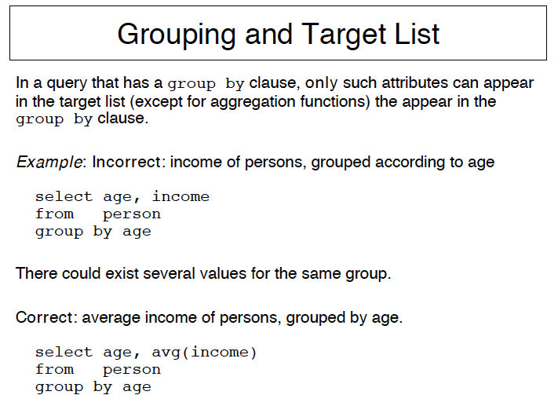


Slide 25
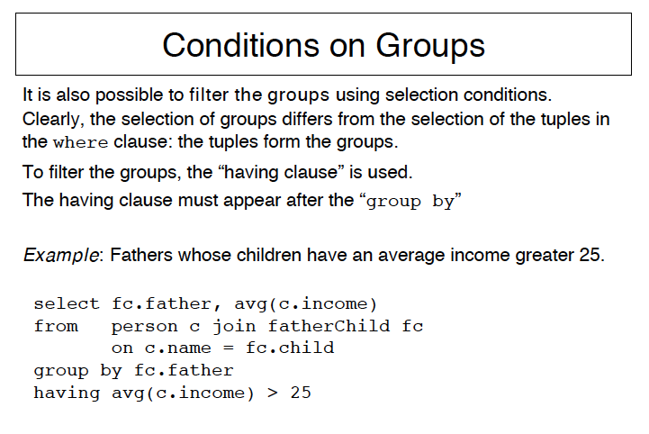


Slide 26
Having or Where?
Find father whose children under 20 have an average income >25.

Slide 27
