Slide 1
Functional Dependencies and Normal Form Design of Relational DB Schemas
CS143 notes
****
Warning: The most difficult and theoretical part of the course. Pay attention!

Slide 2
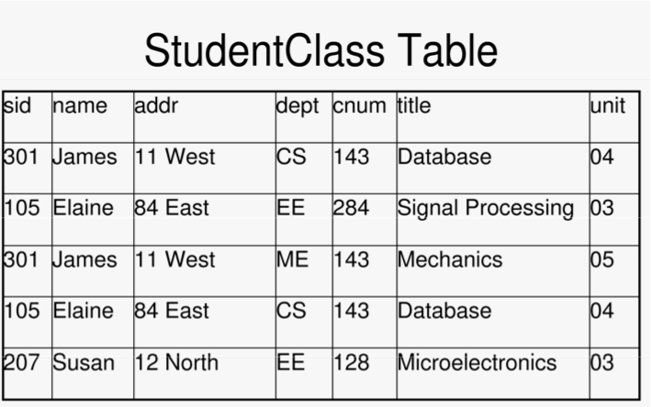

Slide 3
Update Anomalies
Insert anomalies, delete anomalies, and update anomalies
Susan’s address disappears if we delete the only course she is taken
Inconsistency if we only update James address in the first tuple
A pattern of redundancy…. Which is due to functional dependencies

Slide 4
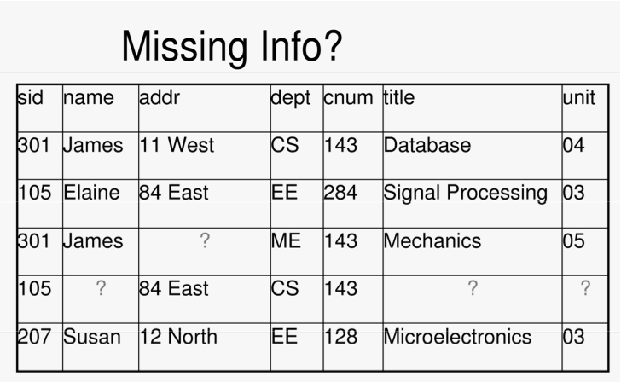

Slide 5
Update Anomalies: Eliminated by decomposition!
sid | name | addr
301 | James | 11 West
105 | Elaine | 84 East
207 | Susan | 12 North
dept | cnum | title | unit
CS | 143 | Databases | 04
EE | 284 | Signal Processing | 05
ME | 143 | Mechanics | 03
EE | 128 | Microeletronics | 04
Decomposition: table replaced by projections. Anomalie are elimnated but …info lost! How to make it work?

Slide 6
Workplan
Detect schemas that are prone to update anomaly problems
Decompose them into schemas which are free from the problem—a.k.a. Normal Form Relations
How?
By Using Functional Dependencies to
Define Keys
Defining bad Key/FD patterns
Using FDs to decompose

Slide 7
Functional Dependencies
Let X= {A1, ..., An}, and Y={B1, ..., Bm} be subsets of the attributes in R(W):
We say that Y is functionally dependent on X and write
X -> Y when
For every pair of tuples u1, u2 in R,
if u1[X] = u2[X], then u1[Y] = u2[Y] –
No two tuples in R can have the same X values but different Y values!
Given R(W), let Z be a subset of W where Z -> W, then Z is said to be a superkey for R(W). Z is a key if
W is not FD on any subset of Z.
Trivial FD: X -> Y where Y is a subset of X.

Slide 8
Only certain FD patterns are a problem. For instance consider two projections of the previous table
LeftTable
RightTable
sid | name | addr
301 | James | 11 West
105 | Elaine | 84 East
207 | Susan | 12 North
dept | cnum | title | unit
CS | 143 | Databases | 04
EE | 284 | Signal Processing | 05
ME | 143 | Mechanics | 03
EE | 128 | Microeletronics | 04
Same FDs here: In LeftTable In RightTable:
sid-> name dept,cnum-> title, unit
sid-> addrdept,
In the old table these FDs were the source of redundancy & update anomalies
As in the original table
But no redundancy or update anomaly here! Why? …Because sid is the key for LeftTable & dept, cnum, title is the key for the right table!

Slide 9
About FDs
A | B | C
a1 | b1 | c1
a1 | b2 | c2
a2 | b1 | c3
Does this FD hold?
AB -> C
Here we have replaced c3 with c1
Does this FD hold?
AB -> C
A | B | C
a1 | b1 | c1
a1 | b2 | c2
a1 | b1 | c3
Since the content of tables change in the DB, we are only interested
in those that hold all the time since they result from integrity constraints
that hold in the real world!
Also important: A -> BD iff A ->B and A->D

Slide 10
Functional Dependencies
Let X= {A1, ..., An}, and Y={B1, ..., Bm} be subsets of the attributes in R(W):
We say that Y is functionally dependent on X and write
X -> Y when
For every pair of tuples u1, u2 in R,
if u1[X] = u2[X], then u1[Y] = u2[Y] –
No two tuples in R can have the same X values but different Y values!
Given R(W), let Z be a subset of W where Z -> W, then Z is said to be a superkey for R(W). Z is a key if
W is not FD on any subset of Z.
Trivial FD: X -> Y where Y is a subset of X.

Slide 11
Norm Forms (Codd 70s)
- 1NF: simple fields—flat relations
2NF: R is 2NF when it does not contain any non trivial FD X-> Y such that X is a proper subset of a candidate key for R.
Transitive FD: if X->Y and Y->Z then X->Z also holds and Z is said to be transitively functionally dependent on X.
- Key attribute in R: an attribute that does not belong to any candidate key for R.
3NF: _x0012_a 2NF relation is 3NF if none of its non-key attribute is transitively dependent on some key.

Slide 12
Problematic FD patterns
dpchair | dept | cnum | title | unit
Tom | CS | 143 | Databases | 04
Eddy | EE | 284 | Signal Processing | 05
Nancy | ME | 143 | Mechanics | 03
Eddy | EE | 128 | Microeletronics | 04
What are the FDs here?: dept-> dpchair dpchair is FD on dept
dept, cnum -> title
dept, cnum -> unit
What is the key here: dept, cnum
Thus dpchair is FD on only a subset of the key. A violation of the 2nd Normal Form which causes problems.To cure these problems, decompose into: (dept, dpchair)(dept,cnum, title, unit)
A relation where there are no such violations is 2nd Normal

Slide 13
Another Problem Pattern: Transitive FD on Key
sid | Advisor | OfficeNo
301 | James | BH 3551
105 | Elaine | MH 2009
207 | James | BH 3551
Sid-> Advisor
Advisor-OfficeNo
Sid -> OfficNo
Key: Sid
Anomalies: ?
Codd’s 3NF: A relation which (i) is in 2NF and (ii) no attribute is transitively dependent on a key.
3NF avoids the anomalies caused by transitive dependencies on keys.
These anomalies can be eliminated by decomposition.
For the case at hand (sid, Advisor) (Advisor, OfficeNo)

Slide 14
Only certain FD patterns are a problem. For instance consider two projections of the previous table
LeftTable
RightTable
sid | name | addr
301 | James | 11 West
105 | Elaine | 84 East
207 | Susan | 12 North
dept | cnum | title | unit
CS | 143 | Databases | 04
EE | 284 | Signal Processing | 05
ME | 143 | Mechanics | 03
EE | 128 | Microeletronics | 04
Same FDs here: sid-> name …in LeftTable
sid-> addr
dept, cnum-> title, unit …in RightTable
In the original table theses FDs caused redundancy & update anomalies
But no redundancy or update anomaly here! Why? …Because sid is the key for LeftTable & dept, cnum, title is the key for the right table!

Slide 15
FDs in
FDs: sid-> name
sid-> addr
dept, cnum-> title, unit
Is this in 3NF? Difficult to decide. Also we simple rules to dedect when a table is N, and if not, to decompose them into a collection of NF tables.For that we have well-developed theory of NF design using FDs.

Slide 16
History of Normal Forms by growing Time & Strictness
First NF: i.e. flat tables [Codd 1970]
2NF: no partiad dependencies on Keys [Codd 1971]
3NF : msut be 2NF and no transitive dependency on keys [Codd 1971]
BCNF: Boyce-Codd Normal Form [1974]
R is in BCNF iff for every non-trivial X -> Y, X contains a key (i.e. it is a superkey)
X->Y is trivial if Y is a subset of X: e.g. A,B ->B is trivial—i.e., it is not a real constraint since it holds in all tables

Slide 17
Understanding NFs
http://en.wikipedia.org/wiki/Third_normal_form
1NF: flat tables: no structured fields [Codd 1970]
2NF: Relations are 2NF when they are 1NF and no non-key attribute is partially FD on a key [Codd 1971].
3NF: Relations are 3NF when they are 2NF and and no non-key attribute is transitively FD on a key [Codd 1971].
BCNF: Relations are BCNF if for every non-trivial X->A,
X is a key or a superset of a key [Boyce and Codd 1974].
Revisiting the definition of 3NF [Zaniolo 1982].
Definition1: R isBCNF 3NF iff for every non-trivial X -> A,
(i) X is a key or a superset of a key.
Definition2: R is 3NF iff for every non-trivial X -> A, either
(i) X is a key or a superset of a key, or
(ii) A is an attribute of some key

Slide 18
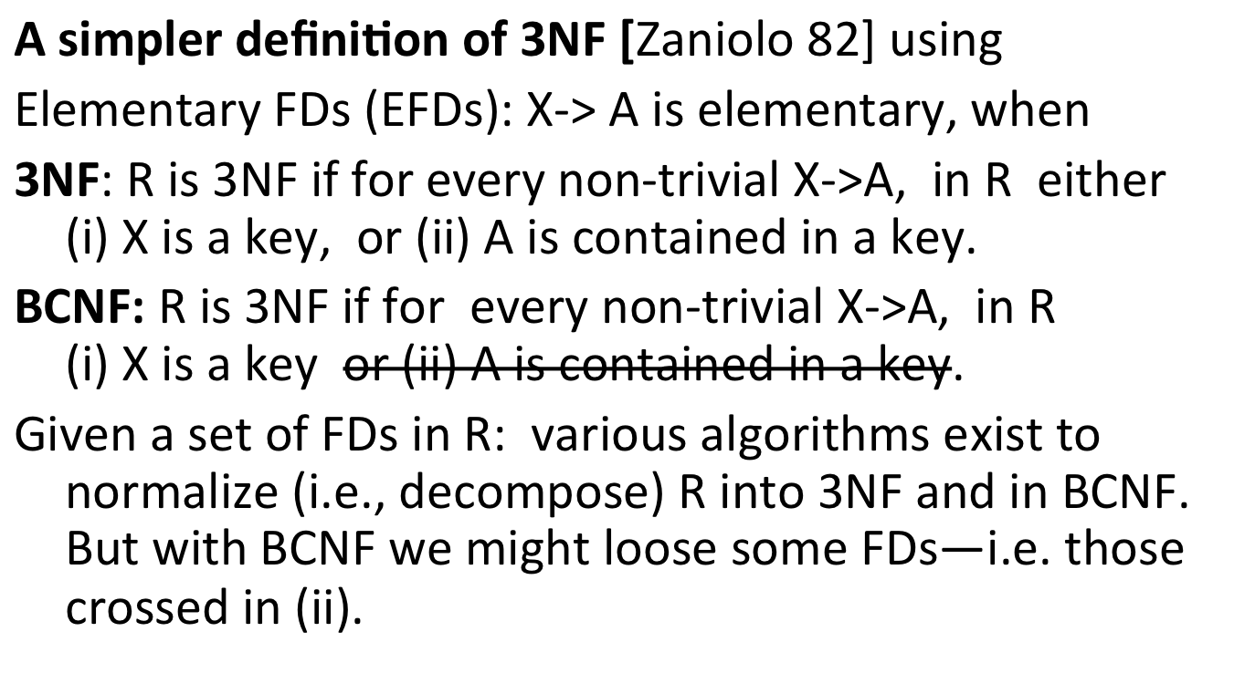
3NF vs BCNF

Slide 19
Uses of Functional Dependencies (FDs)
Keys: X is a KEY of R (W) iff
X -> all attributes of R, i.e. X -> W
No subset of X satisfies 1. i.e. X is minimal
NORMAL FORM Definition and Schema Design—stay tuned.

Slide 20
3NF versus BCNF
zipex( City, StrAddr, ZipCode)
1. City, StrAddr -> ZipCode (thus , City, StrAddr is a key )
2. ZipCode -> City (thus , ZipCode, StrAddr is a key)
FD 2 violates BCNF: but if we decompose we loose FD 1.
FD 2 does not violate 3NF and we do not need to decompose …

Slide 21
Third Normal form: 3NF
Lossless join property is achieved always,
FD preservation is achieved in all cases but the rare case of Key Breaking dependencies
E.g. R(A, B, C) where AB->C and C->A. Two keys: AB and BC. C->A violates BCNF and the decomposition yields the decomposition into R(C, A) and R(C, B) where the constraint AB->C is lost.
So a dependency preserving decomposition into BCNF is not always feasible. To assure universal feasibility one needs to use Third Normal Form (3NF).
Definition: R is 3NF with respect to G: iff for every non-trivial X -> A, either
(i) X is a key or a superset of it, or
(ii) A is an attribute of some key (which will be broken if we decompose since A will go into one projection and the remaining key attributes into the other)

