Slide 1
Chapter 19: Distributed Databases
Heterogeneous and Homogeneous Databases
Distributed Data Storage
Distributed Transactions
Commit Protocols
Concurrency Control in Distributed Databases
Distributed Query Processing
Heterogeneous Distributed Databases
Directory Systems

Slide 2
Distributed Database System
A distributed database system consists of loosely coupled sites that share no physical component
Database systems that run on each site are independent of each other
Transactions may access data at one or more sites

Slide 3
Homogeneous Distributed Databases
In a homogeneous distributed database
  All sites have identical software
  Are aware of each other and agree to cooperate in processing user requests.
  Each site surrenders part of its autonomy in terms of right to change schemas or software
  Appears to user as a single system
In a heterogeneous distributed database
  Different sites may use different schemas and software
    Difference in schema is a major problem for query processing
    Difference in softwrae is a major problem for transaction processing
  Sites may not be aware of each other and may provide only
  limited facilities for cooperation in transaction processing

Slide 4
Distributed Data Storage
Assume relational data model
Replication
  System maintains multiple copies of data, stored in different sites, for faster retrieval and fault tolerance.
Fragmentation
  Relation is partitioned into several fragments stored in distinct sites
Replication and fragmentation can be combined
  Relation is partitioned into several fragments: system maintains several identical replicas of each such fragment.

Slide 5
Data Replication (Cont.)
Advantages of Replication
  Availability: failure of site containing relation r does not result in unavailability of r is replicas exist.
  Parallelism: queries on r may be processed by several nodes in parallel.
  Reduced data transfer: relation r is available locally at each site containing a replica of r.
Disadvantages of Replication
  Increased cost of updates: each replica of relation r must be updated.
  Increased complexity of concurrency control: concurrent updates to distinct replicas may lead to inconsistent data unless special concurrency control mechanisms are implemented.
    One solution: choose one copy as primary copy and apply concurrency control operations on primary copy

Slide 6
Data Fragmentation
Division of relation r into fragments r₁, r₂, …, r_{n} which contain sufficient information to reconstruct relation r.
Horizontal fragmentation: each tuple of r is assigned to one or more fragments
Vertical fragmentation: the schema for relation r is split into several smaller schemas
  All schemas must contain a common candidate key (or superkey) to ensure lossless join property.
  A special attribute, the tuple-id attribute may be added to each schema to serve as a candidate key.
Example : relation account with following schema
Account-schema = (branch-name, account-number, balance)

Slide 7
Horizontal Fragmentation of account Relation
branch-name
account-number
balance
Hillside
Hillside
Hillside
A-305
A-226
A-155
500
336
62
account₁=σ_{branch-name=“Hillside”}(account)
branch-name
account-number
balance
Valleyview
Valleyview
Valleyview
Valleyview
A-177
A-402
A-408
A-639
205
10000
1123
750
account₂=σ_{branch-name=“Valleyview”}(account)

Slide 8
Vertical Fragmentation of employee-info Relation
branch-name
customer-name
tuple-id
Hillside
Hillside
Valleyview
Valleyview
Hillside
Valleyview
Valleyview
Lowman
Camp
Camp
Kahn
Kahn
Kahn
Green
1
2
3
4
5
6
7
deposit₁=Πbranch-name, customer-name, tuple-id(employee-info)
account number
balance
tuple-id
A-305
A-226
A-177
A-402
A-155
A-408
A-639
500
336
205
10000
62
1123
750
1
2
3
4
5
6
7
deposit₂=Πaccount-number, balance, tuple-id(employee-info)

Slide 9
Distributed Transactions
Copyright: Silberschatz, Korth and Sudarhan

Slide 10
Distributed Transactions
Transaction may access data at several sites.
Each site has a local transaction manager responsible for:
  Maintaining a log for recovery purposes
  Participating in coordinating the concurrent execution of the transactions executing at that site.
Each site has a transaction coordinator, which is responsible for:
  Starting the execution of transactions that originate at the site.
  Distributing subtransactions at appropriate sites for execution.
  Coordinating the termination of each transaction that originates at the site, which may result in the transaction being committed at all sites or aborted at all sites.

Slide 11
System Failure Modes
Failures unique to distributed systems:
  Failure of a site.
  Loss of messages
    Handled by network transmission control protocols such as TCP-IP
  Failure of a communication link
    Handled by network protocols, by routing messages via alternative links
  Network partition
    A network is said to be partitioned when it has been split into two or more subsystems that lack any connection between them
      Note: a subsystem may consist of a single node
Network partitioning and site failures are generally indistinguishable.

Slide 12
Commit Protocols
Commit protocols are used to ensure atomicity across sites
  a transaction which executes at multiple sites must either be committed at all the sites, or aborted at all the sites.
  not acceptable to have a transaction committed at one site and aborted at another
The two-phase commit (2 PC) protocol is widely used
The three-phase commit (3 PC) protocol is more complicated and more expensive, but avoids some drawbacks of two-phase commit protocol.

Slide 13
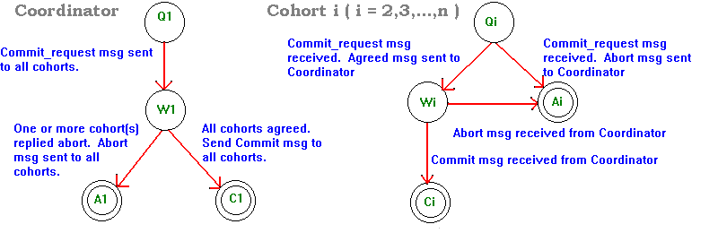
Dsitributed Transactions: 2 Phase Commit
Figure 1 - Finite State Diagram of Commit Protocol for Coordinator and Cohort
Legend
A - accept state
C - commit state
Q - query state
W - wait state

Slide 14
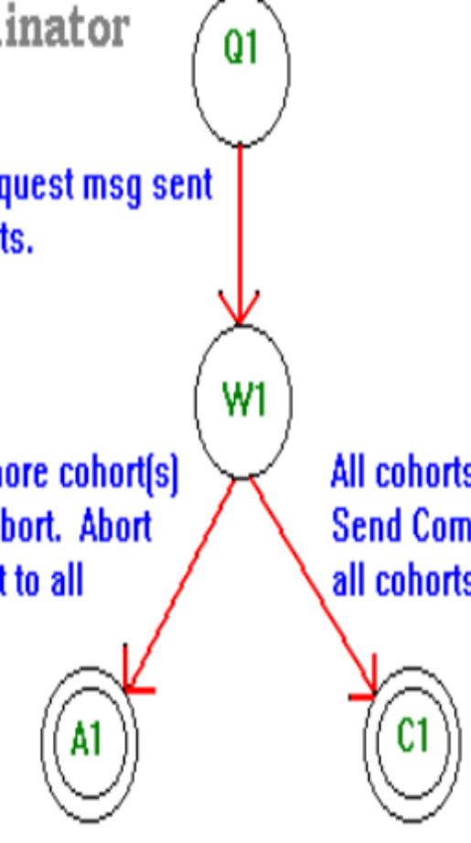
The COORDINATOR:
The COORDINATOR sends the message to each COHORT. The COORDINATOR is now in the preparing transaction state.
Now the COORDINATOR waits for responses from each of the COHORTS. If any COHORT responds ABORT then the transaction must be aborted, proceed to step 5. If all COHORTS respond AGREED then the transaction may be commited, and proceed to step 3. If after some time period all COHORTS do not respond the COORDINATOR can either transmit ABORT messages to all COHORTS or transmit COMMIT-REQUEST messages to the COHORTS that have not responded. In either case the COORDINATOR will eventually go to state 3 or state 5.
Record in the logs a COMPLETE to indication the transaction is now completing. Send COMMIT message to each of the COHORTS.
Wait for each COHORT to respond. They must reply COMMIT. If after some time period some COHORT has not responded retransmit the COMMIT message. Once all COHORTS have replied erase all associated information from permanent memory ( COHORT list, etc. ). DONE.
Send the ABORT message to each COHORT.

Slide 15
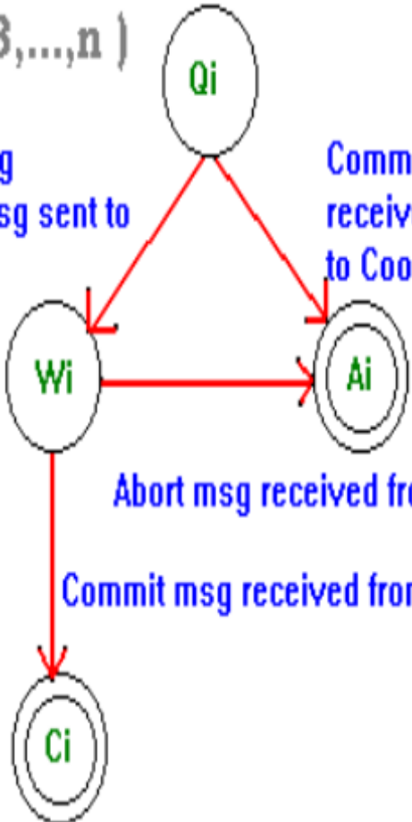
Cohorts:
If a COMMIT-REQUEST message is received for some transaction t which is unknown at the COHORT ( never ran, wiped out by crash, etc ), reply ABORT. Otherwise write the new state of the transaction to the UNDO and REDO log in permanent memory. This allows for the old state to be recovered ( in event of later abort ) or committed on demand regardless of crashes. The read locks of a transaction may be released at this time; however, the write locks are still maintained. Now send AGREED to the COORDINATOR.
If an ABORT message is received then kill the transaction, which involves deleting the new state if the transaction from the REDO and UNDO log the new state of the transaction and restoring any state before the transaction occured.
If a COMMIT message is received then the transaction is either prepared for commital or already committed. If it is prepared, perform all the operations necessary to update the database and release the remaining locks the transaction possesses. If it is already commited, no further action is required. Respond COMMITED to the COORDINATOR.

Slide 16
2PC Questions
a) What happens when a participant votes abort in phase 1? Use the state transition graphs shown in the slides to explain your answer.
(b) What happens when a participant fails in phase 2 without sending anything to the coordinator (e.g. a kernelfreeze)? Again use the state transition graphs to further explain your answer.

Slide 17
Concurrency Control in Distributed Databases… often use timestamp-based protocols

