Slide 1
DB Schema Design: the Entity-Relationship Model
What’s the use of the E-R model?
Entity Sets
Relationship Sets
Design Issues
Mapping Constraints
Keys
E-R Diagram
Extended E-R Features
Design of an E-R Database Schema
Reduction of an E-R Schema to Tables

Slide 2

E-R Diagrams
Rectangles represent entity sets.
Diamonds represent relationship sets.
Lines link attributes to entity sets and entity sets to relationship sets.
Ellipses represent attributes
  Double ellipses represent multivalued attributes.
  Dashed ellipses denote derived attributes.
Underline indicates primary key attributes (will study later)

Slide 3
Attributes
An entity is represented by a set of attributes, that is descriptive properties possessed by all members of an entity set.
Example:
customer = (customer-id, customer-name, customer-street, customer-city)
loan = (loan-number, amount)
Domain – the set of permitted values for each attribute
Attribute types:
  Simple and composite attributes.
  Single-valued and multi-valued attributes
    E.g. multivalued attribute: phone-numbers
  Derived attributes
    Can be computed from other attributes
    E.g. age, given date of birth

Slide 4
Entity Sets
A database can be modeled as:
  a collection of entities,
  relationship among entities.
An entity is an object that exists and is distinguishable from other objects.
Example: specific person, company, event, plant
Entities have attributes
Example: people have names and addresses
An entity set is a set of entities of the same type that share the same properties.
Example: set of all persons, companies, trees, holidays

Slide 5

Relationship Sets with Attributes

Slide 6

E-R Diagram With Composite, Multivalued, and Derived Attributes—try to avoid them

Slide 7

Composite Attributes

Slide 8

Roles
Entity sets of a relationship need not be distinct
The labels “manager” and “worker” are called roles; they specify how employee entities interact via the works-for relationship set.
Roles are indicated in E-R diagrams by labeling the lines that connect diamonds to rectangles.
Role labels are optional, and are used to clarify semantics of the relationship

Slide 9
Mapping Cardinalities
Express the number of entities to which another entity can be associated via a relationship set.
Most useful in describing binary relationship sets.
For a binary relationship set the mapping cardinality must be one of the following types:
  One to one
  One to many
  Many to one
  Many to many

Slide 10

Mapping Cardinalities
One to one
One to many
Note: Some elements in A and B may not be mapped to any
elements in the other set

Slide 11

Mapping Cardinalities
Many to one
Many to many
Note: Some elements in A and B may not be mapped to any
elements in the other set

Slide 12

One-To-Many Relationship
In the one-to-many relationship a loan is associated with at most one customer via borrower, a customer is associated with several (including 0) loans via borrower

Slide 13
Many-To-One Relationships
Example of many-to-one relationships: a loan is associated with several (including 0) customers via borrower, a customer is associated with at most one loan via borrower

Slide 14
Cardinality Constraints
We express cardinality constraints by drawing either a directed line (→), signifying “one,” or an undirected line (—), signifying “many,” between the relationship set and the entity set.
Example of One-to-one relationship:
  A customer is associated with at most one loan via the relationship borrower
  A loan is associated with at most one customer via borrower

Slide 15
Many-To-Many Relationship
Example of Many to Many Relationships:
  A customer is associated with several (possibly 0) loans via borrower
  A loan is associated with several (possibly 0) customers via borrower

Slide 16

Alternative Notation for Cardinality Limits
Cardinality limits can also express participation constraints

Slide 17
Keys
A super key of an entity set is a set of one or more attributes whose values uniquely determine each entity.
A candidate key of an entity set is a minimal super key
  Customer-id is candidate key of customer
  account-number is candidate key of account
Although several candidate keys may exist, one of the candidate keys is selected to be the primary key.

Slide 18
Degree of a Relationship Set
Refers to number of entity sets that participate in a relationship set.
Relationship sets that involve two entity sets are binary (or degree two). Generally, most relationship sets in a database system are binary.
Relationship sets may involve more than two entity sets.
  E.g. Suppose employees of a bank may have jobs (responsibilities) at multiple branches, with different jobs at different branches. Then there is a ternary relationship set between entity sets employee, job and branch
Relationships between more than two entity sets are not as common as binary ones.

Slide 19

E-R Diagram with a Ternary Relationship

Slide 20
Cardinality Constraints in
Ternary Relationships
We allow at most one arrow out of a ternary (or greater degree) relationship to indicate a cardinality constraint
E.g. an arrow from works-on to job indicates each employee works on at most one job at any branch.
If there is more than one arrow, there are two ways of defining the meaning.
  E.g a ternary relationship R between A, B and C with arrows to B and C what does it mean?
  1. each A entity is associated with a unique entity from B and C ?
  2. each pair of entities from (A, B) is associated with a unique C entity, and each pair (A, C) is associated with a unique B ?
  As we will see when we study Functional Dependencies only 2 is consistent and we will adopt it.

Slide 21
Binary Vs. Non-Binary Relationships
Some relationships that appear to be non-binary may be better represented using binary relationships
  E.g. A ternary relationship parents, relating a child to his/her father and mother, is best replaced by two binary relationships, father and mother
    Using two binary relationships allows partial information (e.g. only mother being know)
  But there are some relationships that are naturally non-binary
    E.g. works-on

Slide 22
Weak Entity Sets
An entity set that does not have a primary key is referred to as a weak entity set.
The existence of a weak entity set depends on the existence of a identifying entity set
  it must relate to the identifying entity set via a total, one-to-many relationship set from the identifying to the weak entity set
  Identifying relationship depicted using a double diamond
The discriminator (or partial key) of a weak entity set is the set of attributes that distinguishes among all the entities of a weak entity set.
The primary key of a weak entity set is formed by the primary key of the strong entity set on which the weak entity set is existence dependent, plus the weak entity set’s discriminator.

Slide 23

Weak Entity Sets (Cont.)
We depict a weak entity set by double rectangles.
We underline the discriminator of a weak entity set with a dashed line.
payment-number – discriminator of the payment entity set
Primary key for payment – (loan-number, payment-number)

Slide 24
Weak Entity Sets (Cont.)
Note: the primary key of the strong entity set is not explicitly part of with the weak entity set, since it is implicit in the identifying relationship.
If loan-number were explicitly stored, payment could be made a strong entity, but then the relationship between payment and loan would be duplicated by an implicit relationship defined by the attribute loan-number common to payment and loan

Slide 25
More Weak Entity Set Examples
In a university, a course is a strong entity and a course-offering can be modeled as a weak entity
The discriminator of course-offering would be semester (including year) and section-number (if there is more than one section)
If we model course-offering as a strong entity we would model course-number as an attribute.
Then the relationship with course would be implicit in the course-number attribute

Slide 26
Specialization
Top-down design process; we designate subgroupings within an entity set that are distinctive from other entities in the set.
These subgroupings become lower-level entity sets that have attributes or participate in relationships that do not apply to the higher-level entity set.
Depicted by a triangle component labeled ISA (E.g. customer “is a” person).
Attribute inheritance – a lower-level entity set inherits all the attributes and relationship participation of the higher-level entity set to which it is linked.

Slide 27

Specialization Example

Slide 28
Generalization
A bottom-up design process – combine a number of entity sets that share the same features into a higher-level entity set.
The terms specialization and generalization simply denote a top-down or bottom-up view of the same concept.
Specialization and generalization are denoted by the same representation in the E-R diagram.

Slide 29
Specialization & Generalization (Cont.)
Can have multiple specializations of an entity set based on different features.
The ISA relationship also referred to as superclass-subclass relationship

Slide 30
Integrity Constraints in
Specialization/Generalization
Constraint on which entities can be members of a given lower-level entity set.
    E.g. all customers over 65 years are members of senior-citizen entity set; senior-citizen ISA person.
Constraint on whether or not entities may belong to more than one lower-level entity set within a single generalization.
  Disjoint: an entity can belong to only one lower-level entity set
    In the E-R diagram by write ‘disjoint ‘next to the ISA triangle
  Overlapping
    an entity can belong to more than one lower-level entity set
Completeness constraint – specifies whether each entity must belong to at least one of the lower-level entity sets.
  total: an entity must belong to one of the lower-level entity sets
  partial: an entity need not belong to one of the lower-level entity sets

Slide 31
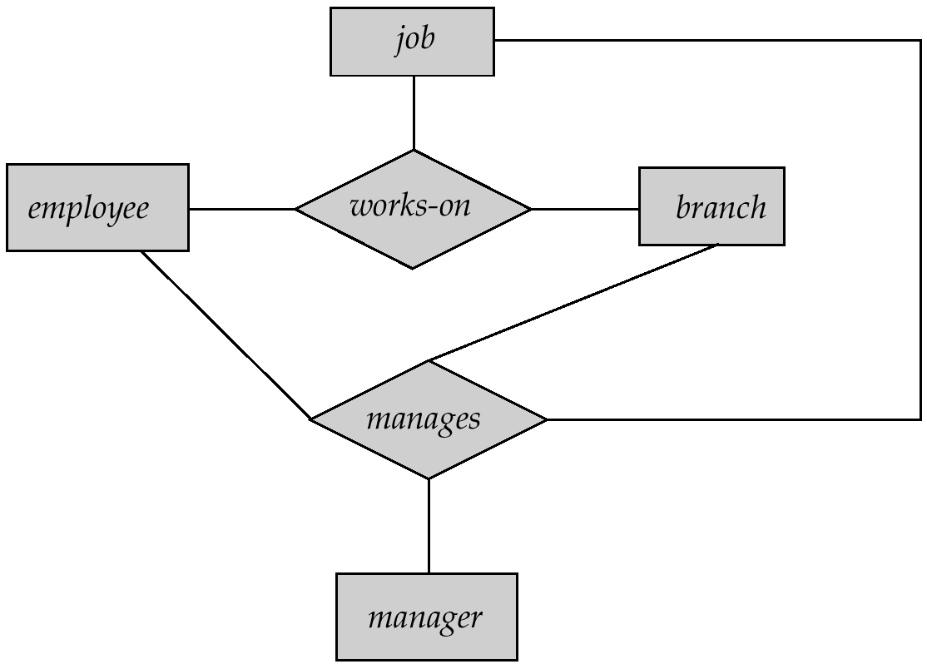
Aggregation
Consider the ternary relationship works-on, which we saw earlier
Suppose we want to record managers for tasks performed by an
employee at a branch

Slide 32
Aggregation (Cont.)
Relationship sets works-on and manages represent overlapping information
  Every manages relationship corresponds to a works-on relationship
  However, some works-on relationships may not correspond to any manages relationships
    So we can’t discard the works-on relationship
Eliminate this redundancy via aggregation
  Treat relationship as an abstract entity
  Allows relationships between relationships
  Abstraction of relationship into new entity
Without introducing redundancy, the following diagram represents:
  An employee works on a particular job at a particular branch
  An employee, branch, job combination may have an associated manager

Slide 33

E-R Diagram With Aggregation

Slide 34
E-R Design Decisions
The use of an attribute or entity set to represent an object.
Whether a real-world concept is best expressed by an entity set or a relationship set.
The use of a ternary relationship versus a pair of binary relationships.
The use of a strong or weak entity set.
The use of specialization/generalization – contributes to modularity in the design.
The use of aggregation – can treat the aggregate entity set as a single unit without concern for the details of its internal structure.

Slide 35

E-R Diagram for a Banking Enterprise

Slide 36

Summary of Symbols Used in E-R Notation

Slide 37
Summary of Symbols (Cont.)

Slide 38

Alternative E-R Notations

Slide 39
Reduction of an E-R Schema to Tables
A database which conforms to an E-R diagram can be represented by a collection of tables
For each (strong) entity set there is a table having as candidate key the key of the entity set
For relationship set there is a table having as columns the keys of the participating entities. The candidate key for the table is determined by the cardinality constraints among participating entities.
A weak entity set becomes a table that includes a column for the primary key of the identifying strong entity set
Inheritance to be discussed later …

Slide 40
Many-To-One Relationships
Example of many-to-one relationships: a loan is associated with several (including 0) customers via borrower, a customer is associated with at most one loan via borrower

Slide 41
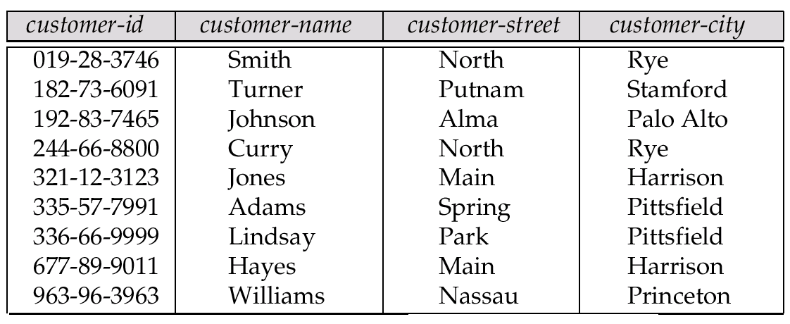
Representing Entity Sets as Tables
A strong entity set reduces to a table with the same attributes.
Key: Customer-id

Slide 42
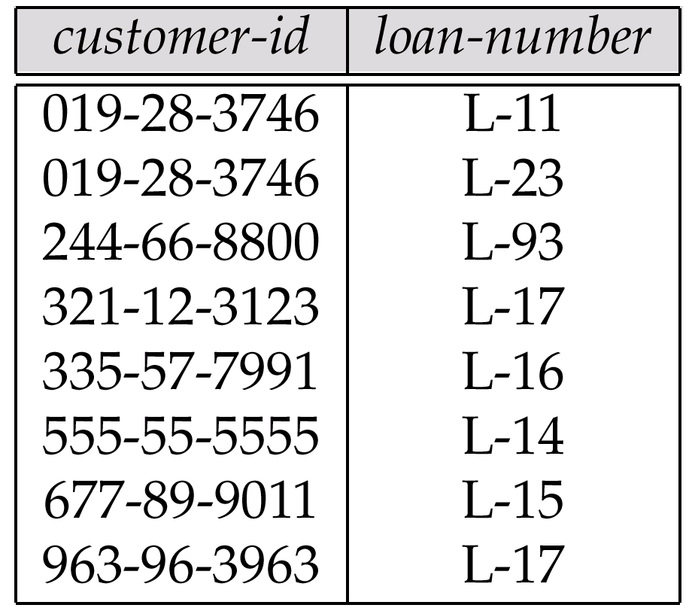
Representing Relationship Sets as Tables
A many-to-many relationship set is represented as a table with columns for the primary keys of the two participating entity sets, and any descriptive attributes of the relationship set.
E.g.: table for relationship set borrower: the arrow tells us that customer-id is a key

Slide 43

Redundancy of Tables
Table with equivalent keys can be merged together---as in the 3NF design algorithm (to be discussed next week)
E.g.: Merge the tables account-branch with account

Slide 44
Composite and Multivalued Attributes
Previous rules hold for simple attributes
Composite attributes are flattened out by creating a separate attribute for each component attribute
  E.g. given entity set customer with composite attribute name with component attributes first-name and last-name the table corresponding to the entity set has two attributes
  name.first-name and name.last-name

Slide 45
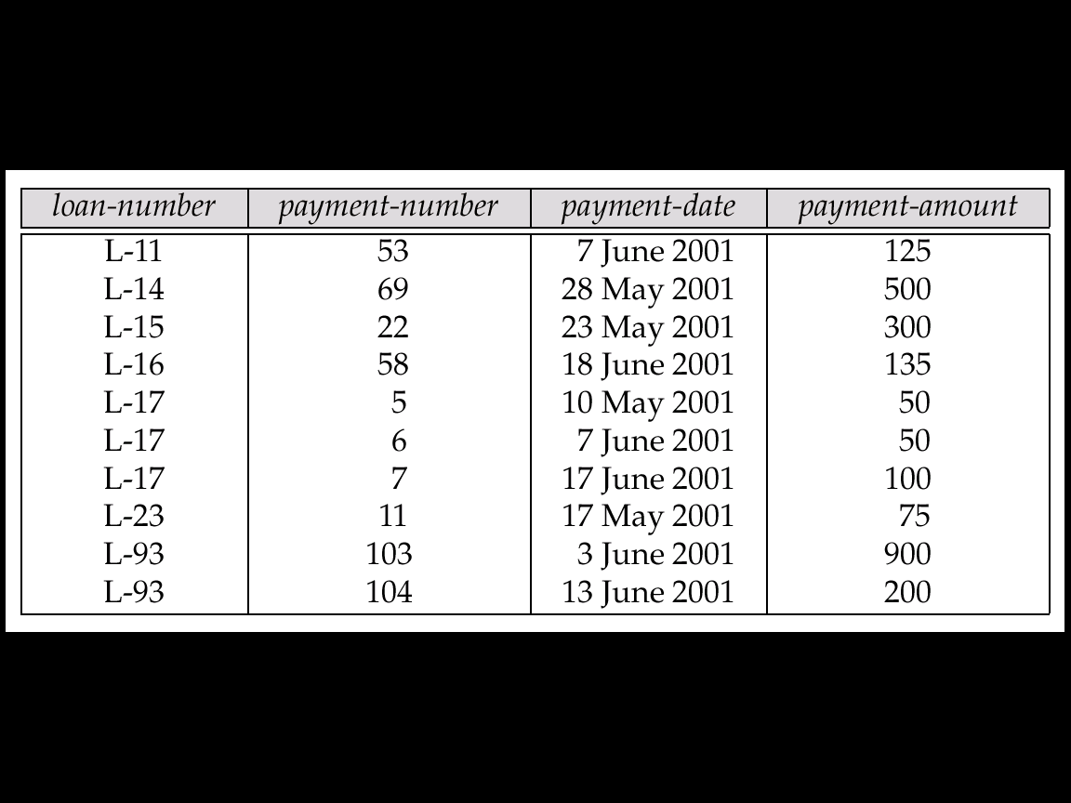
Representing Weak Entity Sets
A weak entity set becomes a table that includes a column for the primary key of the identifying strong entity set:

Slide 46
Representing Specialization as Tables
Method 1:
  Form a table for the higher level entity
  Form a table for each lower level entity set, include primary key of higher level entity set and local attributes
  table table attributes
  person name, street, city
  customer name, credit-rating
  employee name, salary
  Drawback: getting information about, e.g., employee requires accessing two tables

Slide 47
Representing Specialization as Tables (Cont.)
Method 2:
  Form a table for each entity set with all local and inherited attributes
  table table attributes
  person name, street, city
  customer name, street, city, credit-rating
  employee name, street, city, salary
  If specialization is total, no need to create table for generalized entity (person)
  Drawback: street and city may be stored redundantly for persons who are both customers and employees

Slide 48
Relations Corresponding to Aggregation
To represent aggregation, create a table containing
  primary key of the aggregated relationship,
  the primary key of the associated entity set
  Any descriptive attributes

Slide 49
Relations Corresponding to Aggregation (Cont.)
E.g. to represent aggregation manages between relationship works-on and entity set manager, create a table
manages(employee-id, branch-name, title, manager-name)
Table works-on is redundant provided we are willing to store null values for attribute manager-name in table manages

Slide 50
Example
num
grade
ProjectReport
Submit
name
addr
name
addr
TA
title
name
coder
Partner
Student
Take
Class
Teach
Faculty
tester
cnum
addr
quarter
ISA
ForeignStudent
HonorStudent
country
fellowship

