Slide 1

JSON and JSON-Schema
for XML Developers
First five slides authored by
Roger L. Costello, Mitre
November 21, 2015

Slide 2
JSON as an XML Alternative
JSON is a light-weight alternative to XML for data-interchange
JSON = JavaScript Object Notation
  It’s really language independent
  most programming languages can easily read it and instantiate objects or some other data structure
Defined in RFC 4627
Started gaining traction ~2006 and now widely used
http://json.org/ has more information

Slide 3
Example
{"firstName": "John",
"lastName" : "Smith",
"age" : 25,
"address" :
{"streetAdr” : "21 2nd Street",
"city" : "New York",
"state" : "NY",
”zip" : "10021"},
"phoneNumber":
[{"type" : "home",
"number": "212 555-1234"},
{"type" : "fax",
"number” : "646555-4567"}]
}
This is a JSON object with five key-value pairs
Objects are wrapped by curly braces
There are no object IDs
Keys are strings
Values are numbers, strings, objects or arrays
Arrays are wrapped by square brackets

Slide 4
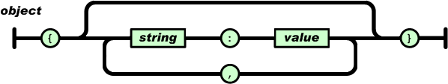
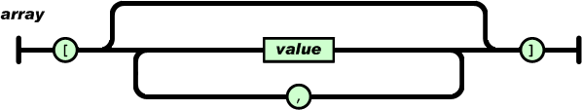
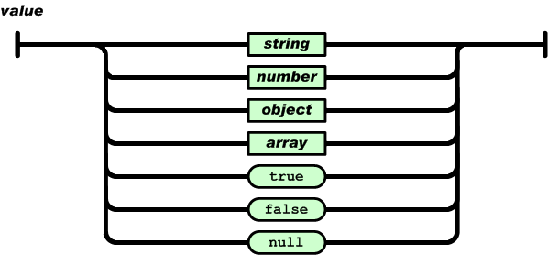
The BNF is simple

Slide 5
Evaluation
JSON is simpler than XML and more compact
  No closing tags, but if you compress XML and JSON the difference is not so great
  XML parsing is hard because of its complexity
JSON has a better fit for OO systems than XML
JSON is not as extensible as XML
Preferred for simple data exchange by many
Less syntax, no semantics
Schemas? We don’t need no stinkin schemas!
Transforms? Write your own.
Worse is better

Slide 6
Worse is better
(According to Wikipedia, the free encyclopedia)
Worse is better, also called New Jersey style, was conceived by Richard P. Gabriel to describe the dynamics of software acceptance, but it has broader application.
The idea is that quality does not necessarily increase with functionality. There is a point where less functionality ("worse") is a preferable option ("better") in terms of practicality and usability. Software that is limited, but simple to use, may be more appealing to the user and market than the reverse.

Slide 7
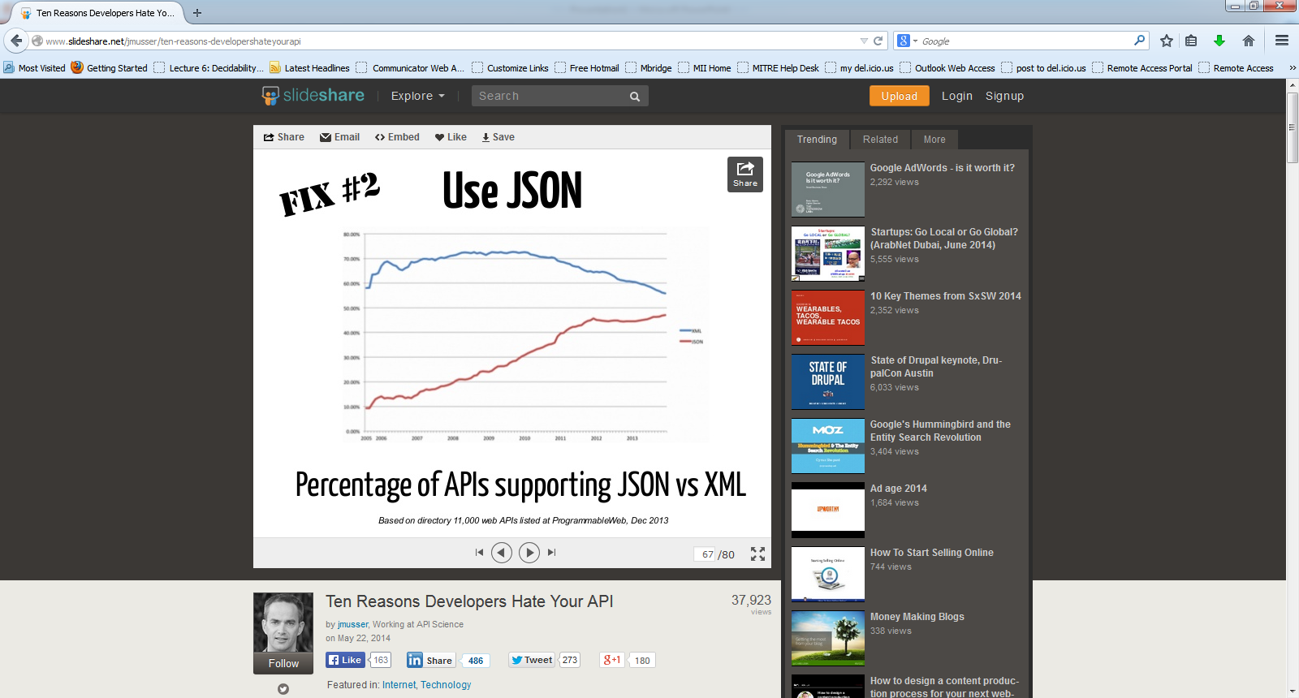
Trends in XML and JSON usage
80%
70%
60%
50%
40%
30%
20%
10%
0%
XML
JSON
2006 2007 2008 2009 2010 2011 2012 2013
Based on directory of 11,000 web APIs listed at Programmable Web, December 2013

Slide 8
Overview: JSON Compared with XML
https://docs.oracle.com/database/121/ADXDB/json.htm
Both JSON and XML (Extensible Markup Language) are commonly used as data-interchange languages. Their main differences are:
JSON data types are few and predefined. XML data can be either typeless or based on an XML schema or a document type definition (DTD).
JSON has simple structure-defining and document-combining constructs: it lacks attributes, namespaces, inheritance and substitution.
The order of the members of a JavaScript object literal is insignificant. In general, order matters within an XML document.

Slide 9
JSON Compared with XML (cont.)
JSON lacks an equivalent of XML text nodes (XPath node test text()).
  In particular, this means that there is no mixed content. JSON is most useful with simple, structured data. XML is useful for both structured and semi-structured data.
JSON is generally data-centric, not document-centric; XML can be either.
Due its simple definition and features, JSON data is generally easier to generate, parse, and process than XML data.

Slide 10
JSON Compared with XML (cont.)
Cases that involve combining different data sources generally lend themselves well to the use of XML, because it offers namespaces and other constructs facilitating modularity and inheritance.
JSON, unlike XML (and unlike JavaScript), has no date data type. A date is represented in JSON using the available data types, such as string. There are some de facto standards for converting between real dates and strings. But programs using JSON must, one way or another, deal with date representation conversion.

Slide 11
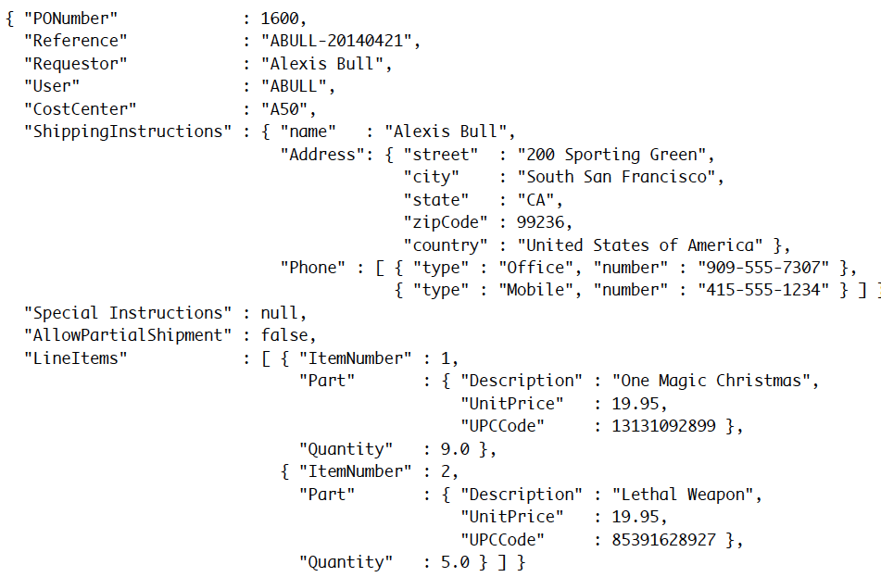
JSON Example

Slide 12
Getting Started with JSON in Oracle DB
In general, you will perform the following tasks when working with JSON data in Oracle:
create a JSON column with an is json check constraint,
CREATE TABLE j_purchaseorder (id RAW (16) NOT NULL, date_loaded TIMESTAMP, po_document CLOB CONSTRAINT ensure_json CHECK (po_document IS JSON));
(2) insert JSON data into the column, using any of the methods available for Oracle Database:
INSERT INTO j_purchaseorder VALUES (SYS_GUID(), SYSTIMESTAMP, '{"PONumber" :1600, "Reference" : "ABULL-20140421", "Requestor" : "Alexis Bull", "User" :"ABULL", "CostCenter" : "A50", "ShippingInstructions" : {...}, "SpecialInstructions" : null, "AllowPartialShipment" : true, "LineItems" : [...]}');
and (3) query the JSON data …next slide

Slide 13
JSON in Oracle DB (cont.)
Query the JSON data. The return value is always a VARCHAR2 instance that represents a JSON value: E.g.
SELECT po.po_document.PONumber FROM j_purchaseorder po;
The next query extracts, from each document in JSON column po_document, an array of JSONphone objects, which is the value of field Phone of the value of field ShippingInstructions:
SELECT po.po_document.ShippingInstructions.Phone FROM j_purchaseorder po;
The next query extracts, from each JSON document, an array of value of field type for each object in array Phone. The returned array is not part of the stored data but is constructed automatically by the query:
SELECT po.po_document.ShippingInstructions.Phone.type
FROM j_purchaseorder as po

Slide 14
Languages for JSON
There is at least one implementation of JSON in most popular web programming languages.
PHP
Ruby
Python with several options
Java, Perl, .NET, Lisp, Erlang … many others.
REGEX expressions are supported in JSON schemas and query expressions. Query languages are being proposed:
  JSONiq - The JSON Query Language
  SpahQL: a Javascript language that let you query and manipulate JSON data.

Slide 15
According to Oracle
JSON data has often been stored in NoSQL databases since these allow for storage and retrieval of data that is not based on any schema. However these do not offer the rigorous consistency and models of relational databases.
To compensate for this shortcoming, a relational database is sometimes used in parallel with a NoSQL database. Applications using JSON data stored in the NoSQL database must then ensure data integrity themselves.

Slide 16
According to Oracle (cont.)
Oracle Database queries are declarative. You can join JSON data with relational data. And you can project JSON data relationally, making it available for relational processes and tools. You can also query, from within the database, JSON data that is stored outside the database in an external table.
JSON data is stored in Oracle Database using SQL data types VARCHAR2, CLOB, and BLOB. Oracle recommends that you always use an is_json check constraint to ensure that column values are valid JSON instances.

Slide 17


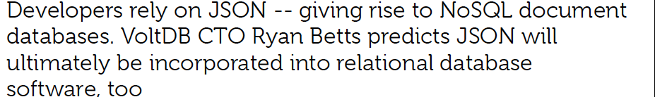

May 21, 2014

Slide 18
The Future of Json
Database vendors are acknowledging the adoption, popularity and the utility of the JSON format and are integrating support for JSON in to their traditional relational systems – a best-of-both-worlds approach.
Adding the ability to store and query JSON records in the context of the traditional relational system gives developers the benefit of a powerful choice. What portions of my data should be abstracted -- and where are constraints and strict schema guarantees important to my application? Where does flexibility instead of consistency checks matter most?
In reality, it will be substantially easier for relational vendors to extend their systems to include JSON than it will be for the new document store vendors to retrofit their non-relational systems with the features lost in the move away from relational structures.

Slide 19
Making Predictions is Hard …
… Particularly about the future
But for JSON and NoSQL we get a strong feeling of Déjà vu …
DBMDS vendors might soon welcome them back to the fold of a (slightly extended) SQL.

