Slide 1
R JOIN S?
C
C
R
40 | T1
60 | T2
30 | T3
10 | T4
20 | T5
S
10 | T6
60 | T7
40 | T8
20 | T9

Slide 2
Nested-Loop Join (NLJ)
For each r ∈ R do
For each s ∈ S do
if r.C = s.C then output r,s pair
40 | T1
60 | T2
30 | T3
10 | T4
20 | T5
10 | T6
60 | T7
40 | T8
20 | T9
R
S
R is called the outer relation and S the inner relation of the join.
Requires no indices and can be used with any kind of join condition.
Expensive since it examines every pair of tuples in the two relations.

Slide 3
Nested-Loop Join (Cont.)
In the worst case, if there is enough memory only to hold one block of each relation, the estimated cost is
n_{R} ∗ b_{S} + b_{R} block transfers
If the smaller relation fits entirely in memory, use that as the inner relation.
  Reduces cost to b_{r} + b_{s} block transfers and 2 seeks
Block nested-loops algorithm (next slide) is preferable.

Slide 4
Block Nested-Loop Join
Variant of nested-loop join in which every block of inner relation is paired with every block of outer relation.
for each block B_{r} of r do begin
for each block B_{s} of s do begin
for each tuple t_{r} in B_{r} do begin
for each tuple t_{s} in B_{s} do begin
Check if (t_{r},t_{s}) satisfy the join condition
if they do, add t_{r} • t_{s} to the result.
end
end
end
end

Slide 5
Block Nested-Loop Join (Cont.)
Worst case estimate: b_{R} ∗ b_{S} + b_{R} block transfers
  Each block in the inner relation S is read once for each block in the outer relation R.
Best case: b_{R}+ b_{S} block transfers.
Many Improvements proposed to nested loop and block nested loop algorithms including:
  Scan inner loop forward and backward alternately, to make use of the blocks remaining in buffer (with LRU replacement)
  Use index on inner relation if available (next slide)
E.g.Compute student takes, with R=student as the outer relation, S= takes the inner relation,
  Number of records of student: 5,000 takes: 10,000
  Number of blocks of student: 100 takes: 400

Slide 6
Index Join (IJ)
Create an index for S.C if one is not already there
For each r ∈ R do
X ← index-lookup(S.C, r.C)
For each s ∈ X, output (r,s)
R
40 | T1
60 | T2
30 | T3
10 | T4
20 | T5
S
10 | T6
60 | T7
40 | T8
20 | T9

Slide 7
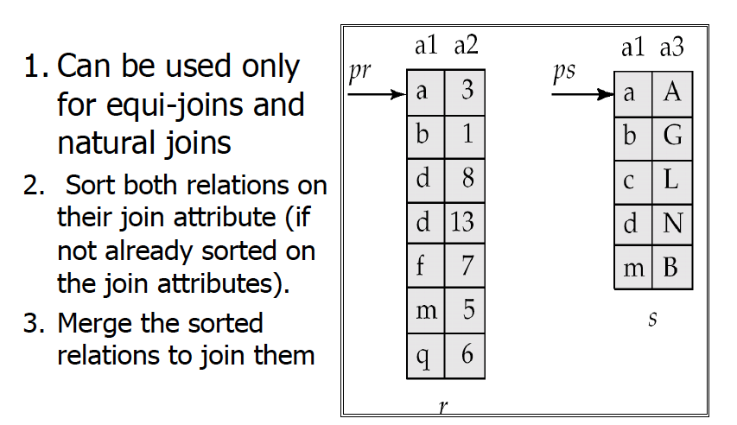
Merge-Join

Slide 8
Sort-Merge Join (SMJ)
  If the two tables fit in memory we can use bubble sorting
  External sorting must be used otherwise.
    This is the litmus test for big data processing
    http://sortbenchmark.org/
2014, 4.27 TB/min
Apache Spark
100 TB in 1,406 seconds 207 Amazon EC2 i2.8xlarge nodes x (32 vCores - 2.5Ghz Intel Xeon E5-2670 v2, 244GB memory, 8x800 GB SSD) Reynold Xin, Parviz Deyhim, Xiangrui Meng, Ali Ghodsi, Matei Zaharia Databricks

Slide 9
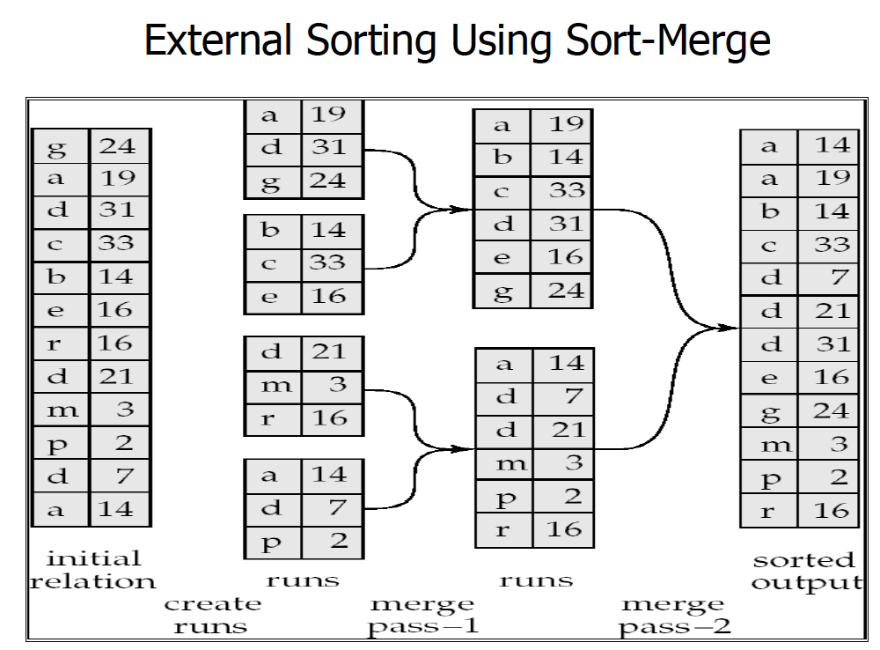

Slide 10
Hash Join (HJ)
Hash function h(v), range 1 → k
Algorithm
Hashing stage (bucketizing): hash tuples into buckets
  Hash R tuples into G1,…,Gk buckets
  Hash S tuples into H1,…,Hk buckets
Join stage: join tuples in matching buckets
  For i = 1 to k do
  match tuples in Gi, Hi buckets
R
S
…
…
…

Slide 11
Hash Join (HJ)
H(k) = k mod 3
R
S
0
0
1
1
2
2
40 | T1
60 | T2
30 | T3
10 | T4
20 | T5
10 | T6
60 | T7
40 | T8
20 | T9

Slide 12
Hash Join (HJ)
Step (1): Hashing stage
Step (2): Join stage
Memory
buckets
G1
R
G2
...
...
Gk
R
S
G1
H1
G2
H2
G3
Gi
Hi
...
...
memory

Slide 13
Summary of Join Algorithms
• Nested-loop join ok for “small” relations
(relative to memory size)
• Hash join usually best for equi-join if relations
not sorted and no index
• Merge join for sorted relations
• Sort merge join good for non-equi-join
• Consider index join if index exists
• DBMS maintains statistics on data

