Slide 1
CS143: Disks and Files

Slide 2
System Architecture
CPU
System Bus
Disk Controller
...
Word
(1B – 64B)
~ x GB/sec
Block
(512B – 50KB)
~ x MB/sec
Disk
Main Memory

Slide 3
Magnetic disk vs SSD
Magnetic Disk
  Stores data on a magnetic disk
  Typical capacity: 100GB – 10TB
Solid State Drive
  Stores data in NAND flash memory
  Typical capacity: 100GB – 1TB
  Much faster and more reliable than magnetic disk
  But, x10 more expensive and limited write cycles (~2000)

Slide 4
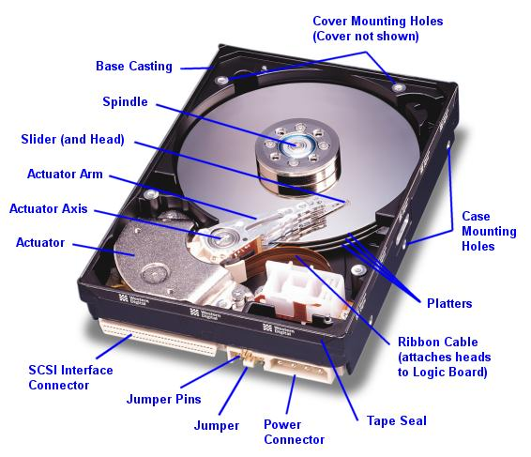

Slide 5
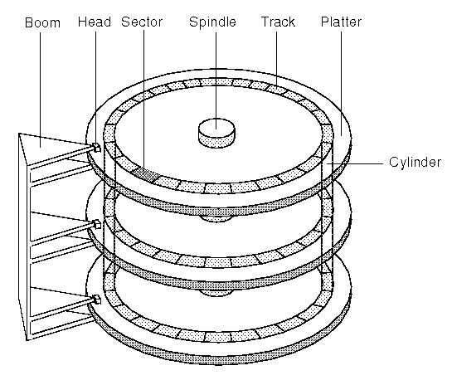

Slide 6
Structure of a Platter
Track, cylinder, sector (=block, page)n

Slide 7
Typical Magnetic Disk
Platter diameter: 1-5 in
Platters: 1 – 20
Tracks: 100 – 5000
Sectors per track: 200 – 5000
Sector size: 512 – 50K
Rotation speed: 1000 – 15000 rpm
Overall capacity: 100G – 10TB Q: 2 platters, 2 surfaces/platter, 5000 tracks/surface, 1000 sectors/track, 1KB/sector. What is the overall capacity?

Slide 8
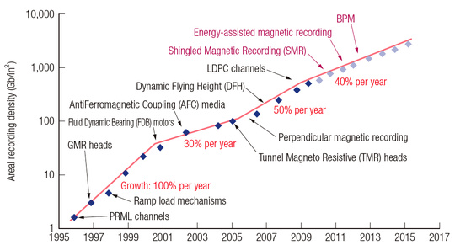
Capacity of Magnetic Disk
- Capacity keeps increasing, but what about speed?

Slide 9
Access Time
CPU
Disk
Q: How long does it take to read a page of a disk to memory?
Q: What needs to be done to read a page?
page
Memory

Slide 10
Access Time
Access time =
(seek time) + (rotational delay) +
(transfer time)

Slide 11
Seek Time
Time to move a disk head between tracks
Track to track ~ 1ms
Average ~ 10 ms
Full stroke ~ 20 ms
5 - 20x
Time
x
1
N
Cylinders Traveled

Slide 12
Rotational Delay
Typical disk:
  1000 rpm – 15000 rpm
Q: For 6000 RPM, average rotational delay?
100 rots per sec: 10 ms per a full rotation
Head Here
Block I Want

Slide 13
Transfer Rate
Read blocks as
the platter rotates
Q: How long to read one sector?
Q: What is the transfer rate (bytes/sec)?
Disk Head
6000 RPM, 1000 sectors/track, 1KB/sector

Slide 14
(Burst) Transfer Rate
(Burst) Transfer rate =
(RPM / 60) * (sectors/track) * (bytes/sector)
(A sector is read in 10/1000 ms delivers 1000 bytes. So, 100 KB per ms; 100 MB per sec.)

Slide 15
Sequential vs. Random I/O
Q: How long to read 3 sequential sectors?
6000 RPM
1000 sectors/track
Assume the head
is above the first
sector

Slide 16
Sequential vs. Random I/O
Q: How long to read 3 random sectors?
6000 RPM
1000 sectors/track
10ms seek time
Assume the head
is above the first
sector

Slide 17
Random I/O
For magnetic disks:
  Random I/O is VERY expensive compared to sequential I/O
  Avoid random I/O as much as we can

Slide 18
Magnetic Disk vs SSD
 | Magnetic | SSD
Random IO | ~100 IOs/sec | ~100K IOs/sec
Transfer rate | ~ 100MB/sec | ~500MB/sec
Capacity/$ | ~1TB/$100 (in 2014) | ~100GB/$100 (in 2014)
SSD speed gain is mainly from high random IO rate

Slide 19
RAID
Redundant Array of Independent Disks
  Create a large-capacity “disk volumes” from an array of many disks
Q: Possible advantages and disadvantages?

Slide 20
RAID Pros and Cons
Potentially high throughput
  Read from multiple disks concurrently
Potential reliability issues
  One disk failure may lead to the entire disk volume failure
  How should we store data into disks?
Q: How should we organize the disks and store data to maximize benefit and minimize risks?

Slide 21
RAID Levels
RAID 0: striping only (no redundancy)
RAID 1: striping + mirroring
RAID 5: striping + parity block

Slide 22
Data Modification
Byte-level modification not allowed
  Can be modified by blocks
Q: How can we modify only a part of a block?

Slide 23
Abstraction by OS
1
2
Sequential blocks
  No need to worry about head, cylinder,
  sector
Access to non-adjacent blocks
  Random I/O
Access to adjacent blocks
  Sequential I/O
3
4
.
.
.
(head, cylinder, sector)

Slide 24
Buffers, Buffer pool
Temporary main-memory “cache” for disk blocks
  Avoid future read
  Hide disk latency
  Most DBMS let users change buffer pool size

Slide 25
Reference
Storage review disk guide
  http://www.storagereview.com/guide2000/ref/hdd/index.html

Slide 26
Files: Main Problem
How to store tables into disks?
Jane | CS | 3.7
Susan | ME | 1.8
June | EE | 2.6
Tony | CS | 3.1

Slide 27
Spanned vs Unspanned
Q: 512Byte block. 80Byte tuple. How to store?

Slide 28
Spanned vs Unspanned
Unspanned
Spanned
Q: Maximum space waste for unspanned?
T1
T4
T2
T5
T3
T6
T1
T4
T5
T2
T6
T3
T4
T7
T8

Slide 29
Variable-Length Tuples
How do we store them?
T1
T2
T3
T4

Slide 30
Reserved Space
Reserve the maximum space for each tuple
Q: Any problem?
T1
T2
T3
T4
T5
T6

Slide 31
Variable-Length Space
Pack tuples tightly
Q: How do we know the end of a record?
Q: What to do for delete/update?
Q: How can we “point to” to a tuple?
R1
R2
R3
R4 R5
R6

Slide 32
Slotted Page
Header
R3
Block
Free
space
R4
R1 R2
Q: How can we point to a tuple?

Slide 33
Long Tuples
ProductReview(
pid INT,
reviewer VARCHAR(50),
date DATE,
rating INT,
comments VARCHAR(1000))
Block size 512B
How should we store it?

Slide 34
Long Tuples
Spanning
Splitting tuples
Block with short attributes.
Block with long attrs.
T1 (a)
T1 (b)
T2 (a)
T2 (b)
T2 (b)
This block may also have fixed-length slots.

Slide 35
Sequential File
Tuples are ordered by certain attribute(s) (search key)
  Search key: Name
Elaine
CS
3.7
James
ME
2.8
John
EE
1.8
Peter
EE
3.9
Susan
CS
1.0
Tony
EE
2.4

Slide 36
Sequencing Tuples
Inserting a new tuple
  Easy case
T1
T3
T6
?
T8
T7

Slide 37
Sequencing Tuples
  Two options
1) Rearrange
2) Linked list
T1
T1
T3
T7
T6
T3
T7
T6
T8
T8

Slide 38
Sequencing Tuples
Inserting a new tuple
  Difficult case
T1
T4
T5
T8
?
T9
T7

Slide 39
Sequencing Tuples
Overflow page
Reserving free space to avoid overflow
  PCTFREE in DBMS
  CREATE TABLE R(a int) PCTFREE 40
header
Overflow page
T1
T8
T2
T9
T4
T6
T7

Slide 40
Things to Remember
Disk
  Platter, track, cylinder, sector, block
  Seek time, rotational delay, transfer time
  Random I/O vs Sequential I/O
Files
  Spanned/unspanned tuples
  Variable-length tuples (slotted page)
  Long tuples
  Sequential file and search key
    Problems with insertion (overflow page)
    PCTFREE

